Slide 1
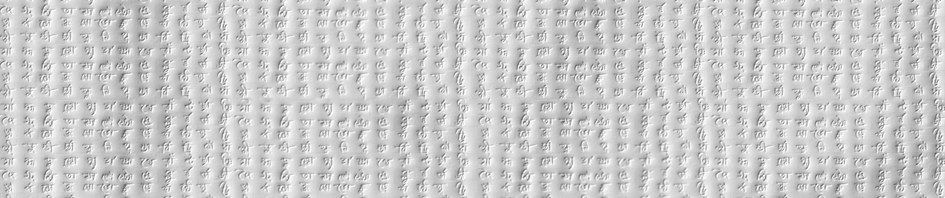
VRDL Homework Final Project
309553047 李育人 0716314 陳鎧勳 0716072 吳季嘉

Slide 2
GitHub link of my code
https://github.com/072jiajia/VRDL_FinalProject
Reference
https://github.com/PeiqinZhuang/API-Net
https://arxiv.org/pdf/2002.10191.pdf

Slide 3
Outline
Introduction
Related Work
Proposed approach
Experimental results

Slide 4
Outline
Introduction
Related Work
Proposed approach
Experimental results

Slide 5
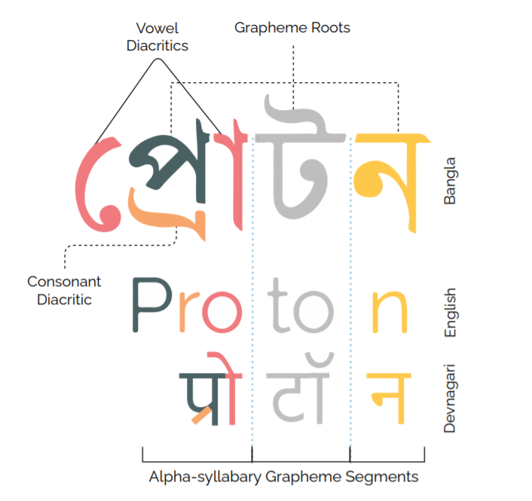
Introduction
Bengali.AI Handwritten Grapheme Classification
Bengali recognition
Notes:
We used API-Net (Attentive Pairwise Interaction Network) to do the classification task. API-Net is a module which can attentively distinguish two fine-grained images via pairwise interaction.

Slide 6
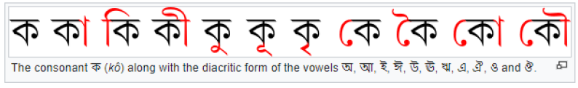
Unseen Object Issue
Words in Bengali
Words in Training Dataset
Words in Testing Dataset
Notes:
We used API-Net (Attentive Pairwise Interaction Network) to do the classification task. API-Net is a module which can attentively distinguish two fine-grained images via pairwise interaction.

Slide 7
Outline
Introduction
Related Work
Proposed approach
Experimental results

Slide 8
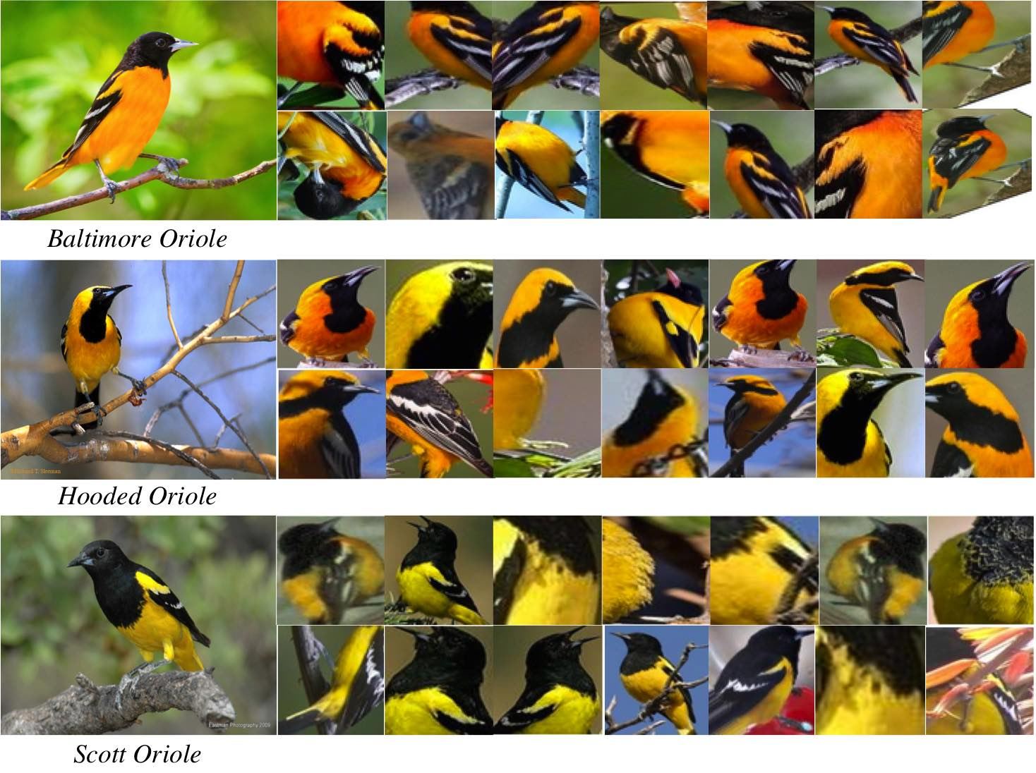
Fine-Grained Classification
A simple CNN may not do well in classification task of similar object .
Notes:
First, it extracts the features of input images, and finds the most similar image of each image. It uses Euclidean distance in the feature space to determine the similarity of two images.

Slide 9
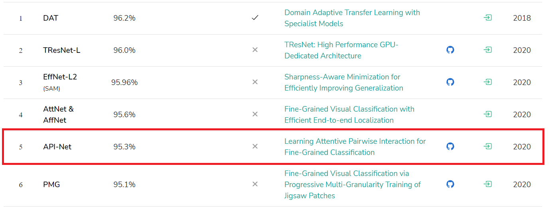
API-Net
Notes:
First, it extracts the features of input images, and finds the most similar image of each image. It uses Euclidean distance in the feature space to determine the similarity of two images.

Slide 10
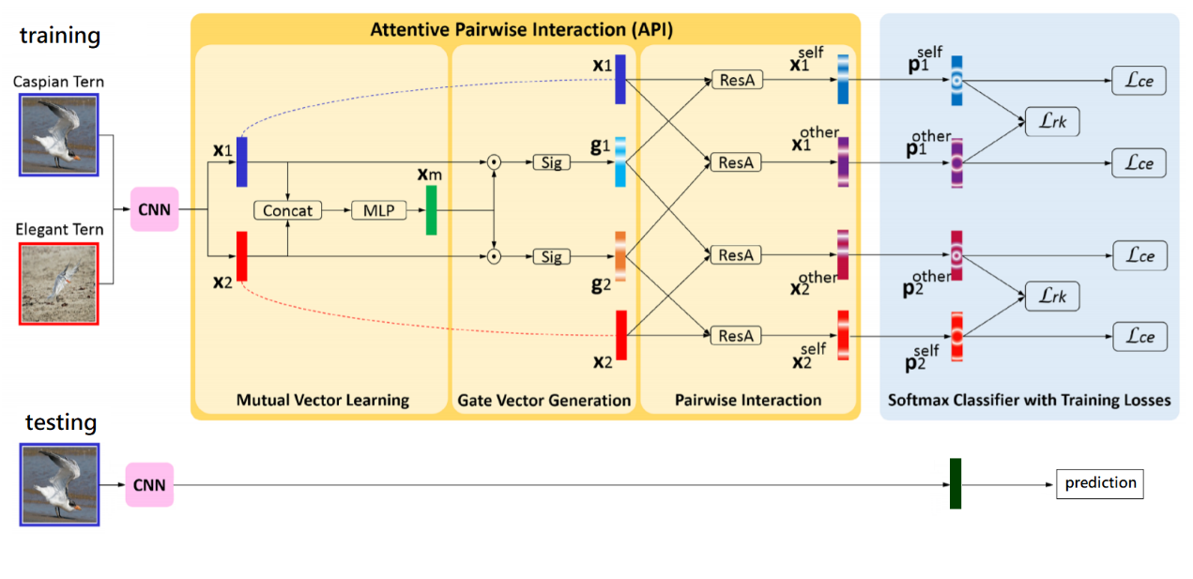
API-Net
Notes:
First, it extracts the features of input images, and finds the most similar image of each image. It uses Euclidean distance in the feature space to determine the similarity of two images.

Slide 11
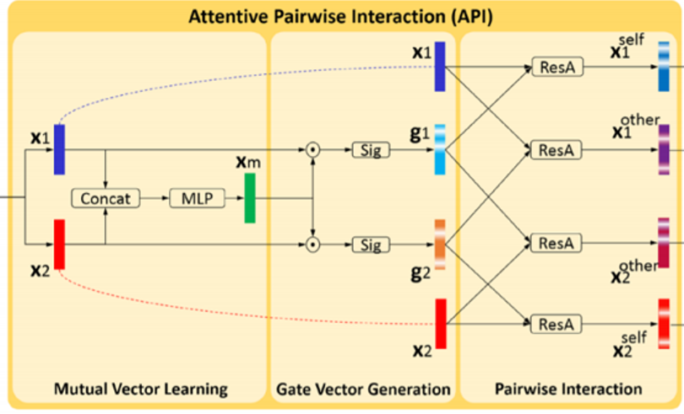
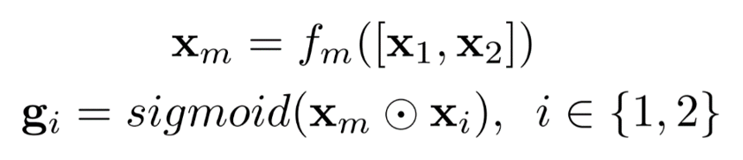
Gate Vector
Discriminative attention of a view
Notes:
Then, as we have the features of itself and its most similar image’s features, it uses the features to compute a gate vector, which can be seen as the discriminative attention of a view.

Slide 12
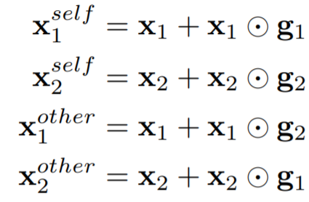
Pairwise Interaction & Pair Construction
Notes:
Next, use the Gate Vector to highlight the discriminative clues via residual attention.
The last layer of this module is a fully-connected layer which can do 196-class classification.
The above process will be done twice for each input image, one of it is pairing with the most similar image in the same class, and the other one is pairing with the most similar image in the other classes.

Slide 13
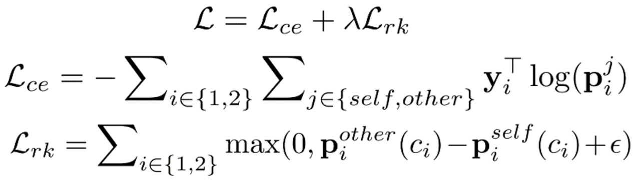
Loss Function
Cross Entropy Loss
Score Ranking Regularization
Feature highlighted by the object in the same class should lead to higher score than the one highlighted by the object in the other classes.
Notes:
The loss function is composed of two parts, cross entropy loss for each image’s prediction, and Score Ranking Regularization for each pair of predictions. The Score Ranking Regularization is thought that the feature highlighted by the object in the same class should lead to higher score than the one highlighted by the object in the other classes.

Slide 14
Outline
Introduction
Related Work
Proposed approach
Experimental results

Slide 15
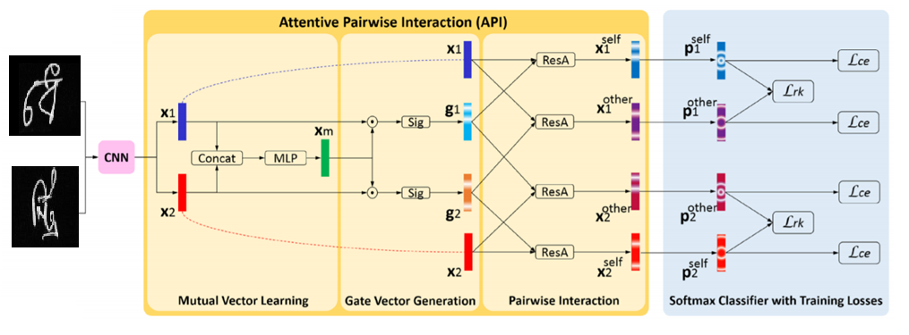
Overview
Train 3 models to root, vowel, consonant separately
Use the same loss function as API-Net

Slide 16
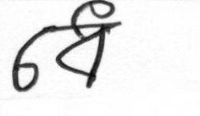
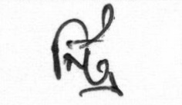
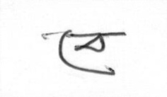
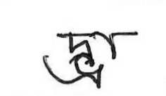
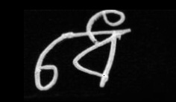
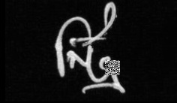
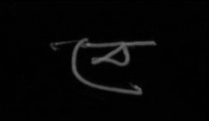

Data Preprocessing
Align the word to the center of the image and add some noise
Cut out, add block, adjust visibility

Slide 17
Unseen Object Issue
Grapheme root classifier
Use the whole dataset
vowel diacritic and consonant diacritic classifier
Drop out the data in which the same grapheme root must lead to the same vowel or consonant in the training set

Slide 18
Outline
Introduction
Related Work
Proposed approach
Experimental results

Slide 19
Dataset and Metric for Evaluation
Public Dataset & Private Dataset of the Challenge
Weighted Accuracy
grapheme root: 0.5
vowel diacritic: 0.25
consonant diacritic: 0.25

Slide 20
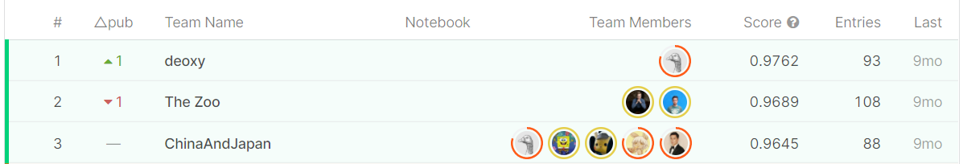
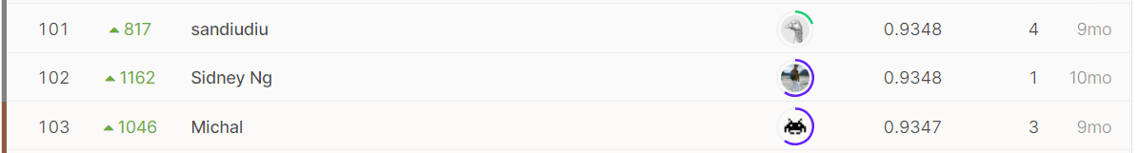
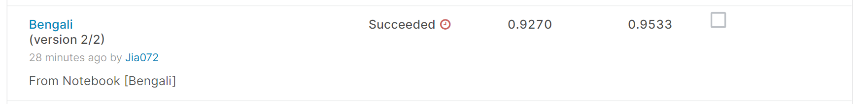
Experimental results

Slide 21
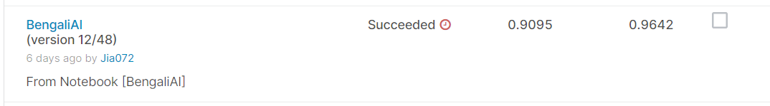
Ablation study
Does our method works when training vowel and consonant classifier
Drop Part of Dataset
Private Score
Public Score
Train with Whole Dataset

Slide 22
Conclusion
In this work, we tried some method to deal with unseen objects problem and we adopt a module named API-Net to do fine-grained classification on the training dataset and make a prediction on the testing data set. we also adjusted the hyperparameters and tried several ways to improve the performance of our models.

