Slide 1
Proposing mental-health intervention strategies based on client intake form data​
Group 004
StoryBoard

Slide 2
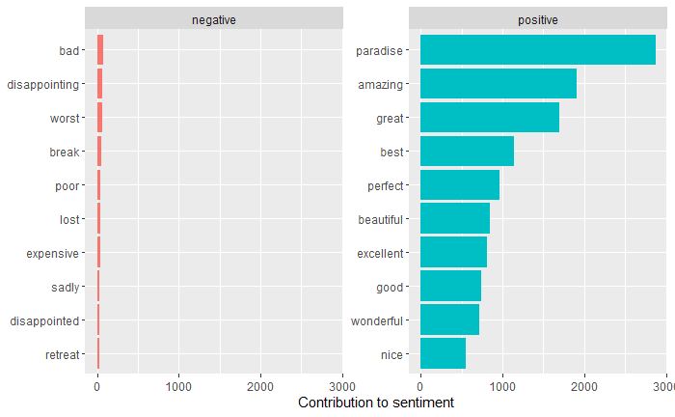
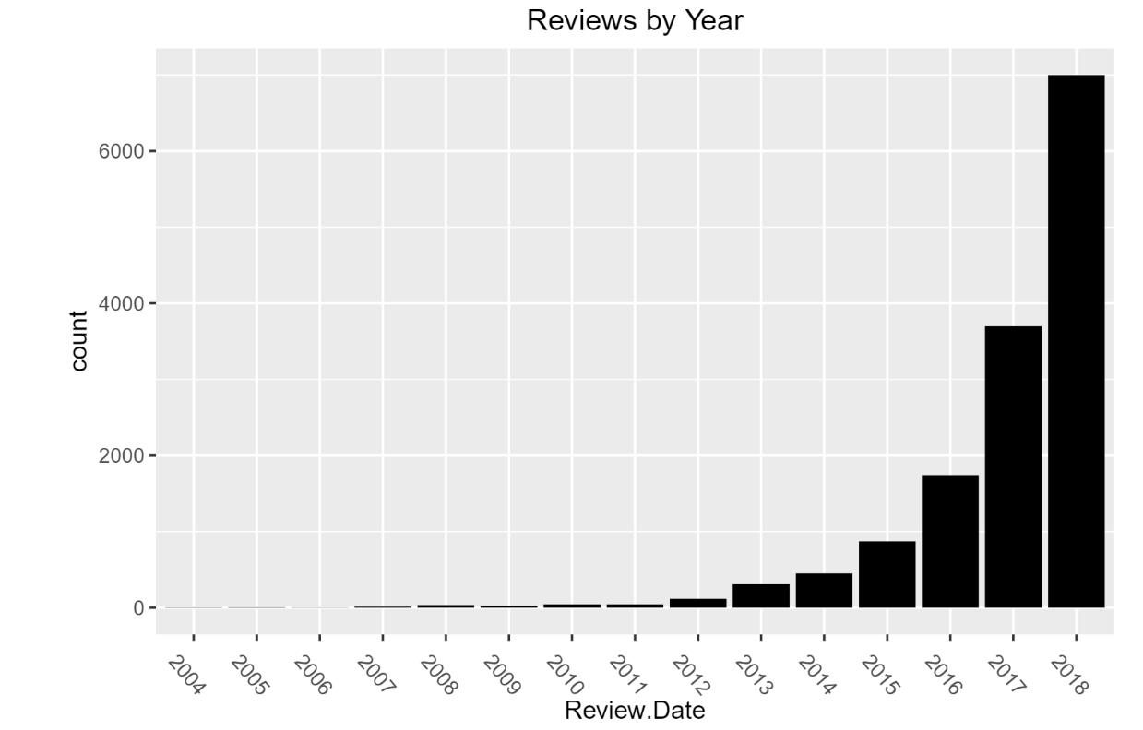
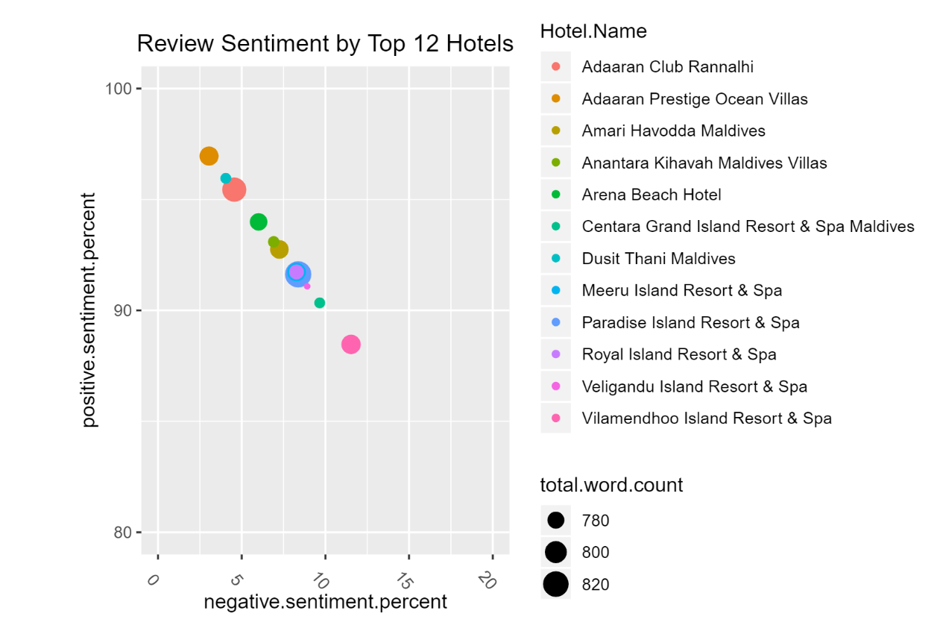
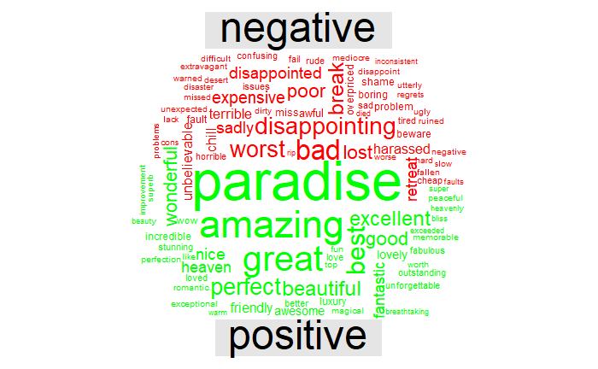
The graph clearly shows that the majority of the reviews take place between 2016 and 2018. This could indicate that reviews were not being collected prior to 2016 or that Maldives Resorts have only recently gained popularity.
One advantage of having the data frame with both sentiment and word is that we can analyze word counts that contribute to each sentiment.
As you can see in the picture, there are more positive reviews than negative reviews.
As seen in figure, the top hotels have an 85% positive review rate.
“Alaaran Prestige Occan Villas” had the best reviews, while “Vilamendhoo Island Resort & Spa” was on the lower end for top hotels.
From Simple WordsCloud, disaster doesn't know whether a review is positive or negative.
So for that, we have created comparison cloud using comparison.cloud() based on positive and negative reviews.

