Slide 1
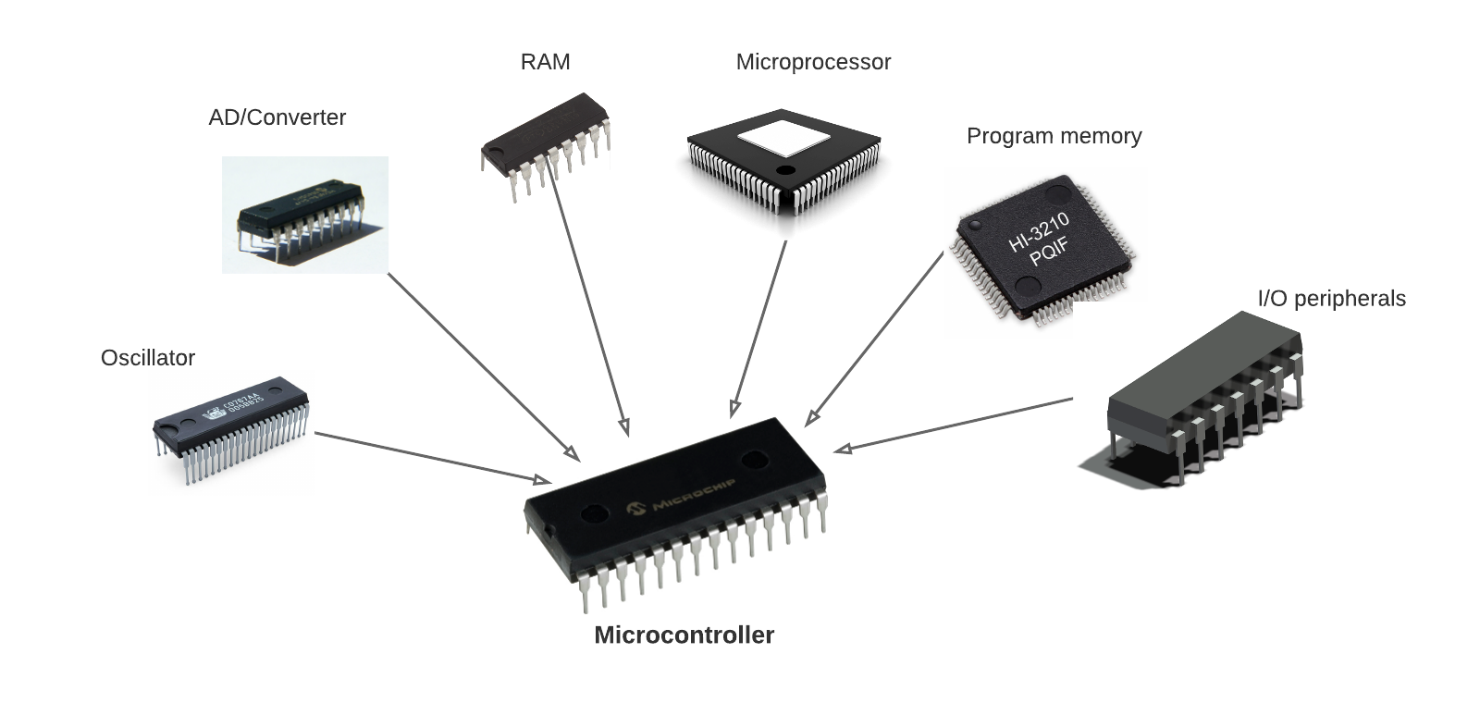
Microcontroller
embedded controller or microcontroller unit (MCU)
Chip optimized(power,cost)
to control electronic devices
Used to perform some
specific tasks such
as controlling motor, reading sensors
information and so on
Comprises of memory systems,
peripheral components, processor.

Slide 2
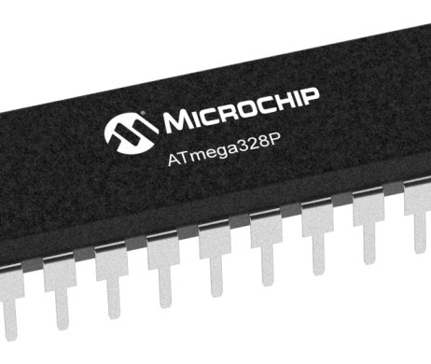
ATMEGA328P
Single-chip microcontroller created by Atmel.
32 KB flash memory and 8 bit architecture.
Found in Arduino uno

Slide 3
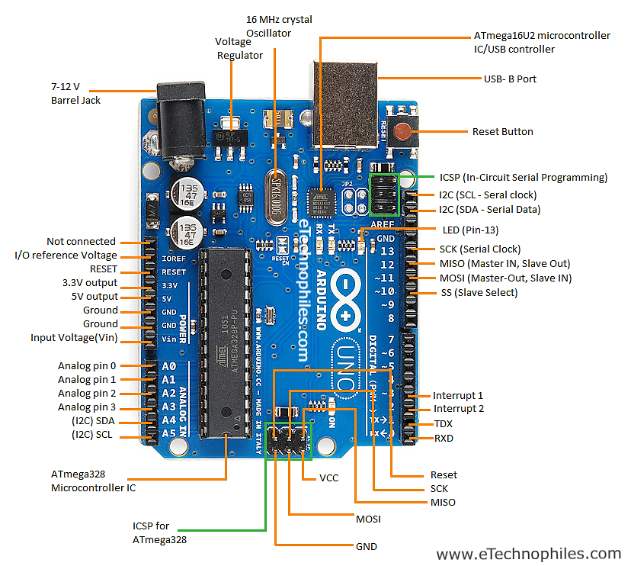
Arduino Uno

Slide 4
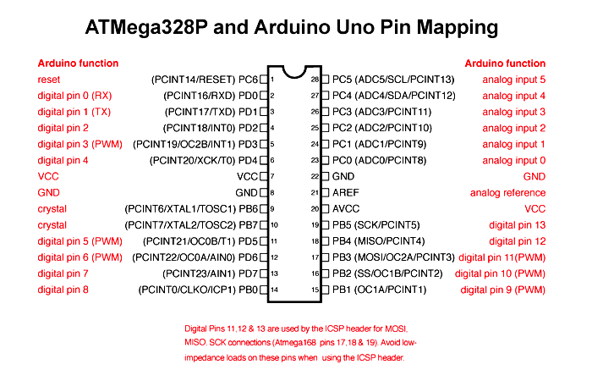

Slide 5
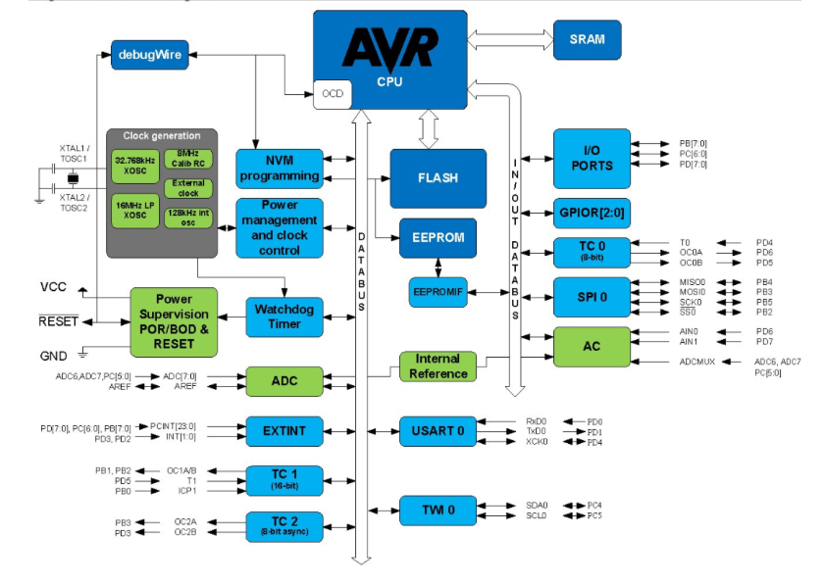

Slide 6
Logic State
Digital logic circuits have three logic states: high, low and floating(or high impedance)
The high-impedance state occurs when the pin is not pulled to a high or low logic level, but is left “floating" instead.
A good illustration of this is an unconnected input pin of a microcontroller.
It is neither in a high or low logic state, and the microcontroller might unpredictably interpret the input value as either a logical high or logical low.

Slide 7
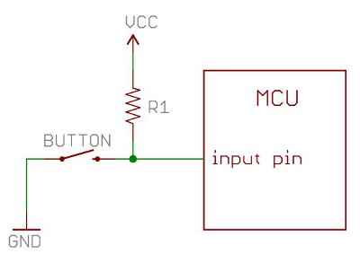
Pull Up Resistor

Slide 8
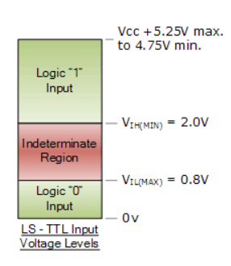
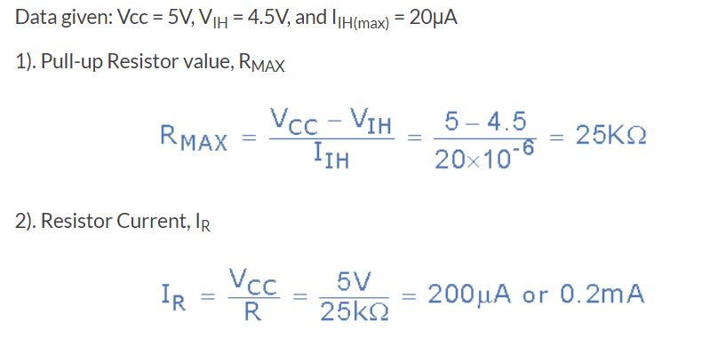
Pull Up Resistor

Slide 9
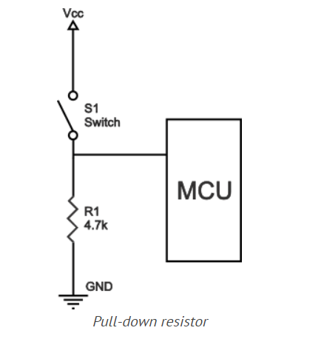
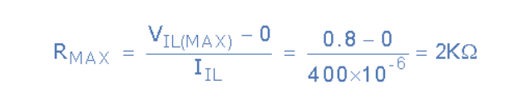
Pull Down Resistor

Slide 10
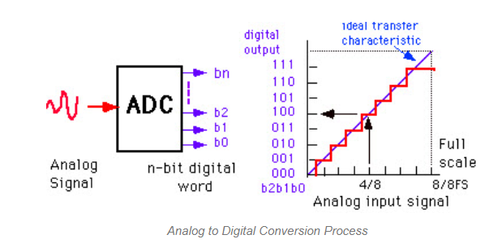
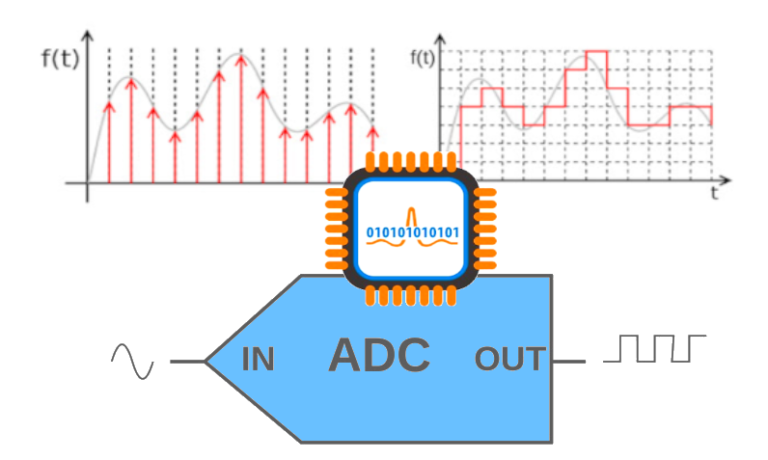
ADC
The ADC resolution is defined as the smallest incremental voltage that can be recognized and thus causes a change in the digital output. It is expressed as the number of bits output by the ADC. Therefore, an ADC which converts the analog signal to a 12-bit digital value has a resolution of 12 bits.

Slide 11
Input/Output pins
Digital port
Read/Write digital value as 1 or 0
LED,Switch and so on
Analog port
Read/Write analog value as 10 bit(0-1023)
Joystick module as potentiometer

Slide 12
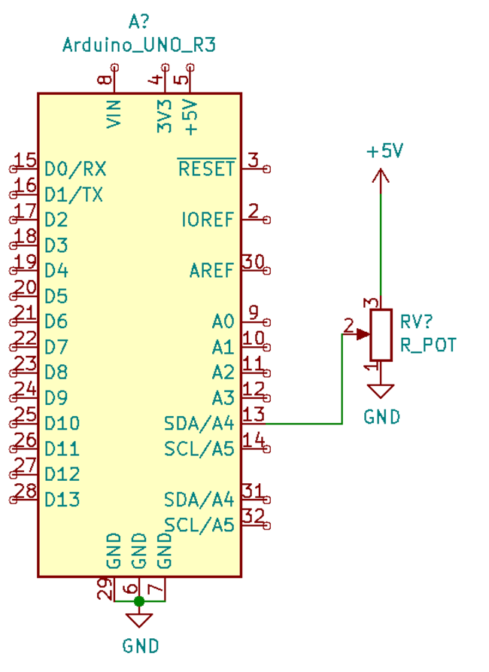
Basics Arduino Programming
pinMode()
•Sets pin as either Input or Output
•Syntax:
pinMode(pin, mode)
digitalRead()
•Reads value from a specified digital pin
•Syntax:
digitalRead(pin)
digitalWrite()
•Writes value to a specified digital pin
•Syntax:
digitalWrite(pin)

Slide 13
analogRead()
•Reads value from specified analog pin.
•Analog pin is denoted with 'A' in the front of pin name.
•Syntax:
analogRead(pin)
analogWrite()
•Writes analog value to a specified pin
•Syntax:
analogWrite(pin, value)

Slide 14
analogRead()
•Reads value from specified analog pin.
•Analog pin is denoted with 'A' in the front of pin name.
•Syntax:
analogRead(pin)
analogWrite()
•Writes analog value to a specified pin
•Syntax:
analogWrite(pin, value)
map()
map(value, fromLow, fromHigh, toLow, toHigh)
Parameters
value: the number to map. fromLow: the lower bound of the value’s current range. fromHigh: the upper bound of the value’s current range. toLow: the lower bound of the value’s target range. toHigh: the upper bound of the value’s target range.

Slide 15
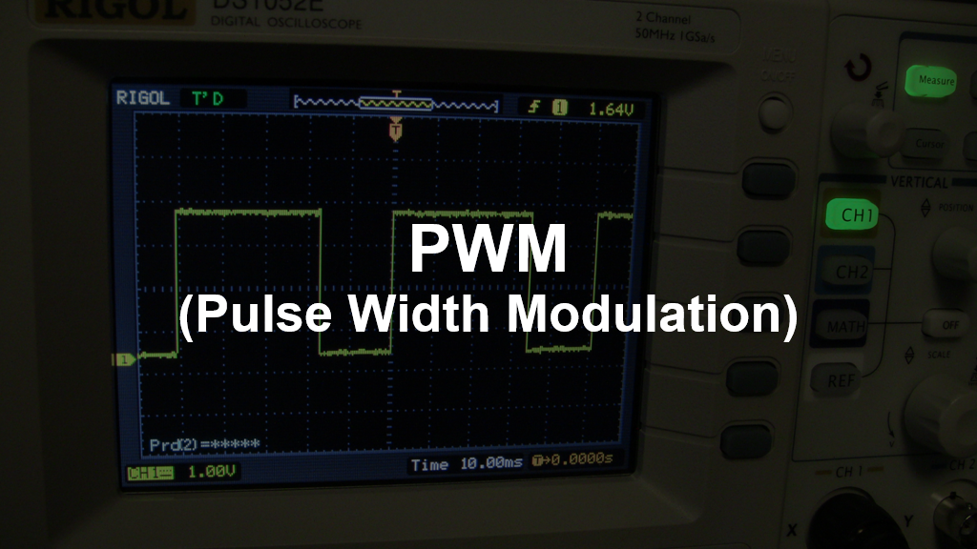

Slide 16
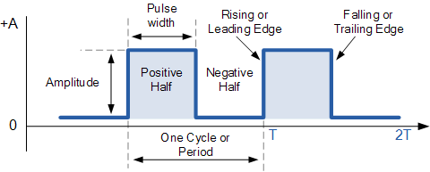
Pulse
Graphical Representation of the flow of current

Slide 17
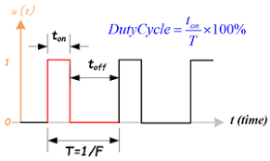
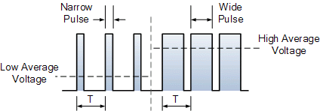
Pulse Width Modulation
A way of controlling the analog quantities by varying pulse width.
Syntax:
analogWrite(pin, PWM_VALUE)

Slide 18
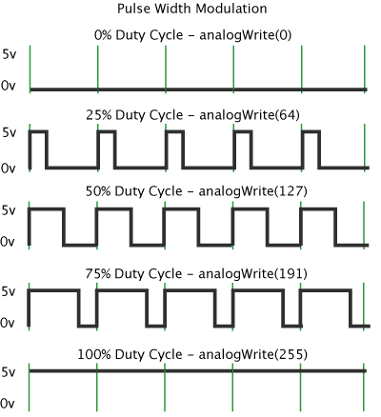
Pulse Width Modulation

Slide 19
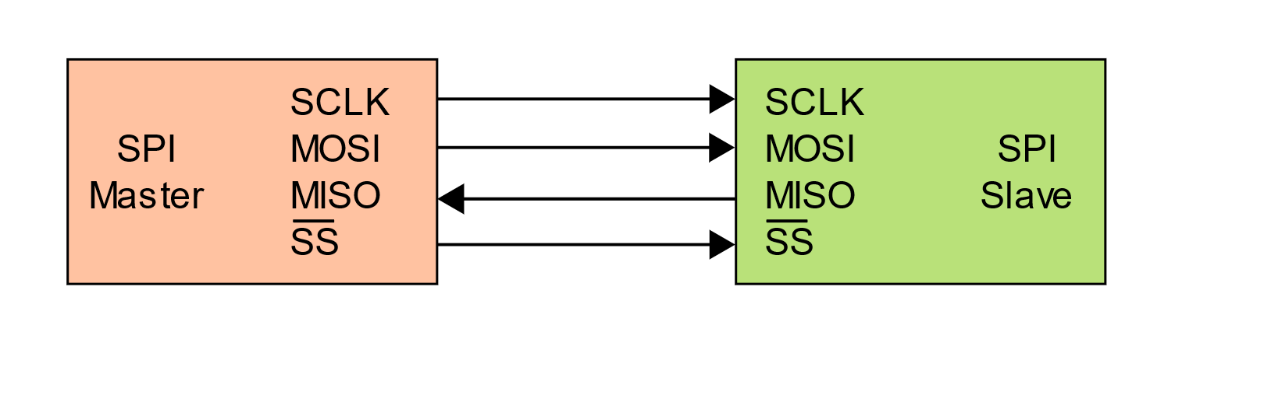
SPI Communication
Serial communication between a master and multiple slaves.
4 pins
MOSI
MISO
SCLK:- Output pin for master and input for slaves
SS:- Slave Select(Depending upon SPI and SS Setting Save is select)
SPI is used for Gather data from sensor at high frequencies, With Display and serial flash to RAM.
Data Communication line is high input impedance until ss is ground.
Half and Full Duplex Communication.
Serial resistor is used to store data as a buffer while sending and receiving data.

Slide 20
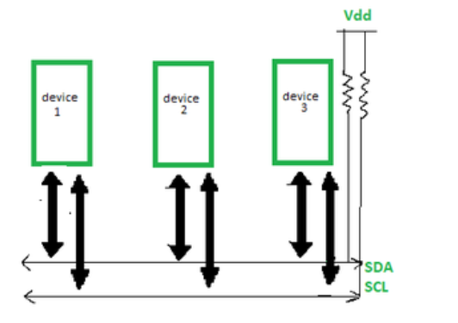
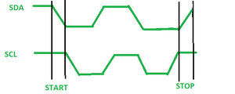
I2C Communication
To achieve serial data communication which are very close to each other
Multi-master capability
Communicates with slaves with slave address
Half duplex
Slave control over serial clock(clock stretching)
4 modes
Standard
Fast mode
Fast mode plus
High speed mode

Slide 21
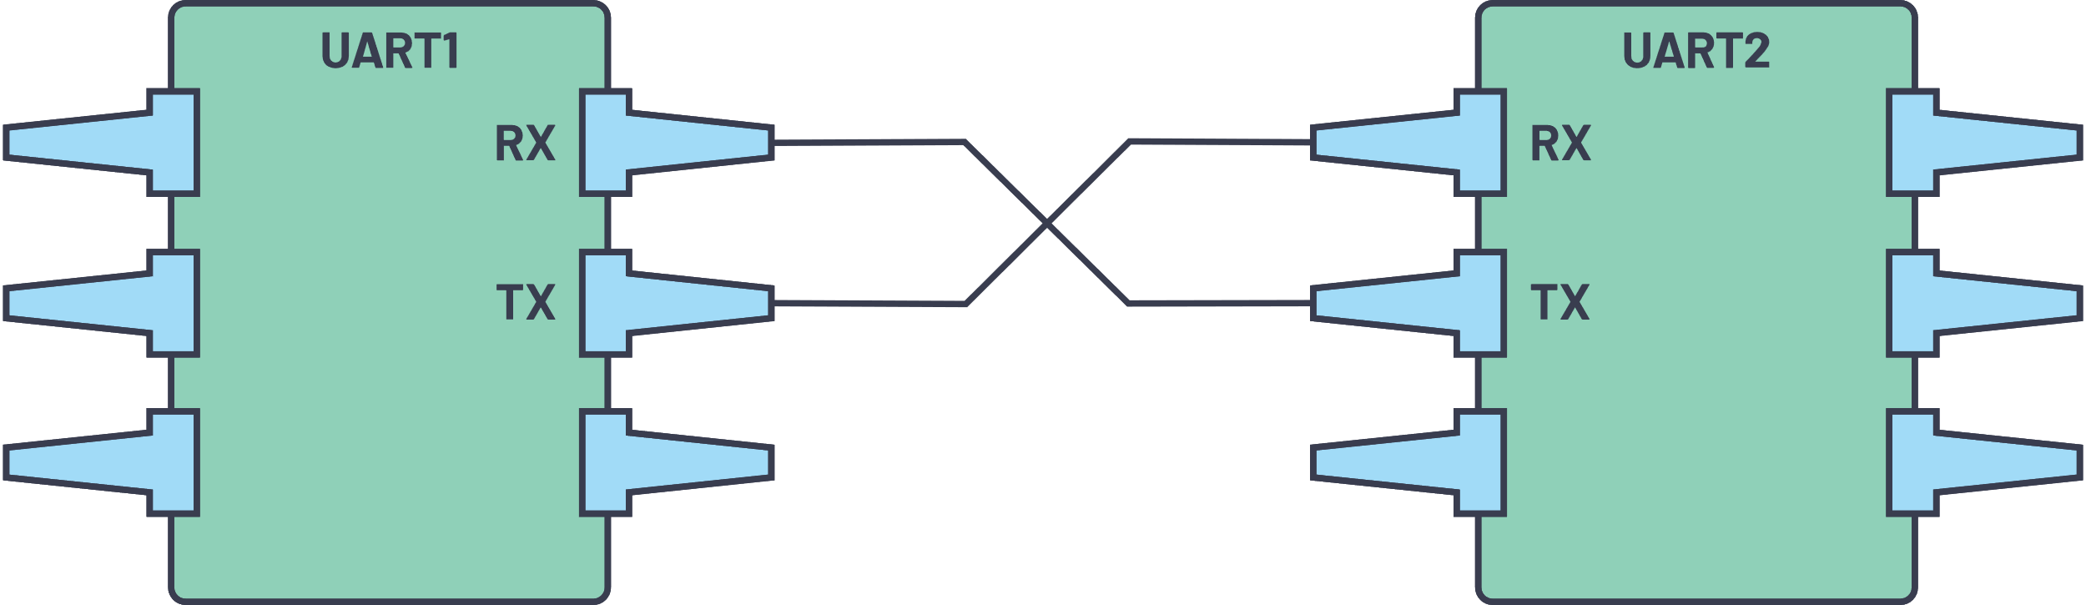
UART Communication
Hardware that converts parallel to serial data.
No specific port for UART communication can be used in conjugation with RS-232,RS-434 USB
When Tx is not transmitting it is held High (ideal state)
Components:
Baud Rate generator
Tx, Rx Register
Tx, Rx Buffer
FIFO Buffer memory

Slide 22
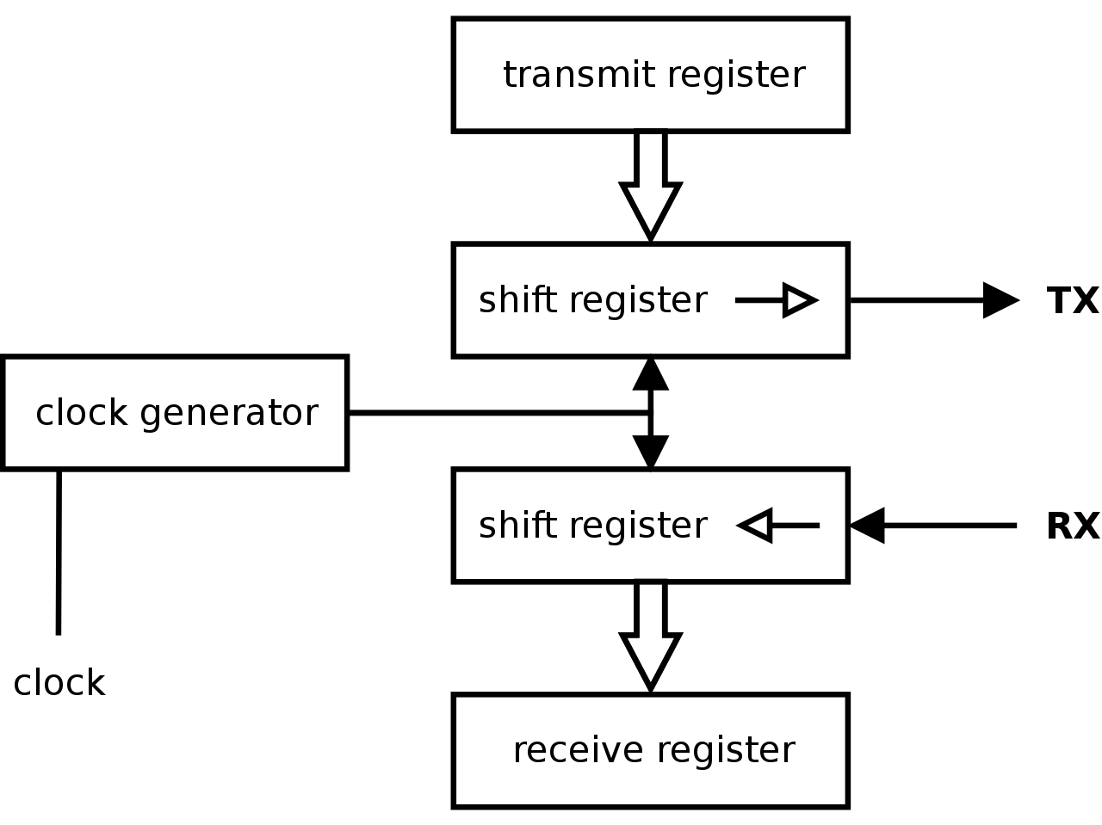
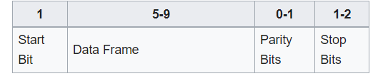

Slide 23
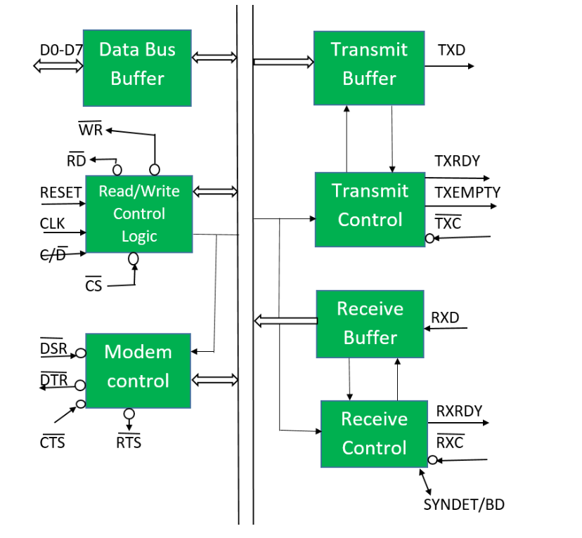
USART Communication
Data Bus Buffer
8-bit data bus used to read or write status command and data from or to the USART
Read/Write Control Logic
Six I/P signals: CS, C/D, WR, RD, RESET, CLK
3 buffer register : Data Reg, Control Reg and Status Reg
Modem Control
DSR: checks data set is ready when communicating with modem
DTR: Data terminal ready indicates device is ready to accept data when USART is communicating with Modem
CST: Clear to send the Data
RTS: Request TO send

Slide 24
USART Communication
Transmitter
Accepts parallel data from MPU and converts them into serial data
Has 2 register
Buffer Register:
Holds 8-bits send by the MPU
O/P Register:
To convert 8-bits into a stream of serial bits
Receiver
Accepts serial data on the RXD Pin and Converts them into Parallel.
Has 2 register
Receiver I/P register
Buffer Register

Slide 25
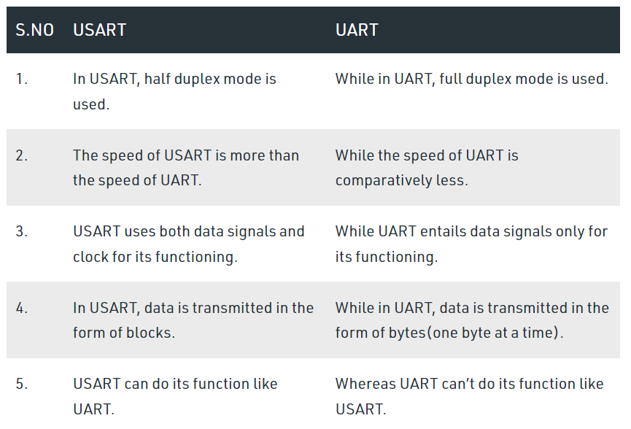
USART Communication

Slide 26
Interrupts
The interrupt is a signal emitted by hardware or software when a process or an event needs immediate attention.
It alerts the processor to a high-priority process requiring interruption of the current working process.
In I/O devices one of the bus control lines is dedicated for this purpose and is called the Interrupt Service Routine (ISR).
Hardware Interrupts:
In a hardware interrupt, all the devices are connected to the Interrupt Request Line.
Handling Multiple Devices:
Polling: In polling, the first device encountered with the IRQ bit set is the device that is to be serviced first. Appropriate ISR is called to service the same. It is easy to implement but a lot of time is wasted by interrogating the IRQ bit of all devices.
Vectored Interrupts: In vectored interrupts, a device requesting an interrupt identifies itself directly by sending a special code to the processor over the bus. This enables the processor to identify the device that generated the interrupt. The special code can be the starting address of the ISR or where the ISR is located in memory and is called the interrupt vector.

Slide 27
Interrupts
The interrupt is a signal emitted by hardware or software when a process or an event needs immediate attention.
It alerts the processor to a high-priority process requiring interruption of the current working process.
In I/O devices one of the bus control lines is dedicated for this purpose and is called the Interrupt Service Routine (ISR).
Hardware Interrupts:
In a hardware interrupt, all the devices are connected to the Interrupt Request Line.
Handling Multiple Devices:
Polling: In polling, the first device encountered with the IRQ bit set is the device that is to be serviced first. Appropriate ISR is called to service the same. It is easy to implement but a lot of time is wasted by interrogating the IRQ bit of all devices.
Vectored Interrupts: In vectored interrupts, a device requesting an interrupt identifies itself directly by sending a special code to the processor over the bus. This enables the processor to identify the device that generated the interrupt. The special code can be the starting address of the ISR or where the ISR is located in memory and is called the interrupt vector.

Slide 28
Interrupts
Interrupt Nesting: In this method, the I/O device is organized in a priority structure. Therefore, an interrupt request from a higher priority device is recognized whereas a request from a lower priority device is not. The processor accepts interrupts only from devices/processes having priority

Slide 29
Code:
void setup()
{
pinMode(A0, INPUT);
pinMode(11, OUTPUT);
Serial.begin(9600);
}
void loop()
{
int val = analogRead(A0);
float voltage = val * (255.0/1023.0);
analogWrite(11, voltage);
delay(100); // Wait for 100 millisecond(s)
}

Slide 30
int ledpin = 11;
int button = 2;
int vrx = A0;
int vry = A1;
int vrx_val, vry_val, button_val, led_val_x, led_val_y;
void setup() {
// put your setup code here, to run once:
Serial.begin(9600);
pinMode(ledpin,OUTPUT);
pinMode(button, INPUT);
//attachInterrupt(digitalPinToInterrupt(interruptPin), blink, CHANGE);
}

Slide 31
void loop() {
vrx_val = analogRead(vrx);
vry_val = analogRead(vry);
button_val = digitalRead(button);
led_val_x = map(vrx_val, 0, 1023, 0, 255);
Serial.print(vrx_val);
Serial.print("\t");
Serial.print(vry_val);
Serial.print("\t");
Serial.println(button_val);
analogWrite(ledpin, led_val_x);
}

