Slide 1
Homework
Try to modify the regression example into neuron network version
https://github.com/acyang/mlmgi/blob/master/regression/simple_regression_tf.ipynb

Slide 2
input_x
……
input_y
input layer
hidden layer
output layer

Slide 3
Solution
https://github.com/acyang/mlmgi/blob/master/regression/simple_regression_tf.ipynb

Slide 4
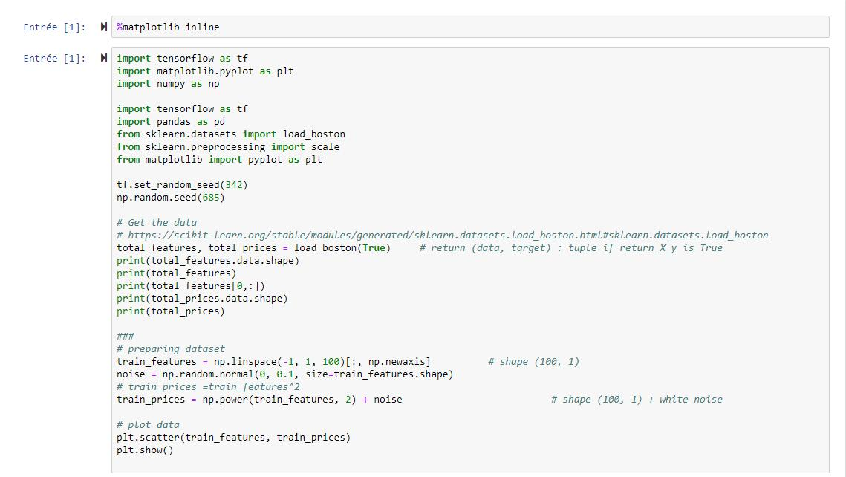

Slide 5
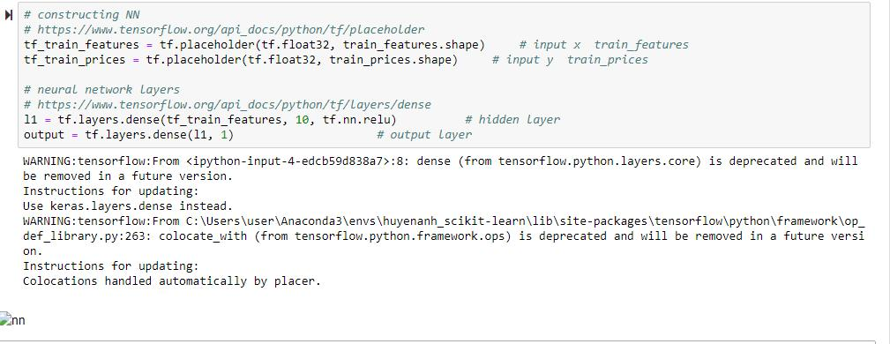
Solution

Slide 6
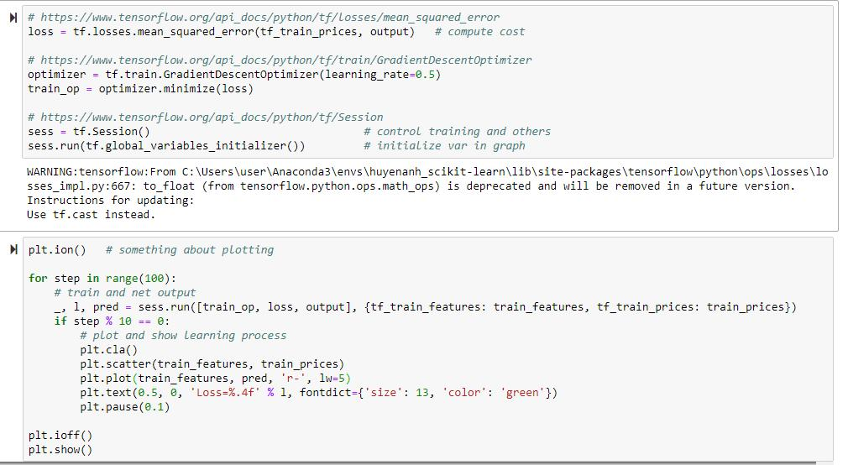

Slide 7
