Slide 1
機器學習於材料資訊的應用 Machine Learning on Material Informatics
陳南佑(nan-yow Chen)
楊安正(An-Cheng Yang)

Slide 2

Program
Program = Data Structure + Algorithm
Data Structure
A data structure is a data organization, management and storage format that enables efficient access and modification. More precisely, a data structure is a collection of data values, the relationships among them, and the functions or operations that can be applied to the data.
Algorithm
A process or set of rules to be followed in calculations or other problem-solving operations, especially by a computer.

Slide 3
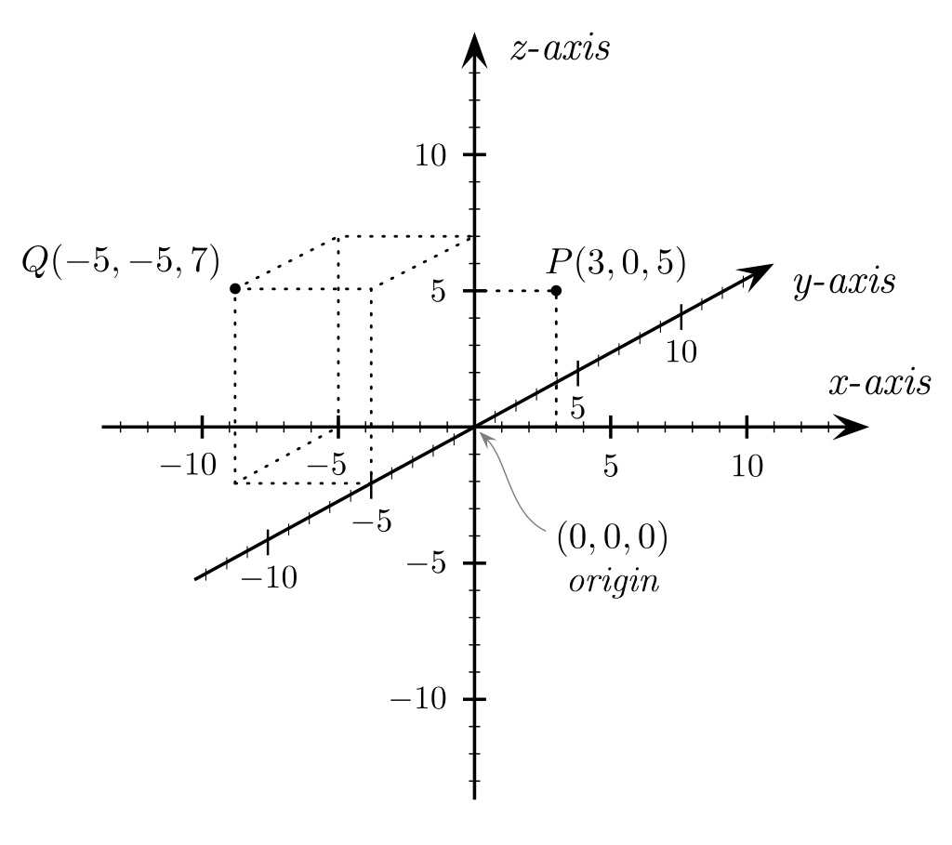
Exercise 3
Quadrant:
I: + + +
II: + ─ +
III: ─ ─ +
VI: ─ + +
V: + + ─
VI: + ─ ─
VII: ─ ─ ─
VIII: ─ + ─
Ex 3: determine a point in which quadrant without using “if …”. Say (-3, 1, 3)
Ref: https://docs.python.org/3/library/random.html

Slide 4
Algorithm for Ex3
Quadrant:
I: + + + ➔ 111
II: + ─ + ➔ 101
III: ─ ─ + ➔ 001
VI: ─ + + ➔ 011
V: + + ─ ➔ 110
VI: + ─ ─ ➔ 100
VII: ─ ─ ─ ➔ 000
VIII: ─ + ─ ➔ 010
Use (address) With coding
➔ 4*1+2*1+1*1=7
➔ 4*1+2*0+1*1=5
➔ 4*0+2*0+1*1=1
➔ 4*0+2*1+1*1=3
➔ 4*1+2*1+1*0=6
➔ 4*1+2*0+1*0=4
➔ 4*0+2*0+1*0=0
➔ 4*0+2*1+1*0=2
➔ A[7]=1
➔ A[5]=2
➔ A[1]=3
➔ A[3]=4
➔ A[6]=5
➔ A[4]=6
➔ A[0]=7
➔ A[2]=8
2²
2¹
2⁰
4
2
1
Use (address) and value)
A[0] = 7 A[1] = 3 A[2] = 8 A[3] = 4 A[4] = 6 A[5] = 2 A[6] = 5 A[7] = 1

Slide 5
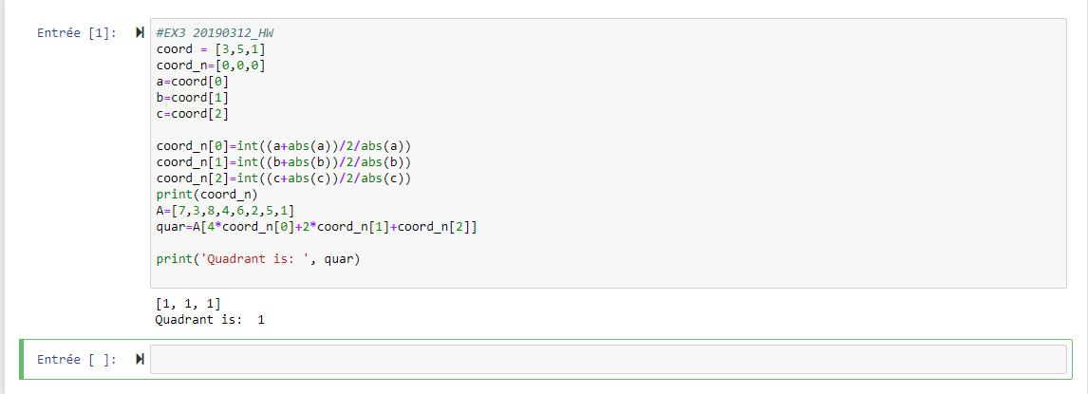
Algorithm for Ex3

