Slide 1
機器學習於材料資訊的應用 Machine Learning on Material Informatics
陳南佑(nan-yow Chen)
楊安正(An-Cheng Yang)

Slide 2

Program
Program = Data Structure + Algorithm
Data Structure
A data structure is a data organization, management and storage format that enables efficient access and modification. More precisely, a data structure is a collection of data values, the relationships among them, and the functions or operations that can be applied to the data.
Algorithm
A process or set of rules to be followed in calculations or other problem-solving operations, especially by a computer.

Slide 3
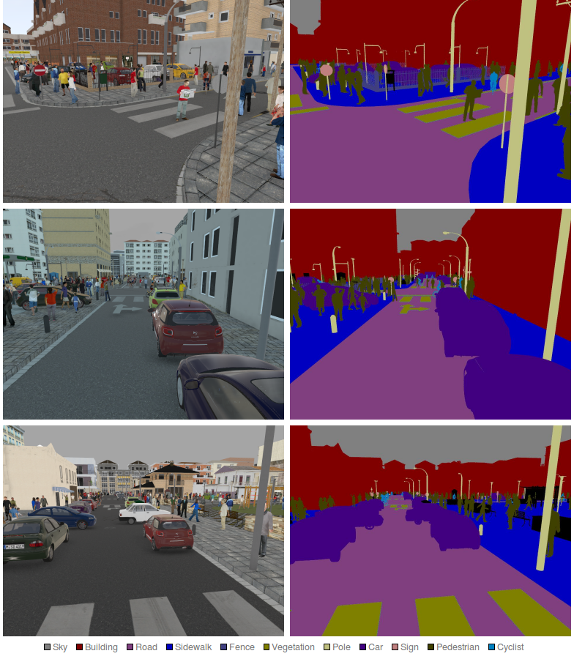
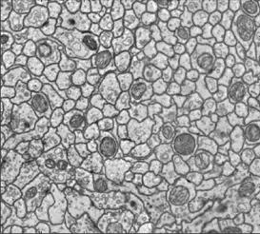
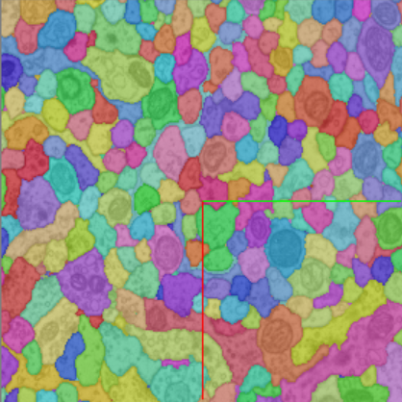

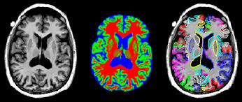
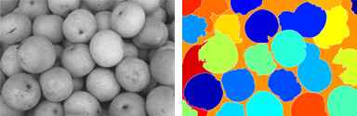
Image segmentation

Slide 4
Exercise 2
Size = 12
Simple image segmentation:
4-connectivity:
Ex 2: segment left image into 3 isolated islands and count their size.
Island 1:
Size = 12
Island 2:
Size = 15
Size = 15
= 0
= 1
Island 3:
Size = 12
Size = 12

Slide 5
Algorithm for Ex2
Find the first nonzero member and check its neighbors!
X
2
3
Buffer
(3,2)
Count = 1
2
X
3
= 2, checked
= 0
= 1
= 3, pushed

Slide 6
Algorithm for Ex2
Start from Buffer[Count].
Ex.
Buffer[1] = (3,2) Count = Count - 1
X
Buffer
Count = 0
3
4
(4,2)
(4,2)
(3,3)
(3,2)
Count = 1
2
Count = 2
X
3
4
= 2, checked
= 0
= 1
= 3, pushed

Slide 7
Algorithm for Ex2
Continue from Buffer[Count].
Ex.
Buffer[1] = (3,3) Count = Count - 1
X
Buffer
3
4
(4,2)
(3,3)
(4,2)
(4,2)
(4,3)
(4,2)
(4,3)
(3,4)
Count = 1
2
Count = 2
3
X
Count = 3
4
= 2, checked
= 0
= 1
= 3, pushed
Continue this step till buffer is empty, then we find the first isolated island!!!

Slide 8
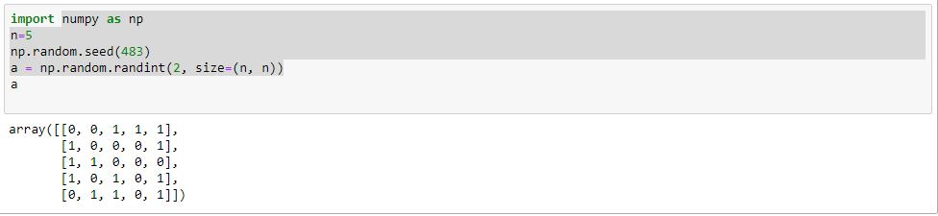
Solution for Ex2

Slide 9
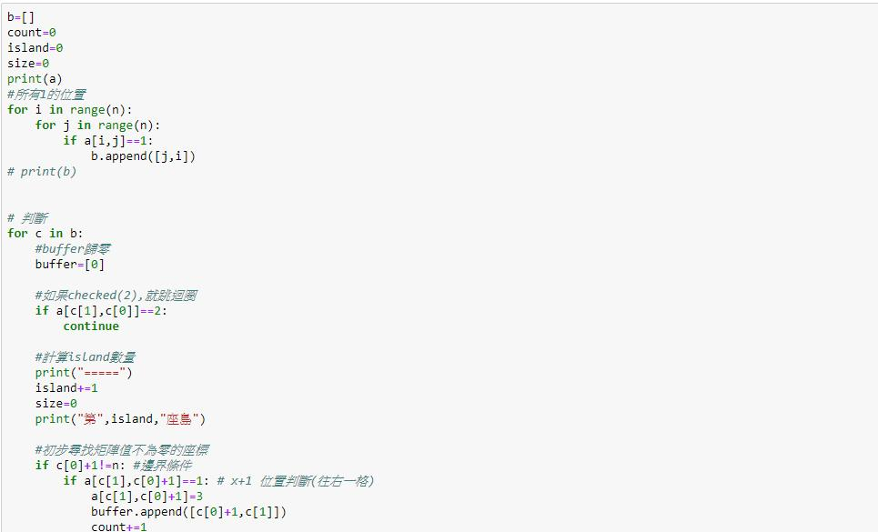

Slide 10
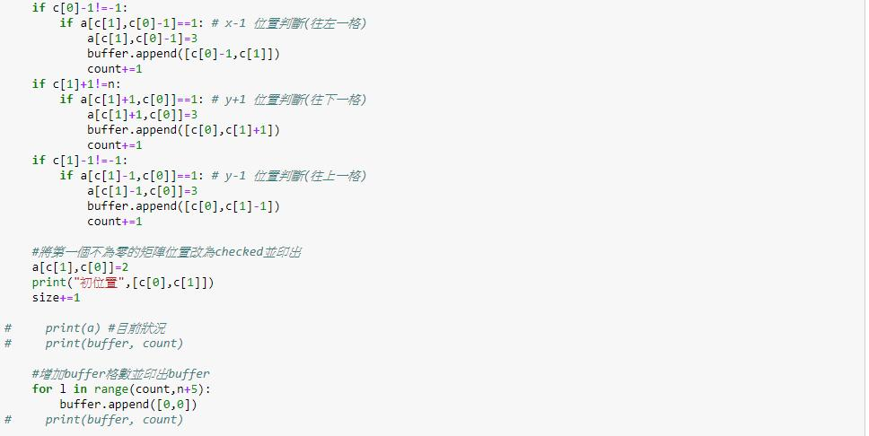
Solution for Ex2

Slide 11
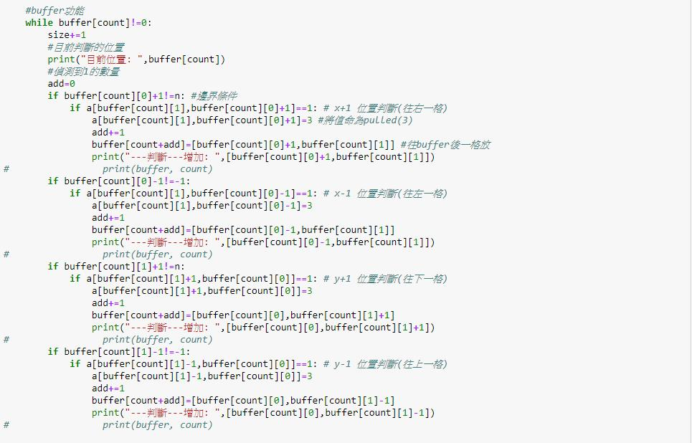

Slide 12
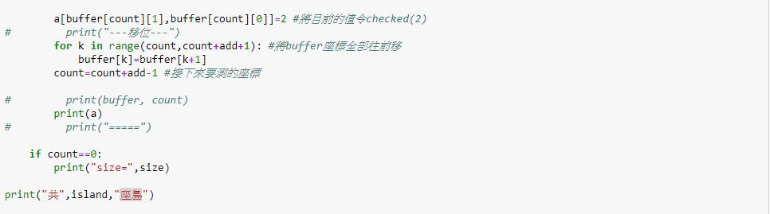
Solution for Ex2

Slide 13
