Slide 1
機器學習於材料資訊的應用 Machine Learning on Material Informatics
陳南佑(nan-yow Chen)
楊安正(An-Cheng Yang)

Slide 2
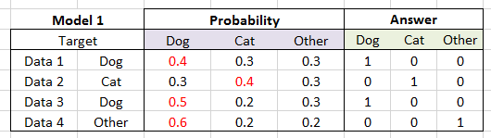
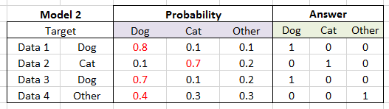
Exercise
Ex: calculate MSE(Mean Square Error), MAE(Mean Absolute Error), cross-entropy for these two models:

Slide 3

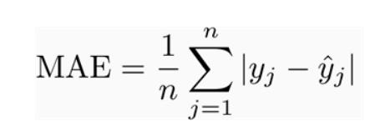
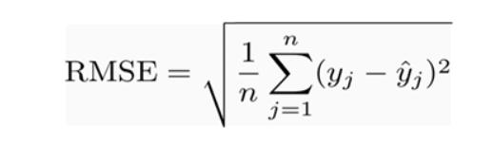
Solution
Loss function
Mean Square Error (MSE):
Mean Absolute Error (MAE):
Root mean squared error (RMSE):

Slide 4
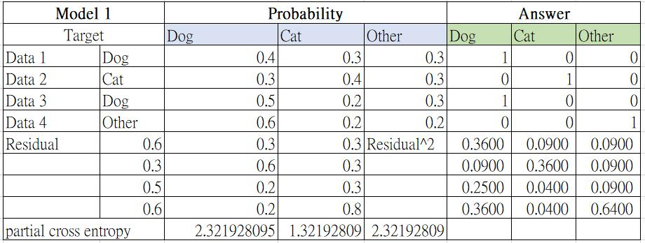
Solution

Slide 5
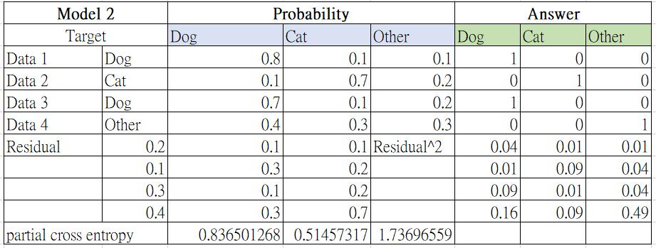
Solution

Slide 6

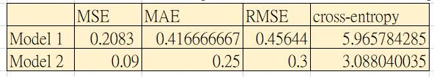
Solution
All error rate are ¼ for these two models
But which models is better?
Cross_entropy:
MSE(Mean Square Error), MAE(Mean Absolute Error), cross-entropy

