Slide 1
UNIT3:JavaScript(JS)
Lecturer: Shimirwa Aline Valerie
Email: a.shimirwa@ines.ac.rw
Tel: 0784931189

Slide 2
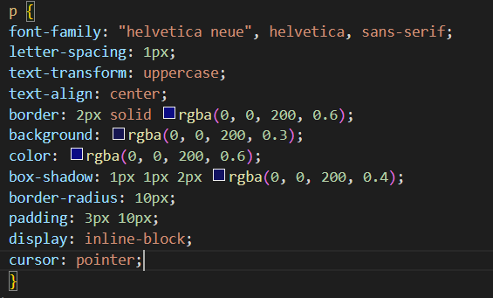
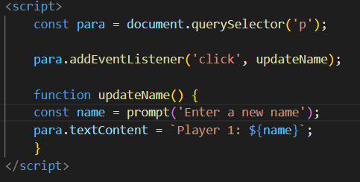

What is JavaScript?
Then we can add some CSS to make it look nice:
And finally, we can add some JavaScript to implement dynamic behavior:
JavaScript is the world's most popular programming language, which is used to program the behavior of website(i.e., JavaScript enables us to create dynamically updating content, control multimedia, animate images, etc.).
JavaScript was invented by Brendan Eich in 1995. It was developed for Netscape 2, and became the ECMA-262 standard in 1997.
It is the third layer of the layer cake of standard web technologies, two of which (HTML and CSS) we have covered. These three layers are built on top of one another nicely. Let's take a simple text as an example:
We can mark it up using HTML to give it structure and purpose:

Slide 3
what can JavaScript do?
The core client-side JavaScript language consists of some common programming features that allow you to do things like:
Storing useful values inside variables. In the above example for instance, we ask for a new name to be entered then store that name in a variable called name.
Operations on pieces of text (known as "strings" in programming). In the above example we take the string "Player 1: " and join it to the name variable to create the complete text label, e.g. "Player 1:Valerie".
Running code in response to certain events occurring on a web page. We used a click event in our example above to detect when the label is clicked and then run the code that updates the text label.
There are functionality built on top of the client-side JavaScript language. So-called Application Programming Interfaces (APIs) provide us with extra superpowers to use in the JavaScript code.
APIs are ready-made sets of code building blocks that allow a developer to implement programs that would otherwise be hard or impossible to implement. APIs generally fall into two categories:
Browser APIs are built into your web browser, and are able to expose data from the surrounding computer environment, or do useful complex things. For example: The DOM (Document Object Model) API allows you to manipulate HTML and CSS, creating, removing and changing HTML, dynamically applying new styles to your page, etc.
Third party APIs are not built into the browser by default, and you generally have to grab their code and information from somewhere on the Web. For example: The Twitter API allows you to do things like displaying your latest tweets on your website. Visit https://developer.mozilla.org/enUS/docs/Learn/JavaScript/Client-side_web_APIs

Slide 4
JavaScript running order
When the browser encounters a block of JavaScript, it generally runs it in order, from top to bottom. This means that you need to be careful what order you put things in. let’s take the script code we use in above example:
In above code, we are selecting a text paragraph , then attaching an event listener to it, so that when the paragraph is clicked, the updateName() function will be called.
If you swapped the order of the first two lines of code, it would no longer work. Instead, you will get an error returned in the browser developer console( TypeError: para is undefined). This means that the para object does not exist yet, so we can't add an event listener to it.
Note: This is a very common error. you need to be careful that the objects referenced in your code exist before you try to do stuff to them.

Slide 5
Interpreted vs Compiled Languages
Interpreted languages: the code in interpreted languages is run from top to bottom and the result of running the code is immediately returned. You don't have to transform the code into a different form before the browser runs it. The code is received in its programmer-friendly text form and processed directly from that.
JavaScript is a lightweight interpreted programming language. The web browser receives the JavaScript code in its original text form and runs the script from that.
Compiled languages on the other hand are transformed (compiled) into another form before they are run by the computer. For example, C/C++ are compiled into machine code that is then run by the computer. The program is executed from a binary format, which was generated from the original program source code.

Slide 6
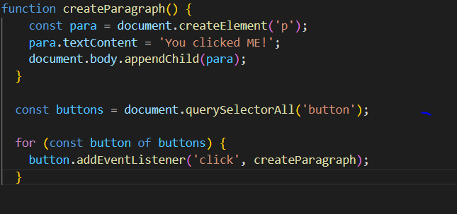
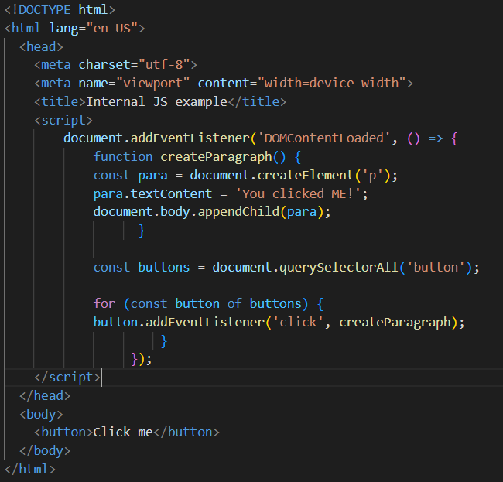
How do you add JavaScript to your page
JavaScript is applied to your HTML page in a similar manner to CSS. Whereas CSS uses <link> elements to apply external stylesheets and <style> elements to apply internal stylesheets to HTML, JavaScript only needs one friend in the world of HTML — the <script> element.
Internal JavaScript
External JavaScript
First, create a new file in the same directory as your sample HTML file. Call it script.js.
Inside scriptthat.js, add the following scrip:
Inside the head element put the following

Slide 7
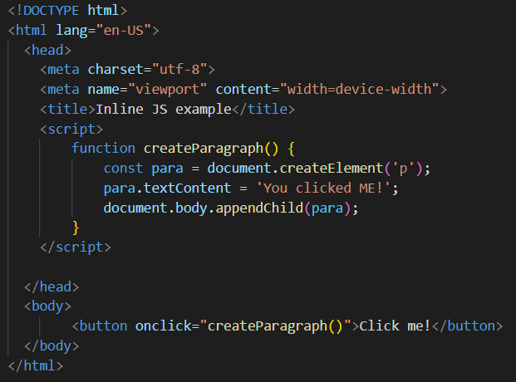
Inline JavaScript
Sometimes you will come across bits of actual JavaScript code living inside HTML. It might look something like this:
The above code has exactly the same functionality as in the previous two codes, except that the <button> element includes an inline onclick handler to make the function run when the button is pressed.
Note: It is bad practice to pollute your HTML with JavaScript, and it is inefficient. You’d have to include the onclick="createParagraph()" attribute on every button you want the JavaScript to apply to.

Slide 8

Script loading strategies
There are a number of issues involved with getting scripts to load at the right time.
A common problem is that all the HTML on a page is loaded in the order in which it appears.
If you are using JavaScript to manipulate elements on the page (or more accurately, the Document Object Model), your code won't work if the JavaScript is loaded and parsed before the HTML you are trying to do something to.
In the above code examples, the JavaScript is loaded and run in the head of the document, before the HTML body is parsed. This could cause an error.
So there are some constructs which can be used to get around it.
In the internal JavaScript example, you can see this structure around the code:
This is an event listener, which listens for the browser's DOMContentLoaded event, which signifies that the HTML body is completely loaded and parsed. The JavaScript inside this block will not run until after that event is fired, therefore the error is avoided.

Slide 9


How to add comments in JS
There are two types of comments:
A single line comment is written after a double forward slash (//), e.g:
A multi-line comment is written between the strings /* and */, e.g.:
As with HTML and CSS, it is possible to write comments into your JavaScript code that will be ignored by the browser, and exist to provide instructions to your fellow developers on how the code works (and you, if you come back to your code after six months and can't remember what you did).
Comments are very useful, and you should use them often, particularly for larger applications.

Slide 10
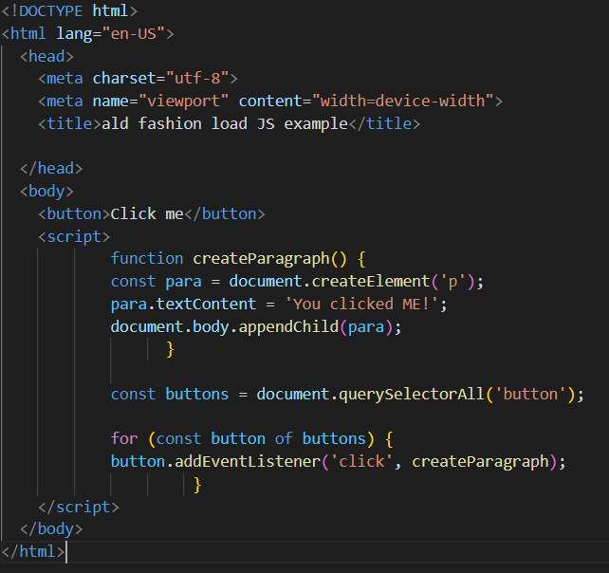
Script loading strategies cont..
In the external example, we use the defer attribute, which tells the browser to continue downloading the HTML content once the <script> tag element has been reached. In this case both the script and the HTML will load simultaneously and the code will work.
An old-fashioned solution to this problem used to be to put your script element right at the bottom of the body (e.g. just before the </body> tag), so that it would load after all the HTML has been parsed. The problem with this solution is that parsing of the script is completely blocked until the HTML DOM has been loaded. On larger sites with lots of JavaScript, this can cause a major performance issue, slowing down your site.

Slide 11




Storing the information you need in Variables
You can declare and initialize a variable at the same time, like this:
Updating a variable
Once a variable has been initialized with a value, you can change (or update) that value by giving it a different value:
What is a variable?
A variable is a container for a value, like a number we might use in a sum, or a string that we might use as part of a sentence.
Declaring a variable
To use a variable, you've first got to create it:
Initializing a variable
Once you've declared a variable, you can initialize it with a value:

Slide 12
Variable Naming Rules
Make variable names intuitive, so they describe the data they contain. Don't just use single letters/numbers, or big long phrases.
Variables are case sensitive. So, myage is a different variable from myAge.
One last point: you also need to avoid using JavaScript reserved words as your variable names. By this, we mean the words that make up the actual syntax of JavaScript! So, you can't use words like function, let, and for as variable names. Browsers recognize them as different code items, and so you'll get errors.
When naming, you should stick to just using Latin characters (0-9, a-z, A-Z) and the underscore character.
You shouldn't use other characters because they may cause errors or be hard to understand for an international audience.
Don't use underscores at the start of variable names — this is used in certain JavaScript constructs to mean specific things, so may get confusing.
Don't use numbers at the start of variables. This isn't allowed and causes an error.
A safe convention to stick to is so-called "lower camel case“, where you stick together multiple words, using lower case for the whole first word and then capitalize subsequent words.

Slide 13




Variable types
Booleans
Booleans are true/false values. These are generally used to test a condition, after which code is run as appropriate. e.g.:
Arrays
An array is a single object that contains multiple values enclosed in square brackets and separated by commas. e.g.:
There are a few different types of data we can store in variables.
Numbers
You can store numbers in variables, either whole numbers or decimal numbers. e.g.:
Strings
Strings are pieces of text. When you give a variable a string value, you need to wrap it in single or double quote marks. e.g.:

Slide 14



Variable types cont…
Note that although a constant in JavaScript must always name the same value, you can change the content of the value that it names. This isn't a useful distinction for simple types like numbers or Booleans, but consider an object:
You can update, add, or remove properties of an object declared using const, because even though the content of the object has changed, the constant is still pointing to the same object:
Objects
In programming, an object is a structure of code that models a real-life object. You can have a simple object that represents a person, and contains data about their name, height, weight, what language they speak, how to say hello to them, and more. e.g.:
To retrieve the information stored in the object, you can use the following syntax:
Constants in JavaScript
As well as variables, you can declare constants. These are like variables, except that:
you must initialize them when you declare them.
you can't assign them a new value after you have initialized them.

Slide 15
Variable types cont…
When to use const and when to use let
If you can't do as much with const as you can with let, why would you prefer to use it rather than let?
In fact const is very useful. If you use const to name a value, it tells anyone looking at your code that this name will never be assigned to a different value. Any time they see this name, they will know what it refers to.
Follow this principle about when to use let and when to use const:
Use const when you can, and use let when you have to. This means that if you can initialize a variable when you declare it, and don't need to reassign it later, make it a constant.

Slide 16
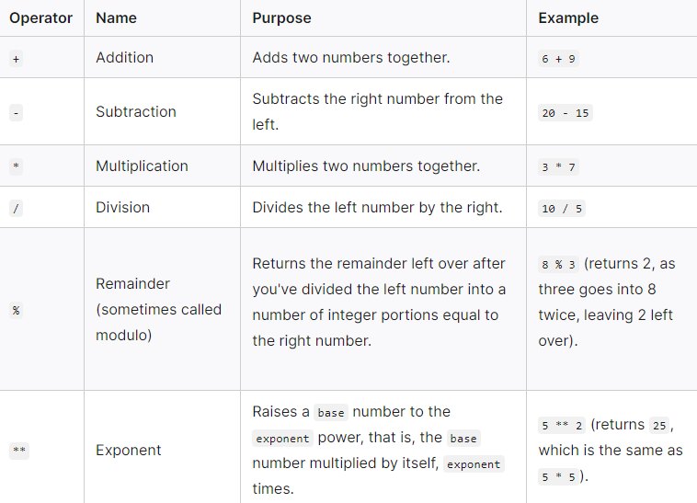


Basic math in JavaScript (operators)
Arithmetic operators
Arithmetic operators are the basic operators that we use to do arithmetic operations in JavaScript.
Operator precedence
some operators are applied before others when calculating the result of a calculation.
multiplication and division are always done first. then addition and subtraction.
the calculation is always evaluated from left to right. e.g.:

Slide 17
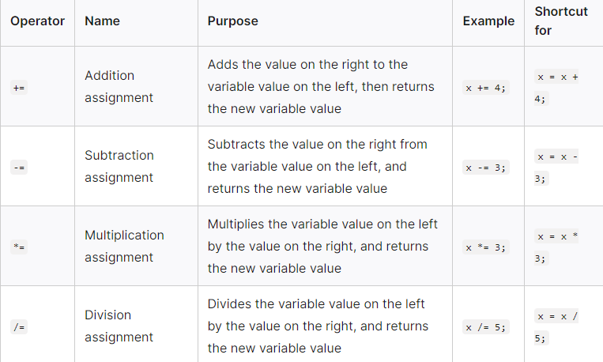
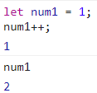
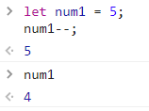
Basic math in JavaScript (operators)
Increment and decrement operators
Sometimes you'll want to repeatedly add or subtract one from a numeric variable value. This can be conveniently done using the increment (++) and decrement (--) operators.
Increment(e.g.,) : Decrement (e.g.,):
Assignment operators
Assignment operators are operators that assign a value to a variable. The figure shows the most common used assignment operators in JavaScript.

Slide 18
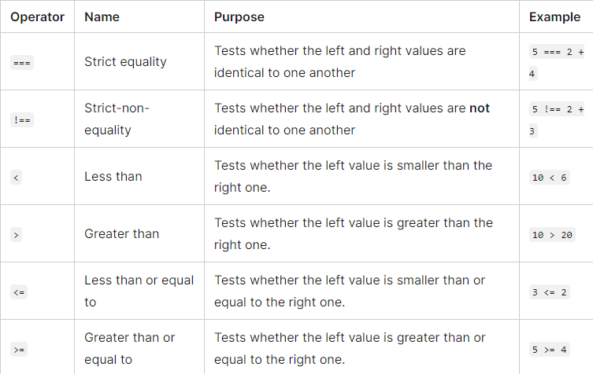
Basic math in JavaScript (operators)
Comparison operators
Sometimes we will want to run true/false tests, then act accordingly based on the result of that test (to do this we use comparison operators). The figure on the right shows comparison operators.
You may see some people using == and != in their tests for equality and non-equality. These are valid operators in JavaScript, but they differ from ===/!==. The former versions test whether the values are the same but not whether the values' datatypes are the same.

Slide 19
Basic math in JavaScript (operators)
Exercise
Create four variables that contain numbers. Call the variables something sensible.
Add the first two variables together and store the result in another variable.
Subtract the fourth variable from the third and store the result in another variable.
Multiply the results from steps 2 and 3 and store the result in a variable called finalResult.
Check if finalResult is an even number using an arithmetic operator and store the result in a variable called evenOddResult.

Slide 20


Handling text(strings in JavaScript)
JavaScript strings are for storing and manipulating text.
Creating a string
Single quotes vs. double quotes
In JavaScript, you can choose single quotes or double quotes to wrap your strings in.
Don’t mix double quotes and single quotes. You should choose one and stick to it. The following will return an error:
Breaking Long Code Lines
If a JavaScript statement does not fit on one line, the best place to break it is after an operator. E.g.:
You can also break up a code line within a text string using string addition. E.g.:

Slide 21
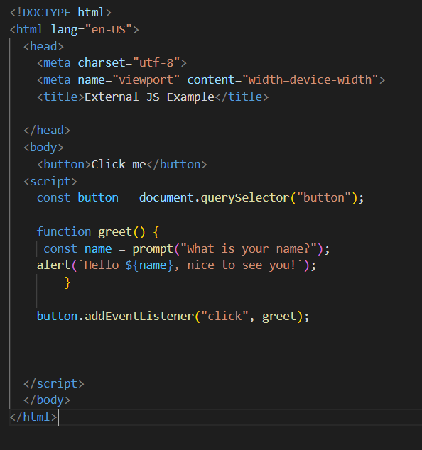


Handling text(strings in JavaScript) cont…
Concatenating strings
Concatenate just means "join together". To join together strings in JavaScript you can use a different type of string, called a template literal(A template literal looks just like a normal string, but instead of using (' or "), you use backtick characters (`). E.g.:
You can also concatenate strings using the + operator. E.g.:
Let's have a look at concatenation being used in action:

Slide 22

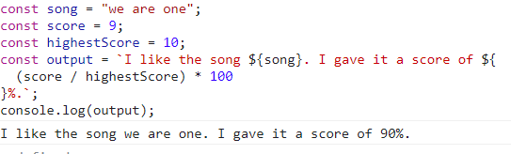

Handling text(strings in JavaScript) cont…
Converting string to numbers and vice-versa
The Number() function converts anything passed to it into a number. E.g.:
Conversely, every number has a method called toString() that converts it to the equivalent string. E.g.:
Including expressions in strings
You can include JavaScript expressions in template literals.

Slide 23
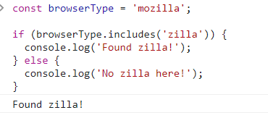


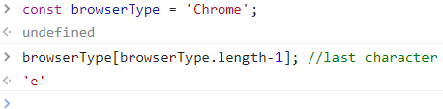
Useful string methods
Now that we've looked at the very basics of strings, let's move up a gear and start thinking about what useful operations we can do on strings with built-in methods, such as finding the length of a text string, joining and splitting strings, substituting one character in a string for another, and more.
Finding the length of a string
you use the length property. E.g.:
Retrieving a specific string character
First Character Last Character
Testing if a string contains a substring
you can check if a smaller string is present inside a larger one using the includes() method, which takes a single parameter. It returns true if the string contains the substring, and false otherwise. E.g.:

Slide 24
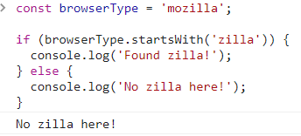
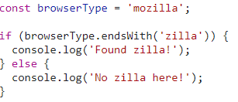

Useful string methods cont..
startsWith() and endsWith() methods
Often you'll want to know if a string starts or ends with a particular substring. There are two special methods for this: startsWith() and endsWith():
Finding the position of a substring in a string
You can find the position of a substring inside a larger string using the indexOf() method. If the string contains the substring, indexOf() returns the index of the first occurrence of the substring. E.g.:
If the string does not contain the substring, indexOf() returns -1.

Slide 25
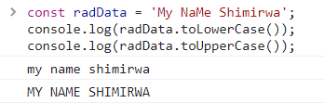

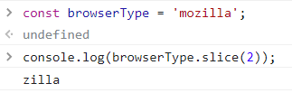
Useful string methods cont..
Extracting a substring from a string
You can extract a substring from a string using the slice() method. It can take the following parameters:
the index at which to start extracting
the index at which to stop extracting. This is exclusive, meaning that the character at this index is not included in the extracted substring. E.g.:
If you know that you want to extract all of the remaining characters in a string after a certain character, you don't have to include the second parameter.
Changing case
The string methods toLowerCase() and toUpperCase() take a string and convert all the characters to lower- or uppercase, respectively. This can be useful for example if you want to normalize all user-entered data before storing it in a database.

Slide 26
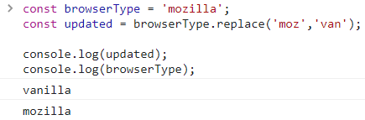


Useful string methods cont..
Updating parts of a string
You can replace one substring inside a string with another substring using the replace() method. E.g.:
Note that replace() in above example doesn't change the string it was called on, but returns a new string. If you want to update the original browserType variable, you would have to do something like this:
replace() method only changes the first occurrence of the substring. If you want to change all occurrences, you can use replaceAll(). E.g.:

Slide 27
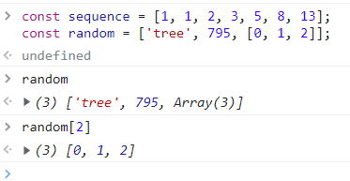
Arrays
What is an array?
Arrays are used to store multiple values in a single variable.
Each item in an array has a number attached to it, called a numeric index, that allows you to access it.
In JavaScript, arrays start at index zero and can be manipulated with various methods.
Creating arrays
Arrays consist of square brackets and items that are separated by commas.
We can also mix data types in a single array. E.g.:

Slide 28

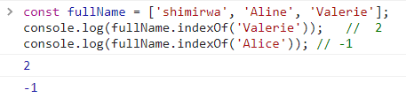
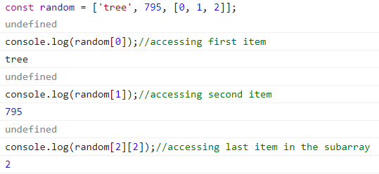
Arrays cont…
Finding the length of an array
You can find the length of an array (how many items are in it) using the length property. E.g.:
Accessing and modifying array items
You can access items in an array using indexes. E.g.:
Finding the index of items in an array
If you don't know the index of an item, you can use the indexOf() method. The indexOf() method takes an item as an argument and will either return the item's index or -1 if the item is not in the array.

Slide 29
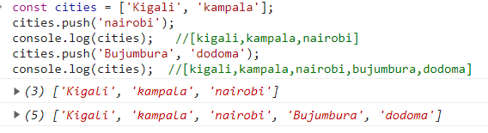



Arrays cont…
To add one or more items to the end of an array we can use push() method. E.g.:
To add an item to the start of the array, use unshift(). E.g:
Removing items
To remove the last item from the array, use pop(). E.g.:
To remove the first item from an array, use shift(). E.g.:

Slide 30
Arrays cont…
To add one or more items to the end of an array we can use push() method. E.g.:
To add an item to the start of the array, use unshift(). E.g:
Removing items
To remove the last item from the array, use pop(). E.g.:
To remove the first item from an array, use shift(). E.g.:

Slide 31
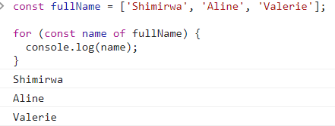
Arrays cont…
Accessing every item
you will want to access every item in the array. You can do this using the for...of statement. E.g:

Slide 32
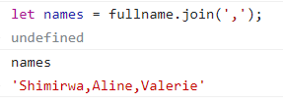
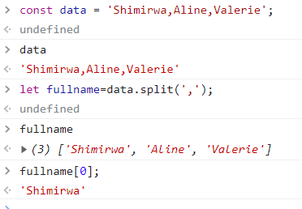
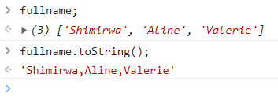
Arrays cont…
Converting between strings and arrays
Often you'll be presented with some raw data contained in a big long string, and you might want to separate the useful items out into a more useful form.
To convert a long string into an array, you can use split() method. E.g.:
To convert an array into a string, you can use join() method. E.g.:
Another way to convert an array to string is to use toString() method.

Slide 33

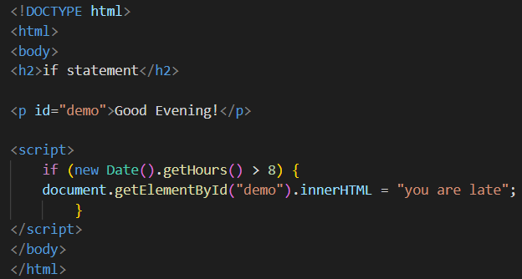
Making decisions in your code(conditions)
The if Statement
Use the if statement to specify a block of JavaScript code to be executed if a condition is true.
Syntax:
Example:
Very often when you write code, you want to perform different actions for different decisions. You can use conditional statements in your code to do this.
In JavaScript we have the following conditional statements:
if statement
else statement
else if statement
switch statement

Slide 34
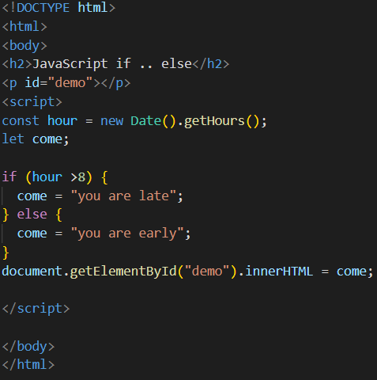
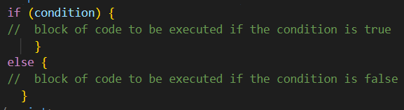
Making decisions in your code(conditions) cont..
Example
The else Statement
Use the else statement to specify a block of code to be executed if the condition is false.
Syntax:

Slide 35
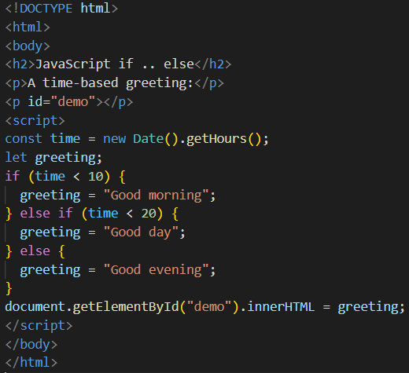
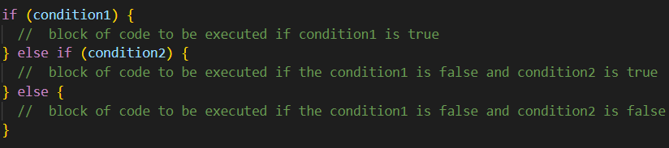
Making decisions in your code(conditions) cont..
Example
The else if Statement
Use the else if statement to specify a new condition if the first condition is false.
Syntax:

Slide 36
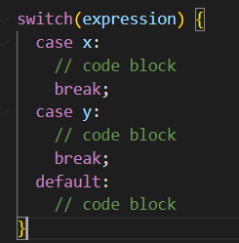
Making decisions in your code(conditions) cont..
The break Keyword When JavaScript reaches a break keyword, it breaks out of the switch block.
This will stop the execution inside the switch block.
If you omit the break statement, the next case will be executed even if the evaluation does not match the case.
The Switch Statement
The switch statement is used to perform different actions based on different conditions.
Syntax:
This is how it works:
The switch expression is evaluated once.
The value of the expression is compared with the values of each case.
If there is a match, the associated block of code is executed.
If there is no match, the default code block is executed.

Slide 37
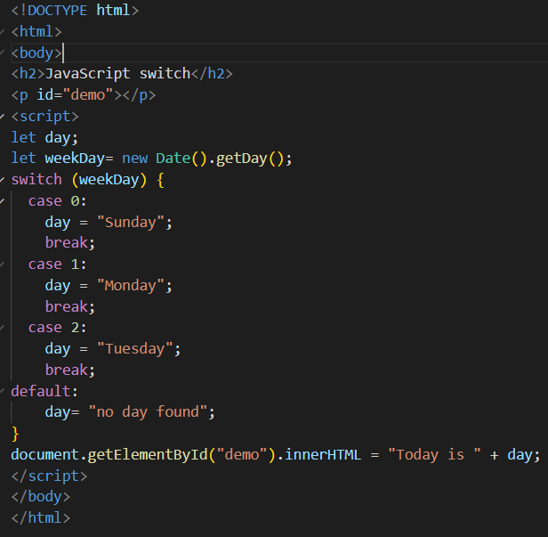
Making decisions in your code(conditions) cont..
The Switch Statement
Example:
The getDay() method returns the weekday as a number between 0 and 6. (Sunday=0, Monday=1, Tuesday=2 ..)
This example uses the weekday number to calculate the weekday name.

Slide 38
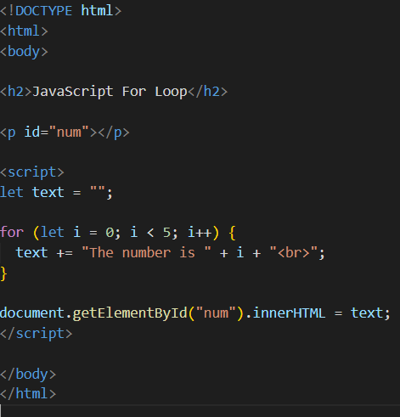

JavaScript Loops
Loops are useful, if you want to run the same code over and over again, each time with a different value.
JavaScript supports different kinds of loops:
for :loops through a block of code a number of times.
for/in :loops through the properties of an object.
while :loops through a block of code while a specified condition is true.
do/while :also loops through a block of code while a specified condition is true.
The For Loop
The diagram on the right shows the for loop in action.

Slide 39
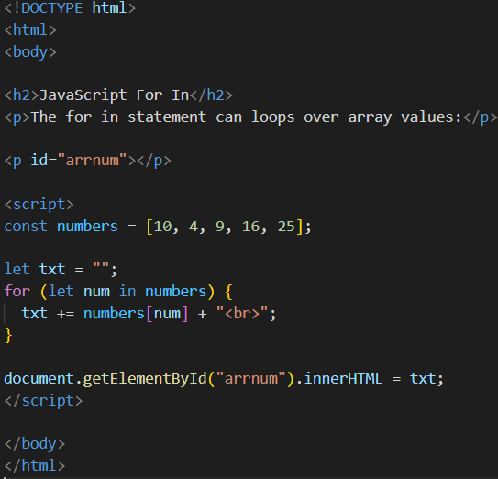

JavaScript Loops cont..
The For In Loop
The JavaScript for in statement can loop over the properties of an Array:
Syntax:
The diagram on the right shows the example of For in loop in action.

Slide 40
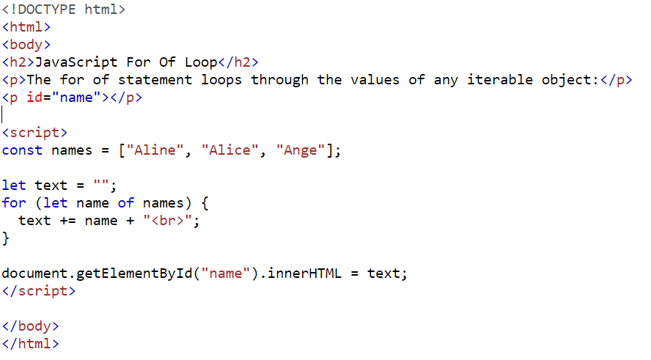
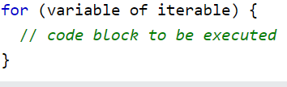
JavaScript Loops cont..
The For of Loop
The JavaScript for of statement loops through the values of an iterable object.
It lets you loop over iterable data structures such as Arrays, Strings, etc.
Syntax:
variable :For every iteration the value of the next property is assigned to the variable. Variable can be declared with const, let, or var.
iterable : An object that has iterable properties.

Slide 41
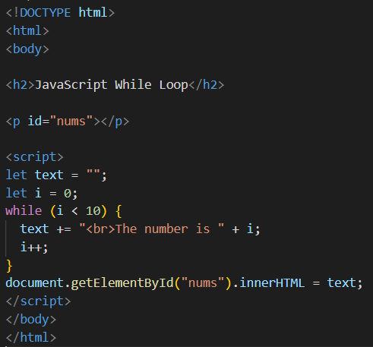

JavaScript Loops cont..
The While Loop
The while loop loops through a block of code as long as a specified condition is true
Syntax:
In the following example, the code in the loop will run, over and over again, as long as a variable (i) is less than 10.
If you forget to increase the variable used in the condition, the loop will never end. This will crash your browser.

Slide 42
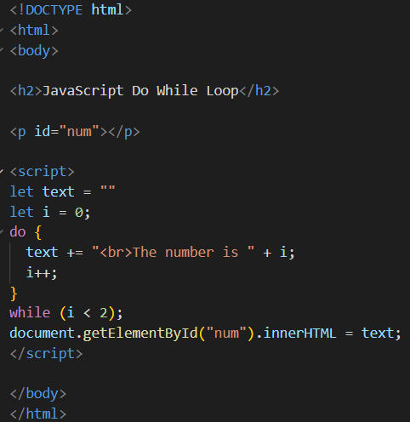
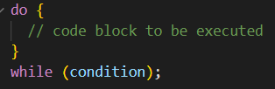
JavaScript Loops cont..
The Do While Loop
The do while loop is a variant of the while loop. This loop will execute the code block once, before checking if the condition is true, then it will repeat the loop as long as the condition is true.
Syntax:
The following example uses a do while loop. The loop will always be executed at least once, even if the condition is false, because the code block is executed before the condition is tested:

Slide 43
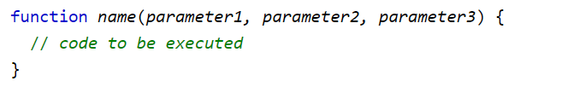
JavaScript Functions
A JavaScript function is a block of code designed to perform a particular task. It is executed when "something" invokes it (calls it).
Syntax:
A JavaScript function is defined with the function keyword, followed by a name, followed by parentheses ().
Function parameters are listed inside the parentheses () in the function definition.
Function arguments are the values received by the function when it is invoked.
Inside the function, the arguments (the parameters) behave as local variables.
The code to be executed, by the function, is placed inside curly brackets: {}.

Slide 44
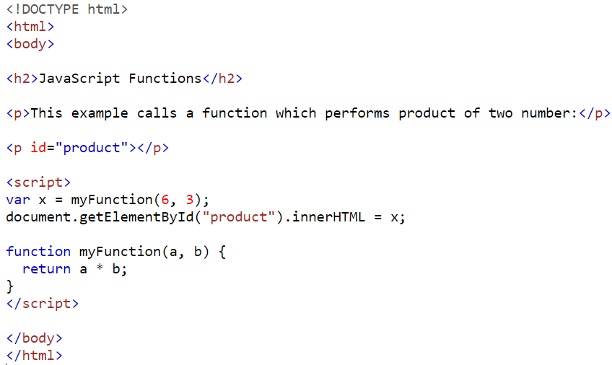
JavaScript Functions cont…
Function Return
When JavaScript reaches a return statement, the function will stop executing.
If the function was invoked from a statement, JavaScript will "return" to execute the code after the invoking statement.
Functions often compute a return value. The return value is "returned" back to the "caller“.

Slide 45
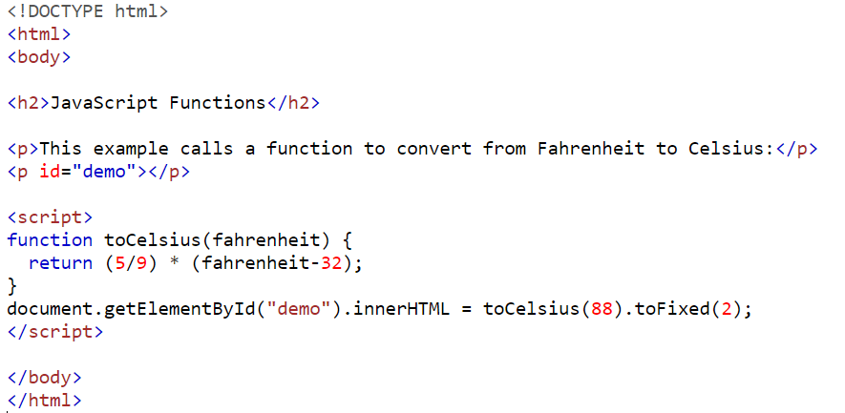
JavaScript Functions cont…
Why Functions?
You can reuse code: Define the code once, and use it many times.
You can use the same code many times with different arguments, to produce different results.
The () Operator Invokes the Function
In this example, toCelsius refers to the function object, and toCelsius() refers to the function result.
Accessing a function without () will return the function object instead of the function result.

Slide 46
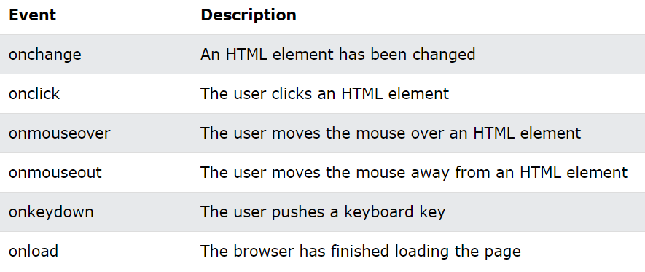
JavaScript Events
HTML events are "things" that happen to HTML elements.
Often, when events happen, you may want to do something.
JavaScript lets you execute code when events are detected.
The diagram shows a list of some common HTML events.

Slide 47
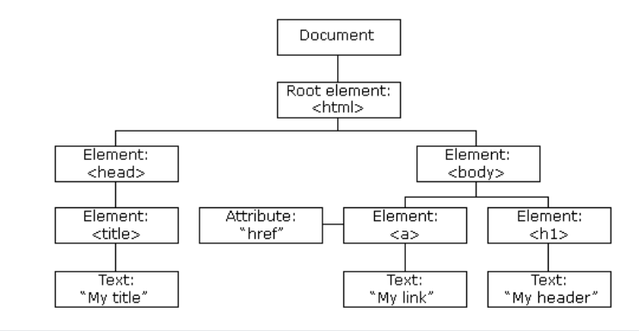
The HTML DOM (Document Object Model)
When a web page is loaded, the browser creates a Document Object Model of the page.
The HTML DOM model is constructed as a tree of Objects( as shown in the diagram).
The DOM defines a standard for accessing documents.
With the object model, JavaScript gets all the power it needs to:
change all the HTML elements in the page
change all the HTML attributes in the page
change all the CSS styles in the page
remove existing HTML elements and attributes
add new HTML elements and attributes
react to all existing HTML events in the page
create new HTML events in the page

Slide 48
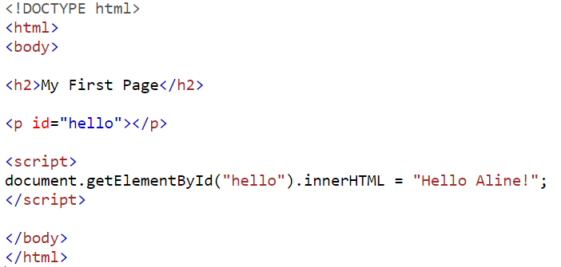
The HTML DOM (Document Object Model) cont…
The DOM Programming Interface
In the DOM, all HTML elements are defined as objects.
The programming interface is the properties and methods of each object.
A property is a value that you can get or set (like changing the content of an HTML element).
A method is an action you can do (like add or deleting an HTML element).
In the code example getElementById is a method, while innerHTML is a property.
The most common way to access an HTML element is to use the id or class of the element. In the example the getElementById method used id=“hello" to find the element.
The easiest way to get the content of an element is by using the innerHTML property. The innerHTML property is useful for getting or replacing the content of HTML elements.

Slide 49
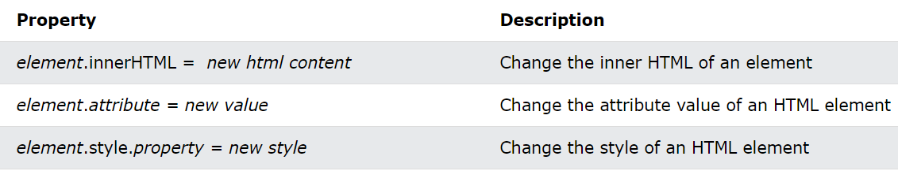
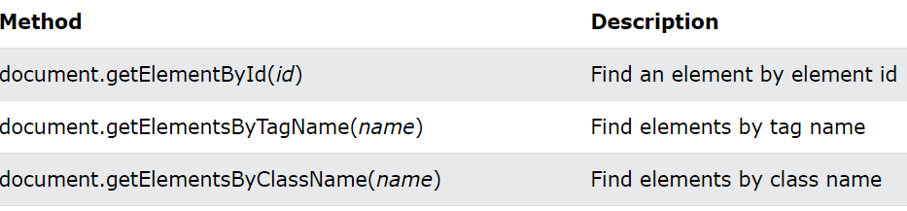

The HTML DOM (Document Object Model) cont…
The HTML DOM Document Object
The document object represents your web page.
If you want to access any element in an HTML page, you always start with accessing the document object. here are some examples of how you can use the document object to:
Finding HTML Elements
change HTML Elements
Adding and Deleting Elements

Slide 50

The HTML DOM (Document Object Model) cont…
Finding HTML Elements
Often, with JavaScript, you want to manipulate HTML elements. To do so, you have to find the elements first. Following are the ways you can find the element:
Finding HTML Element by Id
The easiest way to find an HTML element in the DOM, is by using the element id.
If the element is found, the method will return the element as an object (in element). If the element is not found, element will contain null.
The example in this slide finds the element with id="name" .

Slide 51

The HTML DOM (Document Object Model) cont…
Finding HTML Elements by Tag Name
This example on the right side, finds the element with id="main", and then finds all <p> elements inside "main":

Slide 52

The HTML DOM (Document Object Model) cont…
Finding HTML Elements by Class Name
If you want to find all HTML elements with the same class name, use getElementsByClassName().
This example returns a list of all elements with class="intro".

Slide 53

The HTML DOM (Document Object Model) cont…
Finding HTML Elements by CSS Selectors
If you want to find all HTML elements that match a specified CSS selector (id, class names, types, attributes, values of attributes, etc), use the querySelectorAll() method.
The example on the right side returns a list of all <p> elements with class="intro".

Slide 54

The HTML DOM (Document Object Model) cont…
Changing the Value of an Attribute
To change the value of an HTML attribute, use this syntax:
The example in this slide changes the value of the src attribute of an <img> element.

Slide 55

The HTML DOM (Document Object Model) cont…
Changing HTML Style
To change the style of an HTML element, use this syntax:
The following example changes the style of a <p> element.

Slide 56

The HTML DOM (Document Object Model) cont…
Reacting to Events
A JavaScript can be executed when an event occurs, like when a user clicks on an HTML element. Below are some of examples of HTML events:
When a user clicks the mouse
When a web page has loaded
When an image has been loaded
When the mouse moves over an element
When an input field is changed
When an HTML form is submitted
When a user strokes a key and so on.
In the example here , the <button> will display the date when a user clicks on it.
Visit the following link to learn more on HTML events: https://www.w3schools.com/jsref/dom_obj_event.asp

Slide 57

The HTML DOM (Document Object Model) cont…
The addEventListener() method
The addEventListener() method attaches an event handler to the specified element.
You can add many event handlers to one element.
You can easily remove an event listener by using the removeEventListener() method.
Syntax:
The first parameter is the type of the event (like "click" or "mousedown" or any other HTML DOM Event.).
The second parameter is the function we want to call when the event occurs.
This example Alert "Hello World!" when the user clicks on an the button. Note that you don't use the "on" prefix for the event; use "click" instead of "onclick".

Slide 58
References
1. https://www.w3schools.com/js/default.asp
2. https://developer.mozilla.org/en-US/docs/Learn/JavaScript/First_steps/What_is_JavaScript

