Slide 1
Java Database Connectivity (JDBC)

Slide 2
Content
Java Database Connectivity – Intro
Database Connectivity Architecture
JDBC APIs
Database Access Steps
Conclusion

Slide 3
Introduction
What is JDBC?
JDBC is used to allow java application to perform several operation over the databases.

Slide 4
Java Database Connectivity(JDBC) is a standard SQL database access interface
JDBC allows us to construct SQL statement and embed into java API.
JDBC provides different APIs to perform operations on database.
Establish a connection
Send SQL statements.
Process the result

Slide 5
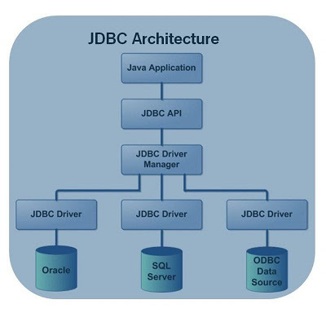
Architecture

Slide 6
JDBC Driver
JDBC Architecture classification
Type 1
Type 2
Type 3
Type 4

Slide 7
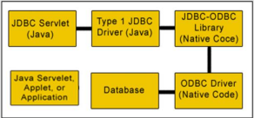
Type 1: JDBC-ODBC Bridge
Implemented in Java 2

Slide 8
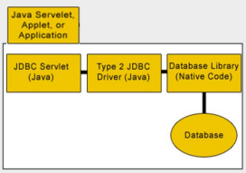
Type 2: Java Native API

Slide 9
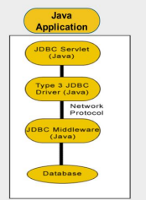
Type 3: Java to Network Protocol

Slide 10
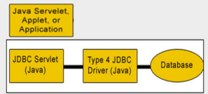
Type 4: Java to Database Protocol
Thin

Slide 11
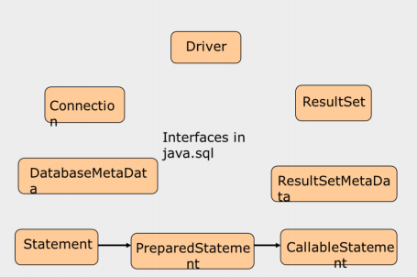
JDBC API

Slide 12
JDBC Database Access
Import the packages
Register/load the driver
Establish the connection
Create JDBC Statement
Executing the query
Closing resources

Slide 13
Conclusion
What we have covered ?
Database connectivity Introduction
JDBC Architecture and classification
JDBC APIs
JDBC Database Access steps

