Slide 1
Java Data Types

Slide 2
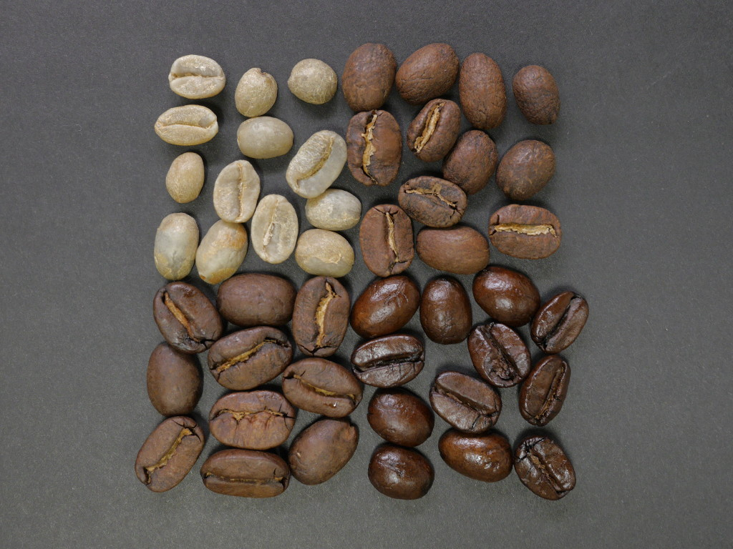
Understanding JAVA Variables & DATA Types
Beans

Slide 3
What is Data Type?
A data type is an attribute of data which tells the compiler how the programmer intends to use the data.
Why it is required?
Java is Strongly Typed Language.
Every variable has a type.
All assignments are checked for type.
All passing parameters are checked for type.

Slide 4
Scope of Data types
Scope of data types (class level)-
i) Public
ii) Protected
iii) Default
iv) Private
Types of Data Types
There are two types of data types:-
i) Primitive Data Types
ii) Non-Primitive Data Types

Slide 5
Primitive Data Types
Primitive data types are predefined types of data, which are supported by the programming language.
For examples :-
Integer, float, character, Boolean.
Non-Primitive Data Types
Non-primitive data types are not defined by the programming language, but are instead created by the programmer.
For examples :-
Arrays, strings, classes, interfaces.

Slide 6
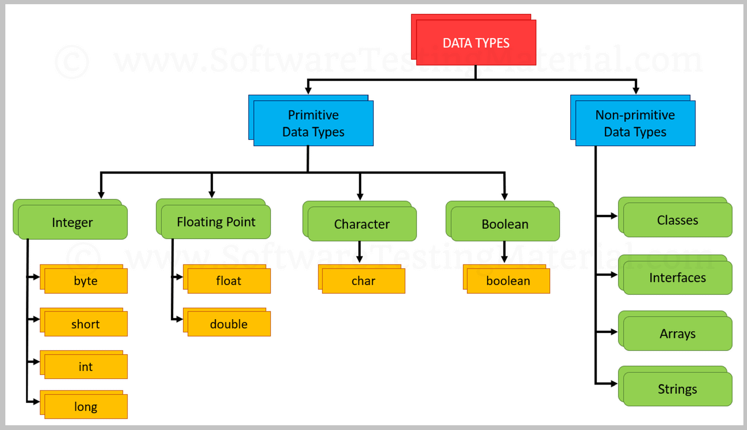
Chart

Slide 7
Integers
Integers data types hold only numeric data.
Types : Size : Range
Byte : 8 bits : From +127 to -128
short : 16 bits : From +32,767 to -32,768
int : 32 bits : From +2,147,483,647 to -2,147,483,648
long : 64 bits : From +9,223,372,036,854,775,807 to -9,223,372,036,854,775,808
Examples:-
i) byte a = 10;
ii) short a = 50;
iii) int a = 100;
iv) long a = 1000;

Slide 8
Floats
Floats data types hold decimal values.
Types : Size : Range
float : 32 bits : From 3.402,823,5 E+38 to 1.4 E-45
double : 64 bits : From 1.797,693,134,862,315,7 E+308
to 4.9 E-324
Example:-
i) float a = 10.2;
ii) double a = 1000.2;

Slide 9
Characters
Character data type holds only characters(alphabets).
Type : Size : Range
char : 16 bits : 2¹⁶-1
Ex:- char a = ‘A’;
Boolean
Boolean data type holds only True or False.
Example:-
i) boolean a = true;
ii) boolean b = false;

Slide 10
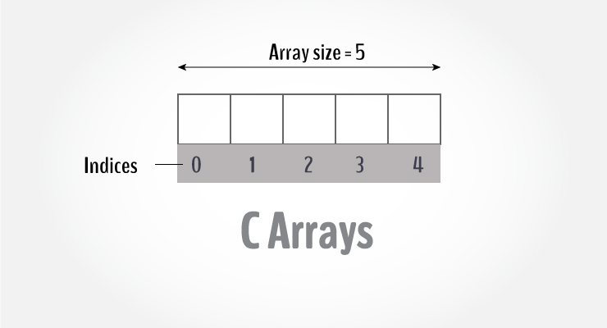
Non-primitive Data Type
Arrays:-
An array is a collection of one or more values of the same type.
Ex:- It is declared as,
int array[]=new int[5];
Char array[]=new char[5];

Slide 11
JAVA CODE
public class Main{
public void main(String args[]){
int a = 10;
char b = ‘A’;
boolean c = true;
if(c==true)
System.out.println(“Integer= “+ a +”, Character= “ + b);
}
}
Output:- ?

Slide 12
Thank You

