Slide 1


Movie Genres Analysis
What types of movies are doing well in the box office?

Slide 2
Introduction
project is aimed at performing an analysis for Microsoft
Review of data with aim to advise the company as it venture into movie production.
The analysis explores data provided to advise on types of Movies to invest in
Analysis pays emphasis on data that have relationship to movie genres
Answers and recommendations focused around "types of films“
The recommendation puts three factors into consideration; Popularity, Profitability and Cost of production

Slide 3
MOST POPULAR MOVIES
Documentaries had the highest population in the dataset.
It is inferred that they are the most popular genre
A close second place was take by drama (24,014)
Third place was take by comedies’
Others in the top ten favorites included Thriller, Horror, Action, Romance, Biography, Crime and Adventure

Slide 4
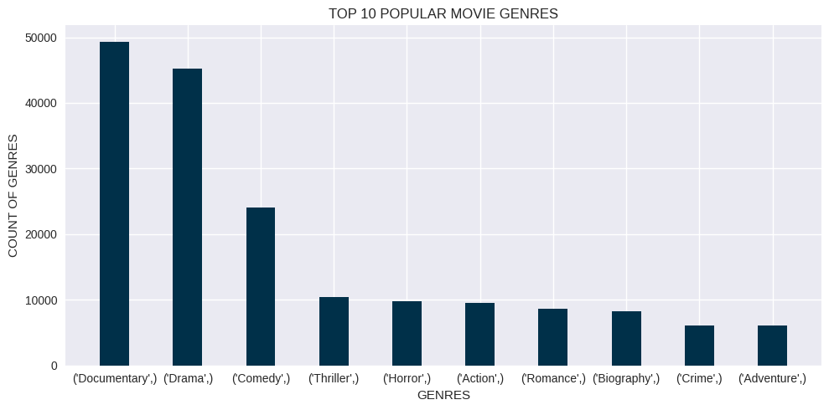
TOP10 POPULAR GENRES

Slide 5
POPULARITY BY RATING
DRAMAS HAVE THE HIGHEST RATINGS
It is DEDUCED that they are the most popular genre
A close second place was taken by COMEDY
other top ten favorites include Adventure, animation and action

Slide 6
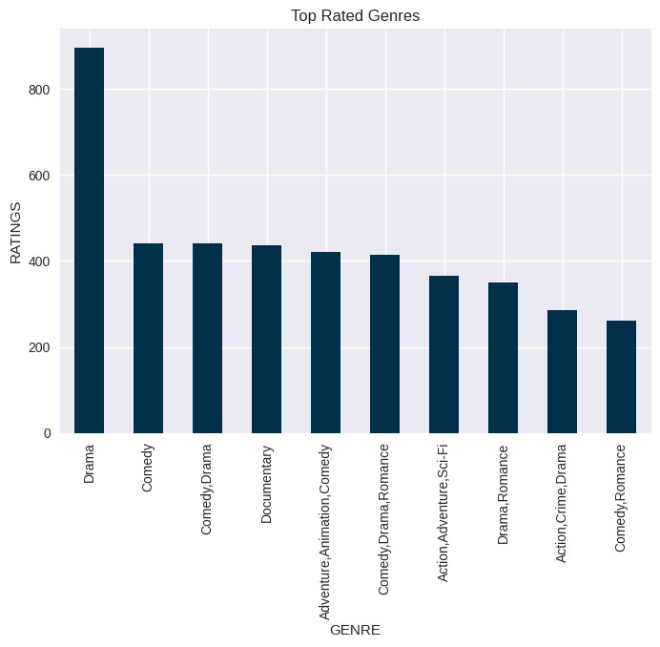
TOP10 POPULAR GENRES

Slide 7
MOST profitable movies genres to make
A blend of Horror/mystery/thrillers had the highest the highest percentage profit
this category had Percentage Profits up to 90,000 per cent.
Dramas and documentaries/biographies came in second and third respectively
The two categories were profitable with percentage profits in the upwards of 30,000.
Horror as a category of their own came in fifth, indicating that horrors are a top earner.
Similarly, drama appeared again at 6th category indicating it is lucrative

Slide 8
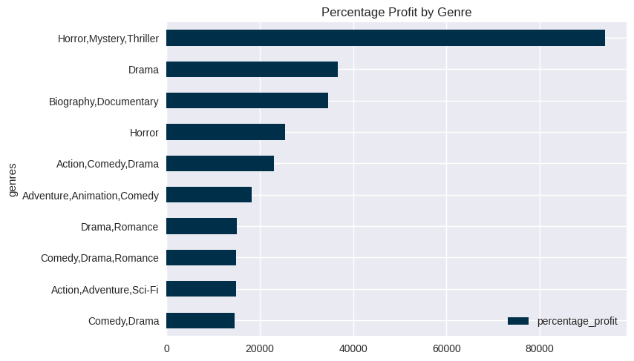
MOST profitable movies genres to make

Slide 9
Production cost vs percentage profit
Graphs below show most profitable genres compared to the most expensive to produce
Horror/mystery/thrillers category is missing amongst the high production cost category
Drama feature in both but in relatively low numbers
Dramas are a safe bet medium cost and medium returns
adventure/animation/comedy had both high returns but also had high production cost
Action movies have high production cost with feasible percentage profits

Slide 10
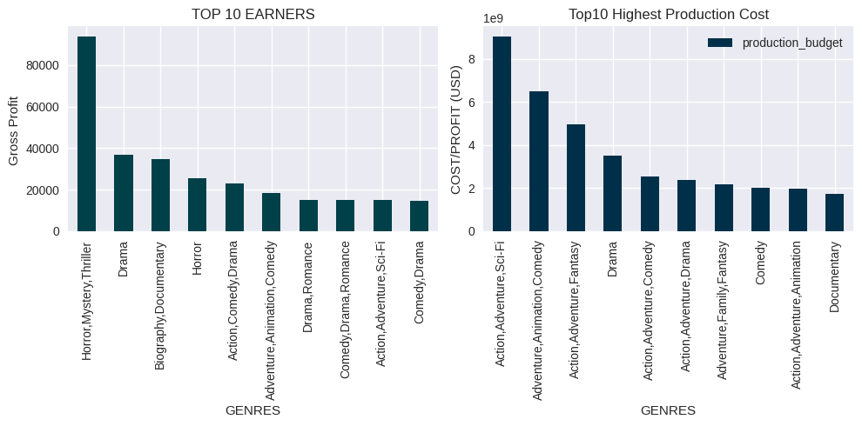
TOP EARNER VS COST OF PRODUCTION

Slide 11
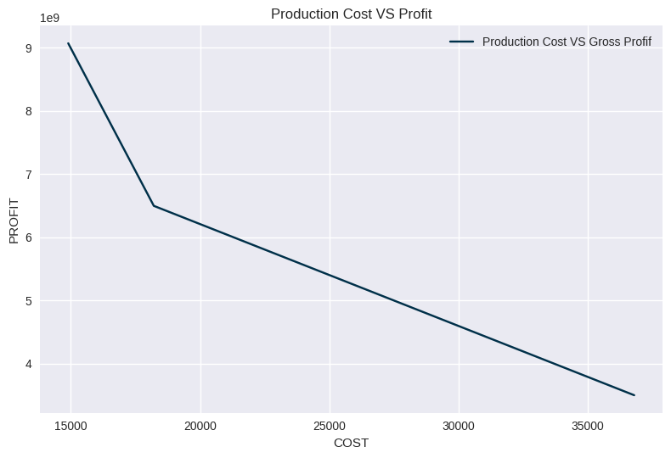

Slide 12
Recommendations
THE company should prioritize production of drama movies
Amongst most popular genre
Have low cost of production
Have relatively high returns on investment
TOP Genres to invest in include adventure/animation/comedy. Despite the high production cost they had some of the highest returns and were as well popular.
For diversity, the company could invest in action, adventure, comedies, documentaries and romance

Slide 13
Contact details
kakikagwa@outlook.com

