Slide 1
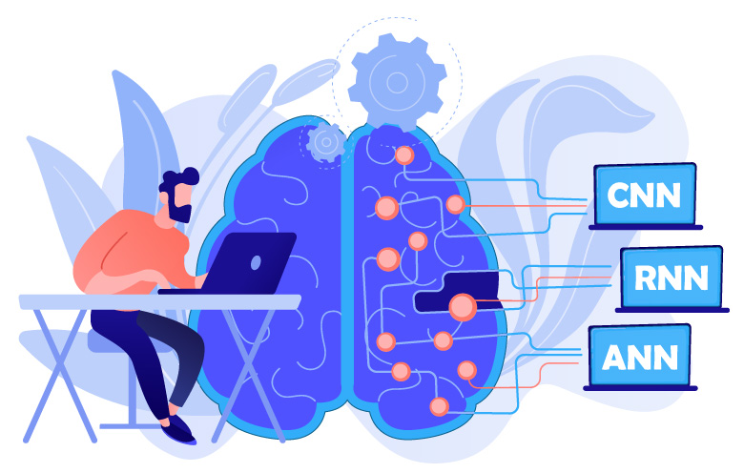
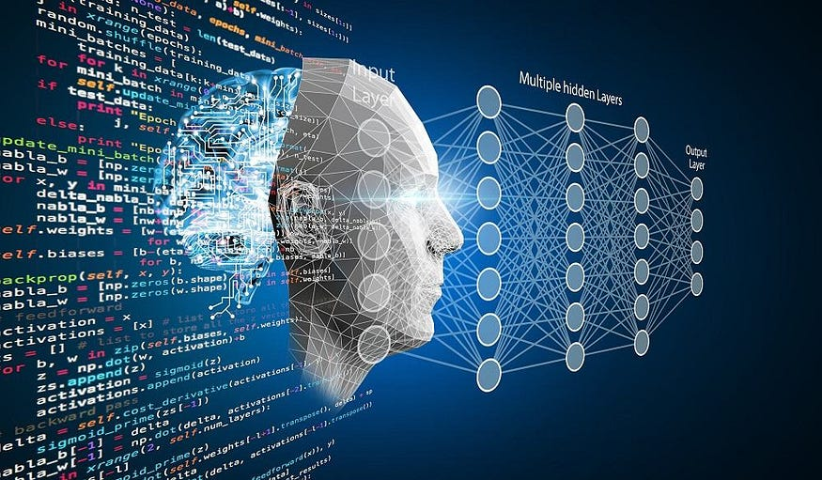
Gender and Age Detection Using Deep Learning
A Computer Vision Project with OpenCV and Pretrained Caffe Models
Presented by: Parth Shrivastava, Pulkit Pandey, Aadesh Kudale
Date: 15/04/2025

Slide 2

Introduction
Age and gender detection is a useful feature in computer vision that helps personalize user experiences, support marketing strategies, and enhance surveillance systems. This project aims to identify a person’s age group and gender from images or videos. By using OpenCV and pretrained deep learning models, it provides a real-time solution that is both fast and accurate.

Slide 3

🧩 Project Overview
📸 Input
Image or Video Stream
👤 Face Detection
Locate faces using OpenCV DNN
📊 Classification
Predict Age Group & Gender
🧠 Models Used
Pre-trained Caffe Models
• Face Detection
• Age Estimation
• Gender Classification

Slide 4
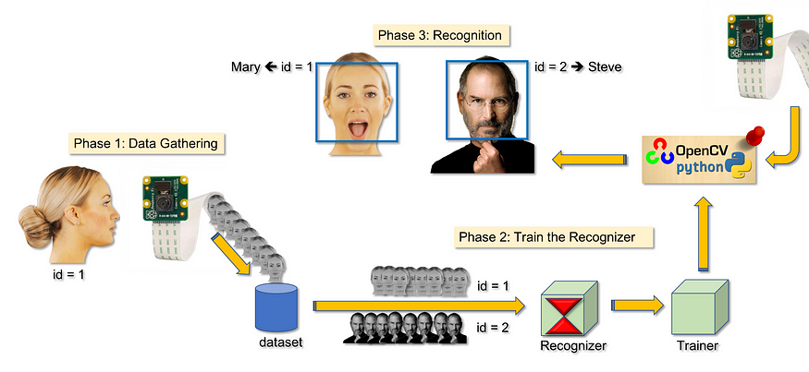
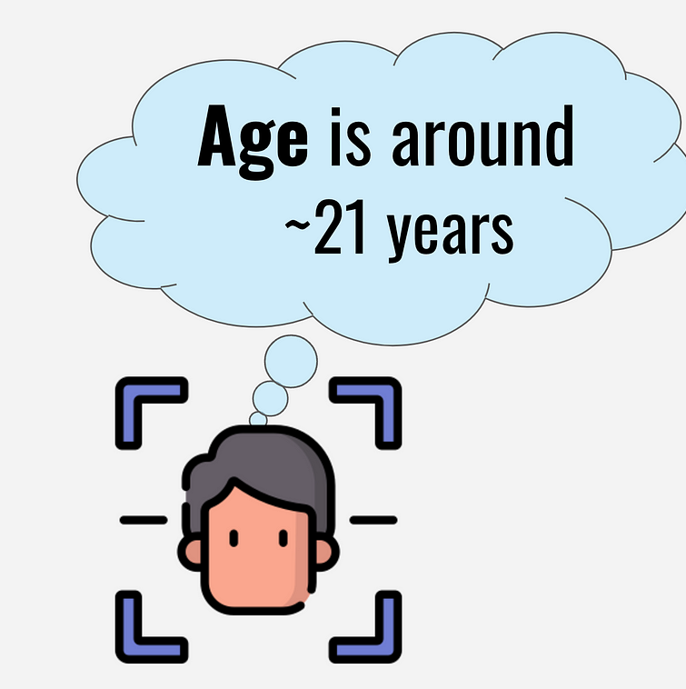
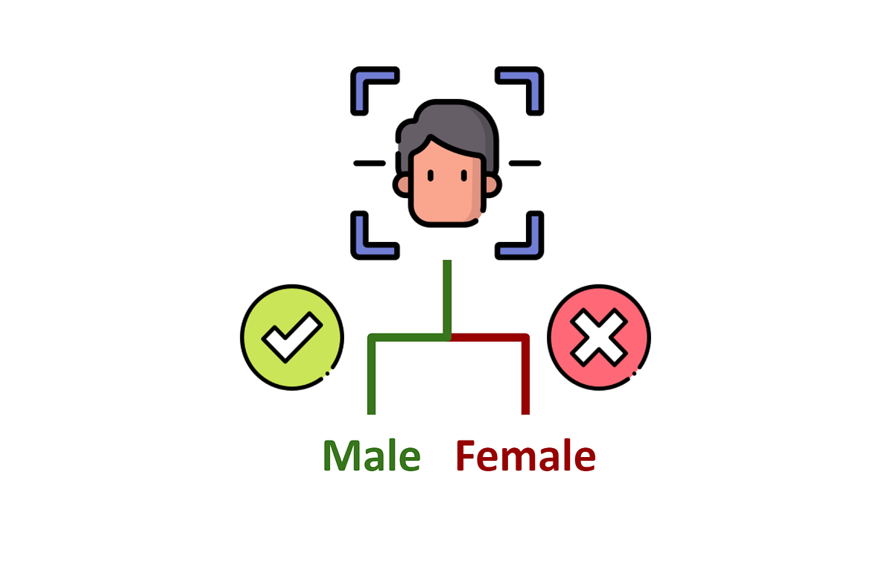
Models Used
Face Detection
Uses OpenCV deep learning model
Detects faces in images or video
Files: .pb, .pbtxt
Age Detection
Uses a Caffe model trained on Adience dataset
Predicts age group from 0 to 100
Files: .caffemodel, .prototxt
Age groups: (0-2) to (60-100)
Gender Detection
Uses a Caffe model
Classifies face as Male or Female
Files: .caffemodel, .prototxt

Slide 5
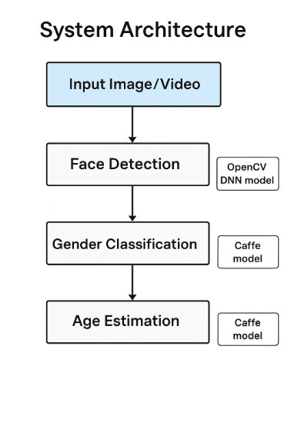
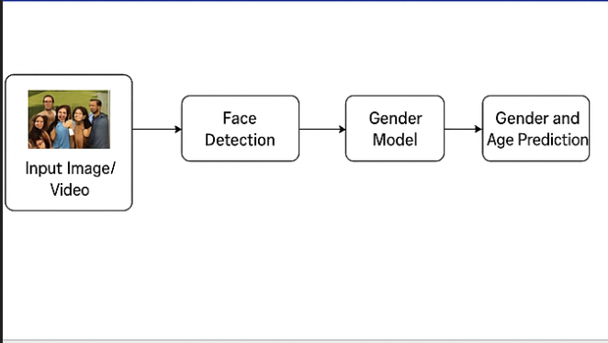
System Architecture

Slide 6
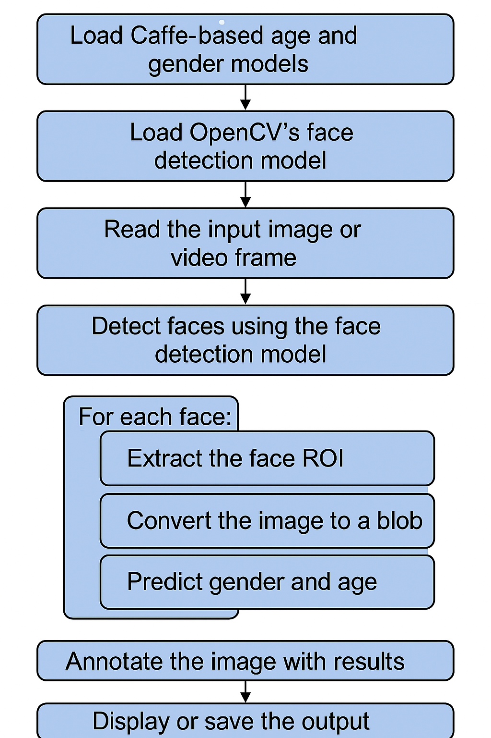
Workflow
1. Load Caffe-based Age and Gender Models
Pre-trained deep learning models built using the Caffe framework are loaded into memory. These models are trained to predict a person’s age and gender from facial features.
2. Load OpenCV’s Face Detection Model
An OpenCV-supported model (like a DNN or Haar Cascade) is loaded to detect faces in images or video frames. This model locates the position of faces in a frame.
3. Read the Input Image or Video Frame
An image is captured from a camera or loaded from a file/video. This is the frame where face detection and analysis will be applied.
4. Detect Faces Using the Face Detection Model
The face detection model scans the frame and identifies the coordinates of any detected faces, usually returning bounding boxes.

Slide 7
5. For Each Face:
A loop processes each detected face individually:
a. Extract the Face ROI
The Region of Interest (ROI) is cropped from the image using the face coordinates.
b. Convert the Image to a Blob
The ROI is preprocessed (resized, normalized) and converted into a blob—a format compatible with deep learning models.
c. Predict Gender and Age
The preprocessed face blob is fed into the Caffe models to generate predictions for gender and age.
6. Annotate the Image with Results
The original frame is marked with rectangles and text showing the predicted age and gender for each detected face.
7. Display or Save the Output
The annotated image can be displayed in a window or saved to disk for further use or review.

Slide 8
detect.py Code Summary
Key Functions:
highlightFace(net, frame, conf_threshold=0.7)
Uses a DNN to detect faces and return their bounding boxes.
Model Initialization:
ageNet = cv2.dnn.readNet(ageModel, ageProto) genderNet = cv2.dnn.readNet(genderModel, genderProto)
Blob Creation:
blob = cv2.dnn.blobFromImage(face, 1.0, (227, 227), MODEL_MEAN_VALUES, swapRB=False)
Prediction:
genderNet.setInput(blob) gender = genderList[genderNet.forward().argmax()]
ageNet.setInput(blob)
agePreds = ageNet.[genderNet.forward().argmax()]
Annotation:
Draws boxes and labels over faces with predicted age and gender.

Slide 9
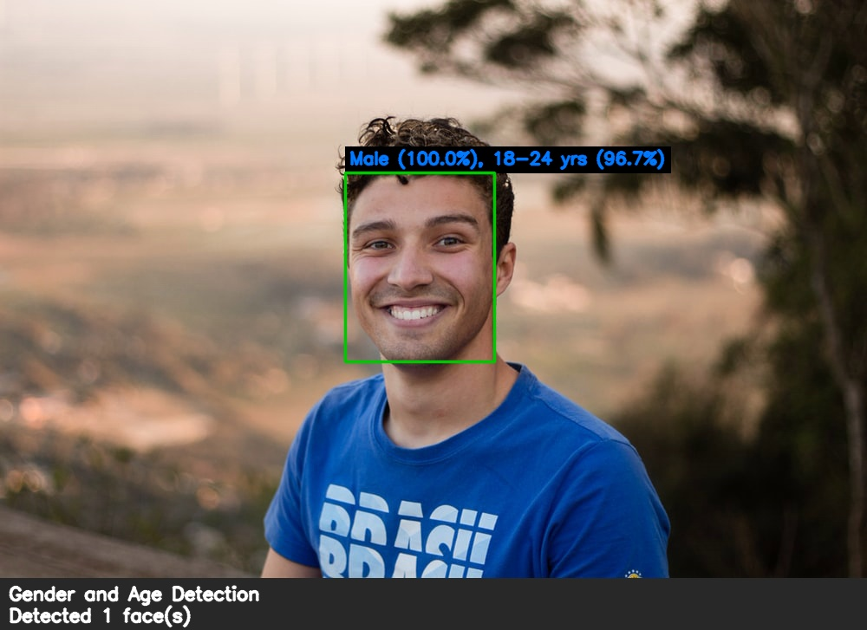
Output Screenshots

Slide 10
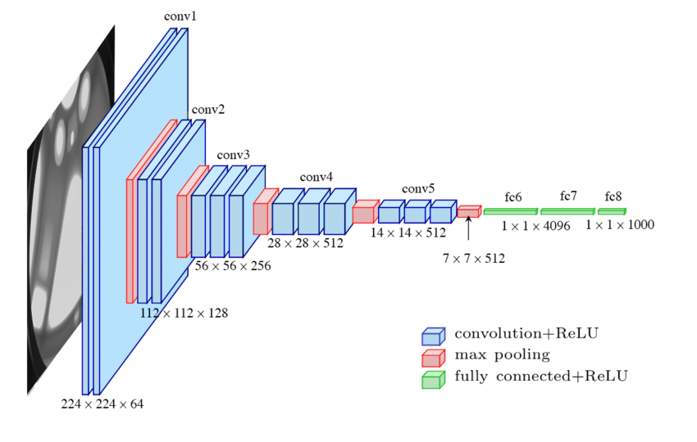
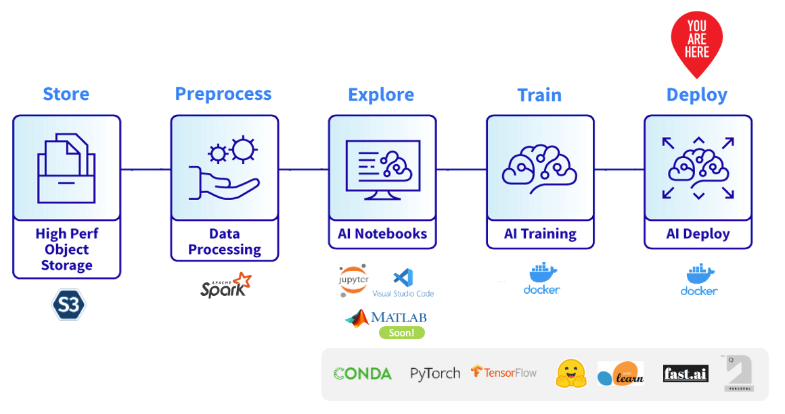
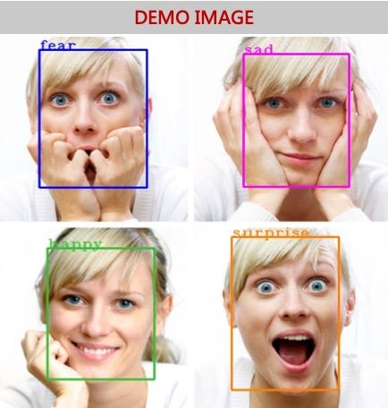
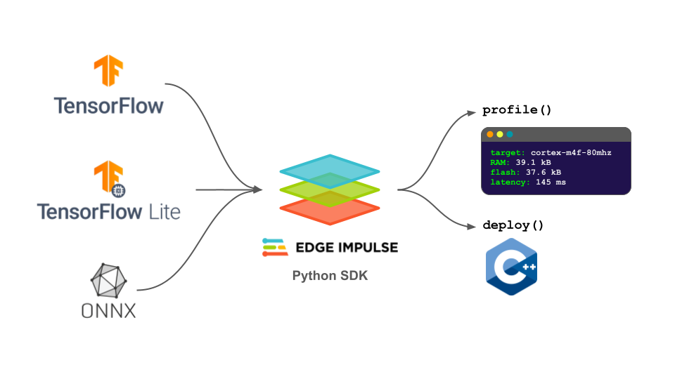
Future Scope
Upgrade to more accurate and lightweight models (e.g., MobileNet, ResNet).
Deploy in web or mobile applications.
Integrate emotion recognition alongside age/gender.
Improve model performance with diverse datasets.
Use TensorFlow Lite or ONNX for edge deployment.

Slide 11
Conclusion
This project demonstrates a practical application of deep learning in computer vision, specifically targeting human-centric tasks like facial analysis.
Real-time age and gender classification using pre-trained models is both feasible and efficient, making it suitable for deployment in real-world scenarios.
By leveraging Caffe-based models and OpenCV’s DNN module, the system achieves a good balance between accuracy and performance.
The pipeline can be easily integrated into surveillance systems, retail analytics, human-computer interaction interfaces, and more.
It showcases the power of transfer learning, where pre-trained models can be reused for quick development without needing to train from scratch.
The modular workflow makes the system scalable and adaptable—it can be extended to include emotion detection, face recognition, or demographic analysis.
This project highlights the growing trend of AI-powered automation in visual data processing, emphasizing real-time inference and user-friendly outputs.

Slide 12
Thank you

