Slide 1
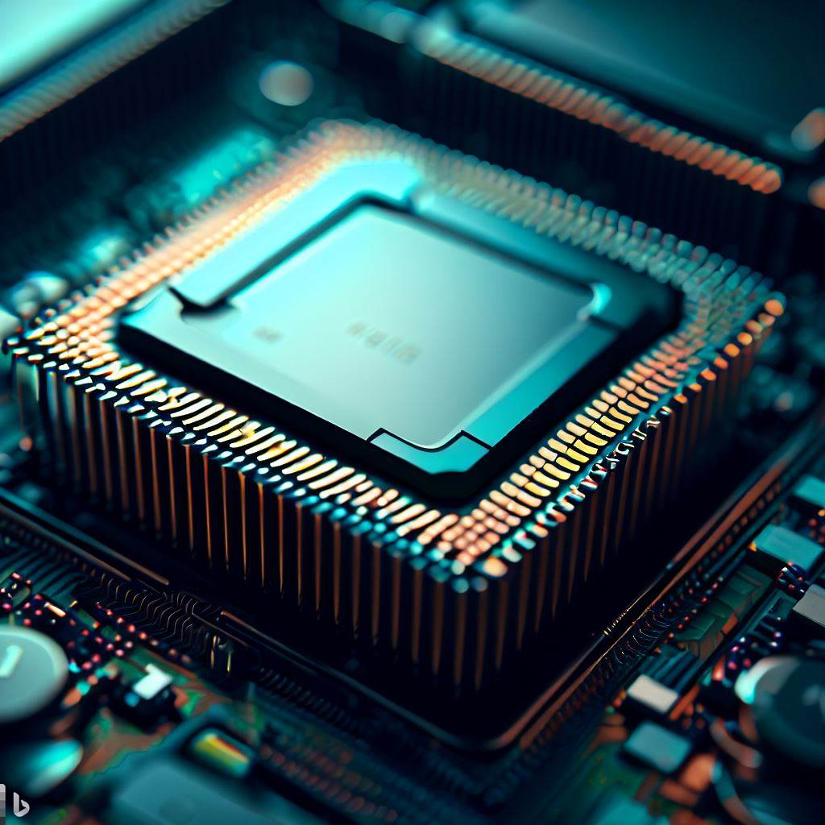
Boosting System Performance with
Cache Memory

Slide 2
Index
What Is Cache Memory?
Examples Of Cache Memory
Cache Hierarchy
Cache Operation Overview
Cache Hit Vs. Cache Miss
Conclusion

Slide 3
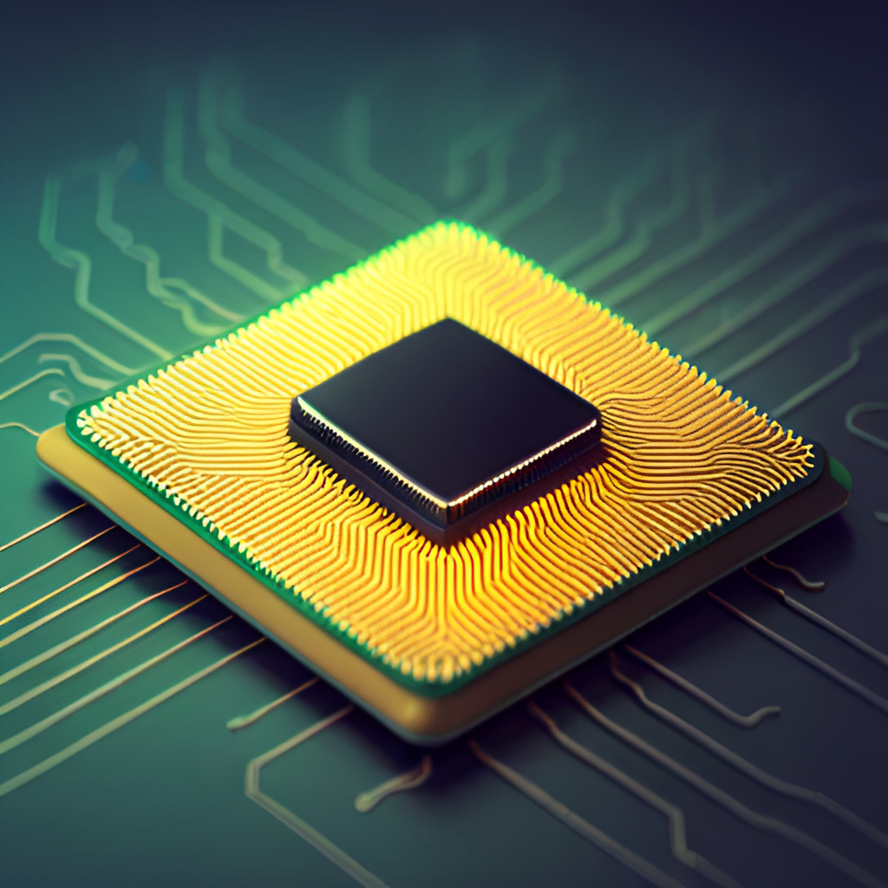
What is Cache Memory?
Cache memory is a type of high-speed memory that stores frequently accessed data and instructions from the main memory for faster access. Its purpose is to improve system performance by reducing the time it takes to retrieve data and instructions that are repeatedly used by the CPU.
Cache memory works by storing copies of data from the main memory in a smaller, faster memory that is closer to the CPU. When the CPU needs to access data, it first checks the cache memory to see if the data is already there. If it is, the CPU can access it quickly without having to wait for the slower main memory.

Slide 4

The Role of Cache Memory in Online Video Streaming
Cache memory plays a vital role in video streaming services like Netflix. It stores frequently accessed video data, allowing for quick access and reducing the need for repeated downloads from the server. This helps in providing seamless, high-quality video to the users, even during times of high traffic and network congestion.

Slide 5
Execution of a program without cache and with cache
WITH CACHE:
The CPU fetches instructions from the main memory, but the cache is checked first for the required data. a. Cache hit: The data is found in the cache, resulting in faster access and reduced latency. b. Cache miss: The data is not found in the cache, so it is retrieved from the main memory. The retrieved data is also stored in the cache for future access, reducing latency in subsequent accesses.
Since frequently accessed data and instructions are stored in the cache, the CPU can quickly fetch them from the cache, reducing the need for repeated access to the main memory and improving execution speed.
In a multiprocessor system or systems with multiple cores, cache memory facilitates data sharing. Modified data is stored in the cache and propagated to the main memory, allowing other processors or cores to access the modified data from their caches, minimizing the need for accessing the main memory frequently.
The presence of cache memory significantly improves overall system performance. Faster data access, reduced latency, and optimized instruction fetching enhance the efficiency and speed of program execution.
WITHOUT CACHE
The CPU fetches instructions from the main memory.
Data is fetched from the main memory for every access, resulting in higher latency.
This process repeats for each data or instruction access, leading to slower execution.
Data sharing among multiple processing units requires accessing the main memory for every read or write operation, resulting in more memory access conflicts and lower efficiency.
Overall performance is affected by slower memory access and frequent access to the main memory.

Slide 6
Cache Hierarchy
L1
The L1 cache is the closest cache to the CPU and is divided into separate instruction cache (L1I) and data cache (L1D). It is small in size but has the lowest latency and fastest access time among the caches. The L1 cache stores frequently accessed instructions and data, providing quick access to the CPU.
CACHE
L2
The L2 cache is larger in size than the L1 cache and operates at a slightly slower speed. It serves as a secondary cache that stores additional instructions and data that are not found in the L1 cache. The L2 cache acts as a buffer between the L1 cache and the main memory, providing a larger storage capacity and improving overall cache hit rates.
CACHE

Slide 7
L3
The L3 cache is a shared cache that is larger in size compared to the L1 and L2 caches. It is typically shared among multiple processor cores or across a group of processors in a multiprocessor system. The L3 cache acts as a global cache for the entire system, storing frequently accessed data and instructions that are not found in the L1 or L2 caches. It helps reduce the cache miss rate and improves overall system performance.
CACHE

Slide 8
THANKYOU

