Slide 1

Boosting System Performance with
Cache Memory
BY
SUJITH T S

Slide 2

Index
Memory Hierarchy
Locality of Reference
What Is Cache Memory?
Working of Cache
Cache Hit Vs. Cache Miss
Cache mapping
Cache replacement policies

Slide 3
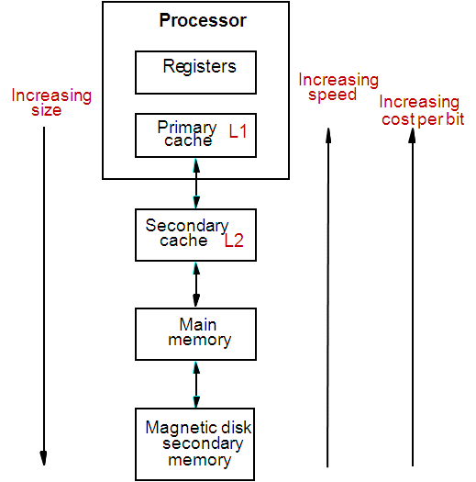
Memory Hierarchy
Fastest access is to the data held in processor registers. Registers are at the top of the memory hierarchy.
Relatively small amount of memory that can be implemented on the processor chip.
This is processor cache.
Two levels of cache. Level 1 (L1) cache is on the processor chip. Level 2 (L2) cache is in between main memory and processor.
Next level is main memory, Much larger, but much slower than cache memory.
Next level is magnetic disks. Huge amount of inexpensive storage.

Slide 4
Locality of Reference
locality of reference, also known as the principle of locality, is the tendency of a processor to access the same set of memory locations repetitively over a short period of time. There are two basic types of reference locality – temporal and spatial locality.
Temporal Locality
Temporal locality refers to the reuse of specific data and/or resources within a relatively small time duration
Recently executed instruction is likely to be executed again very soon
Spatial Locality
spatial locality refers to the use of data elements within relatively close storage locations.
Instructions with addresses close to a recently executed instruction are likely to be executed soon.

Slide 5
What is Cache Memory?
CPU
Cache is a small amount of fast memory, between larger, slower main memory and CPU , may be located on CPU chip or module to reduce the memory access time
Two levels of cache: Level 1 (L1) cache on the processor chip. Level 2 (L2) cache is in between main memory and processor.
Holds the currently active segments of a program and its data.
CACHE MEMORY
MAIN MEMORY

Slide 6
WORKING OF CACHE
Cache memory is based on the property of computer programs known as “locality of reference”.
An entire block of data is copied from memory to the cache because the principle of locality tells us that once a byte is accessed, it is likely that a nearby data element will be needed soon.
The CPU initially looks in the cache for the data it needs.
If the data there , it will retrieve it and process it.
If the data is not present there, then the CPU access the system main memory and then puts a copy of the new data in the cache before processing it.
Next time , if the CPU needs to access the same data again, it will just retrieve the data from the cache instead of going through the whole loading process again.
When the cache is full, and a block of words needs to be transferred from the main memory, some block of words in the cache must be replaced. This is determined by a “replacement algorithm”.

Slide 7
CACHE HIT
Processor issues a Read request, a block of words is transferred from the main memory to the cache, one word at a time.
The processor issues Read and Write requests in the same manner.
A cache hit is when data is found in cache – read hit / write hit
A cache miss is when data is not found – read miss / write miss
Read hit:
The data is obtained from the cache if Cache block is valid , has proper address.
Main memory not involved
Write hit:
Cache has a replica of the contents of the main memory.
Write-through protocol: Contents of cache and main memory may be updated simultaneously. Memory is always kept updated.
Write-back or copy-back protocol. Update the contents of the cache, and mark it as updated by setting a bit known as the dirty bit or modified bit. The contents of the main memory are updated when this block is replaced.

Slide 8
CACHE MISS
If data is not present in the cache, then a Read miss or Write miss occurs.
Read miss:
Block of words containing this requested word is transferred from the memory.
After the entire block is transferred, the desired word is forwarded to the processor.
Load-through or Early-restart: The desired word may also be forwarded to the processor as soon as it is transferred without waiting for entire block
to be transferred.
Write-miss:
If write-through protocol is used, then the contents of the main memory are updated directly.
If write-back protocol is used, the block containing the addressed word is first brought into the cache. The desired word is overwritten with new information.

Slide 9
CACHE PERFORMANCE
It is measured in terms of HIT RATIO.
CACHE HIT : If the CPU’s demanded content is present in cache is called cache hit.
CACHE MISS : If the CPU’s demanded content is not present in cache is called cache miss.
HIT RATIO (H)= Number of cache hits
Number of CPU references
Number of CPU reference = no. of cache hits + no. of cache miss
MISS RATIO(M) = 1 – HIT RATIO(H)

Slide 10
MAPPING FUNCTIONS
The mapping functions are used to map a particular block of main memory to a particular block of cache. This mapping function is used to transfer the block from main memory to cache memory. Mapping functions determine how memory blocks are placed in the cache. Three mapping functions:
• Direct mapping.
The simplest way of associating main memory blocks with cache block is the direct mapping technique. In this technique, block k of main memory maps into block k modulo m of the cache (k % m), where m is the total number of blocks in cache.
• Associative mapping
Here the mapping of the main memory block can be done with any of the cache block. The memory address has only 2 fields here: word & tag. This technique is called as fully associative cache mapping
• Set-associative mapping
Blocks of the cache are grouped into sets, and the mapping allows a block of main memory to reside in any block of a specific set. Therefore, the flexibility of associative mapping is reduced from full freedom to a set of specific blocks.

Slide 11
Direct Mapping
MAIN MEMORY
CACHE MEMORY
000
001
010
011
100
101
110
111
BLOCK (2 byte size)
Tag
BLOCK
00
01
10
11
Block no
Here CPU generated 4 bit address will divided into 3 section
TAG | BLOCK NO OF CACHE | BYTE NO (WORD NO)
Block no

Slide 12
Associative mapping
In the associative mapping function, any block of main memory can probably consist of any cache block position. It breaks the main memory address into two parts - the word ID and a tag as shown in the figure. To check for a block stored in the memory, the tag is pulled from the memory address and a search is performed through all of the lines of the cache to see if the block is present.
TAG | BYTE OFFSET

Slide 13
MAIN MEMORY
000
001
010
011
100
101
110
111
BLOCK (2 byte size)
CACHE MEMORY
TAG
BLOCK
Here CPU generated 4 bit address will be divided into 2 section
TAG | WORD ID
Block no

Slide 14
Set-associative mapping
MAIN MEMORY
reduces the searching overhead, because the search is restricted to number of sets, instead of number of blocks.
000
001
010
011
100
101
110
111
BLOCK (2 byte size)
SET
CACHE MEMORY
O
1
Here CPU generated 4 bit address will be divided into 3 section
TAG | SET | WORD
Block no

Slide 15
CACHE REPLACEMENT POLICIES
When the cache is full, there is a need for replacement algorithm for replacing the cache block with a new block. For achieving the high-speed such types of the algorithm is implemented in hardware. In the cache memory, there are three types of replacement algorithm are used that are:
Random replacement policy.
This is a very simple algorithm which used to choose the block to be overwritten at random. In this algorithm replace any cache line by using random selection. It is an algorithm which is simple and has been found to be very effective in practice.
First in first Out (FIFO) replacement policy
Evicts blocks from cache in their order of arrival.
Cache behaves as a First-In-First-Out queue.
Least recently used (LRU) replacement policy
Evicts least recently referred block .

Slide 16
FIFO
LRU
Evicts blocks from cache in their order of arrival.
Cache behaves as a First-In-First-Out queue.
Evicts least recently referred block .
Consider the block request : 1,2,3,1,4,5,1,4,3,6
Consider the block request : 1,2,3,1,4,5,1,4,3,6

Slide 17
THANKYOU

