Slide 1
Enabling Payments on your WebMatrix Powered ecommerce Sites
Everything a developer would need to know !
March, 26th 2011
Rasesh Shah
Developer Evangelist
PayPal

Slide 2
Agenda
Introduction
Setting up WebMatrix
Setting up PayPal sandbox
Setting up PayPal Helper
Developing photo sharing site with Chained payment
Monetize Facebook like button
Q & A

Slide 3
Introduction

Slide 4

Open global Payments Platform
PayPalX
Enables various monetization models
Over 190 countries and 24 currencies
Flexible Services and APIs
Serves Consumers, Merchants/Sellers & Developers!
Risk and Fraud Management

Slide 5
Different Monetization Models
Offers
Direct Monetization
e/m-commerce
Freemium/Causium
Pay as you Use
Free to use Pay for Services
Referrals
Premium Content
Digital Goods
Virtual Currency
Subscriptions
Advertizing
Indirect Monetization

Slide 6

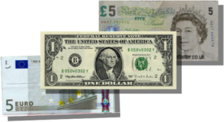






different payment models
Simple Payments
Chained Payments
Parallel Payments
Preapprovals
Subscriptions
Recurring Payments
Web Checkout
Micro Payments
C
Pre Approval
Primary

Slide 7
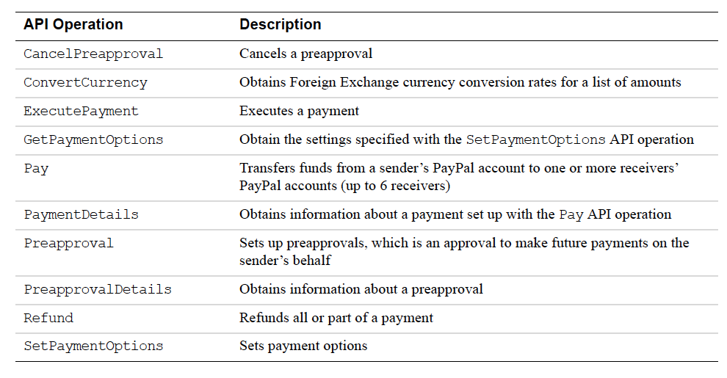
Adaptive Payment API Operations

Slide 8
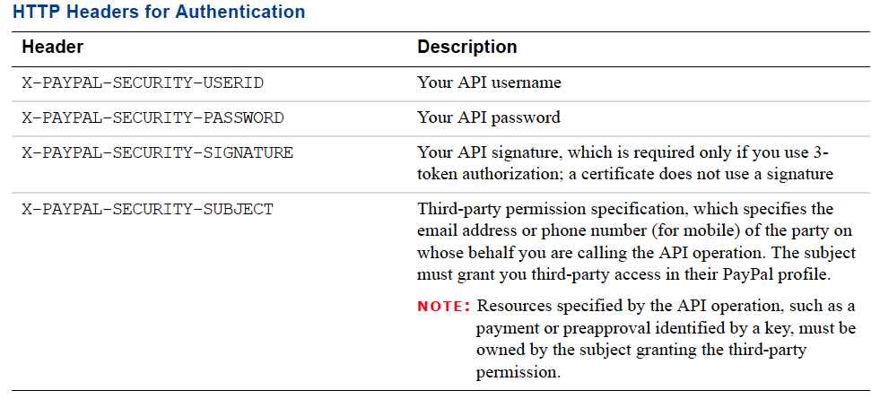
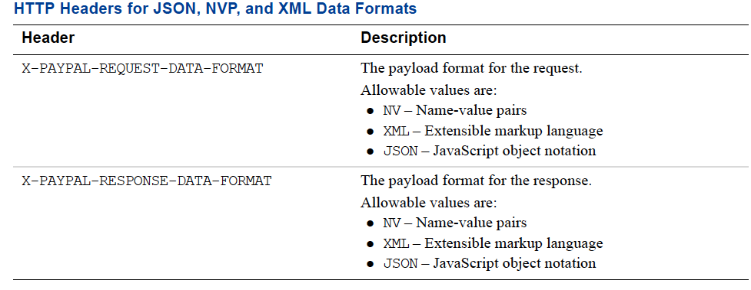
Http Headers for API Calls

Slide 9
Setting up WebMatrix

Slide 10
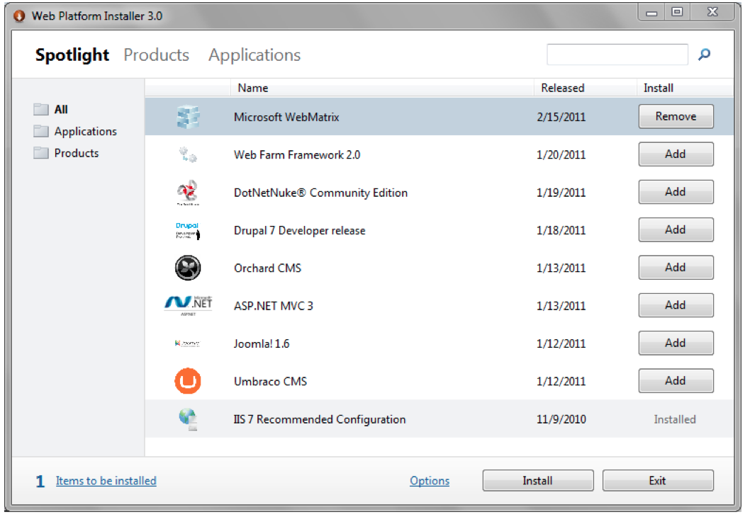
Environment setup
Download WebMatrix
http://www.microsoft.com/web/webmatrix/
Use Web Installer to install the WebMatrix

Slide 11
Features
Create, develop and publish your web site
Small but complete package
Simple database connectivity
Start > Open Source

Slide 12
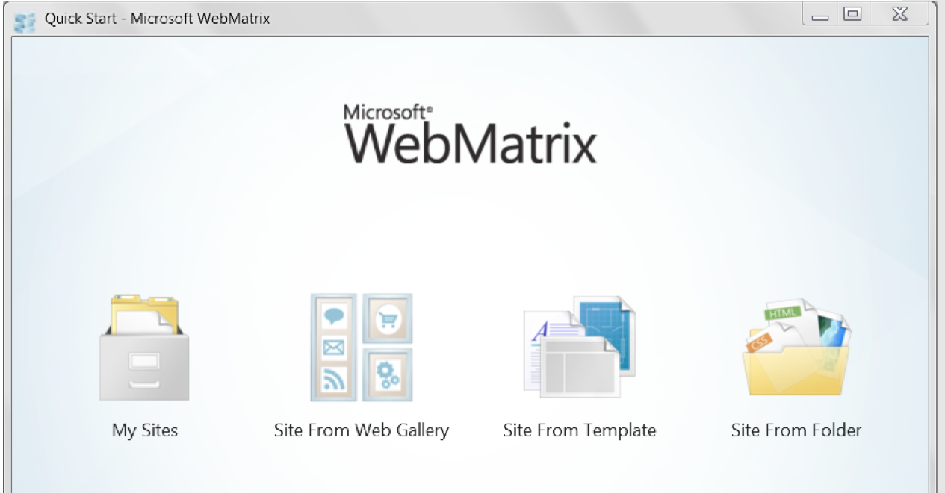
Quick start
Start WebMatrix
Site from Web Gallery
Site from template
Site from folder

Slide 13
Setting up PayPal Sandbox

Slide 14
Paypal Sandbox
Create the developer account
http://developer.paypal.com
Set up the test accounts buyer , seller, developer
Note down the API credentials
User Name , Password , Signature

Slide 15
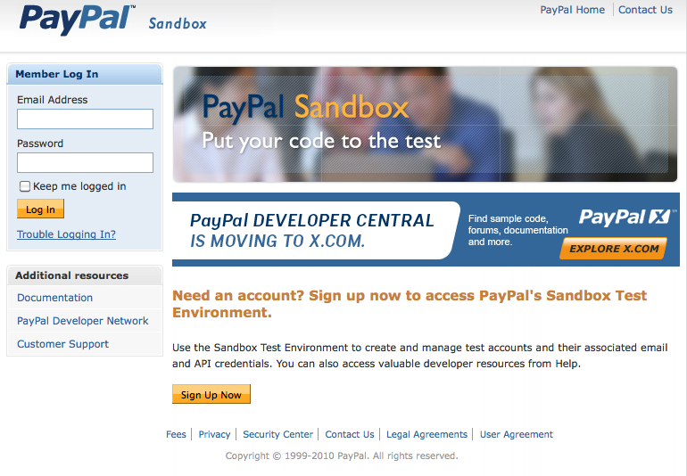
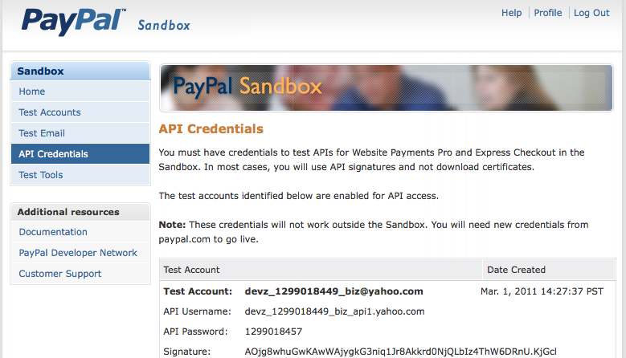
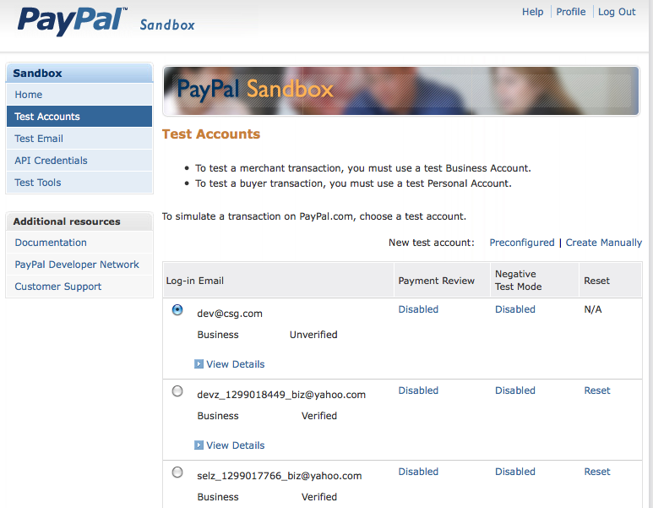
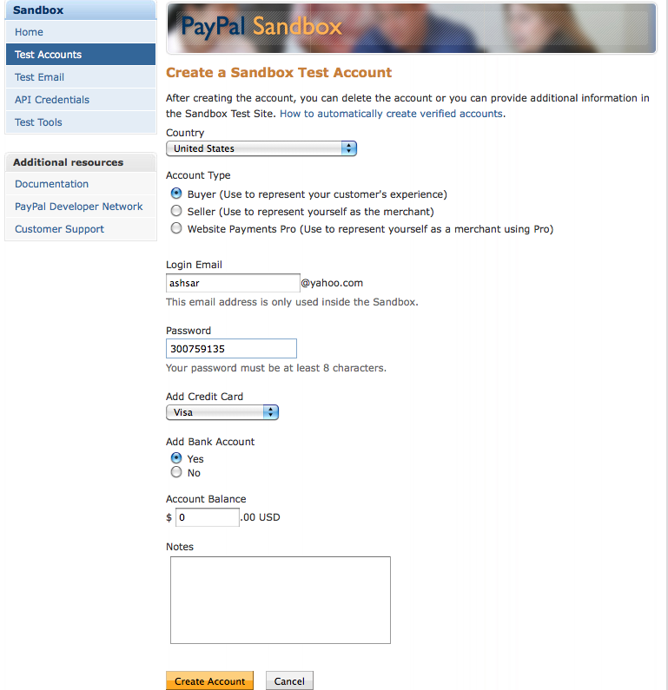
Paypal Sandbox

Slide 16
PayPal Helpers for WebMatrix

Slide 17
PayPal helpers
Wrapper classes on top of Adaptive Payments API
Wrapper classes on top of Button Manager APIS
Payment enabled Bakery template to bootstrap your application
Open source for making any modification to your need

Slide 18
Get started in 60 seconds
Download the PayPal helper library
http://paypalhelper.codeplex.com
Create a new website or template in WebMatrix
Create a bin folder off the root
Copy and paste the PayPal library into the bin folder
Read the documentation and start monetizing

Slide 19
Monetizing Photo Sharing Site

Slide 20
Use case
Developer hosts a photo sharing site
Publisher publishes good quality pictures
Printer prints a picture copy and send it to consumer
Consumer orders a copy of the picture
printer
consumer
Developer
publisher

Slide 21
Step by step development
Start WebMatrix and create a new web site from photo gallery template
Paste PayPal.dll in bin folder
Run the web Site and see the starting page
Data stored in /App_Data/PhotoGallery.sdf file

Slide 22
App start file
Modify _AppStart.chtml file to initialize PayPal helper
PayPal.Profile.Initialize(
"msft_1284494024_biz_api1.yahoo.com",
"1284494030", "AXmPHOGl57wrwF1dy49VI0W9gisLAWm4raYoWQy9KHCtpd7kLlSQcsFG",
"sandbox",
"APP-80W284485P519543T"
);

Slide 23
Modify the View page
Add button for buying a print in /Photo/View file
<div id="paypal">
Order this Print for just $1
<form name"frmPayPal" action="/Photo/OrderSuccess">
<input type="hidden" name="publisher" value="@user.Email">
Shipping Address : <input type="text" name="shippingAddress" value=""/><br/><br/>
<input type="submit" value="Buy"/>
</form>
</div>

Slide 24
Order Success script
Add new chtml file OrderSuccess under Photo folder
Set the pricing options
var shippirngAddress = Request["shippingAddress"];
var qty = "1";
var price = new Decimal(1);
var publisher = "mytest_1296498503_biz@yahoo.com";
var printer = "isv_1284493468_biz@yahoo.com";
var developer = "msft_1284494024_biz@yahoo.com";

Slide 25
Order Success script
Set the receivers
var DevRcv = new PayPal.AdaptivePayments.Receiver();
DevRcv.email = developer;
DevRcv.amount = price;
var PayReceivers = new List<PayPal.AdaptivePayments.Receiver>();
var PubRcv = new PayPal.AdaptivePayments.Receiver();
PubRcv.email = publisher;
PubRcv.amount = decimal.Round(price * .10m, 2);
PayReceivers.Add(PubRcv);
var PrintRcv = new PayPal.AdaptivePayments.Receiver();
PrintRcv.email = printer;
PrintRcv.amount = decimal.Round(price * .70m, 2);
PayReceivers.Add(PrintRcv);

Slide 26
Execute the call
var Language = "en_US";
var CancelUrl = "http://localhost:30546"; //Change the domain and port to your environment
var ReturnUrl = "http://localhost:30546"; //Change the domain and port to your environment
var CurrencyCode = "USD";
var response = PayPal.AdaptivePayments.ChainedPay.Execute
(DevRcv, PayReceivers, "", "Test Photo Payment", "127.0.0.1", "MyDevice",CancelUrl,ReturnUrl,"",CurrencyCode,Language);
if (response == null) {
Response.Write("null");
}
else
{
Response.Write("full");
}
var payKey = response.payKey;
//Points to the paypal sandbox account. Change it to production url for live.
var redirectUrl = "https://www.sandbox.paypal.com/webscr?cmd=_ap-payment&paykey=" + payKey;
Response.Redirect(redirectUrl);

Slide 27
Other Helpers
Pre approval helpers
Refund helpers
Payment Detail helpers
Currency Conversion helpers
Button Manager Helpers (Buy Now , Add to Cart etc)

Slide 28
Little fun - Monetize Facebook like button

Slide 29
Facebook Like button
Download Facebook helpers
http://facebookhelper.codeplex.com
Copy facebook.chtml into App_Code folder
Modify View.chtml file to make a call
@Facebook.LikeButton([your site url])
Share revenue with the like referrer by adding him as one more receiver of the payment

Slide 30
Q&A
www.x.com
Twitter: @paypalx, @srasesh
www.facebook.com/paypalx

