Slide 1

In-App payments for the Kitchen Sink
Praveen (@ppalavilli)
Developer Evangelist, PayPal

Slide 2


Slide 3
very engaging

Slide 4
better awesome conversion

Slide 5
more $$$

Slide 6
delightful experience
Notes:
Compelling, totally natural, intuitive, no training/setup needed, no break in flow, seamless and magical experience. Think of how RFID based keys work – you carry the key in your pocket, open car door and press start button without even inserting the key into any lock. maps app is a good example – gets the current location without even we doing anything. Think about how magical it would be if you can walk into a store, walk along the aisles, stop at the product you want to purchase, take your mobile device out, it shows the product you are holding in your hand and let’s you pay for it right there so you can simply walk out. Isn’t that a delightful/magical experience ?

Slide 7
In-app Payments
Notes:
That’s what in-app payments are – they let you collect payment right inside your app – you would ask what can I collect payment for ?

Slide 8
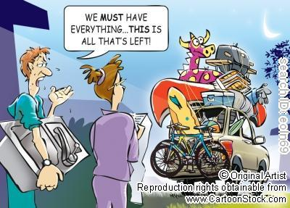
Notes:
Everything but kitchen sink

Slide 9
Service Payments
Rent
Parking
Expense Sharing
Social Commerce
P2P
Group Gifts / Registry
Digital Goods
Healthcare
Marketplaces
Mobile Payments
Device Payments
B2B
Invoicing
Govt. Services
Food Orders
Tickets
Referrals
Bill Pay
Taxi

Slide 10
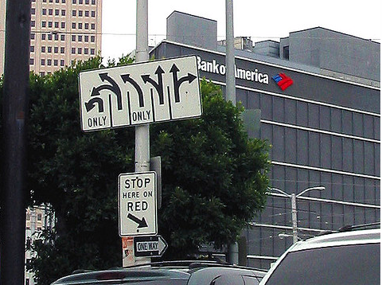

Slide 11
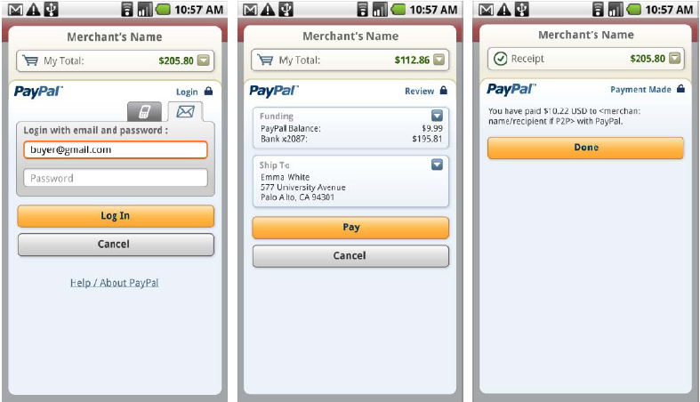
PayPal Mobile Payment Library (MPL) & Mobile Express Checkout (MEC)

Slide 12
406: Monetizing with PayPal’s In-App and Mobile Web Payment Solutions
Attend our class tomorrow at 3:45 PM

Slide 13
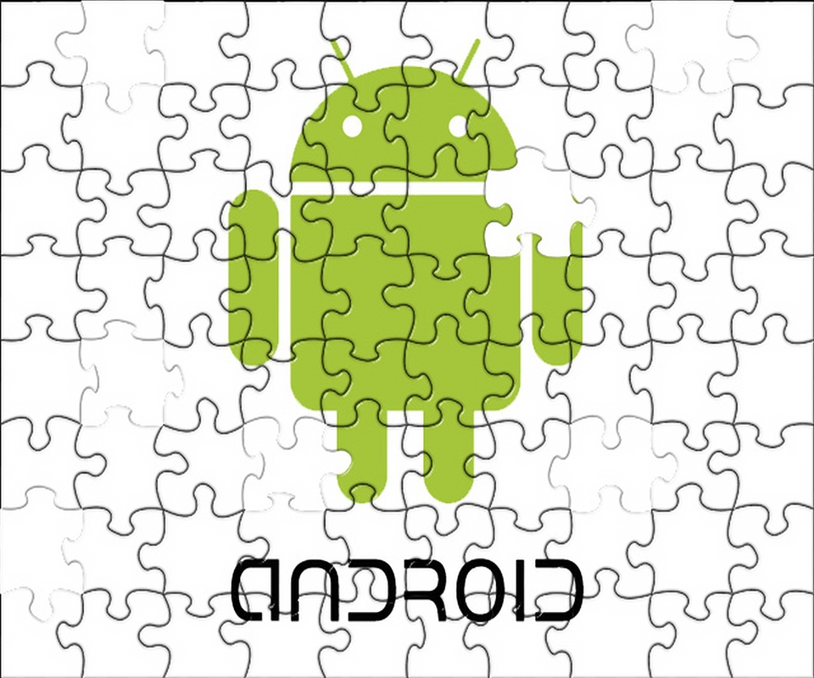
PayPal X Developer Challenge for AndroidTM
https://www.x.com/devchallenge

Slide 14
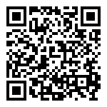
www.x.com
@paypalx
facebook.com/paypalx

