Slide 1
406: Monetizing with PayPal’s In-App and Mobile Web Payment solutions
Kent Griffin
Praveen Alavilli (@ppalavilli)
www.x.com/mobile

Slide 2
What we are going to cover
Opportunities in Mobile Payments
PayPal Mobile Payments Library
PayPal Mobile Express Checkout
In-app Payments
PayPal Mobile Payments Library – implementation walk through
Advanced Features
Next steps (going live, tech support)

Slide 3
CONFLICTING STATEMENTS?
M-Commerce is predicted to reach US$119 billion in 2015,
Japan remains king (Gartner – 1/2011)
The worldwide market for mobile payments will grow to
$633.4 billion by 2014, up from $68.7 billion in 2009
(Generator– 5/2010)
The total value of global mobile transactions will increase from
$162 billion in 2010 to $984 billion in 2014 (Yankee – 2/2011)

Slide 4
M-commerce is exploding
Apps
Remote
Global Mobile Apps Revenues ($B)
eBay reached ~2B+ in 2010
Amazon reached $1B in last year
Japan showing the way with Rakuten mcommerce volume @ 20% of total
Source: Gartner (January, 2010)
Notes:
# developers?
# consumers? And what buying?

Slide 5
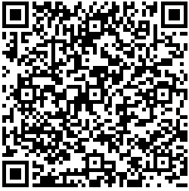
M-commerce is also expanding
Moving offline
New use cases are extending this field beyond digital content and e-commerce:
Selling merchandise in games
LBS and coupons
Comparison shopping
Private and time sensitive sales
Ticketing
Mobile driving store traffic with daily deals

Slide 6
Indirect Monetization
Direct Monetization
Advertizing
e/m-commerce
Freemium/Causium
Pay as you Use
Free to use Pay for Services
Pay for App
Offers
Premium Content
Digital Goods
Referrals
Virtual Currency
Subscriptions
Reselling
Donations

Slide 7
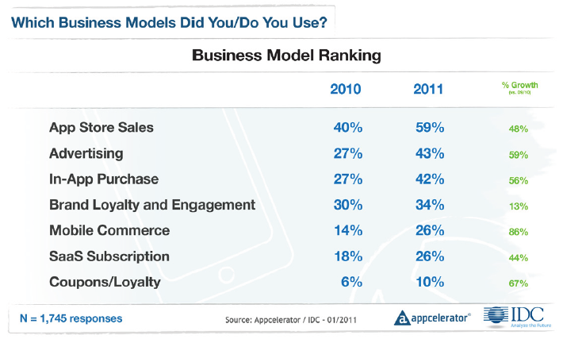
PREFERRED BUSINESS MODELS

Slide 8
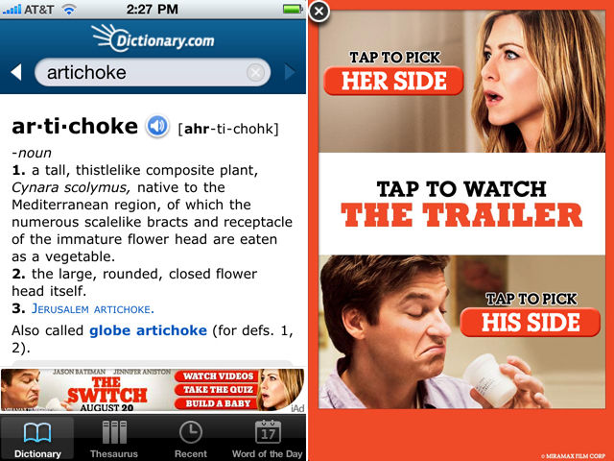
ADVERTISING
An option to supplement free content or services
Mobile Ad metrics:
Engagement rates up to
33% for rich media and
7% for expandable ads
Source: Adicit (Aug 2010)
Dictionary.com has seen its overall iPhone mobile app eCPM (effective cost-per-thousand impressions) increase by 177%
Source: Mashable (Jan 2011)
Notes:
engagement rates as high as 33% on rich media ads with rates consistently exceeding 20%. At the other end of the scale, simple, expandable ads reach 6-7% engagement rates, which can still be considered relatively high when compared to other advertising options including both mobile and online. These rates are unheard of in the online world. – aditic study
http://mashable.com/2010/08/19/mobile-advertising-trends/#

Slide 9
VIRTUAL GOODS
Great model for free apps able to up-sell features or content
Others use it as a way to pay for an ad-free app
30% fee
Kleiner Perkins Case Study
Virtual goods introduction drove 5x increase in revenue over paid apps
2009 Revenue: 64% paid downloads, 30% ads
2010 Revenue: 63% ads, 35% virtual goods
Source: Kleiner Perkins Mobile Trends Report (Feb 2011)
Source: Playspan survey (Sept 09)

Slide 10
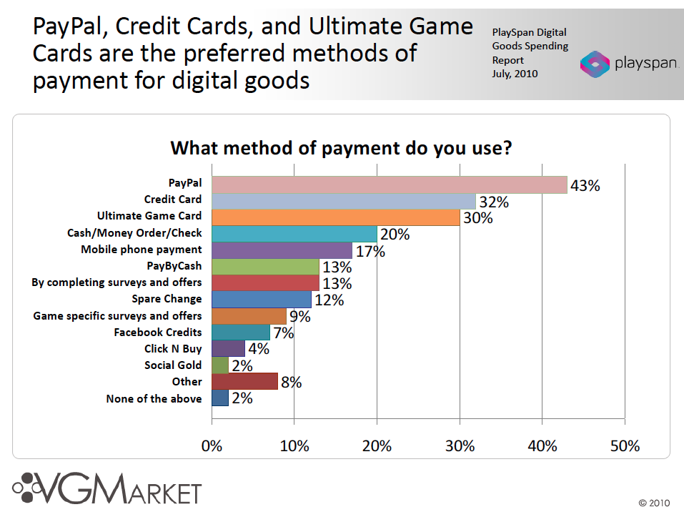

Slide 11
Paypal use cases can include
Payments Anywhere !
Credit Cards
eComm
mComm
Chained
Payments
Mobile Payments
P2P
Payments
Disbursements
Utility Payments
Social Payments
Cloud
Payments
Delayed
Payments
Parallel
Payments
Digital Goods
Business
Payments
Embedded
Payments
Subscriptions
eWallet
Affiliate
Payments
Preapprovals
Refunds

Slide 12
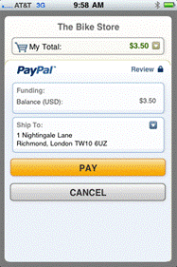
PayPal’s Mobile Payment Library
Making it easier for developers
Designed to be integrated in less than 10 minutes
No need to code payment UI
Don’t need to worry about sensitive financial info
More convenient than always typing credit card
Can use existing account information
Physical goods and services
In-app purchase
Simple, Chained, Parallel, and Pre-approved payments
Supports Android 1.5 and above (and iOS 3.0 and above)
Making it better for consumers
A growing feature set

Slide 13
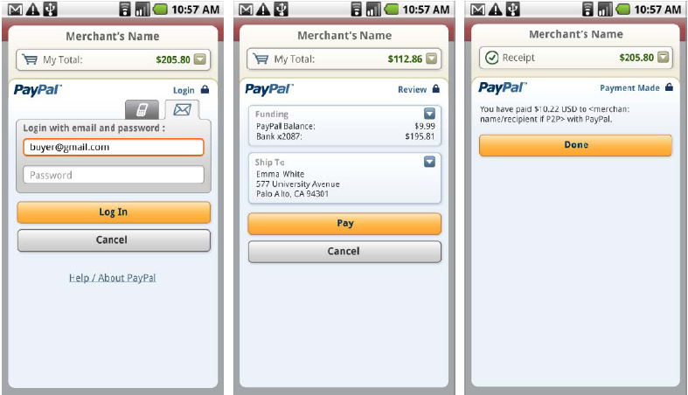
Simple in-app Payment Demo
Notes:
MPL and MEC

Slide 14
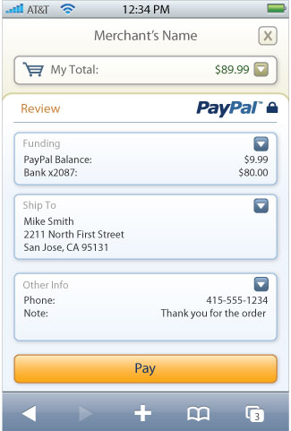
Mobile Express Checkout: Overview
Mobile Express Checkout launched in beta with
several merchants (Nike.com, Buy.com,
Footlocker.com)
Optimized UI for webkit browsers
Supports iPhone and Android 2.0 browsers
Uses the same APIs as the web version so
any online integrations can be reused
More information at www.x.com/mobile
Notes:
Note: App developers may want to use the mobile
web if you already have an EC integration
or the app store requires a web flow.

Slide 15
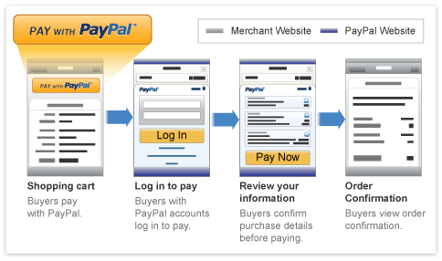
Mobile Express Checkout: Demo
Notes:
Demo

Slide 16
Mobile Express Checkout: APIS
Uses the same APIs as online
SetExpressCheckout
GetExpressCheckout
DoExpressCheckout
Just add one extra parameter to the redirect:
cmd=_express-checkout-mobile

Slide 17
“In-APP Payments”

Slide 18
What are in-app payments (billing) ?
Payments made inside an app
Users never leave the app
Contextual and Trusted experience

Slide 19
What are your options ?
Google
PayPal
Digital goods
Virtual currencies
Premium features
(Digital content subscriptions)
Physical goods
P2P payments
Service payments
e/m-commerce
Donations
Crowd Sourcing
Subscriptions
SaaS Payments
Non-traditional commerce
Other Providers :
Use cases vary

Slide 20
Google in-app payments
Supported through Android Market in-app billing service for requesting and validating the form of payment and processing the financial transactions

Slide 21
Google in-app User Experience
http://developer.android.com/guide/market/billing/index.html

Slide 22
PayPal In-app payments
Supported through a library that includes both Activities and Views required for “inline” checkout experience.
Over 190 countries and 25 different currencies – global ready from get go!
Simple, Chained, Parallel and Preapproval payments
Refunds, Transaction details, Instant Payment notifications

Slide 23
PayPal in-app – User Experience

Slide 24
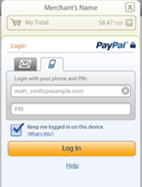
PayPal in-app – component diagram
Your Application
Your Server
(Optional)
Your Activity
onCreate(){
…
getCheckoutButton(…);
}
onClickListener() {
…
startActivityForResult(…);
}
onPaymentSucceeded() {
…
}
onPaymentFailed(){
…
}
onPaymentCanceled() {
…
}
onActivityResult(){
…
}
Item delivery
Purchase data
PayPal Checkout Activity
Instant Payment
Notifications
(Optional)
PayPal Server
User Wallet
Fraud/Risk
Transaction data

Slide 25
Let’s build an app http://bit.ly/ppx-andevcon

Slide 26
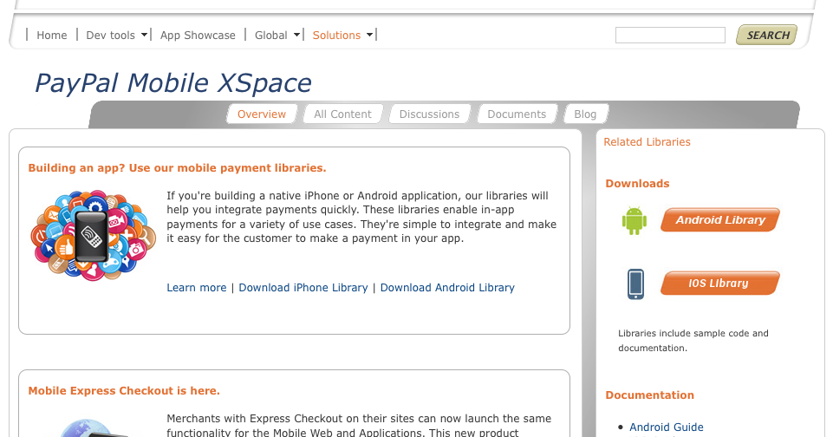
Step 1: Download the library & add it to your app
https://www.x.com/mobile

Slide 27
Step 2: Update your AndroidManifest.xml
Add permissions:
<uses-permission android:name="android.permission.INTERNET" />
<uses-permission android:name="android.permission.READ_PHONE_STATE"/>
Declare the PayPal Activity:
<activity android:name="com.paypal.android.MEP.PayPalActivity"
android:theme="@android:style/Theme.Translucent.NoTitleBar"
android:configChanges="keyboardHidden|orientation"/>

Slide 28
Step 3: initialize the library
public void onCreate() {
…..
if(this.isOnline()){
Thread libraryInitializationThread = new Thread() {
public void run() {
initLibrary();
}
};
libraryInitializationThread.start();
}
….
}

Slide 29
Step 3: initialize the library
public void initLibrary() {
PayPal pp = PayPal.getInstance();
// If the library is already initialized, then we don't need to
// initialize it again.
if (pp == null) {
// This is the main initialization call that takes in your Context,
// the Application ID, and the server you would like to connect to.
pp = PayPal.initWithAppID(this, "APP-80W284485P519543T",
PayPal.ENV_NONE);
// -- These are required settings.
pp.setLanguage("en_US"); // Sets the language for the library.
// --
// -- These are a few of the optional settings.
// Sets the fees payer. If there are fees for the transaction, this
// person will pay for them. Possible values are FEEPAYER_SENDER,
// FEEPAYER_PRIMARYRECEIVER, FEEPAYER_EACHRECEIVER, and
// FEEPAYER_SECONDARYONLY.
pp.setFeesPayer(PayPal.FEEPAYER_EACHRECEIVER);
// Set to true if the transaction will require shipping.
pp.setShippingEnabled(true);
// Dynamic Amount Calculation allows you to set tax and shipping
// amounts based on the user's shipping address. Shipping must be
// enabled for Dynamic Amount Calculation. This also requires you to
// create a class that implements PaymentAdjuster and Serializable.
pp.setDynamicAmountCalculationEnabled(false);
// --
_paypalLibraryInit = true;
}
}

Slide 30
Step 4: generate PayPal button w/ onClickListener
private void showPayPalButton() {
removePayPalButton();
// Back in the UI thread -- show the "Pay with PayPal" button
// Generate the PayPal Checkout button and save it for later use
PayPal pp = PayPal.getInstance();
launchPayPalButton = pp.getCheckoutButton(this, PayPal.BUTTON_278x43,
CheckoutButton.TEXT_PAY);
// You'll need to have an OnClickListener for the CheckoutButton.
launchPayPalButton.setOnClickListener(this);
// add it to the layout
RelativeLayout.LayoutParams params = new RelativeLayout.LayoutParams(
LayoutParams.WRAP_CONTENT, LayoutParams.WRAP_CONTENT);
params.addRule(RelativeLayout.ALIGN_PARENT_BOTTOM);
params.bottomMargin = 10;
launchPayPalButton.setLayoutParams(params);
launchPayPalButton.setId(PAYPAL_BUTTON_ID);
((RelativeLayout) findViewById(R.id.RelativeLayout01))
.addView(launchPayPalButton);
((RelativeLayout) findViewById(R.id.RelativeLayout01))
.setGravity(Gravity.CENTER_HORIZONTAL);

Slide 31
Step 4: generate PayPal button w/ onClickListener
private void removePayPalButton() {
// Avoid an exception for setting a parent more than once
if (launchPayPalButton != null) {
((RelativeLayout) findViewById(R.id.RelativeLayout01))
.removeView(launchPayPalButton);
}
}

Slide 32
Step 5: Start payment Activity using Checkout Intent
public void PayPalButtonClick(View arg0) {
// Create a basic PayPalPayment.
PayPalPayment payment = new PayPalPayment();
// Sets the currency type for this payment.
payment.setCurrencyType("USD");
// Sets the recipient for the payment. This can also be a phone
// number.
payment.setRecipient("ppalav_1285013097_biz@yahoo.com");
// Sets the amount of the payment, not including tax and shipping
// amounts.
payment.setSubtotal(new BigDecimal(_theSubtotal));
// Sets the payment type. This can be PAYMENT_TYPE_GOODS,
// PAYMENT_TYPE_SERVICE, PAYMENT_TYPE_PERSONAL, or
// PAYMENT_TYPE_NONE.
payment.setPaymentType(PayPal.PAYMENT_TYPE_GOODS);
// PayPalInvoiceData can contain tax and shipping amounts. It also
// contains an ArrayList of PayPalInvoiceItem which can
// be filled out. These are not required for any transaction.
PayPalInvoiceData invoice = new PayPalInvoiceData();
// Sets the tax amount.
invoice.setTax(new BigDecimal(_taxAmount));

Slide 33
Step 6: Handle result from library
public void PayPalActivityResult(int requestCode, int resultCode, Intent intent) {
switch (resultCode) {
case Activity.RESULT_OK:
// The payment succeeded
String payKey = intent.getStringExtra(PayPalActivity.EXTRA_PAY_KEY);
this.paymentSucceeded(payKey);
break;
case Activity.RESULT_CANCELED:
// The payment was canceled
this.paymentCanceled();
break;
case PayPalActivity.RESULT_FAILURE:
// The payment failed -- we get the error from the
// EXTRA_ERROR_ID and EXTRA_ERROR_MESSAGE
String errorID = intent.getStringExtra(PayPalActivity.EXTRA_ERROR_ID);
String errorMessage = intent.getStringExtra(PayPalActivity.EXTRA_ERROR_MESSAGE);
this.paymentFailed(errorID, errorMessage);
}
}

Slide 34
Advanced Functionality
ResultDelegate
Chained, Parallel and Preapproved Payments
Dynamic Amount Calculation
more…

Slide 35
ResultDelegate
Implement PayPalResultDelegate interface
Provides a way to be notified immediately when a payment has completed
Get’s called before the PayPal MPL Activity is returned (onActivityResult())
public interface PayPalResultDelegate{
void onPaymentSucceeded(String payKey, String paymentStatus);
void onPaymentFailed(String paymentStatus, String correlationID, String payKey, String errorID, String errorMessage);
void onPaymentCanceled(String paymentStatus);
}

Slide 36





Chained, Parallel and Preapproved Payments
$10
$100
$100
$10
$40
$40
Primary
$50
Parallel Payment
$50
Chained Payment
Pre Approval
C

Slide 37
Dynamic Amount Calculation
Allows modification of the payment (Amount, tax, shipping) based on the buyer’s shipping address
Enable by setting payPal.setDynamicAmountCalculationEnabled(true);
Implement PaymentAdjuster interface
public interface PaymentAdjuster {
public MEPAmounts adjustAmount(MEPAddress address, String currency, String tax, String shipping);
public Vector<MEPReceiverAmounts> adjustAmountsAdvanced(MEPAddress address, String currency, Vector<MEPReceiverAmounts> receivers);
}

Slide 38
More…
Instant Payment Notifications
Refunds
Transaction Search/Details

Slide 39
Next Steps

Slide 40
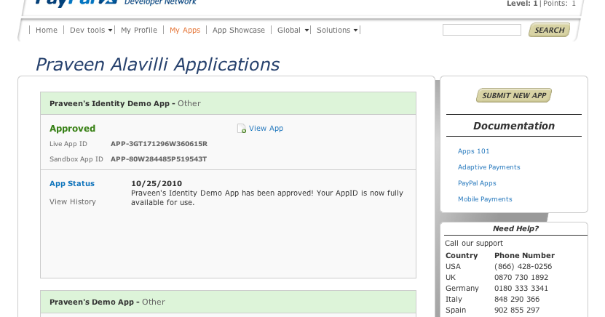
Going live

Slide 41
Going live
Update your AppID
Submit your app for App Store/Marketplace

Slide 42
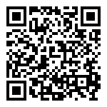
Technical Support
https://www.paypal.com/dts
https://www.x.com/mobile

Slide 43
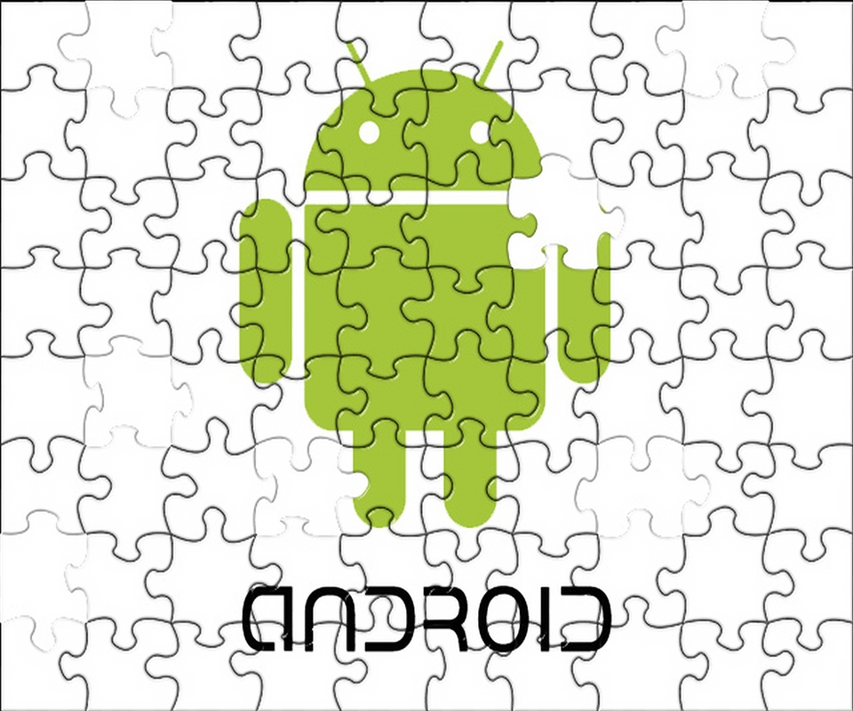
PayPal X Developer Challenge for AndroidTM
Must use MPL or MEC
Deadline May 14th
Awards:
$25000
$15000
$10000
+ Marketing and PR support
https://www.x.com/devchallenge

Slide 44
Q & A
www.x.com
@paypalx
facebook.com/paypalx

