Slide 1



CGB1201 – JAVA PROGRAMMING
PROJECT REVIEW-2
Department of Computer Science and Engineering
Academic Year: 2024 – 2025 (Odd Semester)
Register Number:2303811710421163
Name :P.Surya
Year :II
Semester :III
Section :C
Date :23/11/2024
1
CGB1201 – JAVA PROGRAMMING –PROJECT REVIEW 2

Slide 2
TITLE OF THE PROJECT
NUMBER GUESSING GAME
2
CGB1201 – JAVA PROGRAMMING –PROJECT REVIEW 2

Slide 3
AGENDA
Abstract
Introduction
Java Programming – Concepts Used
Proposed Architecture
Module Description
Result and Discussion
Conclusion
3
EGB1201 – JAVA PROGRAMMING –PROJECT REVIEW 2

Slide 4
ABSTRACT
This project presents a simple number guessing game developed in Java. The game generates a random number between 1 and 100, and the player has to guess the number in as few attempts as possible. The game provides feedback to the player after each guess, indicating whether the guess is too high or too low. The game continues until the player correctly guesses the number. This project demonstrates the use of Java programming concepts, such as random number generation, conditional statements, and loops, to create a interactive and engaging game.
4
CGB1201 – JAVA PROGRAMMING –PROJECT REVIEW 2

Slide 5
INTRODUCTION
The Number Guessing Game is a timeless and captivating game that has been a source of entertainment for people of all ages. This game is not only fun, but it also tests a player's ability to think strategically, make educated guesses, and learn from their mistakes. The game involves guessing a randomly generated number within a specified range, with the goal of finding the correct number in as few attempts as possible. With each guess, the player receives feedback in the form of hints, such as "too high" or "too low," which helps them refine their strategy and ultimately guess the correct number
5
CGB1201 – JAVA PROGRAMMING –PROJECT REVIEW 2

Slide 6
JAVA PROGRAMMING - CONCEPTS USED
1. *Conditional Statements*: The program uses `if-else` statements to check the player's guess and provide feedback.
2. *Loops*: The program uses a `while` loop to repeatedly ask the player for their guess until they correctly guess the number.
3. *Variables*: The program uses variables to store the random number, the player's guess, and the number of attempts.
4. *Input/Output*: The program uses `Scanner` to get input from the player and `System.out.println` to display output to the player.
6
CGB1201 – JAVA PROGRAMMING –PROJECT REVIEW 2

Slide 7
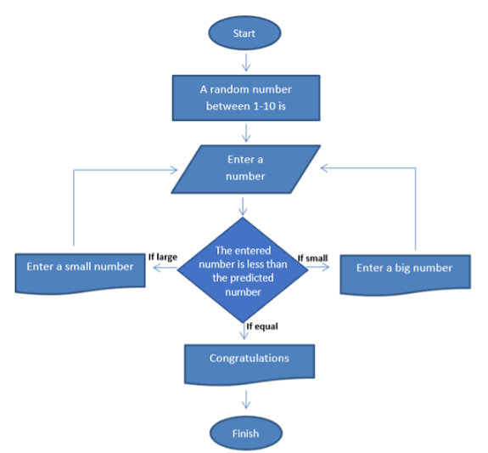
PROPOSED ARCHITECTURE
7
CGB1201 – JAVA PROGRAMMING –PROJECT REVIEW 2

Slide 8
MODULE DESCRIPTION
1. Game Initialization
2. User Input
3. Guess Evaluation
4. Game Logic
5. Game Termination
6. Result Display
8
CGB1201 – JAVA PROGRAMMING –PROJECT REVIEW 2

Slide 9
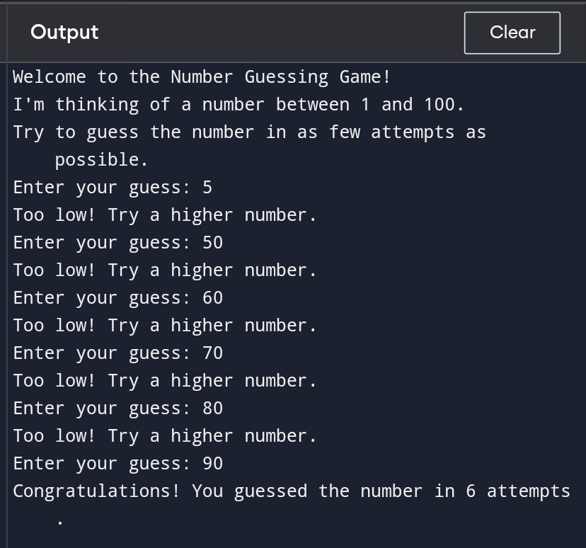
RESULTS AND DISCUSSION
9
CGB1201 – JAVA PROGRAMMING –PROJECT REVIEW 2

Slide 10
CONCLUSION
In conclusion, the Number Guessing Game is a simple yet engaging game that demonstrates the use of Java programming concepts. The game effectively utilizes random number generation, conditional statements, loops, and variables to create an interactive experience for the player. With its straightforward gameplay and user-friendly interface, the Number Guessing Game is an excellent example of how programming can be used to create entertaining and educational applications.
10
CGB1201 – JAVA PROGRAMMING –PROJECT REVIEW 2

Slide 11
THANK YOU
11
CGB1201 – JAVA PROGRAMMING –PROJECT REVIEW 2

