Slide 1


CGB1201 – JAVA PROGRAMMING PROJECT REVIEW-2
Department of Computer Science and Engineering
Academic Year: 2024 – 2025 (Odd Semester)
Register Number :2303811710421163
Name :Surya.p
Year :II
Semester :III
Section :C
Date :23/11/2024

Slide 2
TITLE OF THE PROJECT
NUMBER GUESSING GAME

Slide 3
AGENDA
Abstract
Introduction
Java Programming – Concepts Used
Proposed Architecture
Module Description
Result and Discussion
Conclusion

Slide 4
ABSTRACT
This project presents a simple number guessing game developed in Java. The game generates a random number between 1 and 100, and the player has to guess the number in as few attempts as possible. The game provides feedback to the player after each guess, indicating whether the guess is too high or too low. The game continues until the player correctly guesses the number. This project demonstrates the use of Java programming concepts, such as random number generation, conditional statements, and loops, to create a interactive and engaging game.

Slide 5
INTRODUCTION
The Number Guessing Game is a timeless and captivating game that has been a source of entertainment for people of all ages. This game is not only fun, but it also tests a player's ability to think strategically, make educated guesses, and learn from their mistakes. The game involves guessing a randomly generated number within a specified range, with the goal of finding the correct number in as few attempts as possible. With each guess, the player receives feedback in the form of hints, such as "too high" or "too low," which helps them refine their strategy and ultimately guess the correct number.

Slide 6
JAVA PROGRAMMING - CONCEPTS USED
1. *Conditional Statements*: The program uses `if-else` statements to check the player's guess and provide feedback.
2. *Loops*: The program uses a `while` loop to repeatedly ask the player for their guess until they correctly guess the number.
3. *Variables*: The program uses variables to store the random number, the player's guess, and the number of attempts

Slide 7
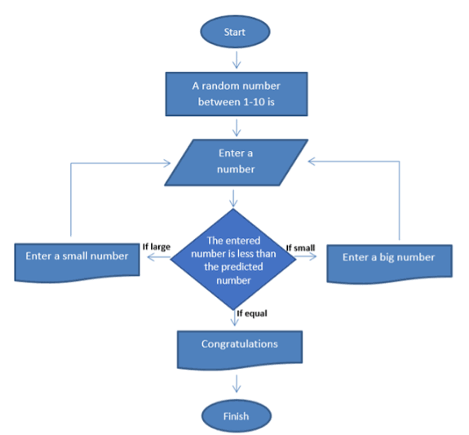
PROPOSED ARCHITECTURE

Slide 8
MODULE DESCRIPTION
- Display the correct number
- Display the number of attempts taken by the player
- Display a congratulatory message for winning the game
- Display a "Game Over" message if the player fails to guess the number within the allowed attempts.

Slide 9
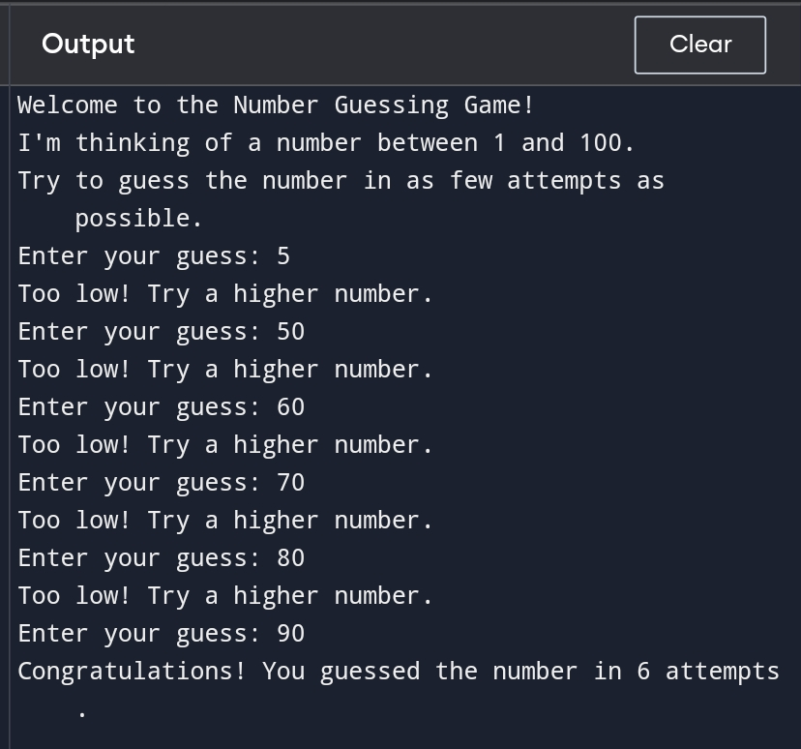
RESULTS AND DISCUSSION

Slide 10
CONCLUSION
In conclusion, the Number Guessing Game is a simple yet engaging game that demonstrates the use of Java programming concepts. The game effectively utilizes random number generation, conditional statements, loops, and variables to create an interactive experience for the player. With its straightforward gameplay and user-friendly interface, the Number Guessing Game is an excellent example of how programming can be used to create entertaining and educational applications

Slide 11
THANK YOU

