Slide 1
INTERRUPTS

Slide 2
What is interrupt?
An interrupt is an mechanism that makes the microcontroller to interrupt the execution of current program and execute another program.
After receiving an interrupt signal, the microcontroller interrupts the execution of main program. After saving the current status of main program, it jumps to the memory location specified by interrupt and executes a subprogram called interrupt service routine (ISR). This memory location is called vector.
These interrupts are occurred due to internal and external events

Slide 3
Interrupt Sources
External Interrupt 0
Timer 0
External Interrupt 1
Timer 1
Serial Port

Slide 4
Each interrupt can be enabled separately.
Each interrupt type has a separate vector address.
Each interrupt type can be programmed to one of two priority levels.
External interrupts can be programmed for edge or level sensitivity.
Each interrupt can be enabled or disabled by setting bits of the IE (interrupt enable) register. Likewise, the whole interrupt system can be disabled by clearing the EA bit of the same register

Slide 5
In 8051 microcontroller, interrupts are generated by internal operations such as Timer flag 0 (TF0), Timer flag 1 (TF1), and serial port interrupt (RI or TI).
When the timer/counter 0 overflows, the TF0 flag is set to 1. If the timer/counter 1 overflows, the TF1 flag is set to 1.
The TF0 and TF1 flag will be cleared when the timer flag interrupt makes a program call from the timer subroutine.
In serial port interrupt, a data byte will be received if RI=1 and a data byte will be transmitted if TI=1.

Slide 6
Interrupts are also generated by external signals INT0 and INT1
External inputs on INT0 and INT1 pins set the interrupt flags IE0 and IE1 in the TCON register (Timer Control register) to 1 by level triggered or edge triggered
If the IT0 and IT1 bits of the TCON register are set, an interrupt will be generated on high to low transition.
If these bits are cleared, an interrupt will be continuously executed as far as the pins are held low.

Slide 7
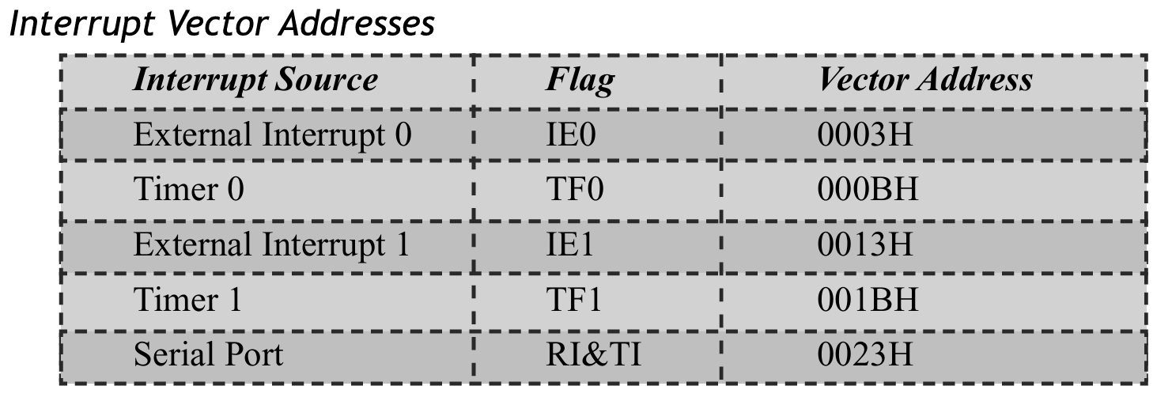
Interrupt vector address

Slide 8
Interrupt Control Register
Interrupt Enable (IE) register
Interrupt Priority(IP) register
Timer Control Register(TCON)
Interrupt Enable (IE) Register:
It consist of EA, ES, ET1, EX1, ET0 and EX0
EA global interrupt enable/disable:
0—disables all interrupt requests.
1—enables all individual interrupt requests.

Slide 9
ES (Serial Communication Interrupt Enable)- This bit enables or disables the interrupt for serial communication.
1- Interrupt is enabled by UART system
0-Interrupt cannot be generated by UART system
ET0- Bit enables or disables timer 0 interrupt.
1-Timer 0 is enables an interrupt
0-Interrupt cannot be generated by the timer 0
ET1- Bit enables or disables timer 1 interrupt.
1- Interrupt is enabled by timer 1
0-Interrupt is disabled by timer 1

Slide 10
EX0 and EX1 (External Interrupt 0 and External Interrupt 1 Enable)
These bits control the interrupts from external devices.
EX0 - bit enables or disables external 0 interrupt: 0 - change of the INT1 pin logic state cannot generate an interrupt and 1 - enables an external interrupt on the pin INT1 state change.
EX1 - bit enables or disables external 1 interrupt: 0 - change of the pin INT0 logic state cannot generate an interrupt and 1 - enables an external interrupt on the pin INT0 state change.

Slide 11
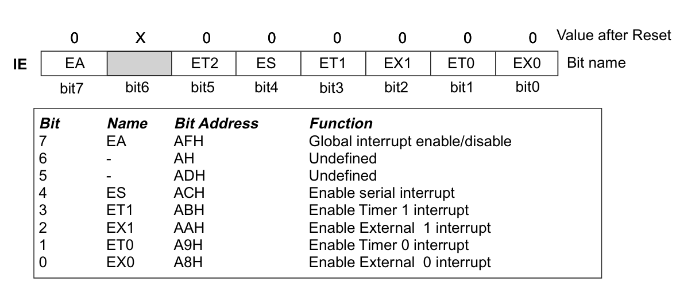
Interrupt Enable Register(IE)

Slide 12
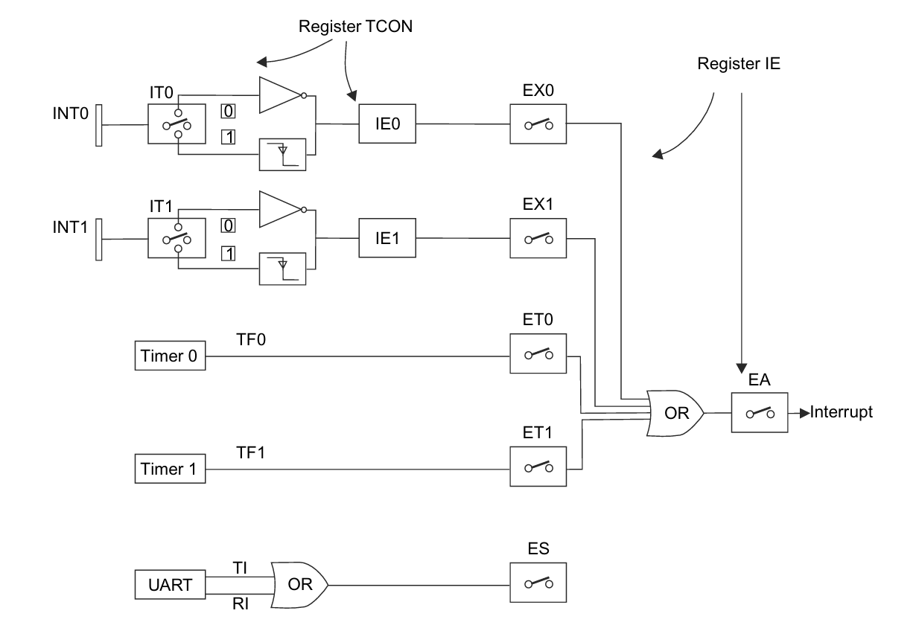

Slide 13
Interrupt Priority (IP) Register > The Interrupt Priority (IP) Register is used to determine the interrupt priority. > When the bit is 0, the corresponding interrupt has lowest priority and if the bit is 1, the corresponding interrupt has the higher priority. > When two interrupts occur at the same time, the higher priority interrupt gets service fast and then the next higher priority interrupt gets service.

Slide 14
The priority of interrupts :
Bit0 (PX0)- External0 interrupt priority bit
0- Sets low priority to external 0 interrupt
1- Sets high priority to external 0 interrupt
Bit1 (PT0)- Timer 0 interrupt priority bit
0- Assigns low priority to Timer0 interrupt
1- Assigns high priority to Timer0 interrupt
Bit2 (PX1)- External1 interrupt priority bit
0- Sets low priority to external1 interrupt
1- Sets high priority to external1 interrupt
Bit3 (PT1)- Timer1 interrupt priority bit
0- Sets low priority to timer1 interrupt
1- Sets high priority to timer1 interrupt
Bit4 (PS)- Serial Input priority bit
0- Assigns low priority to serial interrupt
1- Assigns high priority to serial interrupt
Bit 5,6 & 7- These bits are called as the Reserved bits.

Slide 15
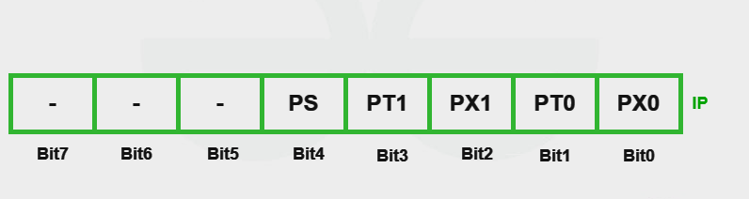
IP (Interrupt Priority) Register

Slide 16
TCON (Timer Control) Register
IE0- External interrupt 0 edge flag- When an external interrupt edge is detected, hardware sets it. Cleared by the device upon processing the interrupt.
IE1- External interrupt 1 edge flag-Set by hardware when external interrupt edge is detected. Cleared by hardware when the interrupt is processed.
TF0- Timer 0 overflow flag-This bit is set whenever timer 0 overflows and is processed by the hardware.
TF1- Timer 1 overflow flag - This bit is set whenever timer 1 overflows and is processed by the hardware.

Slide 17
TR0- Timer 0 Run Control- Set this bit to start Timer 0 and clear it to stop the timer. This is important because the timer needs to be running for it to generate interrupts.
TR1 Timer 1 Run Control - Similar to TR0, this bit controls the running state of Timer 1.
IT0- Interrupt 0 type control bit- Set/cleared by the device or software to indicate falling edge/low-level triggered external interrupts.
IT1- Interrupt 1 type control bit- Set/cleared by the device or software to indicate falling edge/low-level triggered external interrupts. Whenever the IT0 and IT1 bits are set, the external interrupts 0 and 1 edge-triggered respectively.

Slide 18
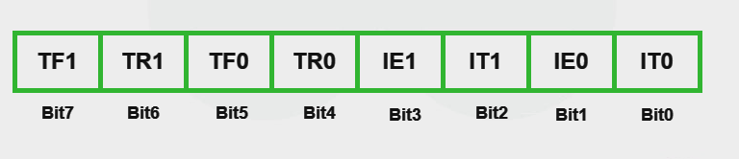
TCON (Timer Control) Register

Slide 19
Serial Communication Interrupts (UART)
UART (Universal Asynchronous Receiver/Transmitter) is a serial communication protocol used with 8051 microcontrollers. Data is sent over a single cable, bit by bit, in serial transmission
Addressing UART communication with the 8051's interrupts:
Initialization of UART- Set the data format, baud rate, and enable the UART module by configuring the UART registers.
Interrupt Enable- Depending on the operation you wish to interrupt for, enable the UART's transmit interrupt (TI) or receive interrupt (RI).

Slide 20
ISR (interrupt service routine)- To handle the interrupt, write an ISR. The ISR in UART communication normally verifies whether the transmit buffer is ready (TI) or whether data has been received (RI).
Clearing the Flag- To recognize the interrupt and get ready for the next one, in the ISR, clear the associated interrupt flag (RI or TI).

