Slide 1


“THE RISE AND REVOLUTION OF IPO’S IN INDIA (2010-2021)”
group name: The Visualizers
Amrita Maharana (240402100001)
Smruti Pragyan Sahoo (240402100006)
Shyam Sundar Mohapatra (240402100043)
Sourabha Prakash Mohanty (240402100051)
Swayang Swabhiman Jena (240402100054)

Slide 2
OBJECTIVES :-
Home
About
1. Identify Key Drivers of Listing Day Performance.
2. Segment IPOs by Subscription Demand (Hype vs. Value).
3. "Listing Pop vs. Long-Term Value" Quadrant Analysis.
4. Profile Investor-Specific Demand ("Smart Money")
5. (Stand-b,0y) Analyze Market Sentiment Over Time.

Slide 3
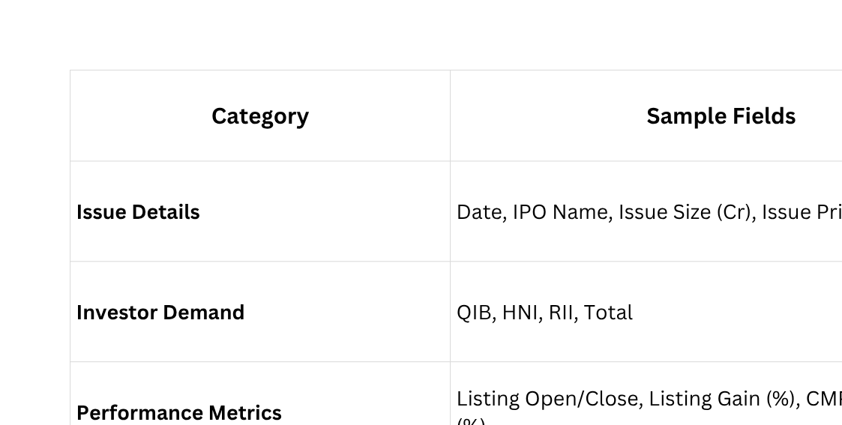
DATA UNDERSTANDING AND CLEANING SUMMARY
Dataset Overview:-
Home
About
  Source: IPO performance dataset containing 264 records (company-wise IPOs).
  Scope: Captures issue details, investor demand, and market performance
from listing to current date.
  Granularity: One record per IPO → enables time, segment, and investor-type analysis.

Slide 4

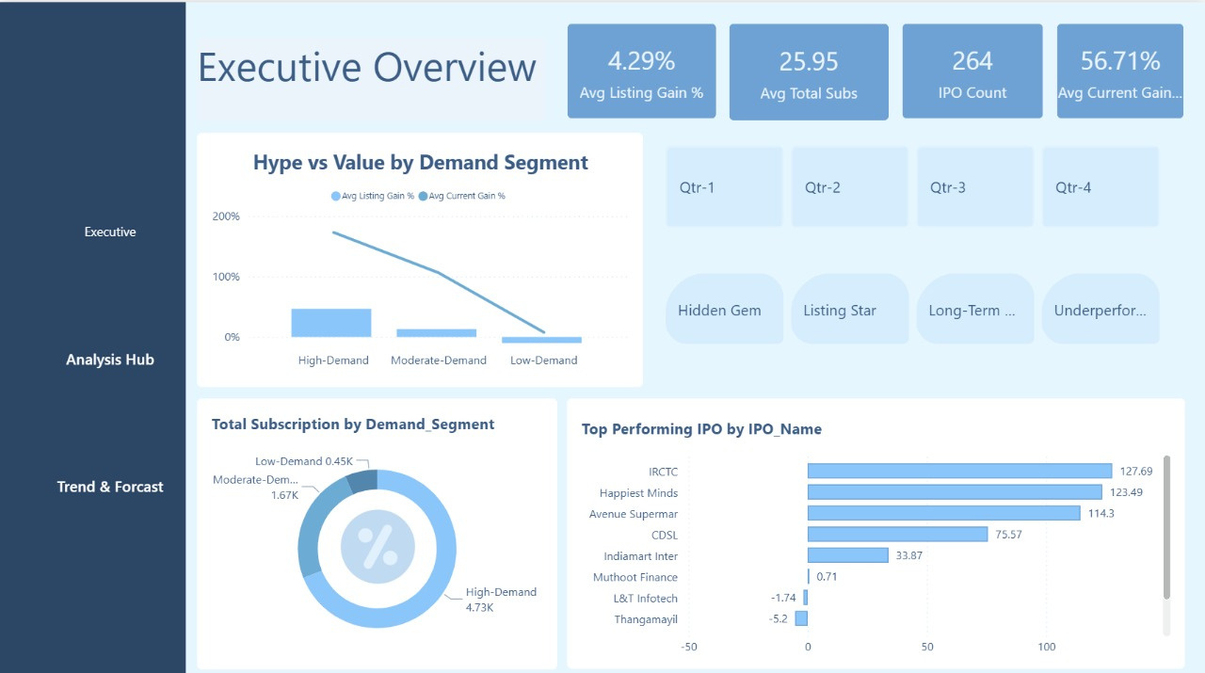
DASHBOARD DESIGN AND STRUCTURE:-
LICERIA.CO
Home
About
Contact

Slide 5
KEY INSIGHTS AND ANALYTICS:-
Contact
1. Listing Day Performance: IPOs with high QIB oversubscription and smaller issue sizes show stronger listing gains.
2. Subscription Demand: Balanced participation from QIB, HNI, and RII leads to more stable IPO performance.
3. Listing Pop vs Long-Term Value: Many IPOs give a high initial pop but low long-term returns — fundamentals matter more than hype.
4. Smart Money Trend: Strong institutional (QIB) interest predicts sustained post-listing growth.
5. Market Sentiment Insight: IPO success closely aligns with overall market confidence — bullish markets drive higher subscriptions and better listings.
02

Slide 6
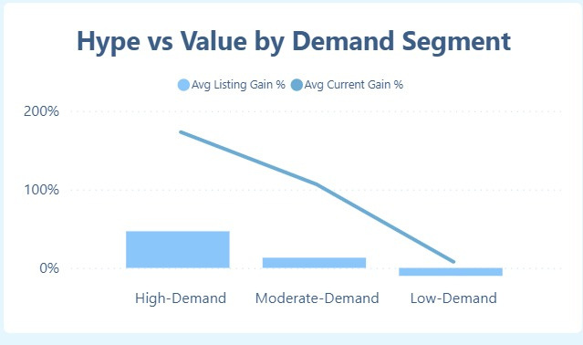
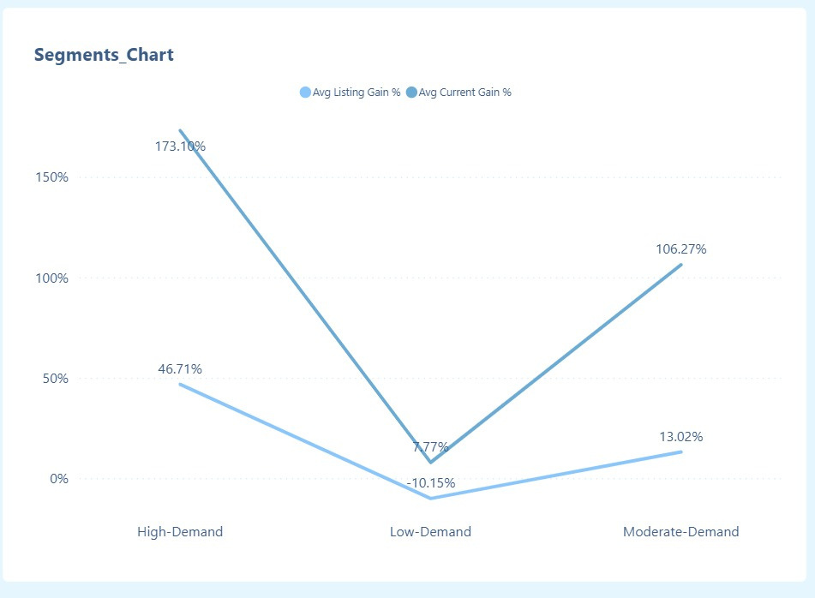
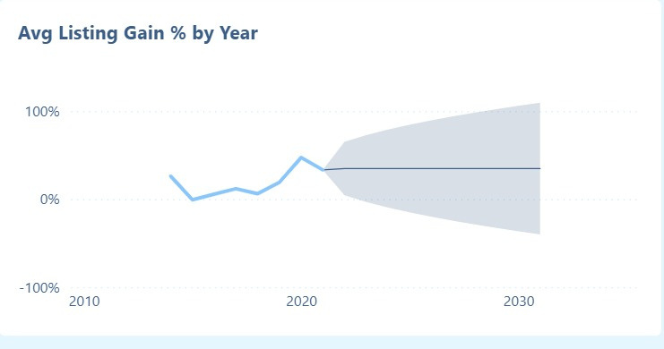
Home

Slide 7
RECOMMENDATIONS / BUSINESS IMPLICATIONS:-
  Demand-Driven Strategy
Home
About
High-Demand IPOs deliver the strongest listing gains but show faster long-term value erosion.
2. Segment-Wise Investment Focus
Moderate-Demand IPOs sustain better long-term returns despite lower listing spikes.
3. Issue Size & Pricing Efficiency
Large-issue IPOs show diluted short-term gains but attract more stable participation.

Slide 8
CONCLUSION AND LEARNING SUMMARY:-
LICERIA.CO
Home
About
Contact
  Clean, structure, and model large datasets efficiently using Power Query and DAX.
  Design interactive dashboards that communicate complex metrics in a visually intuitive way.
  Translate analytical findings into business implications supporting marketing, finance, and investor decisions.

Slide 9

THANK YOU

