Slide 1
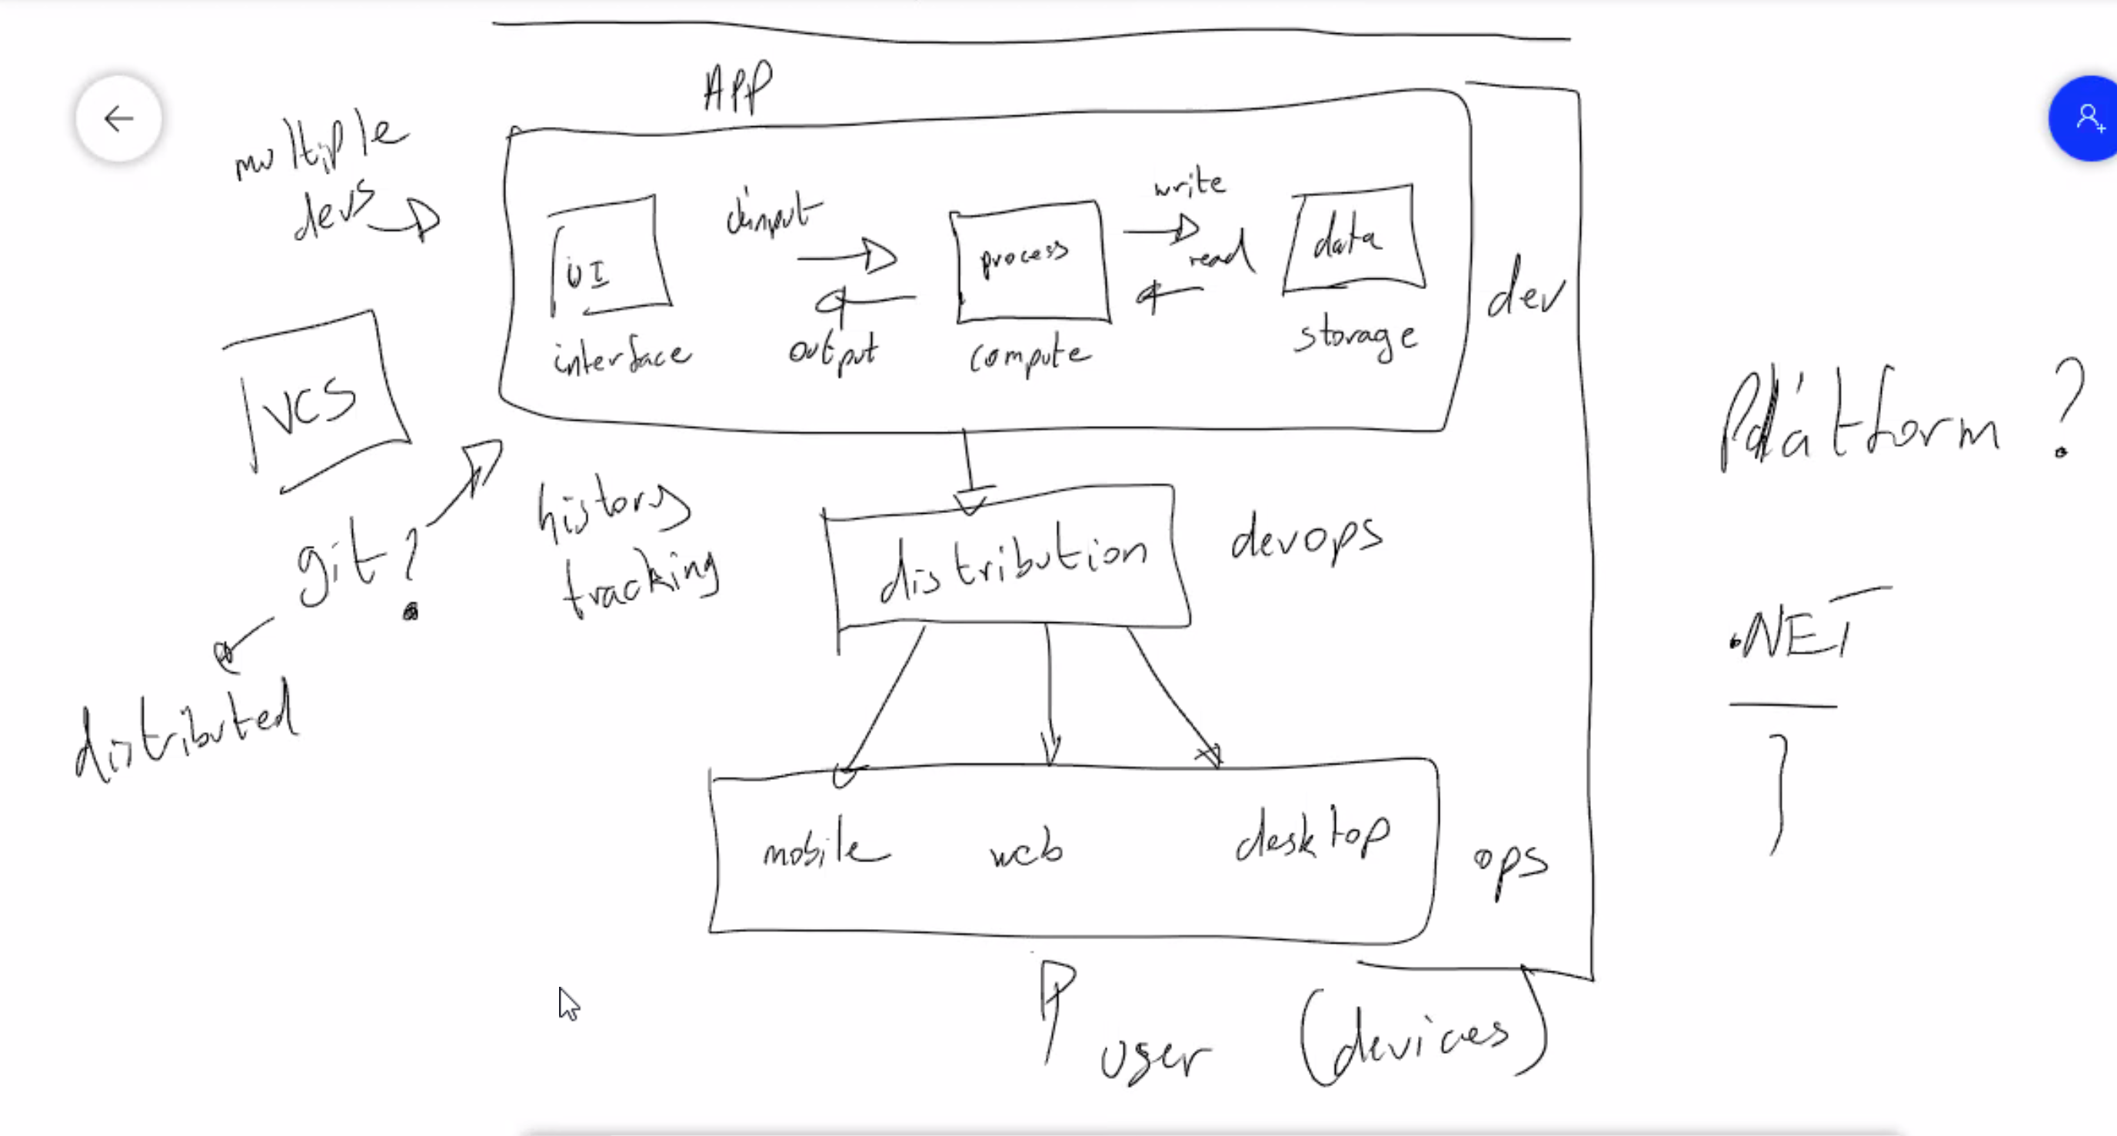

Slide 2
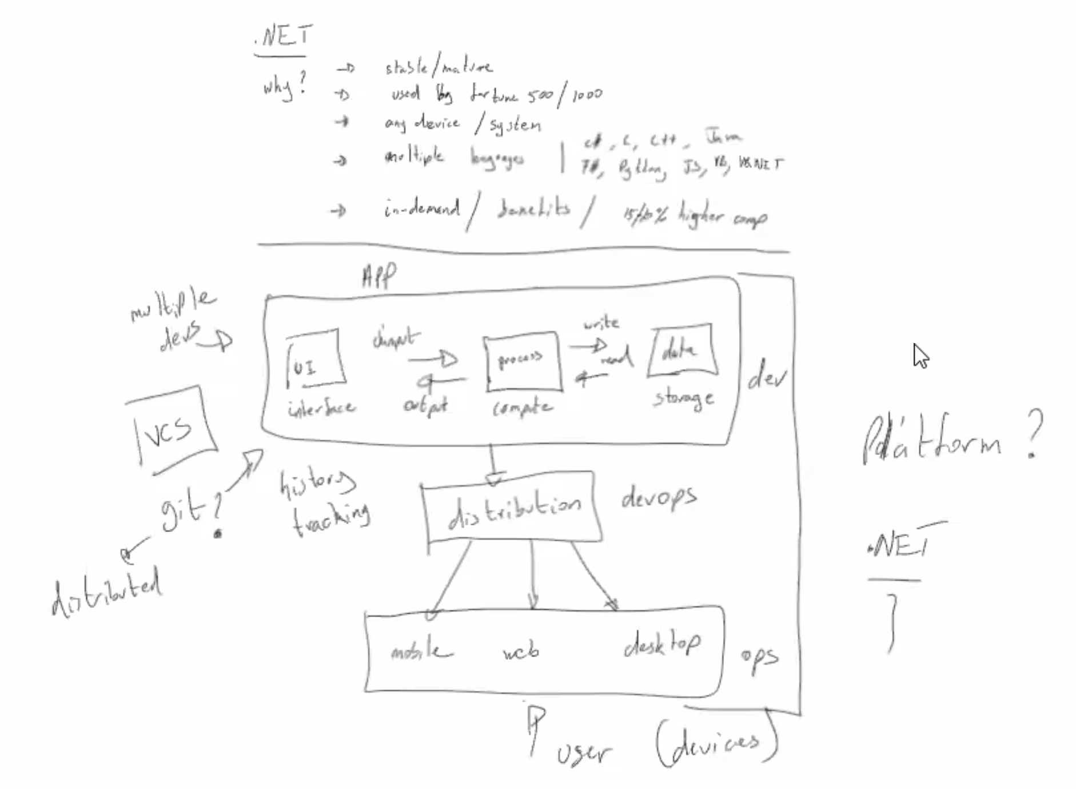

Slide 3
BE N.E.R.T.I.
Nutrition
Exercise
Rest
Time
Iteration

Slide 4
A Good Software Engineer…. will ShowUp
Is Self aware
Is Humble
Is Observant
Works through problems.
Understands the documentation
Perserveres

Slide 5
Store app structure
UI Layer
Models Layer
Business Layer
Context Layer
Repository Layer

