Slide 1
OBJECT ORIENTED PROGRAMMING
BY SIMRAN MANANDHAR

Slide 2
PROCEDURAL PROGRAMMING
Divided into functions
Data stored in variables
Bigger programs = Bunch of functions
Copying/pasting codes
One change in a function breaks several other functions

Slide 3
SOLUTION? OBJECT ORIENTED PROGRAMMING
Combine variables & functions
Unit called as Object!
Variables => Properties
Functions => Methods
CAR
Name
Color
Start()
Stop()
Move()

Slide 4
4 PILLARS
ENCAPSULATION
ABSTRACTION
INHERITANCE
POLYMORPHISM

Slide 5
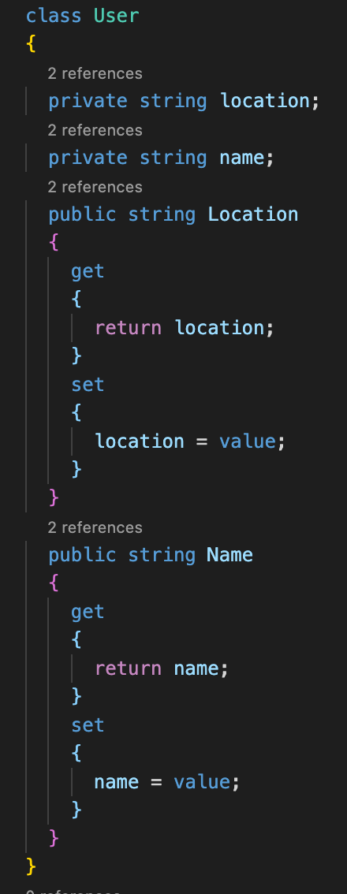
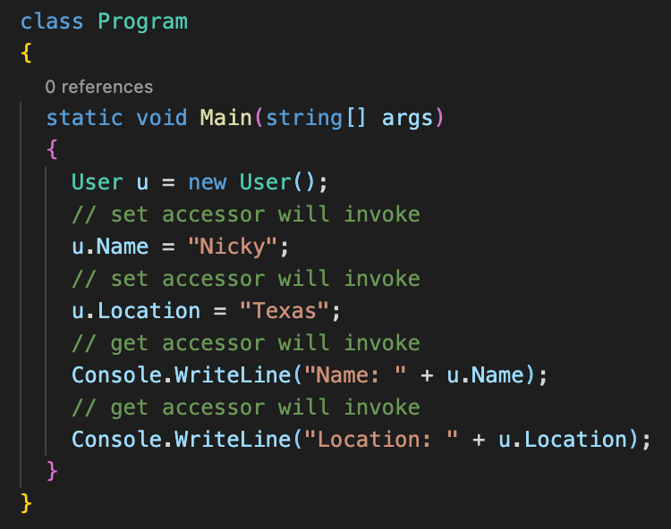
ENCAPSULATION
Encapsulation is defined as the wrapping up of data under a single unit. It is the mechanism that binds together code and the data it manipulates.
Data Hiding
Restrict access of methods and properties

Slide 6
ABSTRACTION
Abstraction is the act of representing the essential features without knowing the background details
Data Hiding => show necessary information / hide unnecessary part
Example: Computer monitor
Push a button and see the monitor turn on
Inner mechanisms (hidden)
Exposing necessary details needed by whomever is using the object

Slide 7
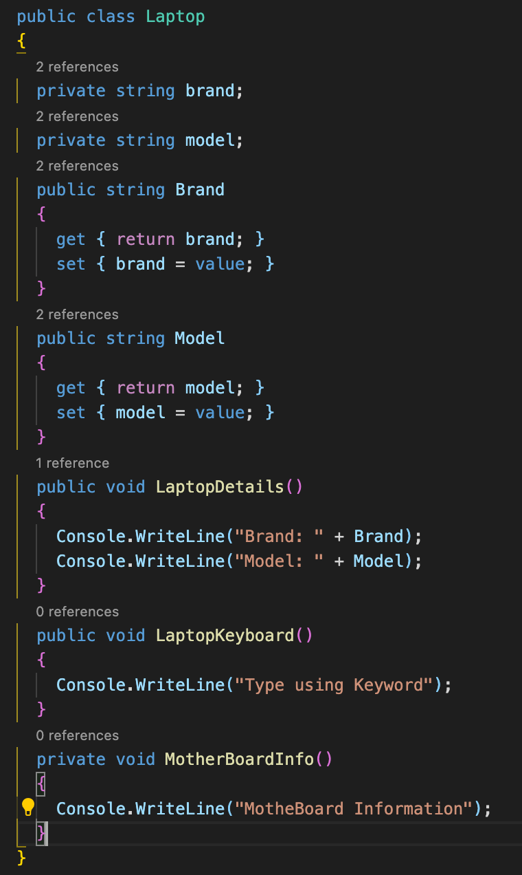
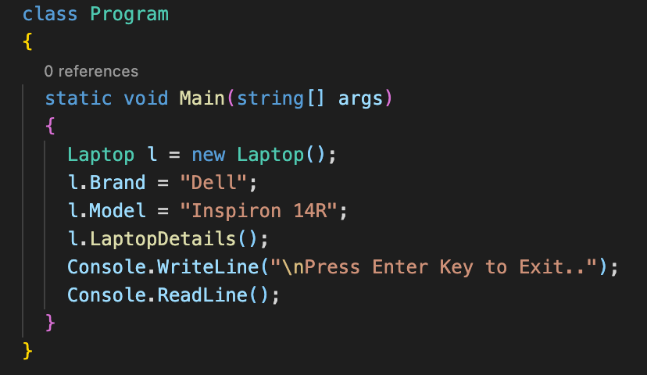
Abstraction contd..

Slide 8
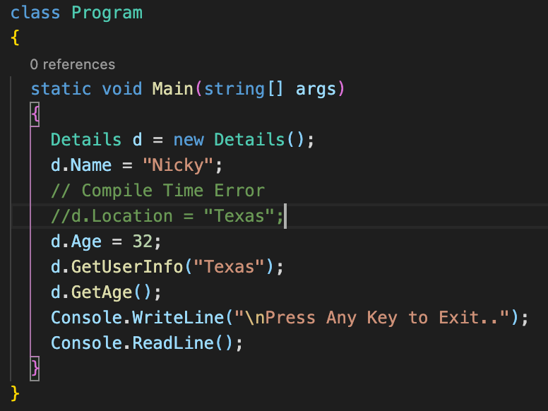
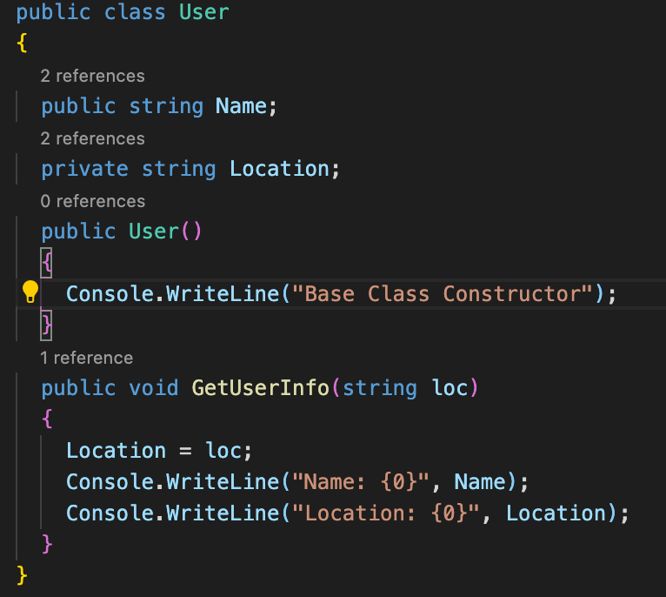
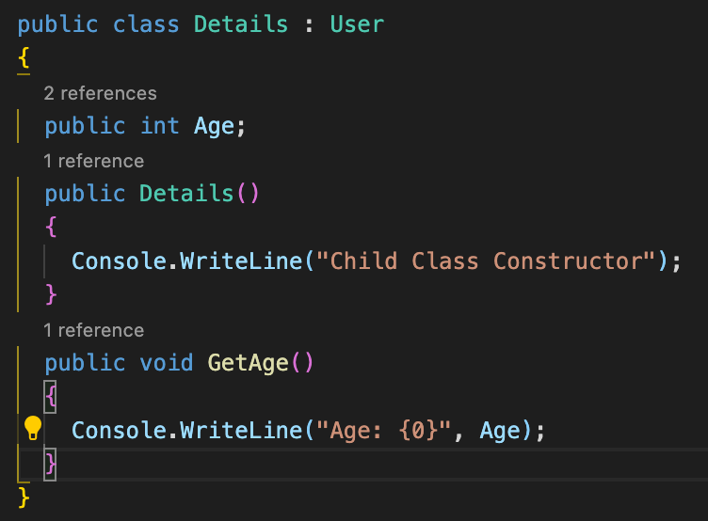
INHERITANCE
Inheritance is the mechanism by which one class is allowed to inherit the features(fields and methods) of another class.
Allows code reusability
Receives methods and properties from existing class

Slide 9
POLYMORPHISM
Polymorphism is the ability of an object to take on many forms
Compile Time Polymorphism
Same method name but different parameters
Achieved by Method overloading
Run Time Polymorphism
Same method and same parameters but different implementation
Achieved by method overriding

Slide 10
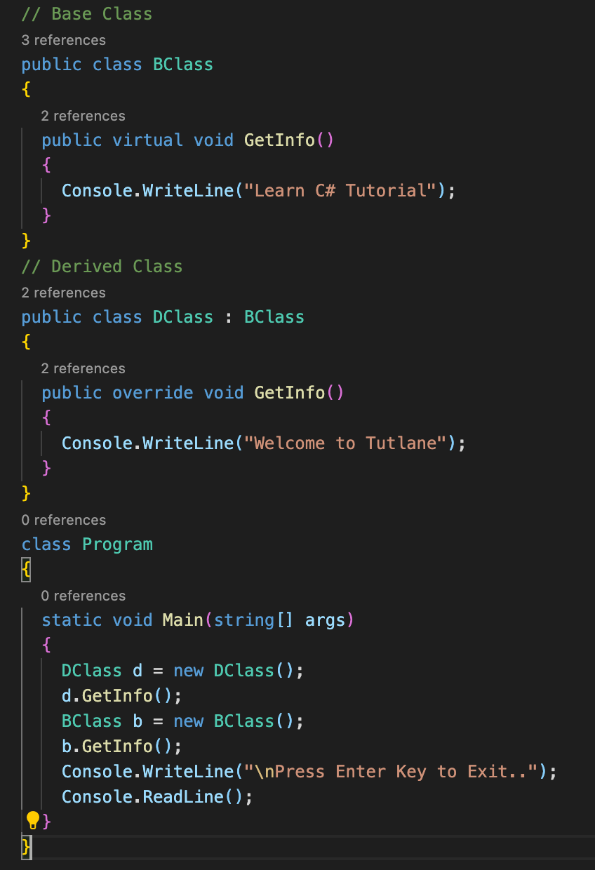
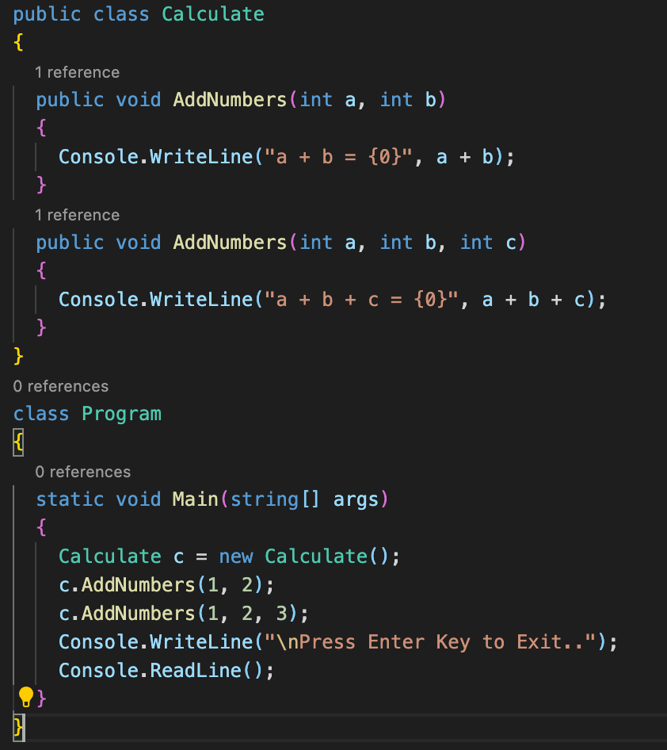
Method Overriding
Method Overloading

Slide 11
Summary
Encapsulation
Data and the programs that manipulate those data are bound together and their complexity is hidden
Abstraction
To simplify reality and focus only on the data and processes relevant to the application being built
Inheritance
A class can derive methods and properties from another class, resulting in a hierarchy of classes
Polymorphism
Different subclasses of same superclass, can implement their shared interface in different ways

