Slide 1

Common Type System (CTS) Common Language Specification(CLS)
Presenter: Davian Ramsay

Slide 2
What is a CTS?
According to techopedia.com , Common Type System (CTS) is a standard for defining and using data types in the .NET framework. CTS defines a collection of data types, which are used and managed by the run time to facilitate cross-language integration.

Slide 3
What is a CTS cont’d
The CTS is in-charge of several things, some includes:
Provides the framework for cross-language execution.
Provides a library for the common basic primitive data types used across languages (int, bool, char).
Provides the set of rules all languages in the .NET framework must follow when it comes on to types.

Slide 4
What are the types supported by CTS?
CTS defines two main kinds of types that are supported, these are:
Value Types : Stores its content in memory allocated on the stack. Ex. (int, bool, float)
Reference Types: Store a reference (address) to the object which are allocated on the heap. Reference types include: (String, Class, Arrays(even if their elements are value types))

Slide 5
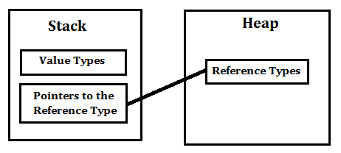
Graphical Representation

Slide 6
Examples
C# has int Data Type and VB.Net has Integer Data Type. Hence a variable declared as int in C# or Integer in vb.net, after compilation they both use the same structure Int32 from CTS.

Slide 7
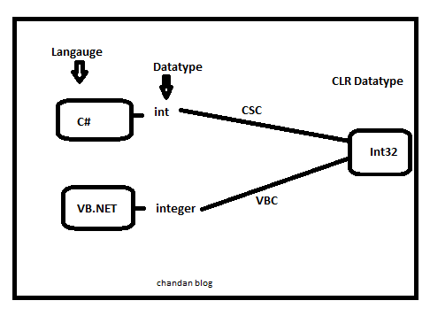

Slide 8
What is CLS?
Common Language Specification (CLS) is a subset of CTS. According to c-sharpecorner.com. CLS is a set of rules and restrictions that every language must follow that runs on the .NET framework. Simply put, CLS enables cross-language integration and interoperability by providing the ‘recipe’ needed for any language on the .NET framework.

Slide 9
What is CLS cont’d
CLS represents the guidelines to the compiler of a language, which targets the .NET Framework. CLS-compliant code is the code exposed and expressed in CLS form. (MSdocs) Even though various .NET languages differ in their syntactic rules, their compilers generate the Common Intermediate Language instructions, which are executed by CLR

Slide 10
What does it means for CLS to be a subset of CTS?
All rules that apply to CTS should also applies to CLS.

Slide 11
How is CLS achieved? Be CLS compliant!
The following are the basic rules that should be followed when writing a CLS complaint C# code.
1. Class names and member names should not differ only based on their case. For example we cannot have two methods named MyMethod and MYMETHOD.
2. Only properties and methods may be overloaded, Operators should not be overloaded.
3. All names introduced in a CLS-compliant scope shall be distinct independent of kind, except where the names are identical and resolved via overloading.
4. Global static fields and methods are not CLS-compliant

Slide 12
Example?
We will talk about C# and VB.NET, in C# every statement must have to end with a semicolon. it is also called a statement Terminator, but in VB.NET each statement should not end with a semicolon(;).
Expl:
So these syntax rules which you have to follow from language to language differ but CLR can understand all the language Syntax because in .NET each language is converted into one main language called the Common Intermediate Language (CIL) after compilation and the CIL code is a language specification of CLR.

Slide 13
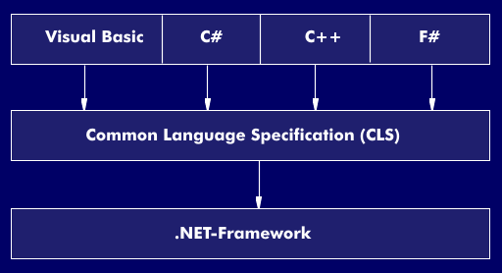

Slide 14

Questions?

