Slide 1
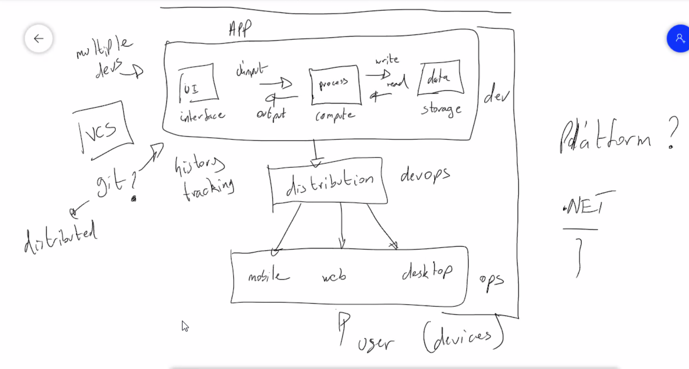

Slide 2
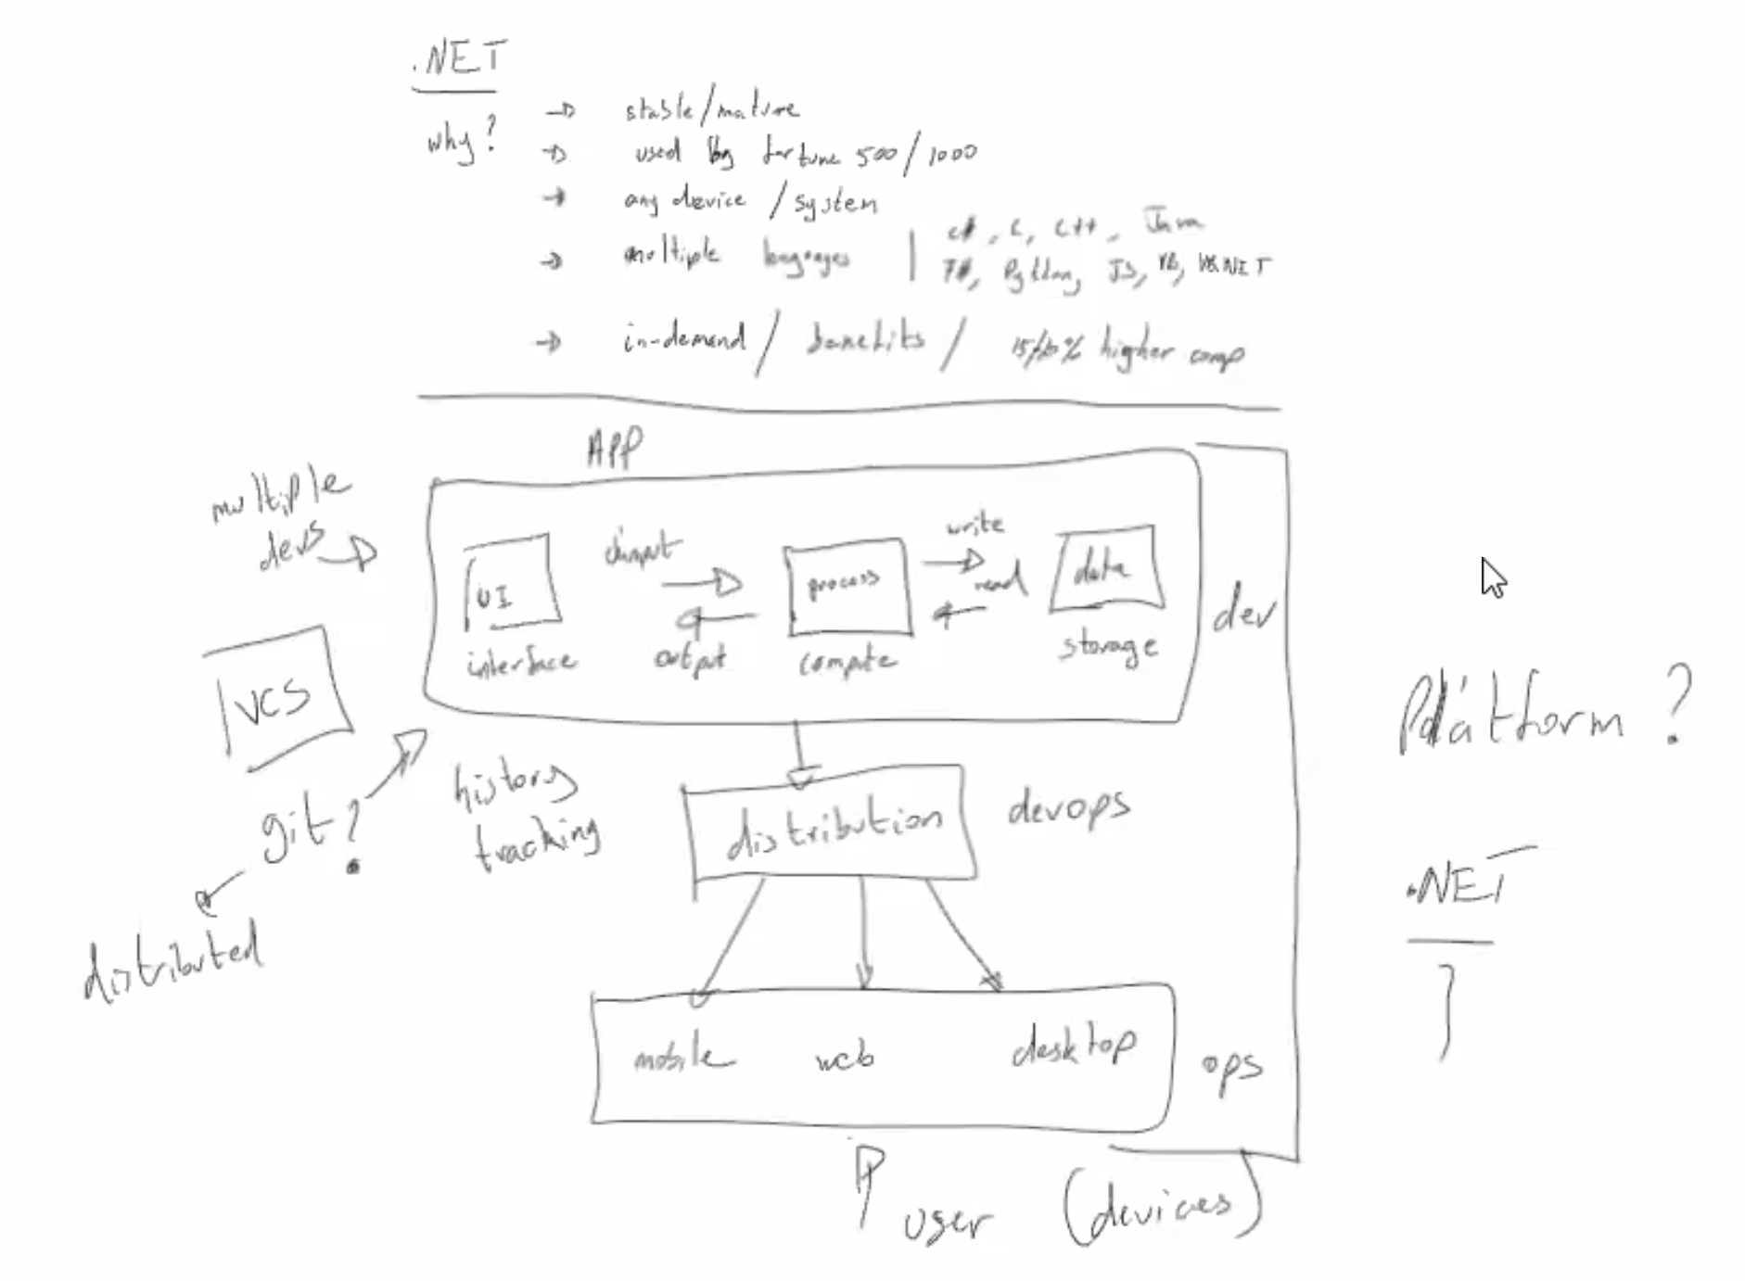

Slide 3

Stack vs Heap
Stack | Heap
Var myObject = 0xa25f1c
Var mybigint = 16756549843219876219874321689
Var myint = 2; | 0xa25f1c (customer{name:’Mark”, age”42})

