Slide 1
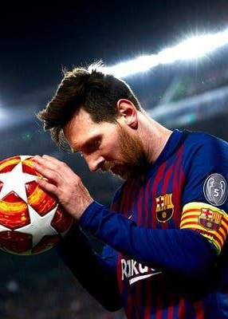
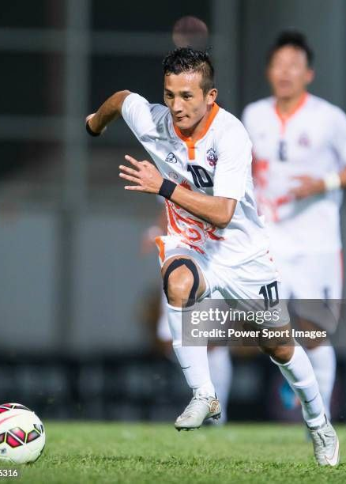
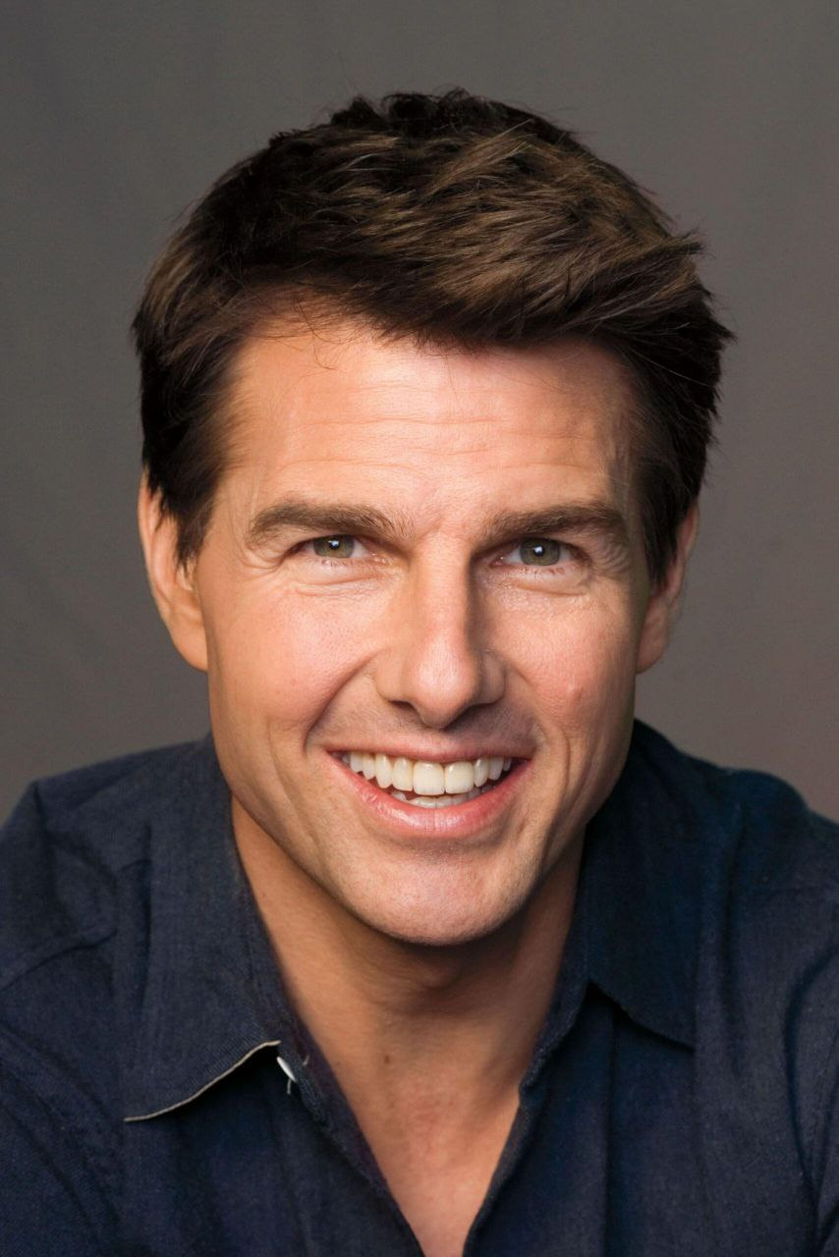
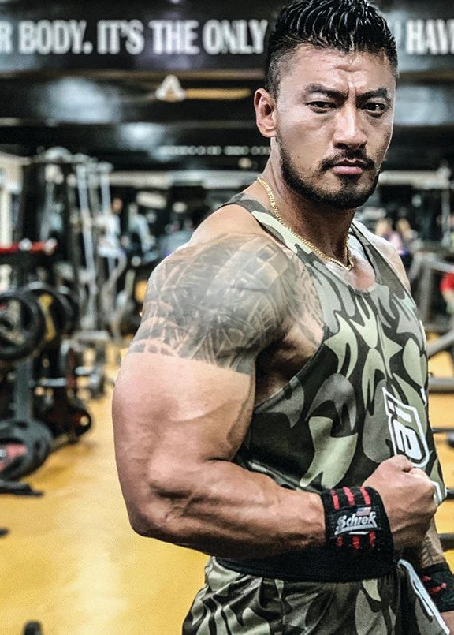
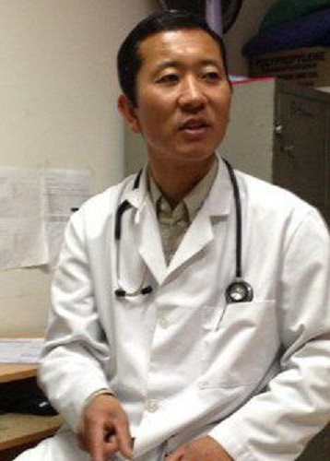
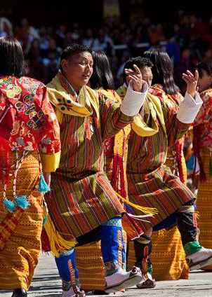
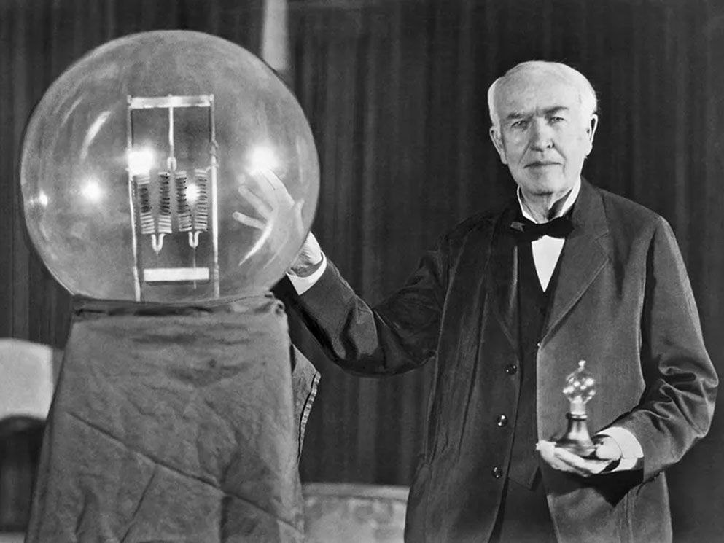
Examples
Lionel Messi

Slide 2
Examples
Chencho Gyeltshen

Slide 3
Examples
Tom Cruise

Slide 4
Examples
Sangay Tsheltrim

Slide 5
Examples
Dr. Lotay Tshering

Slide 6
Examples
Women of Bhutan

Slide 7
Examples
Thomas Edison

Slide 8

Examples
Who he is:
One of the greatest footballers in the world, known for his incredible dribbling, balance, and goal-scoring skills.
Why he’s an example:
Messi learns by practicing and playing football. He gets better through physical movements like dribbling, running, and shooting. His body learns the best way to move by actually doing it on the field.
Messi’s brain and body work together on the field-he understands the game through movement.
Lionel Messi

Slide 9
Examples
Who he is:
Bhutan’s most well-known footballer, nicknamed “Bhutanese Ronaldo,” admired for his speed, agility, and sharp goal-scoring skills.
Why he’s an example:
Chencho learns football by playing it. His body gets better at controlling the ball, passing, and shooting through practice and real game experiences. He improves by moving and playing, which shows his bodily-kinesthetic intelligence.
Chencho’s talent shows how the body can be a powerful tool for learning and performance.
Chencho Gyeltshen

Slide 10
Examples
Who he is:
A famous Hollywood actor known for his roles in action films like Mission Impossible, often performing his own stunts.
Why he’s an example:
Tom learns acting by using his body to action based scenes. He didn’t need words; his movements and gestures are his way of expressing emotions.
Tom Cruise connects with his audience not just though dialogue, but through intense physical action.
Tom Cruise

Slide 11
Examples
Who he is:
A well-known Bhutanese actor and retired army captain, recognized for his powerful roles in Bollywood films like Radhe and Jawan.
Why he’s an example:
Sangay learns acting by performing. He uses his body to express emotions and create characters, improving through practice and real performances.
Sangay Tsheltrim shows how physical intelligence can thrive in both real life and cinema.
Sangay Tsheltrim

Slide 12
Examples
Who he is:
A well-known surgeon and politician who served as the Prime Minister from 2018 to 2023. Remarkably, he continued performing surgeries on weekends while leading the country.
Why he’s an example:
Dr. Lotay learns surgery by physically performing operations. His hands and body become skilled through practice and precision in the operating room.
Dr. Lotay Tshering exemplifies how bodily-kinesthetic intelligence can be harnessed in both healing and governance
Dr. Lotay Tshering

Slide 13
Examples
Who he is:
A legendary American inventor best known for creating the electric bulb, phonography, and motion picture camera.
Why he’s an example:
Edison learned by experimenting with his hands. He created and tested inventions by physically building and working with materials.
Edison’s success shows that innovation often starts with action-learning by doing, not just reading.
Thomas Edison

