Slide 1
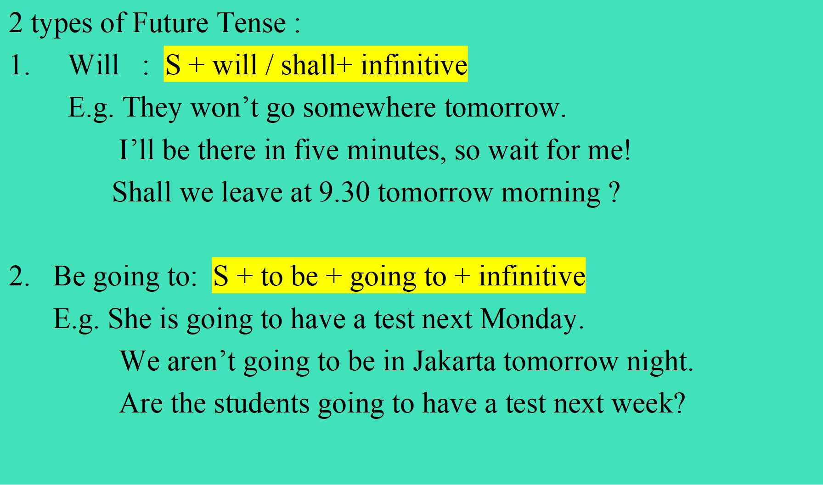
FUTURE TENSE

Slide 2
Exercise 1:
Say these sentences in English !
Kapan kamu akan menelpon ibumu?
Apa yang akan kamu lakukan besok?
Apakah kamu akan menemani ku pergi ke dokter?
Semester depan, kita akan mulai kerja praktek di perusahaan swasta.
Dua minggu lagi, saya akan mengikuti wawancara kerja di perusahaan asing.
Jika kamu banyak merokok, kamu akan terkena kanker paru-paru.

Slide 3
Exercise 2. Complete the blanks in each sentence!
Tomorrow morning, my manager is _________check the new office branch in Surabaya.
Mrs. Shinta______employ some fresh graduates one day.
The client_______meet Mr.Johnson to talk about their project tonight.
The new students_______attend the international seminar in Jakarta next Tuesday.
When_______you start to do your assignment?
I think I ____ not call you if you’re too busy.
When you realize that knowledge is important for you, you________ never waste your time to talk about unimportant things.

Slide 4
Exercise 3:
Make a sentence with be going to!
E.g. St. A : I’m going to go to class tomorrow morning.
St. B : What is (St. A) going to do tomorrow morning?
St. C : S/he is going to go to class tomorrow morning.
tomorrow afternoon 6. tonight
in a couple of hours 7. next week
the day after tomorrow 8. next year
this weekend 9. pretty soon
next Saturday night 10. Next Sunday

Slide 5
Answer the question below!
What are your short and long plans?
Mention at least 3 for each. Short plans refer to the plan while you are studying in Amikom, and long plans mean after you graduate from this university.

Slide 6
Thank You

