Slide 1
Reliable Data
Transfer

Slide 2
Transport Layer
Goals:
understand principles behind transport layer services:
  multiplexing/demultiplexing
  reliable data transfer
  flow control
  congestion control
instantiation and implementation in the Internet
Overview:
transport layer services
multiplexing/demultiplexing
connectionless transport: UDP
principles of reliable data transfer
connection-oriented transport: TCP
  reliable transfer
  flow control
  connection management
principles of congestion control
TCP congestion control

Slide 3





Transport services and protocols
provide logical communication between app’ processes running on different hosts
transport protocols run in end systems
transport vs network layer services:
network layer: data transfer between end systems
transport layer: data transfer between processes
  relies on, enhances, network layer services
application
transport
network
data link
physical
network
data link
physical
network
data link
physical
network
data link
physical
logical end-end transport
network
data link
physical
network
data link
physical
application
transport
network
data link
physical
Similar issues at data link layer

Slide 4
Transport-layer protocols
Internet transport services:
reliable, in-order unicast delivery (TCP)
  congestion
  flow control
  connection setup
unreliable (“best-effort”), unordered unicast or multicast delivery: UDP
services not available:
  real-time
  bandwidth guarantees
  reliable multicast
application
transport
network
data link
physical
network
data link
physical
network
data link
physical
network
data link
physical
logical end-end transport
network
data link
physical
network
data link
physical
application
transport
network
data link
physical

Slide 5

Principles of Reliable data transfer
important in app., transport, link layers
Highly important networking topic!
characteristics of unreliable channel will determine complexity of reliable data transfer protocol (rdt)

Slide 6

Reliable data transfer: getting started
rdt_send(): called from above, (e.g., by app.). Passed data to
deliver to receiver upper layer
deliver_data(): called by rdt to deliver data to upper
send
side
receive
side
udt_send(): called by rdt,
to transfer packet over
unreliable channel to receiver
rdt_rcv(): called when packet arrives on rcv-side of channel

Slide 7
Unreliable Channel Characteristics
Packet Errors:
  packet content modified
  Assumption: either no errors or detectable.
Packet loss:
  Can packet be dropped
Packet duplication:
  Can packets be duplicated.
Reordering of packets
  Is channel FIFO?
Internet: Errors, Loss, Duplication, non-FIFO

Slide 8
Specification
Inputs:
  sequence of rdt_send(data_in_{i})
Outputs:
  sequence of deliver_data(data_out_{j})
Safety:
  Assume L deliver_data(data_out_{j})
  For every i ≤ L: data_in_{i} = data_out_{i}
Liveness (needs assumptions):
  For every i there exists a time T such that data_in_{i} = data_out_{i}

Slide 9
Reliable data transfer: protocol model
We’ll:
incrementally develop sender, receiver sides of reliable data transfer protocol (rdt)
consider only unidirectional data transfer
  but control info will flow on both directions!
use finite state machines (FSM) to specify sender, receiver
event causing state transition
actions taken on state transition
state: when in this “state” next state uniquely determined by next event
state
1
state
2
event
actions

Slide 10
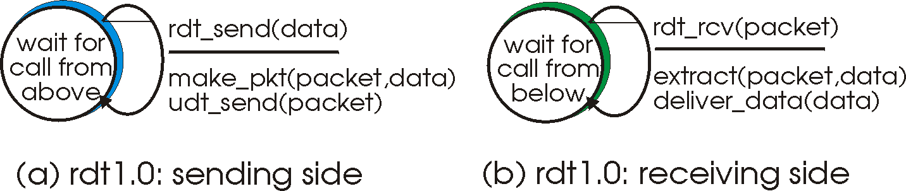
Rdt1.0: reliable transfer over a reliable channel
underlying channel perfectly reliable
  no bit erros, no loss or duplication of packets, FIFO
  LIVENESS: a packet sent is eventually received.
separate FSMs for sender, receiver:
  sender sends data into underlying channel
  receiver read data from underlying channel

Slide 11
Rdt 1.0: correctness
Safety Claim:
  After m rdt_send() :
  There exists a k ≤ m such that:
    k events: deliver_data(data₁) … deliver_data(data_{k})
    In transit (channel): data_{k+1} … data_{m}
Proof:
  Next event rdt_send(data_{m+1})
    one more packet in the channel
  Next event rdt_rcv(data_{k+1})
    one more packet received and delivered.
    one less packet in the channel
Liveness: if k < m eventually delivery_data()

Slide 12
Rdt2.0: channel with bit errors
underlying channel may flip bits in packet
  use checksum to detect bit errors
the question: how to recover from errors:
  acknowledgements (ACKs): receiver explicitly tells sender that pkt received OK
  negative acknowledgements (NACKs): receiver explicitly tells sender that pkt had errors
  sender retransmits pkt on receipt of NACK
new mechanisms in rdt2.0 (beyond rdt1.0):
  error detection
  receiver feedback: control msgs (ACK,NACK) rcvr->sender

Slide 13
uc 2.0: channel assumptions
Packets (data, ACK and NACK) are:
  Delivered in order (FIFO)
  No loss
  No duplication
Data packets might get corrupt,
  and the corruption is detectable.
  ACK and NACK do not get corrupt.
Liveness assumption:
  If continuously sending data packets, udt_send()
  eventually, an uncorrupted data packet received.

Slide 14
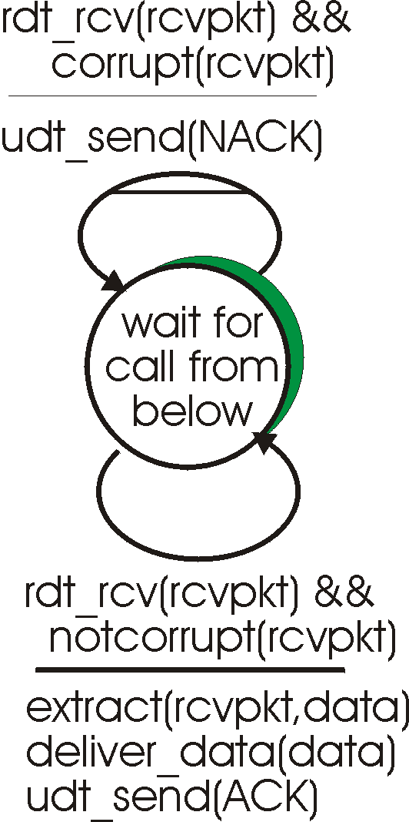
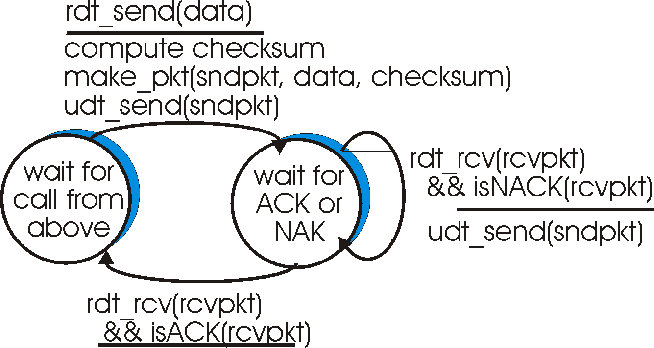
rdt2.0: FSM specification
sender FSM
receiver FSM

Slide 15
rdt2.0: in action (no errors)
sender FSM
receiver FSM

Slide 16
rdt2.0: in action (error scenario)
sender FSM
receiver FSM

Slide 17
Rdt 2.0: Typical behavior
Typical sequence in sender FSM:
“wait for call”
rdt_send(data)
udt_send(data)
“wait for Ack/Nack”
udt_send(NACK)
udt_send(data) udt_send(NACK)
. . .
udt_send(data) udt_send(NACK)
udt_send(data) udt_send(ACK)
“wait for call”
Claim A: There is at most one packet in transit.

Slide 18
rdt 2.0 (correctness)
Theorem :
rdt 2.0 delivers packets reliably over channel uc 2.0.
Sketch of Proof: By induction on the events.
Inductive Claim I: If sender in state “wait for call” :
all data received (at sender) was delivered (once and in order) to the receiver.
Inductive Claim II: If sender in state “wait ACK/NACK”
(1) all data received (except maybe current packet) is delivered, and
(2) eventually move to state “wait for call”.

Slide 19
Rdt 2.0 (correctness)
Initially the sender is in “wait for call”
  Claim I holds.
Assume rdt_snd(data) occurs:
  The sender changes state “wait for Ack/Nack”.
  Part 1 of Claim II holds (from Claim I).
In “wait for Ack/ Nack”
  sender receives rcvpck = NACK
  sender performs udt_send(sndpkt).
If sndpkt is corrupted,
  the receiver sends NACK, the sender re-sends.

Slide 20
Rdt 2.0 (correctness)
Liveness assumption:
  Eventually sndpkt is delivered uncorrupted.
The receiver delivers the current data
  all data delivered (Claim I holds)
  receiver sends Ack.
The sender receives ACK
  moves to “wait for call”
  Part 2 Claim II holds.
When sender is in “wait for call”
  all data was delivered (Claim I holds).

Slide 21
rdt2.0 - garbled ACK/NACK
What happens if ACK/NACK corrupted?
sender doesn’t know what happened at receiver!
If ACK was corrupt:
  Data was delivered
  Needs to return to “wait for call”
If NACK was corrupt:
  Data was not delivered.
  Needs to re-send data.
What to do?
Assume it was a NACK -retransmit, but this might cause retransmission of correctly received pkt! Duplicate.
Assume it was an ACK - continue to next data, but this might cause the data to never reach the receiver! Missing.
Solution: sender ACKs/NACKs receiver’s ACK/NACK.
What if sender ACK/NACK corrupted?

Slide 22
rdt2.0 - garbled ACK/NACK
Handling duplicates:
sender adds sequence number to each packet
sender retransmits current packet if ACK/NACK garbled receiver discards (doesn’t deliver up) duplicate packet
stop and wait
Sender sends one packet,
then waits for receiver
response

Slide 23
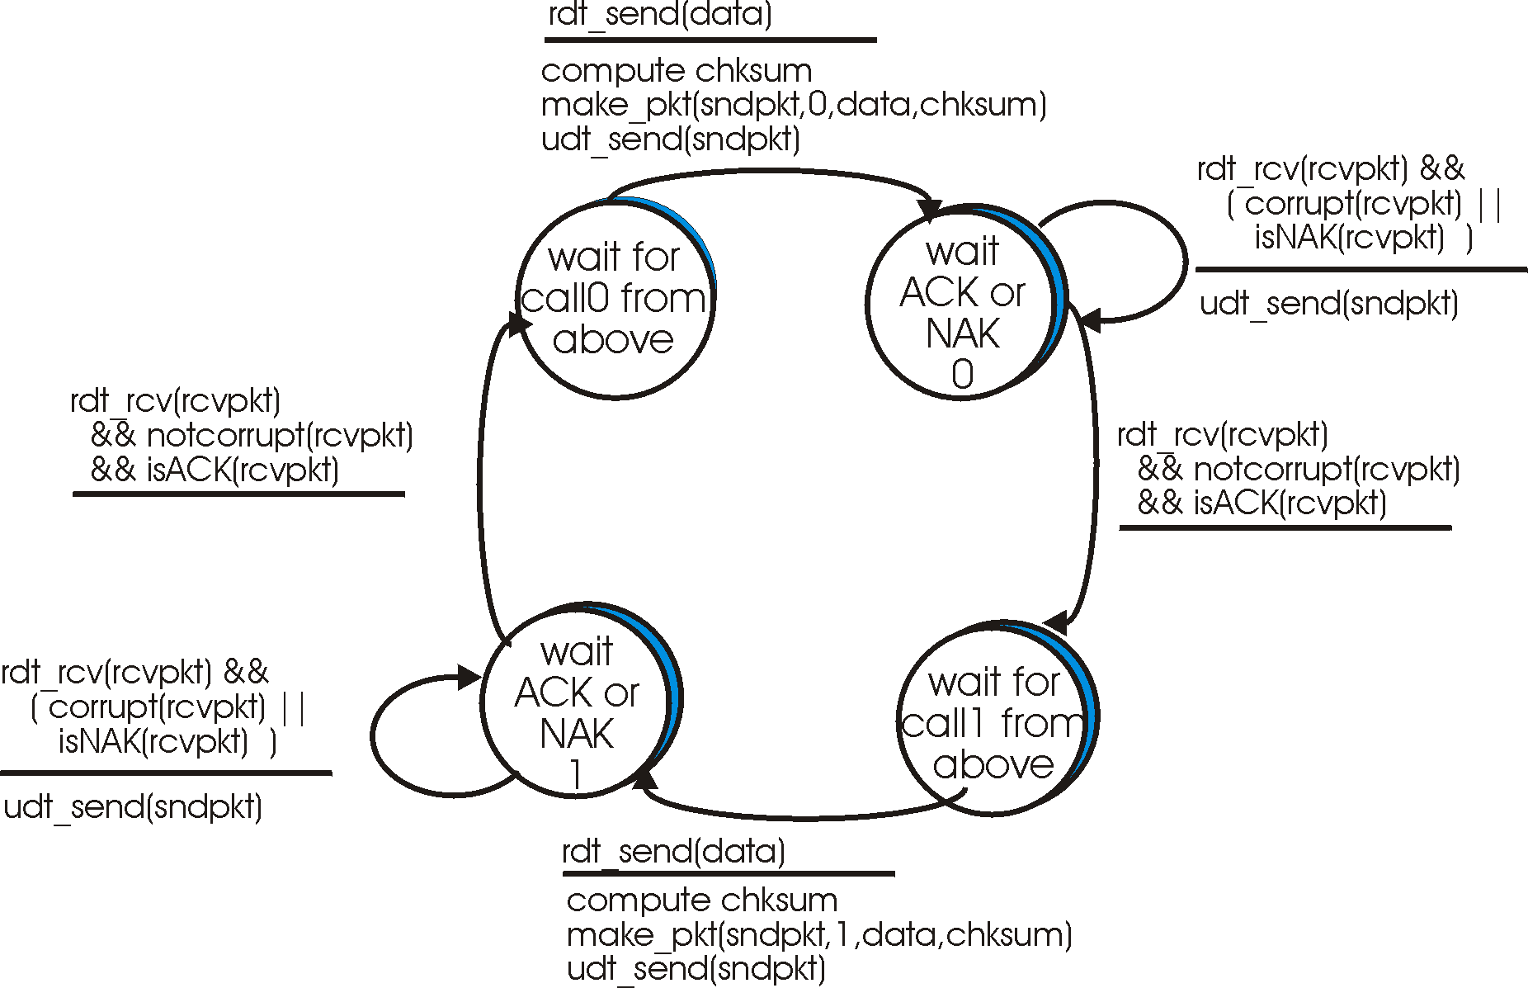
rdt2.1: sender, handles garbled ACK/NAKs

Slide 24
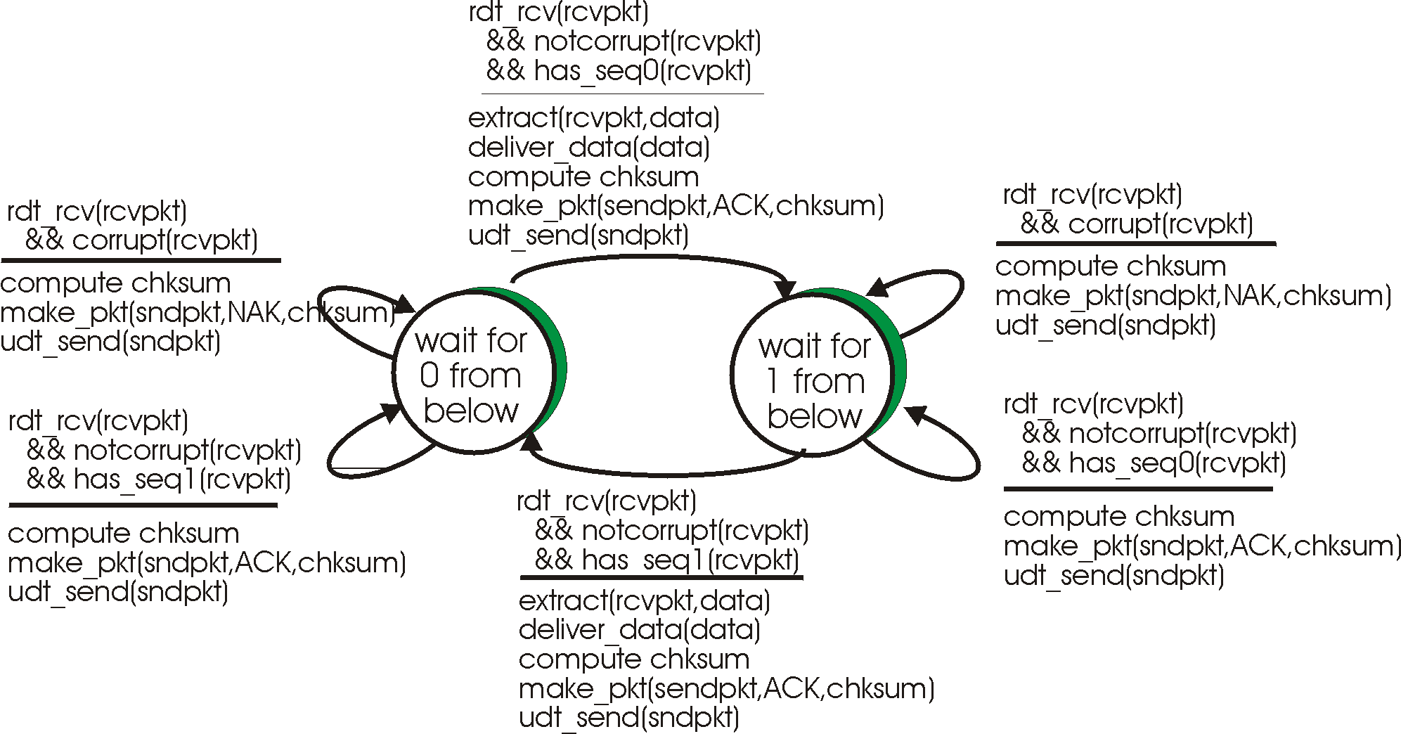
rdt2.1: receiver, handles garbled ACK/NAKs

Slide 25
rdt2.1: discussion
Sender:
seq # added to pkt
two seq. #’s (0,1) will suffice. Why?
must check if received ACK/NACK corrupted
twice as many states
  state must “remember” whether “current” pkt has 0 or 1 seq. #
Receiver:
must check if received packet is duplicate
  state indicates whether 0 or 1 is expected pkt seq #
note: receiver can not know if its last ACK/NACK received OK at sender

Slide 26
Rdt 2.1: correctness
Claim A: There is at most one packet in transit.
Inductive Claim I: In state wait for call b
  all data received (at sender) was delivered
Inductive Claim II: In state wait ACK/NAK b
  all data received (except maybe last packet b) was delivered, and
  eventually move to state “wait for call [1-b]”.
Inductive Claim III: In state wait for b below
  all data, ACK received (except maybe the last data)
  Eventually move to state wait for 1-b below

Slide 27
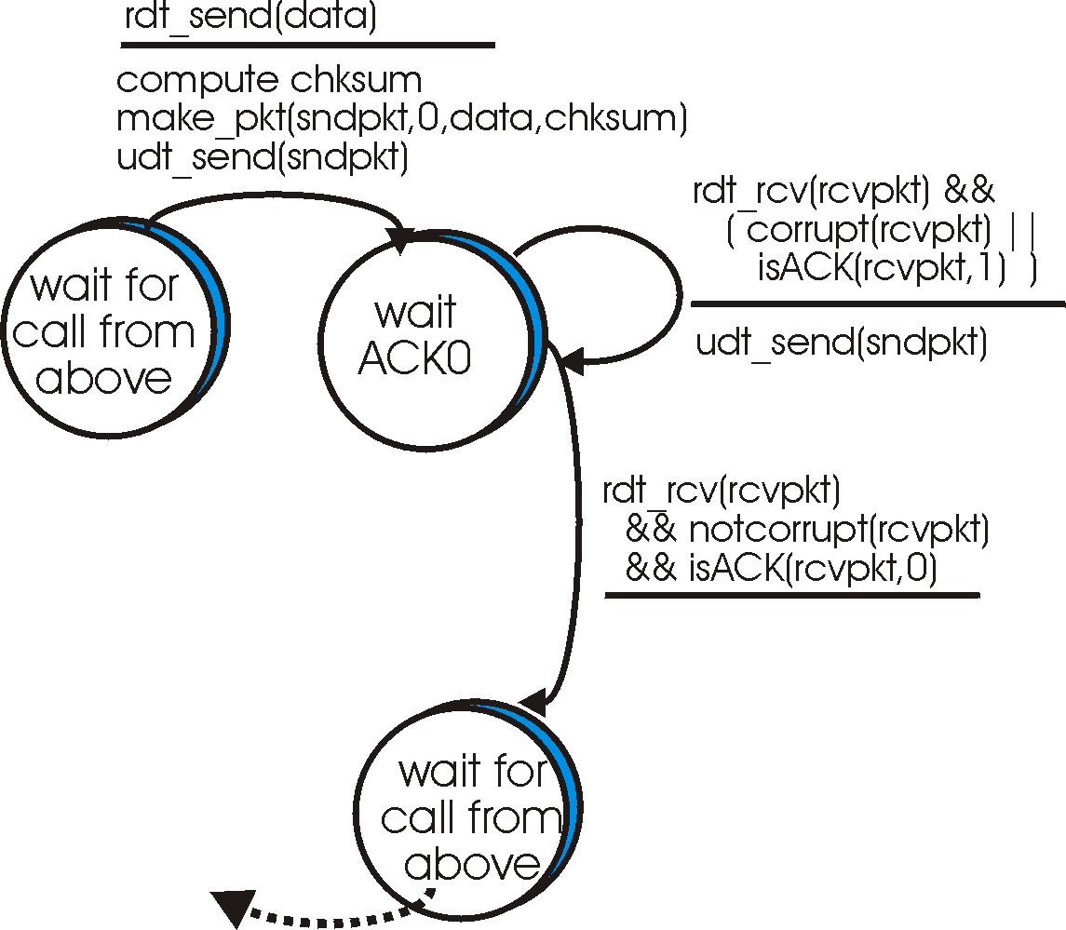
rdt2.2: a NACK-free protocol
sender
FSM
same functionality as rdt2.1, using ACKs only
instead of NACK, receiver sends ACK for last pkt received OK
  receiver must explicitly include seq # of pkt being ACKed
duplicate ACK at sender results in same action as NACK: retransmit current pkt
!

Slide 28
rdt3.0: channels with errors and loss
New assumption: underlying channel can also lose packets (data or ACKs)
  checksum, seq. #, ACKs, retransmissions will be of help, but not enough
Q: how to deal with loss?
  sender waits until certain data or ACK lost, then retransmits
  feasible?
Approach: sender waits “reasonable” amount of time for ACK
retransmits if no ACK received in this time
if pkt (or ACK) just delayed (not lost):
  retransmission will be duplicate, but use of seq. #’s already handles this
  receiver must specify seq # of pkt being ACKed
requires countdown timer

Slide 29
Channel uc 3.0
FIFO:
  Data packets and Ack packets are delivered in order.
Errors and Loss:
  Data and ACK packets might get corrupt or lost
No duplication: but can handle it!
Liveness:
  If continuously sending packets, eventually, an uncorrupted packet received.

Slide 30
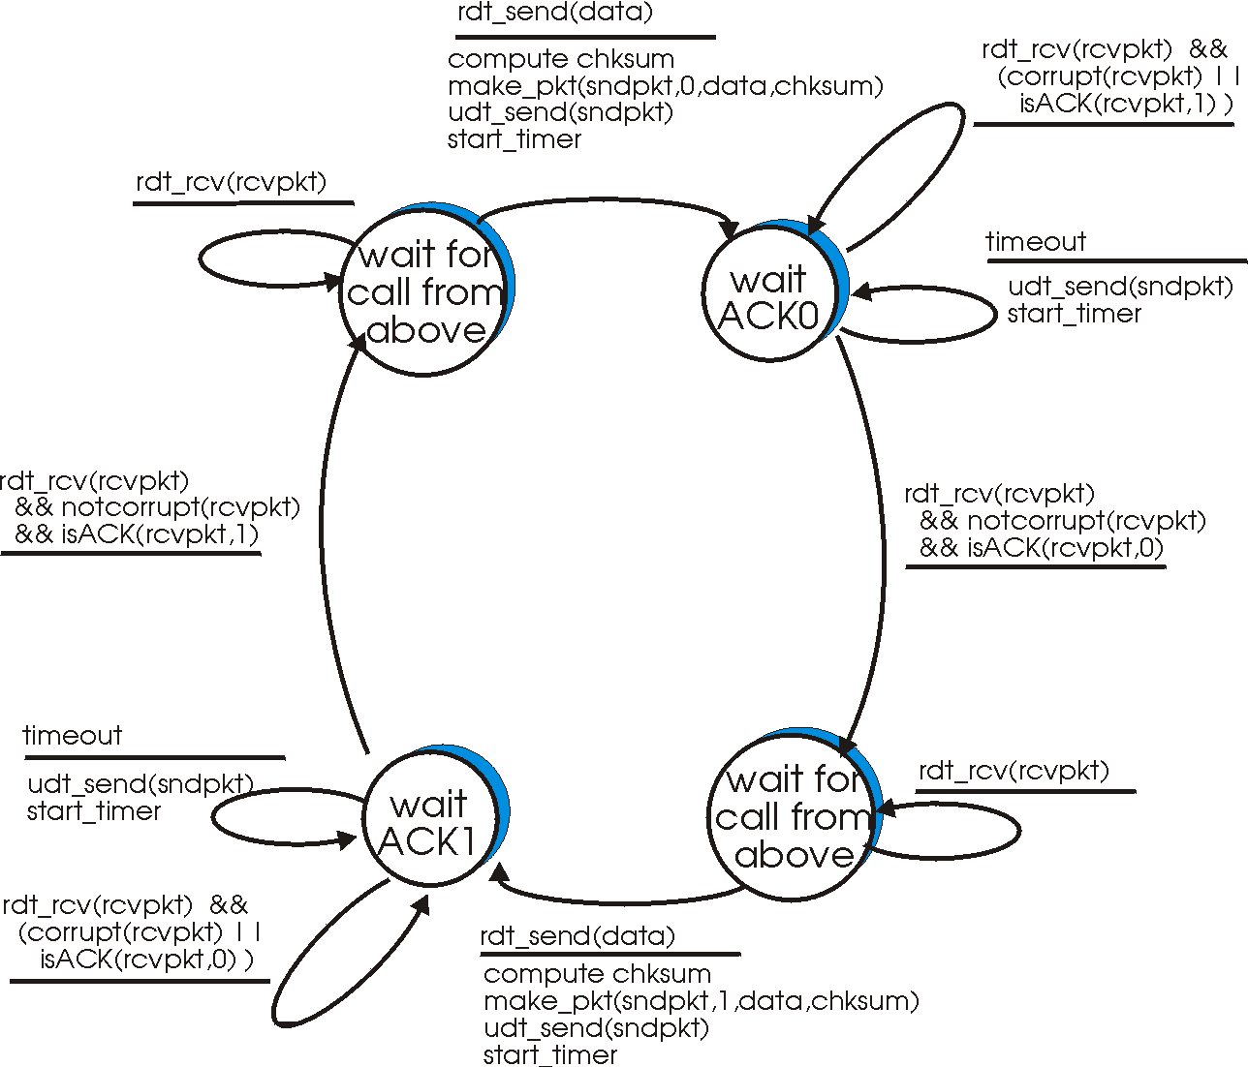
rdt3.0 sender

Slide 31
rdt 3.0 receiver
rdt_rcv(rcvpkt)
&& notcorrupt(rcvpkt)
&& has_seq0(rcvpkt)
Extract(rcvpkt,data)
deliver_data(data)
udt_send(ACK[0])
rdt_rcv(rcvpkt)
&& corrupt(rcvpkt)
rdt_rcv(rcvpkt)
&& corrupt(rcvpkt)
udt_send(ACK[1])
udt_send(ACK[0])
Wait for 0
Wait for 1
rdt_rcv(rcvpkt)
&& notcorrupt(rcvpkt)
&& has_seq1(rcvpkt)
rdt_rcv(rcvpkt)
&& notcorrupt(rcvpkt)
&& has_seq0(rcvpkt)
rdt_rcv(rcvpkt)
&& notcorrupt(rcvpkt)
&& has_seq1(rcvpkt)
udt_send(ACK[1])
udt_send(ACK[0])
Extract(rcvpkt,data)
deliver_data(data)
udt_send(ACK[1])

Slide 32

rdt3.0 in action

Slide 33

rdt3.0 in action

Slide 34
Rdt 3.0: Claims
Claim I: In state “wait call 0” (sender)
  all ACK in transit have seq. num. 1
Claim II: In state “wait for ACK 0” (sender)
  ACK in transit have seq. num. 1
  followed by (possibly) ACK with seq. num. 0
Claim III: In state “wait for 0” (receiver)
  packets in transit have seq. num. 1
  followed by (possibly) packets with seq. num. 0

Slide 35
Rdt 3.0: Claims
Corollary II: In state “wait for ACK 0” (sender)
  when received ACK with seq. num. 0
  only ACK with seq. num. 0 in transit
Corollary III: In state “wait for 0” (receiver)
  when received packet with seq. num. 0
  all packets in transit have seq. num. 0

Slide 36
rdt 3.0 - correctness
rdt_send(data)
udt_send(data,seq0)
rdt_rcv(ACK1)
Wait call 0 wait for 0
Wait Ack0 wait for 0
Wait Ack1 wait for 0
rdt_rcv(data, seq0)
rdt_rcv(data,seq1)
Wait Ack0 wait for 1
Wait Ack1 wait for 1
Wait call 1 wait for 1
rdt_rcv(ACK0)
rdt_send(data)
udt_send(data,seq1)

Slide 37
rdt 3.0 - correctness
Wait Ack0 wait for 0
All packets in transit have seq. Num. 0
rdt_rcv(data, seq0)
Wait Ack0 wait for 1
Wait Ack0 wait for 1
All ACK in transit are ACK0
rdt_rcv(ACK0)
Wait call 1 wait for 1

Slide 38
Performance of rdt3.0
rdt3.0 works, but performance stinks
example: 1 Gbps link, 15 ms e-e prop. delay, 1KB packet:
T
8kb/pkt
transmit
=
= 8 microsec
10**9 b/sec
fraction of time
sender busy sending
8 microsec
Utilization = U =
=
= 0.00015
30.016 msec
  1KB pkt every 30 msec -> 33kB/sec thruput over 1 Gbps link
  transport protocol limits use of physical resources!

