Slide 1


Introducing Functions
Code
Azure Functions
Events + data

Slide 3
How is serverless development different
Mono-lithic application
Inside client app
Complex framework
Loosely coupled components
Outside client app
Micro-functionality
Notes:
Mono-lithic application -> loosely coupled components
Events happening async outside client application
Build/use micro-functionality to react to a single event

Slide 4
Key Indicators for Serverless

Slide 5
Key Indicators for Serverless
Stateless and scale
Not worth deploying a traditional backend
Workload is sporadic (high volatility of demand)
Dev ops favored versus dedicated ops
Lots of different services that need “glue”

Slide 6
Serverless scenarios: anything that responds to events
Timer-based processing
Real-time stream processing
Every 15 minutes
Find and clean invalid data
Clean table
Millions of devices feed into Stream Analytics
Transform to structured data
Store data in SQL DB
Mobile app backends
Real-time bot messaging
?
...
Photo taken and WebHook called
Stores in blob storage
Produces scaled images
Message sent to Chatbot
Chatbot sends
response
Cortana Analytics answers questions

Slide 7
Patterns to Follow
Keep execution short and return quickly
Decouple tasks
Do as little work synchronously as possible
Trigger in batches – and catch exceptions
Global static variables for things like HttpClient
Always use App Insights
Use a DevOps pipeline such as VSTS
Compile and or pack to optimize cold start times
Notes:
Similar to microservice patterns (12 factor)

Slide 8
Hands on Lab: Functions

Slide 9
Serverless scenarios:
Timer-based processing
Every 15 minutes
Find and clean invalid data
Clean table

Slide 10
Timer Demo

Slide 11
Serverless scenarios:
Real-time stream processing
Millions of devices feed into Stream Analytics
Transform to structured data
Store data in SQL DB

Slide 12
IoT data streaming demo

Slide 13
Serverless scenarios:
Mobile app backends
Photo taken and WebHook called
Stores in blob storage
Produces scaled images

Slide 14
Mobile App Backend Demo

Slide 15
Serverless scenarios:
Real-time bot messaging
?
...
Message sent to Chatbot
Chatbot sends
response
Cortana Analytics answers questions

Slide 16
Bot Services Demo

Slide 17
Pete’s SPA application

Slide 18
New Visual Studio 2017 tooling
Based on class libraries
Get the full power of IntelliSense, unit testing, and local debugging
Use WebJobs attributes to define triggers and bindings
Learn more at https://aka.ms/2017functiontools

Slide 19
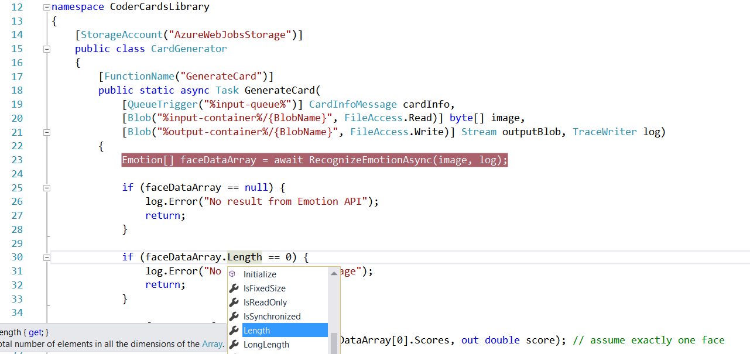
Visual Studio 2017 Tooling

Slide 20
Advanced stuff
Functions CLI and debugging

Slide 21
Platform and scaling
App Service offers dedicated and dynamic tiers.
Dedicated is the existing App Service plan tiers
Basic, Standard, Premium
Pay based on # of reserved VMs
You’re responsible for scale
Dynamic
Pay on number of executions
Platform responsible for scale

Slide 22
Dynamic tier pricing
Pay per execution model - two meters, three units
Number of executions
Duration of execution x reserved memory
First million executions free.

Slide 23




What’s new in Azure Functions
Trigger a function based on changes in Cosmos DB
Database
Local Development
Develop functions locally on Linux, MacOS, Windows
Functions
Durable Functions
Long running, stateful functions
Securely provide access to information in Microsoft Graph through a function
Security
Execute your code based on events you specify
Monitoring
Monitor serverless applications using Application Insights
Trigger a function from a real-time analytics pipeline in Stream Analytics
Analytics

