Slide 1
Serverless with Azure

Slide 2

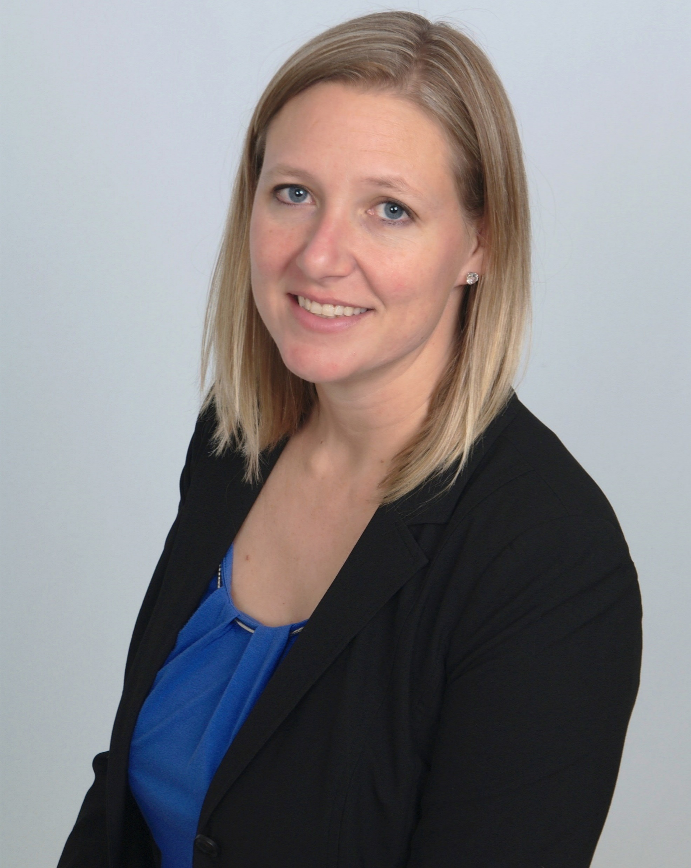
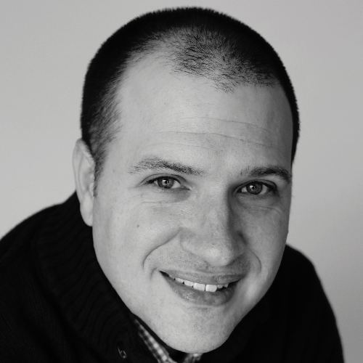

About Us
Elizabeth Graham
Global Black Belt Azure Architect
Based in Indianapolis, IN
Elizabeth.Graham@microsoft.com
@esgraham13
Pete Roden
Global Black Belt Azure Architect
Based in Cincinnati, OH
Pete.Roden@microsoft.com
@peteroden
@azureninjas
#azureserverlesstour
aka.ms/serverlesscontent

Slide 3
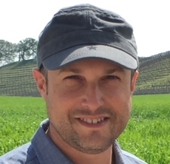
About Us
Elizabeth Graham
Global Black Belt Azure Architect
Based in Indianapolis, IN
Elizabeth.Graham@microsoft.com
@esgraham13
David Barkol
Global Black Belt Azure Architect
Based in Irvine, CA
dabarkol@microsoft.com
@dbarkol
@azureninjas
#azureserverlesstour

Slide 4
Agenda
aka.ms/serverlesscontent
From | To | Session
8:30 AM | 9:00 AM | Check-in
9:00 AM | 9:15 AM | Intros and Overview
9:15 AM | 9:45 AM | Azure Functions Overview
9:45 AM | 10:00 AM | Event Grid Overview
10:00 AM | 10:15 AM | Break
10:15 AM | 11:15 AM | Functions and Event Grid Instructor-Led Lab
11:15 AM | 11:45 AM | Azure Logic Apps Overview
11:45 AM | 12:45 PM | Break
12:45 PM | 1:45 PM | Azure Logic Instructor-Led Lab
1:45 PM | 3:30 PM | Group Code Challenge
3:30 PM | 3:30 PM | Wrap Up

Slide 5
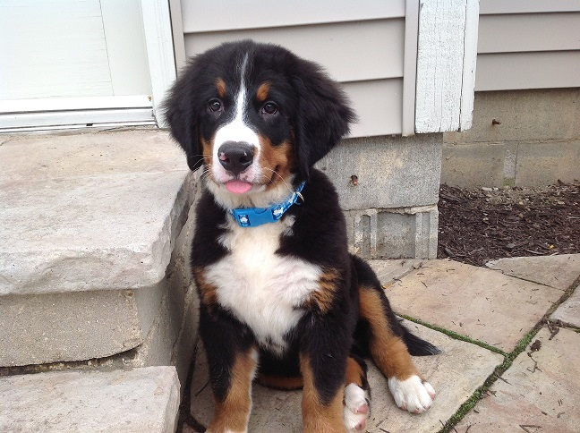
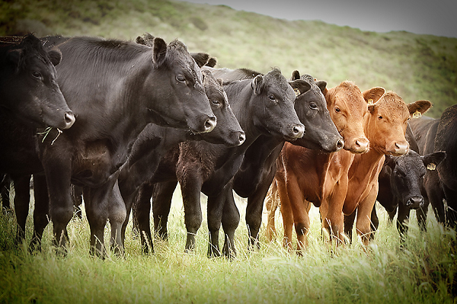
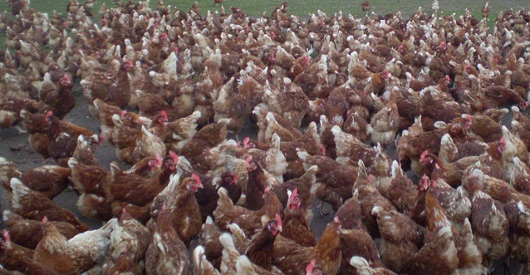
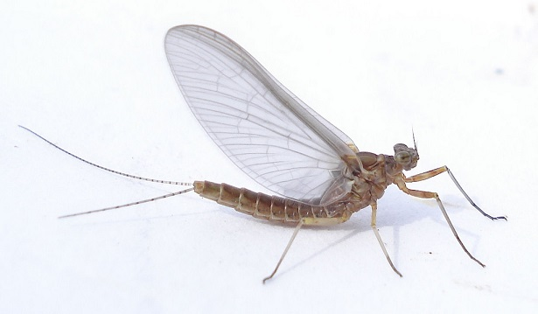
The software infrastructure landscape,
using animals
Pets
Cattle
Chickens
Mayflies

Slide 6
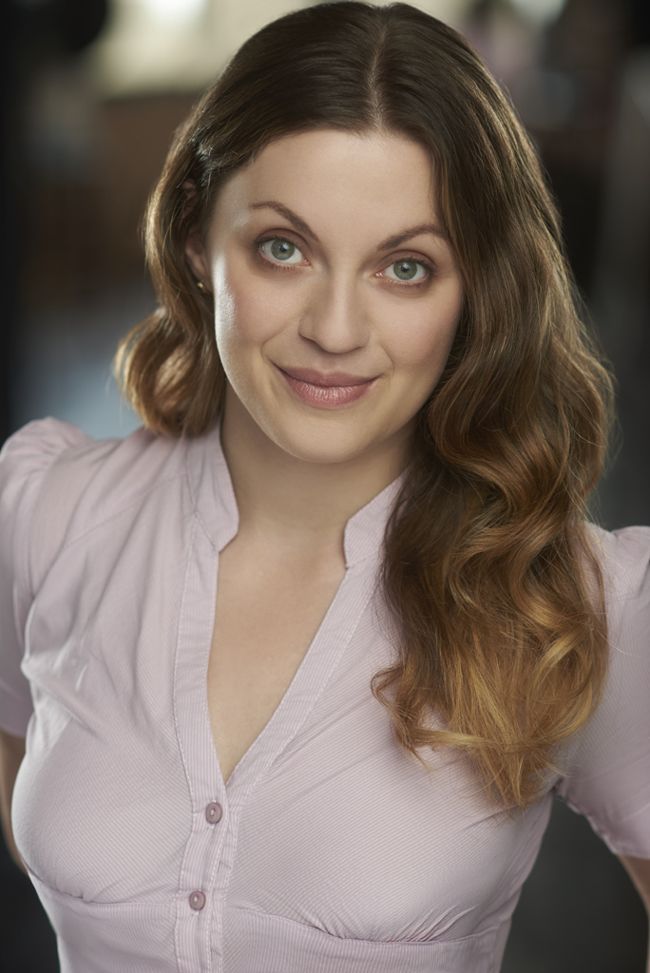
About Us
Pete Roden
Global Black Belt Azure Architect
Based in Cincinnati, OH
Pete.Roden@microsoft.com
@peteroden
Sasha Rosenbaum
Global Black Belt Azure Architect
Based in Chicago, IL
Sasha.Rosenbaum@microsoft.com
@DivineOps
@azureninjas
#azureserverlesstour
aka.ms/serverlesscontent

Slide 7
About Us
Pete Roden
Global Black Belt Azure Architect
Based in Cincinnati, OH
David Barkol
Global Black Belt Azure Architect
Based in Irvine, CA
dabarkol@microsoft.com
@dbarkol
Pete Roden
Global Black Belt Azure Architect
Based in Cincinnati, OH
Pete.Roden@microsoft.com
@peteroden
@azureninjas
#azureserverlesstour
aka.ms/serverlesscontent

Slide 8
About Us
Elizabeth Graham
Global Black Belt Azure Architect
Based in Indianapolis, IN
Elizabeth.Graham@microsoft.com
@esgraham13
@esgraham13
Sasha Rosenbaum
Global Black Belt Azure Architect
Based in Chicago, IL
Sasha.Rosenbaum@microsoft.com
@DivineOps
@azureninjas
#azureserverlesstour
aka.ms/serverlesscontent

Slide 9
The future is Serverless
How do I architect my app to become Serverless?
Notes:
Talking points: (New)
What do we go from here?
Introducing Serverless, an event-driven process, which will grow and scale on demand.
The only remaining question now becomes: How I architect my app to become Serverless? Pretty neat, right?
It all sounds great, naturally, you may ask, how does Serverless fit into the picture?

Slide 10
What is Serverless?
$
Abstraction of servers
Event-driven/ instant scale
Micro-billing
Notes:
Abstraction of servers, infrastructure and configuration of operating system
Event-driven scale
Sub-second billing
Stateless
Serverless compute is a fully managed service. Some refer to it as Functions as a Service
OS and Framework patching is performed for you
There is zero administrative tasks and no need to manage any infrastructure
You just deploy your code (function) and it runs
Your code runs within seconds and for very short period of time
Serverless compute scales quickly (almost instantly) and vastly
Automatically scales within seconds
No scale configuration is required (there is no way to configure scale or limits)
Scales to match any given workload. Scales from zero to handle tens of thousands concurrent functions invocations within seconds
Pay only for the time your code is running
Serverless compute reacts to events
React, in near real-time, to events and triggers
Triggered by virtually any event from Azure service or 3rd party services
Setup time, provisioning is long & costly

Slide 11
Benefits of Serverless
Reduced DevOps
Manage apps not servers
Faster time to market
Notes:
“Pinnacle of PaaS compute”
Not just hardware “servers”, but software servers are also managed for you
Focus on business logic, not solving technical problems not core to business
Lower effort to get started makes it easier to experiment (bots, etc.)
Benefits of “Serverless”

Slide 12
Serverless application platform components
Functions
Execute your code based on events you specify

Slide 13
Serverless application platform components
Logic Apps
Functions
Design workflows and orchestrate processes
Execute your code based on events you specify

Slide 14

Serverless application platform components
Event Grid
Logic Apps
Functions
Manage all events that can trigger code or logic
Design workflows and orchestrate processes
Execute your code based on events you specify

Slide 15

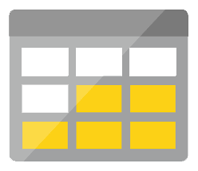
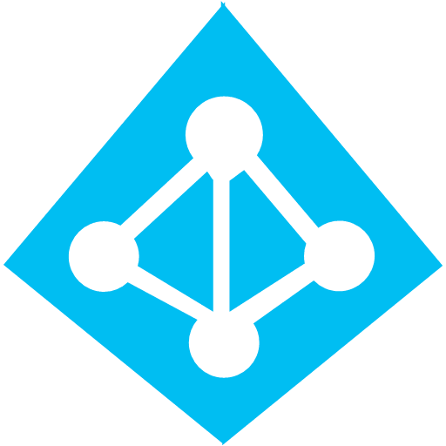



Serverless application platform components
Platform
Event Grid
Logic Apps
Functions
Manage all events that can trigger code or logic
Design workflows and orchestrate processes
Execute your code based on events you specify
Database
Storage
Security
IoT
Analytics
Intelligence

Slide 16

Serverless application platform components
Development
Platform
IDE support
Event Grid
Logic Apps
Functions
Manage all events that can trigger code or logic
Design workflows and orchestrate processes
Execute your code based on events you specify
Integrated DevOps
Local Development
Monitoring
Database
Storage
Security
IoT
Analytics
Intelligence
Visual Debug History

Slide 17
Serverless application platform components
Development
Platform
IDE support
Functions
Logic apps
Event Grid
Integrated DevOps
Developer productivity
Visual designer
Manage all events in one place
Triggers and Bindings
100+ connectors
Near real-time delivery
Local development
Flexible deployment options
Functions orchestration
Broad coverage
Monitoring
Database
Storage
Security & Access Control
IoT
Analytics
Intelligence
Visual Debug History

