Slide 1


Introducing Functions
Code
Azure Functions
Events + data

Slide 2
Logic – not plumbing
Bindings
Inputs
Bindings
CODE
Outputs
Trigger

Slide 3
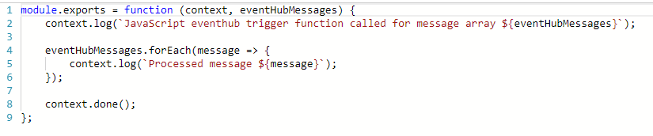
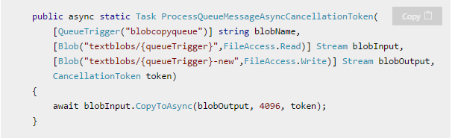
What is the “Functions” programming model?
Function as the unit of work
Functions are executed; they start and finish
Functions have triggers
Functions can have inputs and outputs (bindings)
Notes:
First, a simple event hub JS function (just trigger)
Then, a good example of a C# function with a trigger and input/output bindings

Slide 4
Language Support
Editor | Recommended for* | Features | Platform
Azure Portal | Trying it out, simple scripts (C# / JavaScript) | Browser-based; host compiler; automatic dependencies mgmt | Any
Visual Studio | C# / F# (class library) | Visual Studio build / debug / publish; cloud explorer; rich project types | Windows
Visual Studio Code | JavaScript, Java, Python* | Lightweight; tons of extensions; local debugging | Any
IntelliJ / Eclipse | Java (via Maven) | Refactoring; Smart Completion; Maven integration | Any
Note taking file editor + Functions Core Tools |  | Minimalism; traditional-style | Any
*Additional Experimental Languages: Python, Bash, Powershell, Batch, PHP, TypeScript
Notes:
Per previous slide, you can write Functions in many languages, with more on the way!
All experimental means is that its meant for POCs rather than production workloads in its current state.

Slide 5

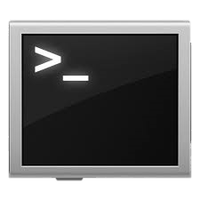


Azure Functions Tooling Options
Portal
Visual Studio
VS Code
CLI
Maven (Java)

Slide 6
Key Indicators for Serverless

Slide 7
Key Indicators for Serverless
Stateless and scale
Not worth deploying a traditional backend
Workload is sporadic (high volatility of demand)
Dev ops favored versus dedicated ops
Lots of different services that need “glue”

Slide 8
Serverless scenarios: anything that responds to events
Timer-based processing
Real-time stream processing
Every 15 minutes
Find and clean invalid data
Clean table
Millions of devices feed into Stream Analytics
Transform to structured data
Store data in SQL DB
Mobile app backends
Real-time bot messaging
?
...
Photo taken and WebHook called
Stores in blob storage
Produces scaled images
Message sent to Chatbot
Chatbot sends
response
Cortana Analytics answers questions

Slide 9
Patterns to Follow
Keep execution short and return quickly
Decouple tasks
Do as little work synchronously as possible
Trigger in batches – and catch exceptions
Global static variables for things like HttpClient
Always use App Insights (now on by default)
Use a DevOps pipeline such as VSTS
Compile and or pack to optimize cold start times
Notes:
Similar to microservice patterns (12 factor)

Slide 10
Hands on Lab: Functions

Slide 11
New Visual Studio 2017 tooling
Based on class libraries
Get the full power of IntelliSense, unit testing, and local debugging
Use WebJobs attributes to define triggers and bindings
Learn more at https://aka.ms/2017functiontools

Slide 12
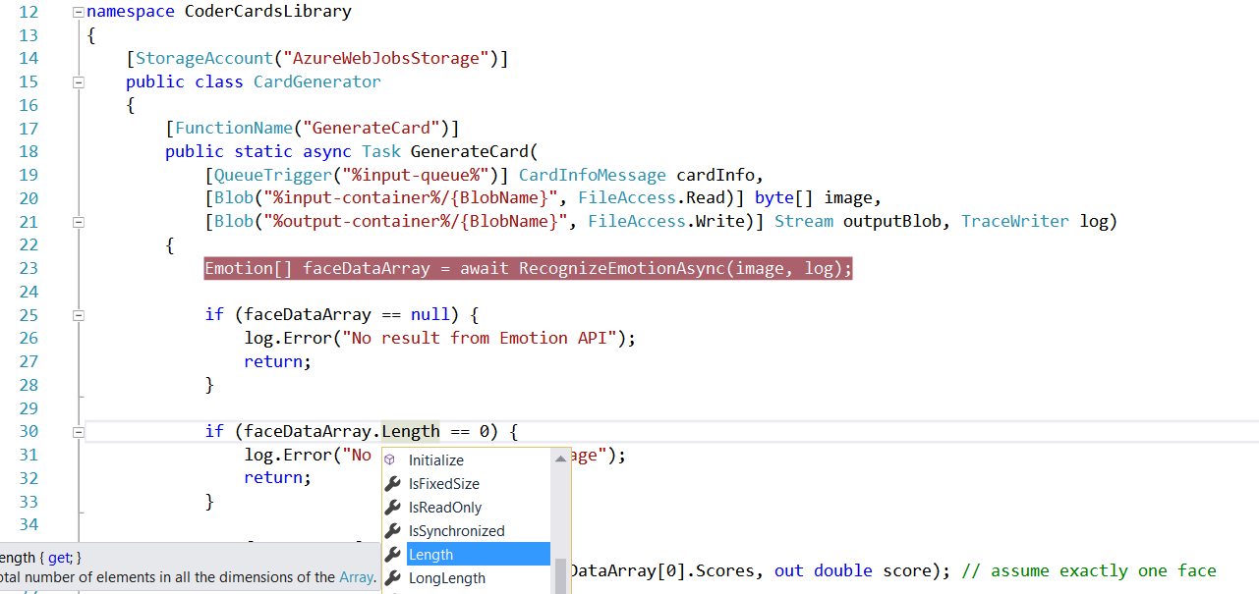
Visual Studio 2017 Tooling

Slide 13
Advanced stuff
Functions CLI and debugging

Slide 14
Platform and scaling
App Service offers dedicated and dynamic tiers.
Dedicated is the existing App Service plan tiers
Basic, Standard, Premium
Pay based on # of reserved VMs
You’re responsible for scale
Dynamic
Pay on number of executions
Platform responsible for scale

Slide 15
Dynamic tier pricing
Pay per execution model - two meters, three units
Number of executions
Duration of execution x reserved memory
First million executions free.

Slide 16
Durable Functions
Azure Functions extension
Enables long-running, stateful serverless operations
Write complex function orchestrations in a single function
Built on the open-source Durable Task Framework
Only pay when your code is running
Orchestrator replays itself to re-establish state every run

Slide 17
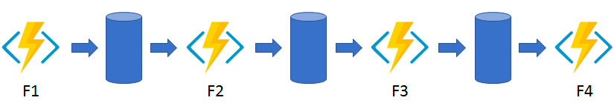
Durable functions - Patterns
Functions chaining
Async HTTP APIs
Fan out / Fan in
Human interaction

Slide 18




What’s new in Azure Functions
Trigger a function based on changes in Cosmos DB
Database
Local Development
Develop functions locally on Linux, MacOS, Windows
Functions
Durable Functions
Long running, stateful functions
Securely provide access to information in Microsoft Graph through a function
Security
Execute your code based on events you specify
Monitoring
Monitor serverless applications using Application Insights
Trigger a function from a real-time analytics pipeline in Stream Analytics
Analytics

