Slide 1
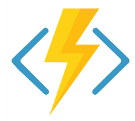
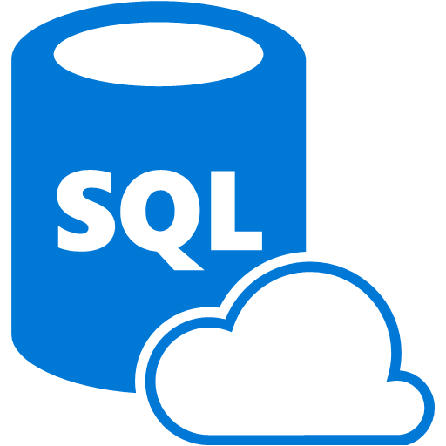

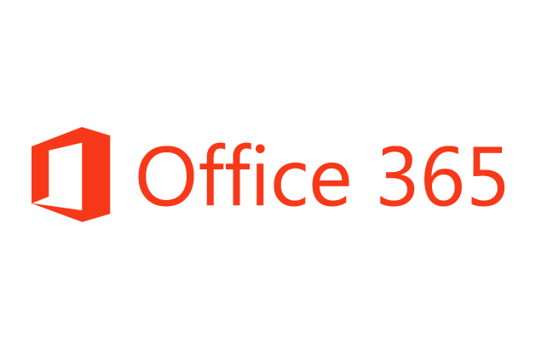
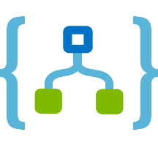
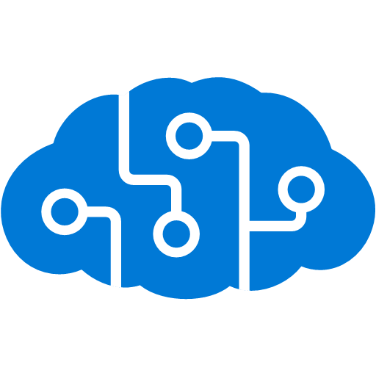
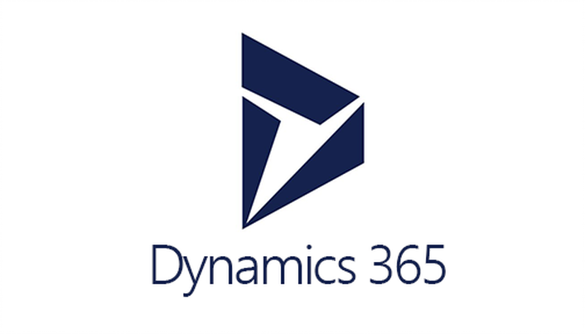


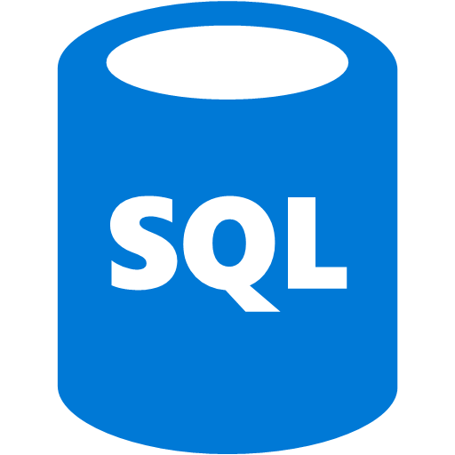




Logic Apps – System Integration
Azure Functions
Service bus
Cognitive services
Logic Apps
Machine learning
On-premises data gateway
BizTalk server
Notes:
Logic Apps can integrate with “anything” (APIs) and solve small or complex problems. Automation in a secure and reliable environment fast and easy.
Connect Anything:
On-premises, hybrid and cloud
Mission critical, complex integration scenarios
Business productivity
Agile Business:
Quickly create workflows
Position to the future API centric
Transform Business:
Extract value from both (on-premises and cloud apps)
Build Holistic integration solutions.

Slide 2
Everything? Really?
Okay, not everything. But there are over 200 connectors and we
have the ability to create custom connectors. With Event Grid,
there are many more options.

Slide 3

SaaS
10to8
Act!
Adobe Creative Cloud
appFigures
Asana
Azure Active Directory
Azure API Management
Azure App Services
Azure Application Insights
Azure Automation
Azure Cognitive Face API
Azure Cognitive LUIS
Azure Cognitive Text Analytics
Azure Cognitive Vision
Azure Data Lake Store
Azure Document DB
Azure Event Hubs
Azure Event Grid
Azure Files
Azure Functions
Azure Machine Learning
Azure Resource Manager
Azure Service Bus
Azure SQL
Azure Storage Blob
Azure Storage Queues
Basecamp2&3
Benchmark Email
Bing Maps
Bing Search
BitBucket
Bitly
Blogger
XML
XML Validation
Transform XML (+Mapper)
Flat File Encode
Flat File Decode
Int Account Artifact Lookup
EDI
X12
EDIFACT
AS2
Protocol/
Native
Batching
HTTP, HTTPS
HTTP Webhook
FTP, SFTP
SMTP
RSS
Compose, Parse JSON
Query, Join, Table, Select
Schedule, Wait
Terminate
Workflow
Hybrid
BizTalk Server
File System
IBM DB2
Informix
Oracle DB
MySQL
PostgreSQL
SharePoint Server
SQL Server
SAP
Teradata
Websphere MQ
Box
Buffer
Calendly
Campfire
CapsuleCRM
Chatter
Cognito Forms
Common Data Service
Disqus
DocuSign
Dropbox
Dynamics CRM Online
Dynamics CRM Service Bus
Dynamics for Financials
Dynamics for Operations
Dynamics NAV
Easy Redmine
Elastic Forms
Eventbrite
Facebook
FreshBooks
Freshdesk
FreshService
GitHub
Gmail
Google Calendar
Google Contacts
Google Drive
Google Sheets
Google Tasks
GoTo Meeting
GoTo Training
GoTo Webinar
Harvest
HelloSign
HipChat
Infusionsoft
Inoreader
Insightly
Instagram
Instapaper
Intercom
JIRA
JotForm
LeanKit
LiveChat
MailChimp
Mandrill
Microsoft Forms
Microsoft Teams
Microsoft Translator
Medium
MSN Weather
Muhimbi PDF
Nexmo
Office 365
Office 365 Users
Office 365 Video
OneDrive
OneDrive for Business
OneNote
Outlook.com
Outlook Customer Manager
Outlook Tasks
Paylocity
PagerDuty
Parserr
Pinterest
Pipedrive
Pivotal Tracker
Planner
Power BI
Project Online
Redmine
Salesforce
Salesforce Chatter
SendGrid
SharePoint Online
Slack
SmartSheet
SparkPost
Stripe
Survey Monkey
Teamwork
Teradata
Todoist
Toodledo
Trello
Twilio
Twitter
Typeform
UserVoice
Vimeo
VS Team Services
Webmerge
Wordpress
Wunderlist
Yammer
YouTube
Zendesk
Cloud APIs and platform functionality
To your services, apps, LOB systems
Hosted and managed within the platform
Scales to meet your needs
First class designer experience
Rapid development
Over 160 built-in connectors
Don’t see what you need?
aka.ms/logicapps-wish
API connections
Authenticate once and reuse
Differentiate connection configuration
Simple to deploy
Portal experience for managing API Connections

Slide 4
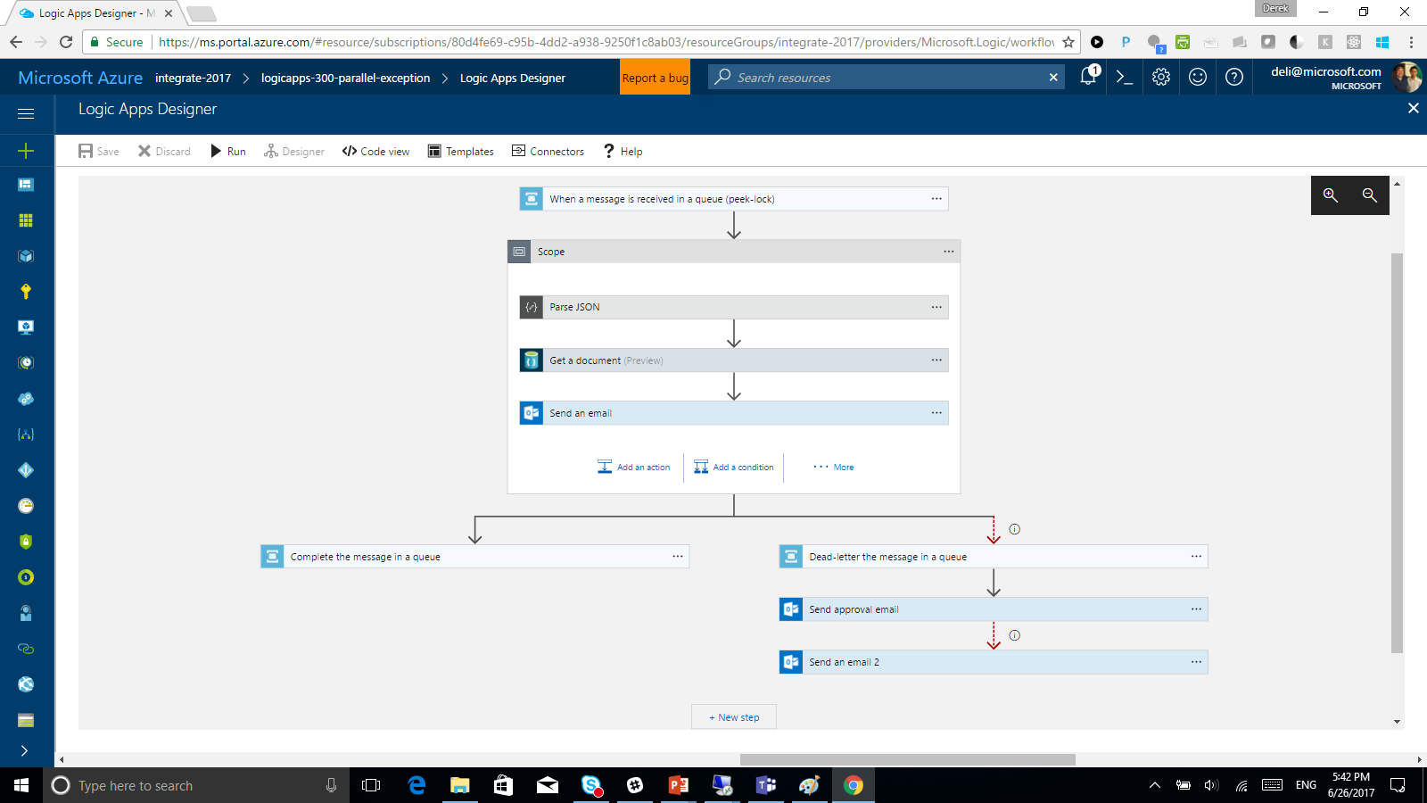
Logic Apps Designer

Slide 5

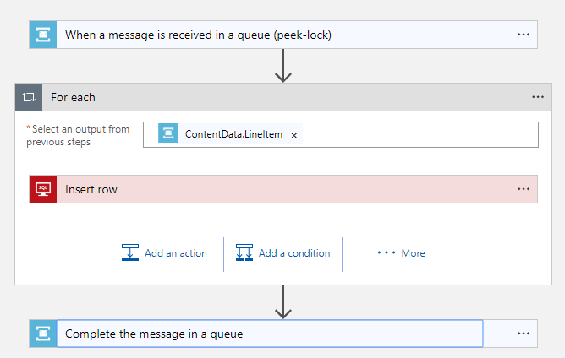
Logic App Workflow Engine
Logic Apps is a job scheduler with a JSON-based DSL describing a dependency graph of actions
Highly parallelized concurrent job execution engine
Notes:
Domain Specific Language

Slide 6
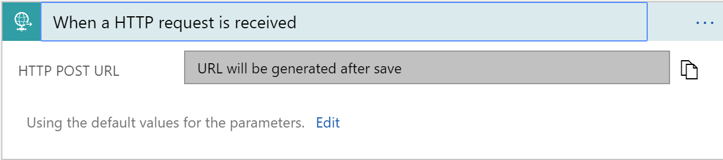
Triggers
All logic apps start with a trigger, typically a connector
Recurring and Adv. Scheduling
Polling
Webhook
Request

Slide 7
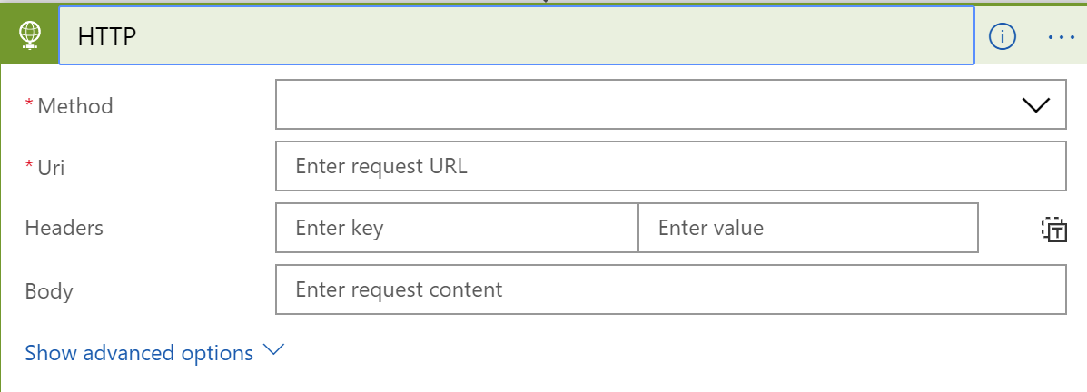
Actions
All logic apps continue with actions, which is also most of the time, a connector
Invoke APIs and Services
Behaviors
Variables
Expressions and Operators

Slide 8
Control flow
Response
For Each
Split On
Do Until
Conditions

Slide 9


Workflow Definition
Service Bus
Trigger Task
Run
Save
ForEach
On new message
SQL Insert
Workflow Orchestrator
Complete Message
Workflow Complete

Slide 10
Task Resiliency
No active thread management – tasks and runs can exist in parallel and at massive scale
At least once guaranteed execution
Transient failures invoke retry-policies (DNS issues, throttles, or 5xx responses)
If the task doesn’t respond, workflow orchestrator will assign a new task (at least once guarantee)

Slide 11
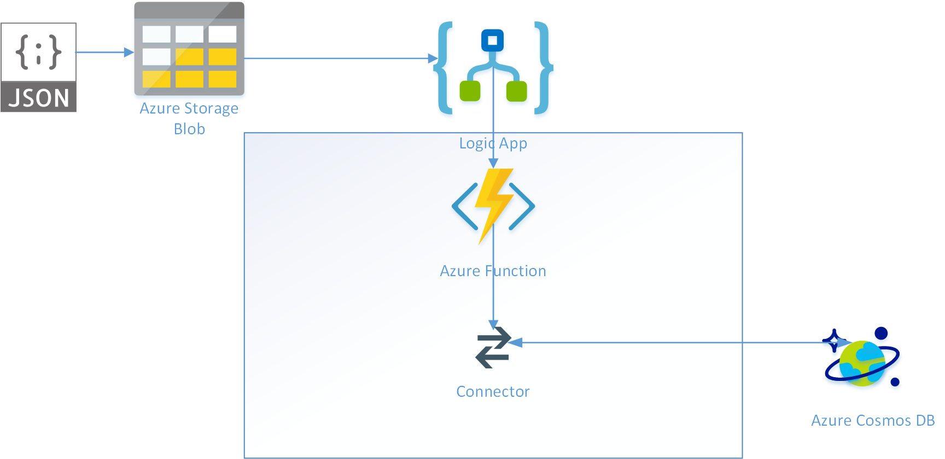
Logic Apps Demo
Notes:
TIME MARKER: 10:40 A.M.

Slide 12
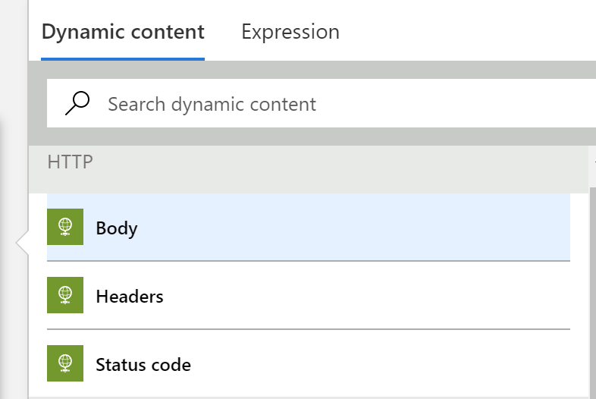
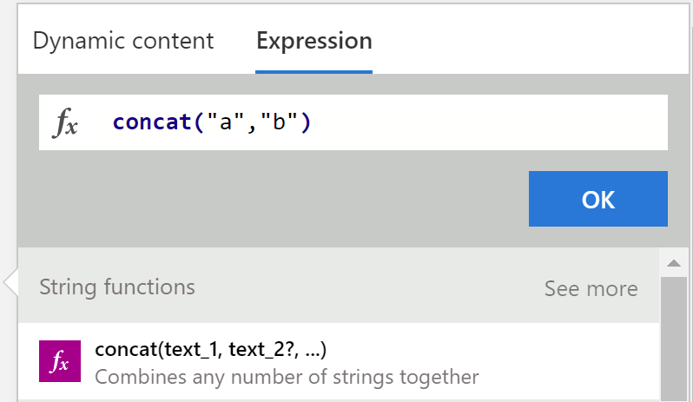
Tips and Tricks
Dynamic Content
Expressions

Slide 13
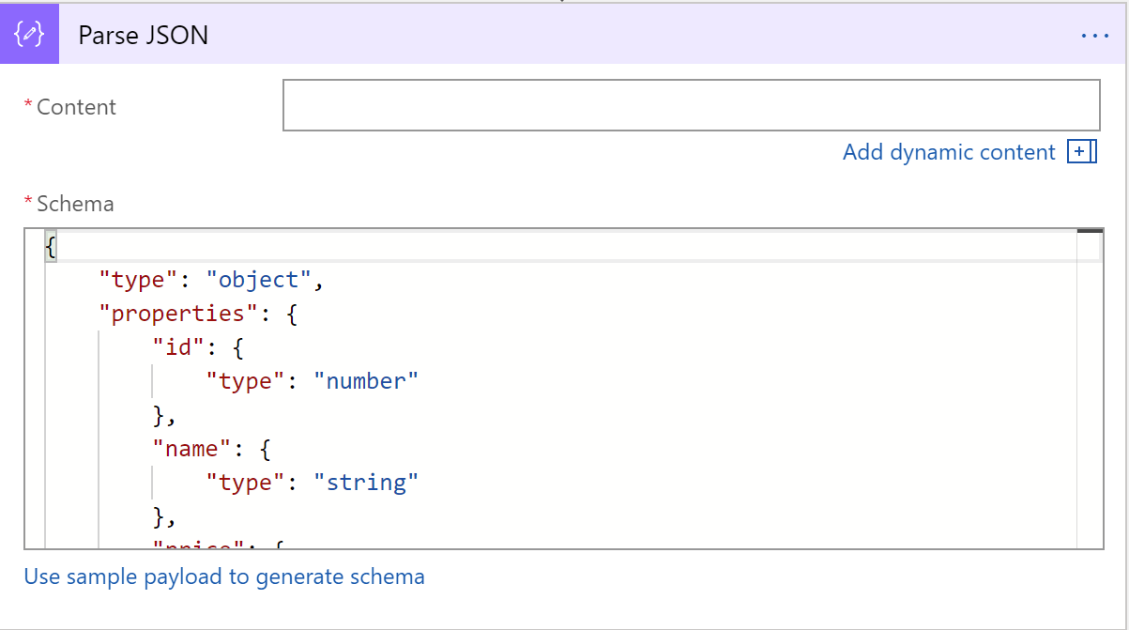
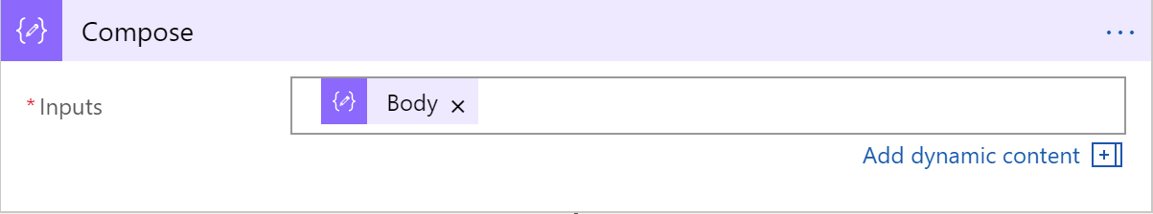
Tips and Tricks
Common shapes that will be used
Parse JSON
Compose
Notes:
Parse JSON – take a JSON object and convert to a specified schema
- constructing any output, including objects, arrays, and any other type natively supported by logic apps

Slide 14
Workflow Patterns

Slide 15
Error Handling
Retry policy
Default, custom, and disabled
Run after
Conditional dependency control
Status: Succeeded, Failed, TimedOut, Skipped
Limit
Limit the duration of execution
Terminate
Early termination
Failed or Successful status
Scopes
Encapsulate a set of actions
Status: determined by the status of the leaf nodes within the scope
Succeeded: all must have succeeded
Skipped: all must have been skipped
Failed: any not succeeded or skipped

Slide 16
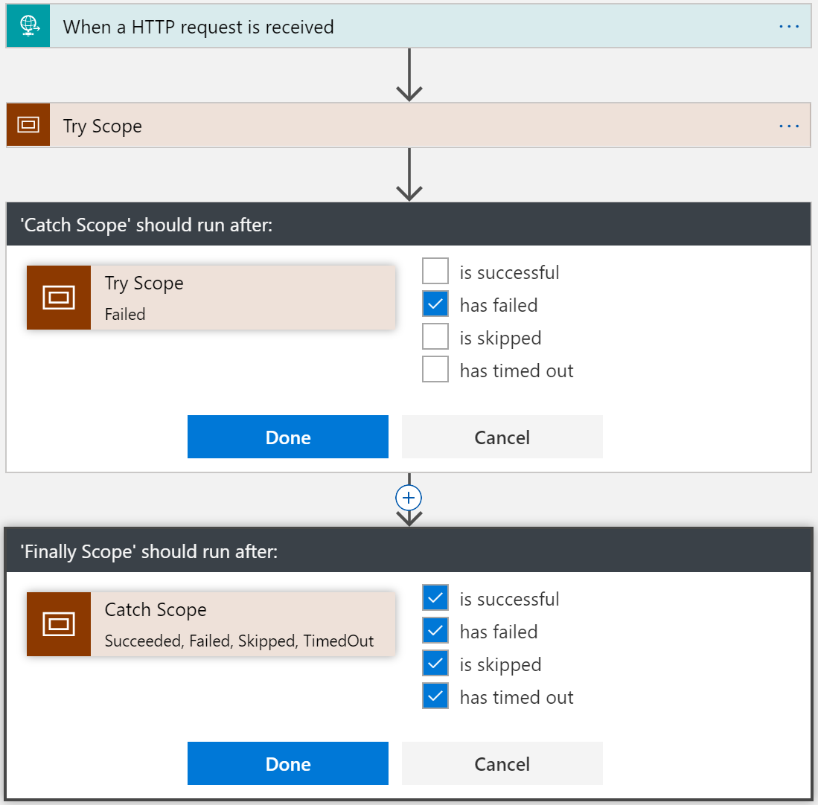
Try-Catch-Finally
Try
Put actions in a Try scope
Catch
Run after Try scope Failed
Finally
Run after Catch scope Succeeded, Skipped, TimedOut, or Failed

Slide 17
Concurrency Control
For Each Loops
Collections handled concurrently
Sequential For Each
For each degrees of parallelism
Runs
Instances are created concurrently
Singleton trigger executions
Degrees of parallel execution
Parallel actions
Explicit parallelization
Join with Run After
Do Until Loops
Runs sequentially
Notes:
50
For each sequential used for aggregation

Slide 18
Scheduling executions
Example workloads
Cleanup jobs, data synchronization, running reports, data compression
Simple Recurrence
Every 5 minutes, every 2 days
Recurrence with deterministic time
Use start time
Every hour on the hour, every day at midnight
Complex schedules
Every Sunday at noon, every 15 minutes during work hours
Run once jobs

Slide 19
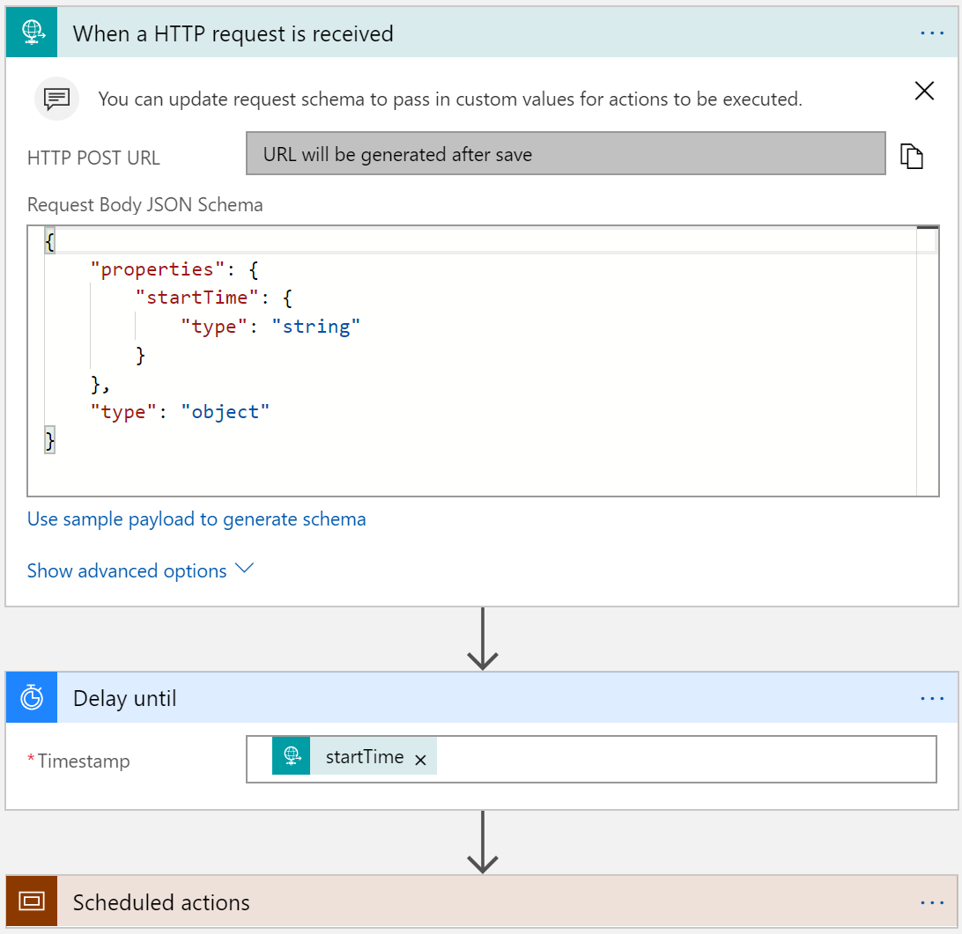
Run Once Jobs
Request trigger
Start time input
Delay Until (start time)
Instantiate millions of scheduled jobs
Can cancel using RunId

Slide 20
Versioning & Long running processes
All published versions are saved
Instance always completes on the version of the definition it started on
New instances use the latest version
Can explicitly call a version
Long running patterns
Break down business process into atomic stages
Use Call Workflow or asynchronous messaging between stages
Process Broker pattern
Master process manager calling each stage
Process Chaining pattern
End of stage calls next stage
Routing Slip pattern
Metadata indicates which stage to call next

Slide 21
Messaging Patterns

Slide 22
Messaging Protocols
REST/ SOAP
HTTP action
Custom connectors
Queues
Storage queues
Service Bus queues
MQ
Pub/Sub
Service Bus topics
Event streams
Event Hubs
Eventing
Event Grid
Connectors
MQ
Workflow Invocation
Call workflow
Batch
IoT Hubs*

Slide 23
Messaging Communication Patterns
Correlation
Send – Async Response
Webhook (approval)
Response queues
Session queues
Ordered Delivery
In order processing (singletons)
Sequential convoys
Partitions
Session queues/topics
Batch with partitions
Direct Synchronous
Request/Reply (blocking)
Call workflow (synchronous)
Direct Asynchronous
Fire and forget (201)
Call Workflow (async) and Send to Batch
Fire and Wait/Poll (202 with retry-after and location header)
Webhooks

Slide 24

Messaging Handling Patterns
Splitter
Claim Check
Data transformation/enricher
Content based router
Message pipelines (VETER)

Slide 25
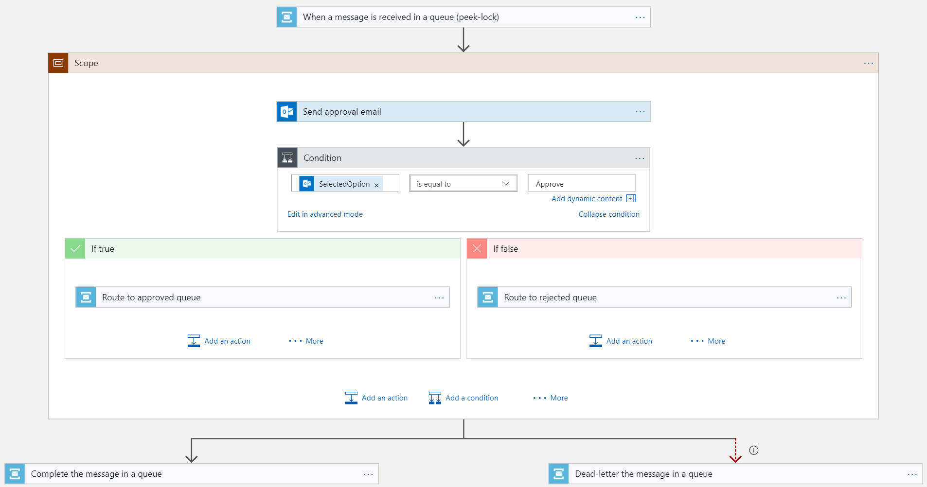
Peek Lock
Service Bus Queues and Topics
When a message arrives (peek-lock)
Complete message with lock token
Error handling
Implicitly abandon message
Explicitly abandon message using lock token
Deadletter message using lock token
Extending the lock
Set expected lock time on message
Renew the lock

Slide 26
Learnings
Know the Limits of Logic Apps
Consider the workflow – high throughput vs long running workflow
Understand the data structure
Leverage concurrency as much as possible
Consider side-by-side strategy for testing

Slide 27
Misconceptions and Gotchas
Not a lightweight BizTalk
Its not a silver bullet – expect to combine with Functions
Be aware of the workload (for loops, etc)
Management is either in the portal or Visual Studio
ALM is defined in VSTS, but has short comings (use ARMClient and LogicAppTemplate)
There is not much guidance – but that’s why we are here!

Slide 28
Integration Service Environments
VNET connectivity
Private static outbound IPs
Dedicated compute
Isolated storage
Flat cost
Custom inbound domain names

Slide 29
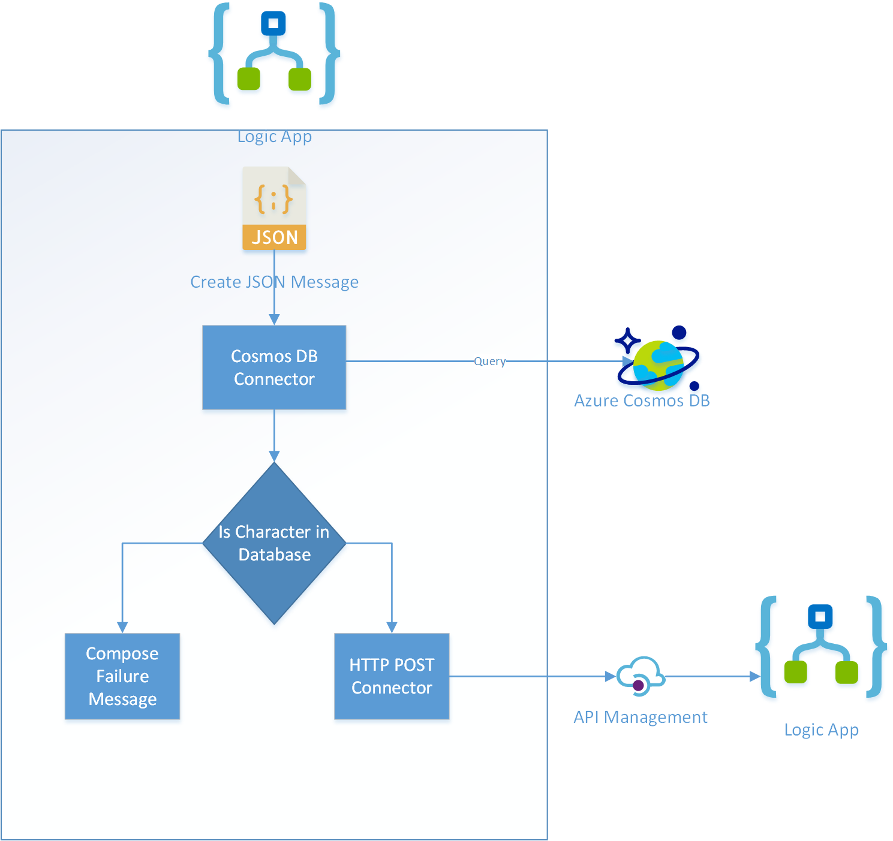
Hands on Lab: Logic Apps
https://aka.ms/LA_CheatSheet

