Slide 1



Azure Event Grid

Slide 2


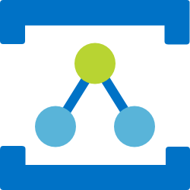
Azure Messaging Services
Service Bus
Event Hubs
Relay
Event Grid
Asynchronous enterprise messaging
Distributed data streaming
Secure two way communication without changes to your network
Cross cloud reactive eventing

Slide 3

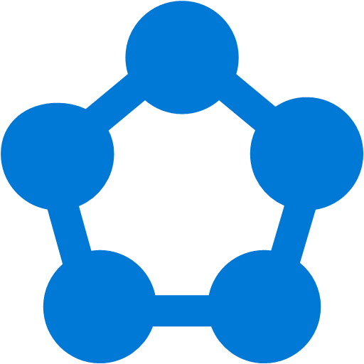









Modern computing is all about events

Slide 4
?
Managing events is important but cumbersome
?
?
?
?
?
?
?
?
?
?
?

Slide 5

What if all these events could be managed and directed from one place?

Slide 6
Command
Transfer
Query
Report
Handover
Notification
Job
Measurement
Assignment
Trace
Update
Request

Slide 7
Intents
Facts

Slide 8
Messaging
Eventing
Intents
Facts
Expectations
History
Conversations
Context
Contracts
Order
Control Transfer
Schema
Value Transfer

Slide 9
Messaging
Eventing
A
B
A
?
C
?

Slide 10
Events
Discrete
Series
Independent
Time Ordered
Report State Change
Context Partitioned
Actionable
Report Condition
Analyzable

Slide 11



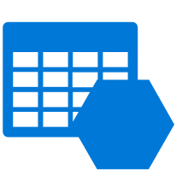

Discovering events is expensive
IoT Devices
1st party events
Storage
Cloud Subscriptions
Application
Resource Groups
Streaming Data
Tables

Slide 12
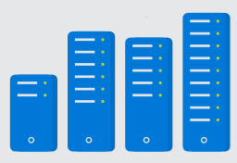
Processing events is cumbersome
IoT Devices
1st party events
Storage
Application
Cloud Subscriptions
Code
</>
Resource Groups
Streaming Data
Tables
Infrastructure

Slide 13
Communication between app components is complicated
IoT Devices
1st party events
Custom app specific events
Storage
Service 1
Service 2
Cloud Subscriptions
Code
</>
Code
</>
Resource Groups
Streaming Data
Tables
Infrastructure
Infrastructure

Slide 14

What if it could be simpler?
IoT Hub
1st party events
Custom app specific events
Blob Storage
Serverless
Function 1
Serverless
Function 2
Azure Subscriptions
Resource Groups
Code
</>
Code
</>
Event Hubs
Event Grid
Functions
Event Grid
Functions
Storage (GPv2)

Slide 15
Azure Event Grid
Fully-managed event routing
Near real-time event delivery at scale
Broad coverage within Azure and beyond
Backbone of event-driven computing

Slide 16
Benefits
Focus on innovation and pay per event
Ensure reliability and performance for your apps
Unlock new scenarios for your apps
Manage all events in one place

Slide 17




Manage all events in one place
Event publishers
Event handlers
Blob Storage
Azure Functions
Resource Groups
Logic Apps
Azure Subscriptions
Azure Automation
Event Hubs
WebHooks
Custom Events

Slide 18

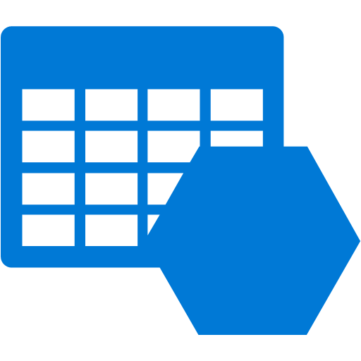

Event Publishers
Blob Storage
Event Hubs
Media Services
Storage (GPv2)
Service Bus
Resource Groups
IoT Hub
Azure Subscriptions
Custom Topic

Slide 19

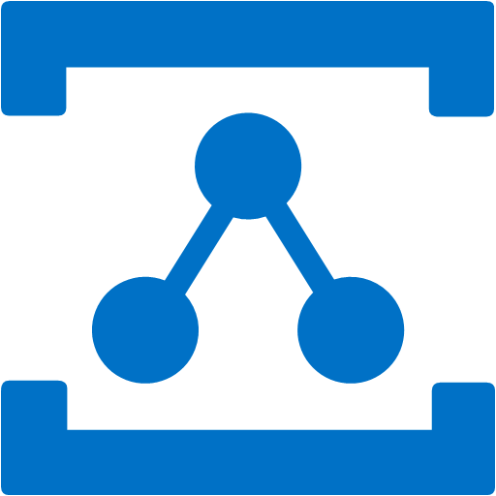
Event Handlers
Azure Functions
Event Hubs
Logic Apps
Storage Queue
Relay Hybrid Connection
Azure Automation
WebHooks

Slide 20

Manage all events in one place
IoT Hub
Blob Storage
Azure Functions
Azure Subscriptions
Logic Apps
Resource Groups
Azure Automation
Event Hubs
WebHooks
Custom Topics
Event Hubs
Storage (GPv2)

Slide 21
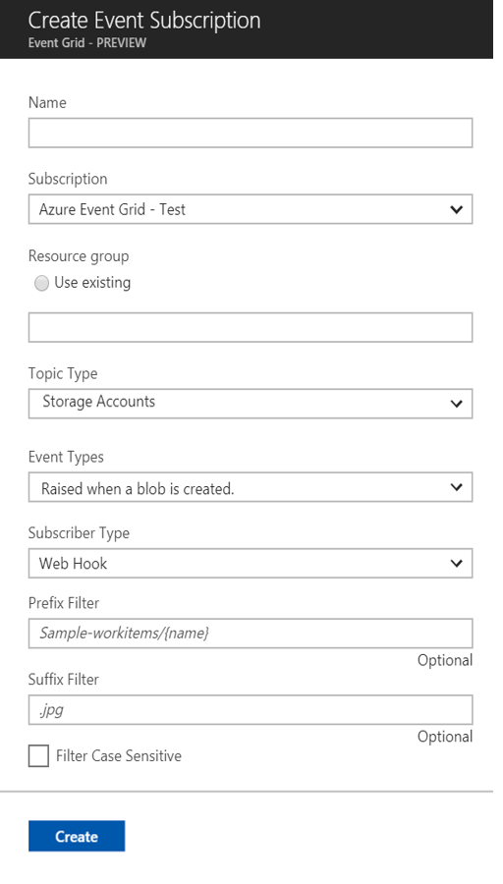
Manage all events in one place
Event publishers
Event handlers
Subscribe to pre-defined system events in Azure or create your own custom topics
Route events to any end-points, Azure or even beyond
Enable filtering and efficient routing of events

Slide 22
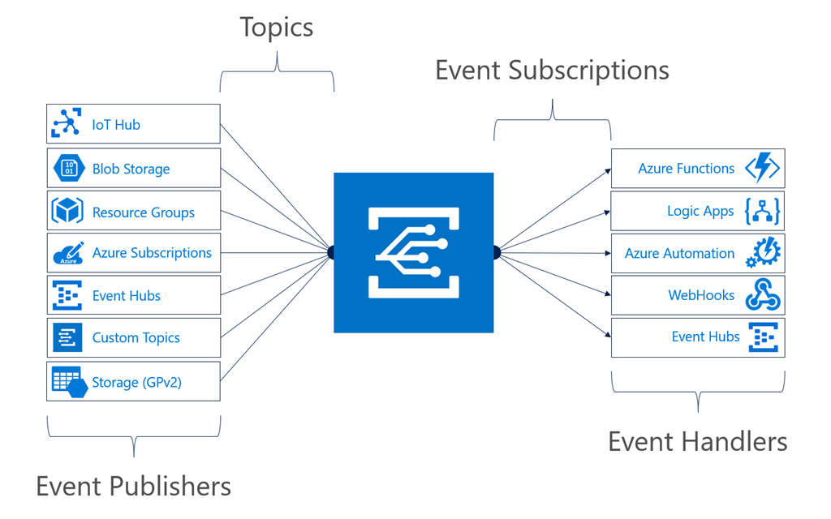
Manage all events in one place
Notes:
It comes down to having a collection of event publishers and event handlers.

Slide 23
Manage all events in one place
Event publishers
Event handlers
Subscribe to pre-defined system events in Azure or create your own custom topics
Route events to any end-points, Azure or even beyond
Enable filtering and efficient routing of events
Notes:
This is a simplified view of what managing events looks like.

Slide 24
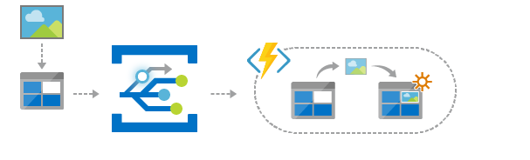
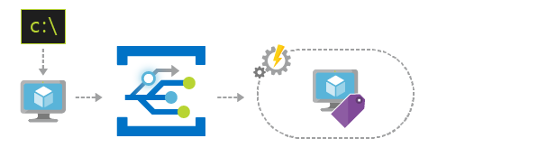
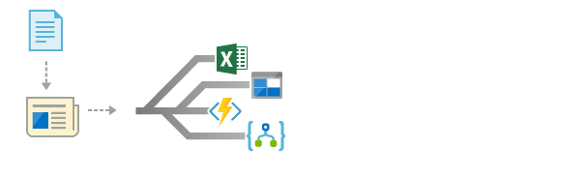
Scenarios
Serverless apps
Ops automation
Application integration
Instantly trigger a serverless function to run analysis when a new file is added to a blob storage container.
Speed up automation and simplify policy enforcement by notifying Azure Automation when underlying infrastructure is provisioned
Connects your app with other services. Create an application topic to route your app’s event data to any desired destination

Slide 25
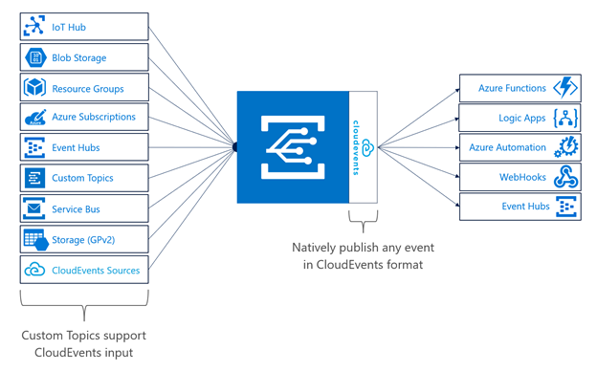

Cloud Events

Slide 26
CloudEvent schema
{
"cloudEventsVersion" : "0.1",
"eventType" : “Zohan.NewEmployee",
"eventTypeVersion" : "",
"source" : "/subscriptions/{subscription-id}/resourceGroups/{resource-group}/providers/Microsoft.Storage/
storageAccounts/{storage-account}#blobServices/default/containers/{storage-container}/blobs/{new-file}",
"eventID" : "173d9985-401e-0075-2497-de268c06ff25",
"eventTime" : "2018-04-28T02:18:47.1281675Z",
"data" : {
“name": “Frank Rizzo",
“employeeId": "6d79dbfb-0e37-4fc4-981f-442c9ca65760",
}
}

Slide 27




Build applications efficiently
Management SDKs
Publish SDKs
Event Schema Store
Consumption SDKs
.Net Python Java Node.js Ruby Go

Slide 28
Ensure reliability and performance in your apps
Sub-second end-to-end latency in the 99th percentile
10,000,000 events per second per region
24-hour retry with exponential back off for events not delivered
Near real-time
Massive scale-out
High reliability
Notes:
We want to deliver reliable notification in near real-time, at massive scale. It needs to be highly reliable, you should be able to create items/messages that you can’t afford to lose.

Slide 29
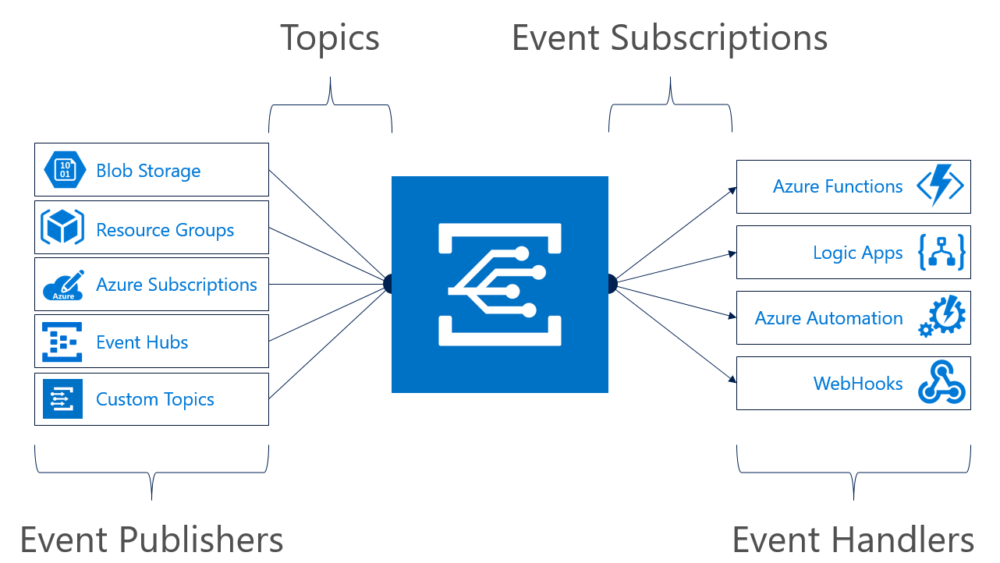
Concepts
Events: what happened
Event Publishers: where it took place
Topics: where publishers send events
Event Subscriptions: how you receive events
Event Handlers: the app or service reacting to the event

Slide 30
Target performance
Sub-second end-to-end latency in the 99th percentile
99.99% availability
10,000,000 events per second per region
100,000,000 subscriptions per region
50 ms publisher latency
24 hour retry with exponential back off for events not delivered
Transparent regional failover
Notes:
24 hour retry is the GA target, today it is just for 2 hours.

Slide 31
Event Schema
[{
"topic": "/subscriptions/{subscription-id}/resourceGroups/rg1/providers/Microsoft.Storage/storageAccounts/socalazure",
"subject": "/blobServices/default/containers/sample/blobs/grid.jpg",
"eventType": "Microsoft.Storage.BlobCreated",
"eventTime": "2018-03-08T02:32:32.3138466Z",
"id": "60b827dd-701e-010a-2e85-b6ba5f0618c4",
"data": {
"api": "PutBlockList",
"clientRequestId": "580ebc71-0b38-4e13-9c3e-5db169ad2032",
"requestId": "60b827dd-701e-010a-2e85-b6ba5f000000",
"eTag": "0x8D5849CD8572590",
"contentType": "image/jpeg",
"contentLength": 687245,
"blobType": "BlockBlob",
"url": "https://socalazure.blob.core.windows.net/sample/grid.jpg",
"sequencer": "0000000000000000000000000000043C00000000004b90e3",
"storageDiagnostics": {
"batchId": "11c2a1b3-013f-4c7a-a31e-cf455a2c7d3f"
}
},
"dataVersion": "",
"metadataVersion": "1"
}]
Properties specific to the publisher
https://docs.microsoft.com/en-us/azure/event-grid/event-schema

Slide 32
Subscription Validation
[{
"id": "d81e1cee-cd14-4bf6-8105-13cdc71284b3",
"topic": "/subscriptions/xxxxxxx/resourceGroups/cbus- eventgrid/providers/microsoft.eventgrid/topics/cbus-topic-1",
"subject": "",
"data": {
"validationCode": "BDC0D448-74DC-4E4A-B9B4-EFAB111FF10A",
"validationUrl": https://rp-eastus.eventgrid.azure.net/eventsubscriptions/mysub1/validate?id=BDC0D448-74DC-4E4A-B9B4-EFAB111FF10A&t=2018-05-19T17:42:44.7966715Z&apiVersion=2018-05-01-preview&token=yUW1lFf3PSTWyQruNtQ5vCszJ3SiIcJzBvwYnMlN80A%3d
},
"eventType": "Microsoft.EventGrid.SubscriptionValidationEvent",
"eventTime": "2018-05-19T17:42:44.8123163Z",
"metadataVersion": "1",
"dataVersion": "2"
}]
https://docs.microsoft.com/en-us/azure/event-grid/security-authentication#webhook-event-delivery

Slide 33

Resource model: extension resource
ARM calls are made to a parent resource
ARM reroutes all Event Grid calls to the Event Grid RP
Notes:
When you are interacting with Event Grid, you are actually communicating with an extension of the resource provider for that service.

Slide 34
Guiding Principles
Events are independent
Always available
Near real-time event delivery
At least once delivery
Dynamic scale
Platform agnostic (WebHook)
Language agnostic (HTTP protocol)

Slide 35
Key Takeaways
Loosely coupled
Using the right tool for the right task
Events vs. Commands
Knowing the difference between Events and Telemetry / streams
Idempotent

Slide 36
References
Azure Documentation: https://azure.com/eventgrid
Event Viewer: https://aka.ms/eventgridviewer
MSDN Article: https://aka.ms/eventgridarticle

Slide 37
Learn more at azure.com/EventGrid

