Slide 1
Serverless with Azure

Slide 2
Where did all the Servers go?
And who are these people with slides?

Slide 3

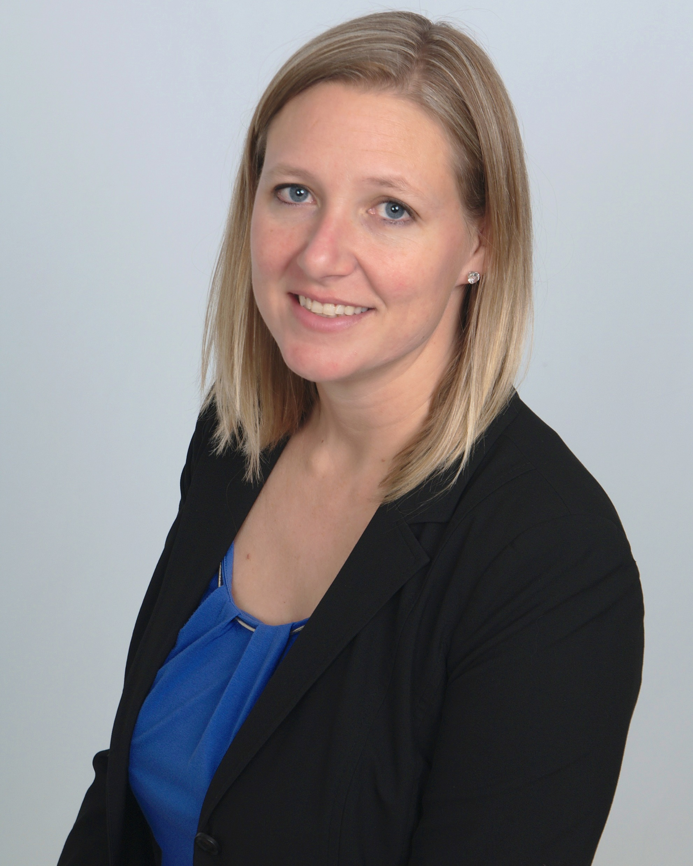


About Us
Elizabeth Graham
Global Black Belt Azure Architect
Based in Indianapolis, IN
With 17 years working with Integration technologies and 8 years working with Azure, now focusing on serverless technology.
Been at Microsoft for ~5 years
@esgraham13
David Barkol
Global Black Belt Azure Architect
Based in Irvine, CA
Interests are primarily around custom application development and serverless technologies.
Been at Microsoft for 2 years
@ dbarkol
@azureninjas
codingwithsasquatch/
serverless_ninjas_workshop

Slide 4


About Us
Pete Roden
Global Black Belt Azure Architect
Based in Cincinnati, OH
Focus areas include Application development, Bot and Cognitive Services, as well as IoT for large-scale applications.
Been at Microsoft for 8 years
@peteroden
Sasha Rosenbaum
Global Black Belt Azure Architect
Based in Chicago, IL
Sasha turns her powerful problem solving approach to helping clients as well as to learning new technology and figuring out how apply it to projects.
Been at Microsoft for 2 years
@DivineOps
@azureninjas
codingwithsasquatch/
serverless_ninjas_workshop

Slide 5
About Us
Pete Roden
Global Black Belt Azure Architect
Based in Cincinnati, OH
Focus areas include Application development, Bot and Cognitive Services, as well as IoT for large-scale applications.
Been at Microsoft for 8 years
@peteroden
David Barkol
Global Black Belt Azure Architect
Based in Irvine, CA
Interests are primarily around custom application development and serverless technologies.
Been at Microsoft for 2 years
@ dbarkol
@azureninjas
codingwithsasquatch/
serverless_ninjas_workshop

Slide 6
About Us
Elizabeth Graham
Global Black Belt Azure Architect
Based in Indianapolis, IN
With 17 years working with Integration technologies and 8 years working with Azure, now focusing on serverless technology.
Been at Microsoft for ~5 years
@esgraham13
Sasha Rosenbaum
Global Black Belt Azure Architect
Based in Chicago, IL
Sasha turns her powerful problem solving approach to helping clients as well as to learning new technology and figuring out how apply it to projects.
Been at Microsoft for 2 years
@DivineOps
@azureninjas
codingwithsasquatch/
serverless_ninjas_workshop

Slide 7
About Us
Elizabeth Graham
Global Black Belt Azure Architect
Based in Indianapolis, IN
With 17 years working with Integration technologies and 8 years working with Azure, now focusing on serverless technology.
Been at Microsoft for ~5 years
@esgraham13
Pete Roden
Global Black Belt Azure Architect
Based in Cincinnati, OH
Focus areas include Application development, Bot and Cognitive Services, as well as IoT for large-scale applications.
Been at Microsoft for 8 years
@peteroden
@azureninjas
codingwithsasquatch/
serverless_ninjas_workshop

Slide 8
The future is Serverless
How do I architect my app to become Serverless?
Notes:
Talking points: (New)
What do we go from here?
Introducing Serverless, an event-driven process, which will grow and scale on demand.
The only remaining question now becomes: How I architect my app to become Serverless? Pretty neat, right?
It all sounds great, naturally, you may ask, how does Serverless fit into the picture?

Slide 9
What is Serverless?
$
Abstraction of servers
Event-driven/ instant scale
Micro-billing
Notes:
Abstraction of servers, infrastructure and configuration of operating system
Event-driven scale
Sub-second billing
Stateless
Serverless compute is a fully managed service. Some refer to it as Functions as a Service
OS and Framework patching is performed for you
There is zero administrative tasks and no need to manage any infrastructure
You just deploy your code (function) and it runs
Your code runs within seconds and for very short period of time
Serverless compute scales quickly (almost instantly) and vastly
Automatically scales within seconds
No scale configuration is required (there is no way to configure scale or limits)
Scales to match any given workload. Scales from zero to handle tens of thousands concurrent functions invocations within seconds
Pay only for the time your code is running
Serverless compute reacts to events
React, in near real-time, to events and triggers
Triggered by virtually any event from Azure service or 3rd party services
Setup time, provisioning is long & costly

Slide 10
Benefits of Serverless
Reduced DevOps
Manage apps not servers
Faster time to market
Notes:
“Pinnacle of PaaS compute”
Not just hardware “servers”, but software servers are also managed for you
Focus on business logic, not solving technical problems not core to business
Lower effort to get started makes it easier to experiment (bots, etc.)
Benefits of “Serverless”

Slide 11
Serverless application platform components
Functions
Execute your code based on events you specify

Slide 12
Serverless application platform components
Logic Apps
Functions
Design workflows and orchestrate processes
Execute your code based on events you specify

Slide 13
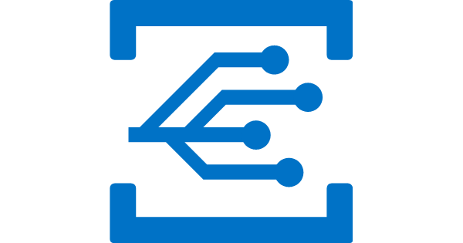
Serverless application platform components
Event Grid
Logic Apps
Functions
Manage all events that can trigger code or logic
Design workflows and orchestrate processes
Execute your code based on events you specify

Slide 14


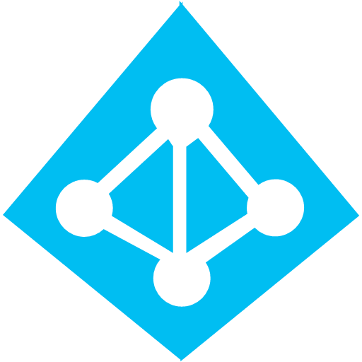


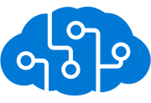
Serverless application platform components
Platform
Event Grid
Logic Apps
Functions
Manage all events that can trigger code or logic
Design workflows and orchestrate processes
Execute your code based on events you specify
Database
Storage
Security
IoT
Analytics
Intelligence

Slide 15

Serverless application platform components
Development
Platform
IDE support
Event Grid
Logic Apps
Functions
Manage all events that can trigger code or logic
Design workflows and orchestrate processes
Execute your code based on events you specify
Integrated DevOps
Local Development
Monitoring
Database
Storage
Security
IoT
Analytics
Intelligence
Visual Debug History

Slide 16
Serverless application platform components
Development
Platform
IDE support
Functions
Logic apps
Event Grid
Integrated DevOps
Developer productivity
Visual designer
Manage all events in one place
Triggers and Bindings
100+ connectors
Near real-time delivery
Local development
Flexible deployment options
Functions orchestration
Broad coverage
Monitoring
Database
Storage
Security & Access Control
IoT
Analytics
Intelligence
Visual Debug History

