Slide 1
Windsor Drafts

Slide 2
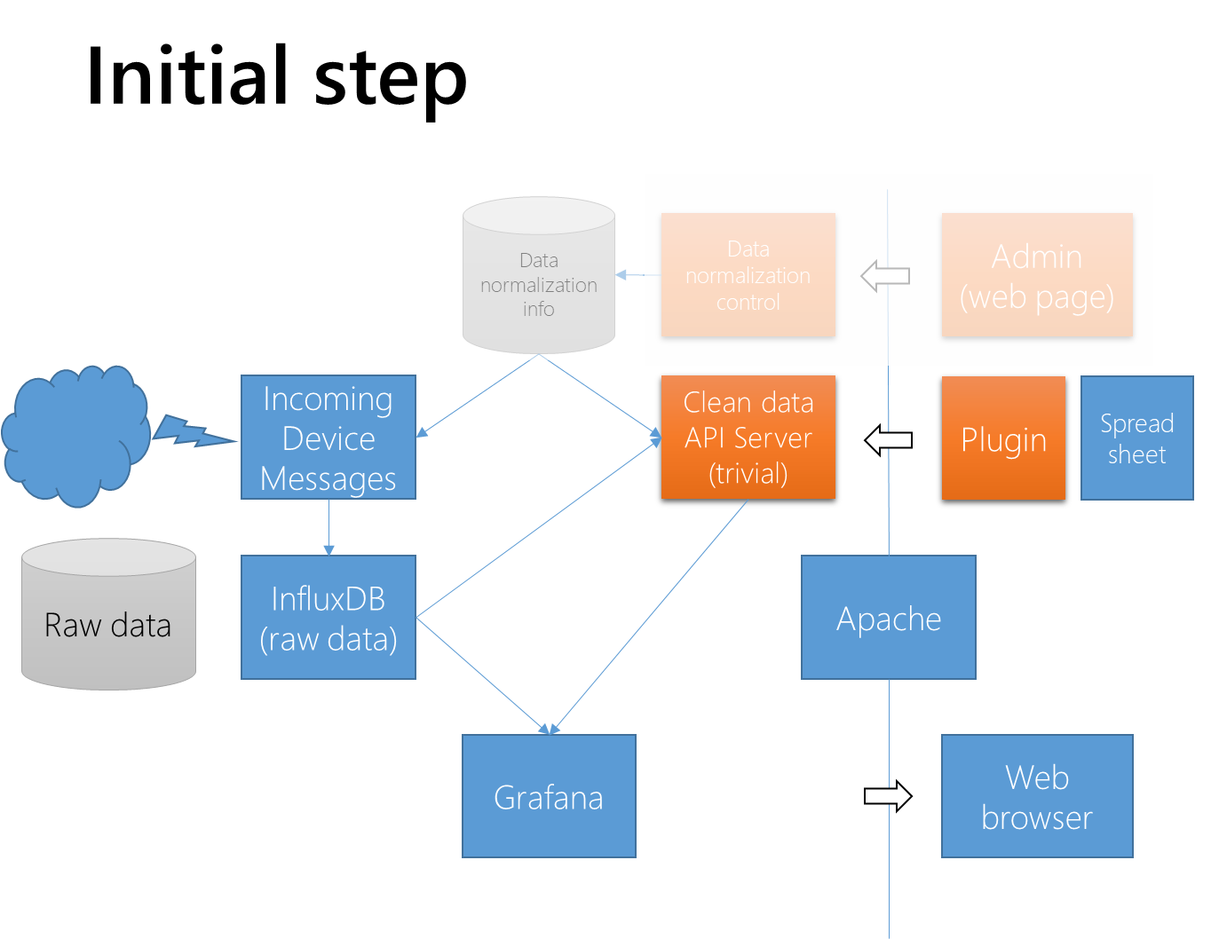
Server setup

Slide 3
UX with the plugin
Very simple.
They somehow insert the automation into a spreadsheet (how: tbd)
They then signal to the spreadsheet “please pull the data” – push a button, hit the “refresh data source” button in Excel, etc. (Excel may auto refresh when you open the spreadsheet default.)
If they want more up-to-date data, then they re-run the query to pull the data.
They may want to set time limits for data (not real-time data) for e.g. monthly reports. They might run the March report in late April, if they’re busy, for example.
This is a spreadsheet plugin, not a spreadsheet generator that runs from a command line.
Need to support Google Docs on ChromeBooks for educational use.
Need to support Excel on PCs for corporate use
Other things are for geeks (Excel on macOS, etc.) – maybe downloadable spreadsheets or CSVs are the best.

Slide 4
Implementation Strategy
In Excel: assume we have a Visual Basic framework, connected to buttons in the ribbon, that
Does some UI (if needed)
Issues the queries
Populates tabs in the spreadsheet (named XXX-{probe1}, XXX-{probe2}, … -- “XXX-” is a prefix from the user, probably optional. Tabs get overwritten if already exist with that name; before starting that, prompt the user (are you sure?).
In Google Sheets: probably they have a similar mechanism based on JavaScript.
For training and simplicity, make these as similar as possible.
So probably have to implement in parallel (step by step).
Excel version: Microsoft 365 online and current desktop. Don’t worry about back versions (for now).
Google Docs: current.
We have to design to support multiple different reports (because we already have at least 2, “qbg” and “dec”.

Slide 5
The proxy (orange box) server
Inject (somehow) information about how many probes there are, how many piles, what they’re named, etc., and mapping to the device ID (by time, eventually)
This needs to be (at least conceptually) “per customer” so that we don’t mix up data across sites.
This needs to be deployable as part of the WeRadiate customer onboarding process (and updatable when customer adds more sensors or piles)

Slide 6
Hi Seenevasan,
The idea is that we create another app (that runs on the server in a docker containter) that listens on a port proxied and secured by NGINX. This app gets queries from clients, creates subqueries for InfluxDB and any other authoritative data sources, merges data as needed, then passes back the results.
The first step is to just proxy the influxdb queries.
Then start filtering and adjusting.
--Terry

Slide 7
They are using exactly our docker ttn dashboard.
We do not want to use PHP, and we don’t want to run “inside Apache/NGINX” – we want to use NGINX only as a proxy and have a stand-alone app that is listening for connections and doing the work (just as InfluxDB does).
Thanks,
--Terry

Slide 8
NGINX
Spreadsheet plugin (Excel/GoogleSheets)
InfluxdB
Custom App Container
Listen port??
Capabilities??
Docker container?? Maintain users list and password

Slide 9
Iotdashboard.mcci.com/80xx

Slide 10
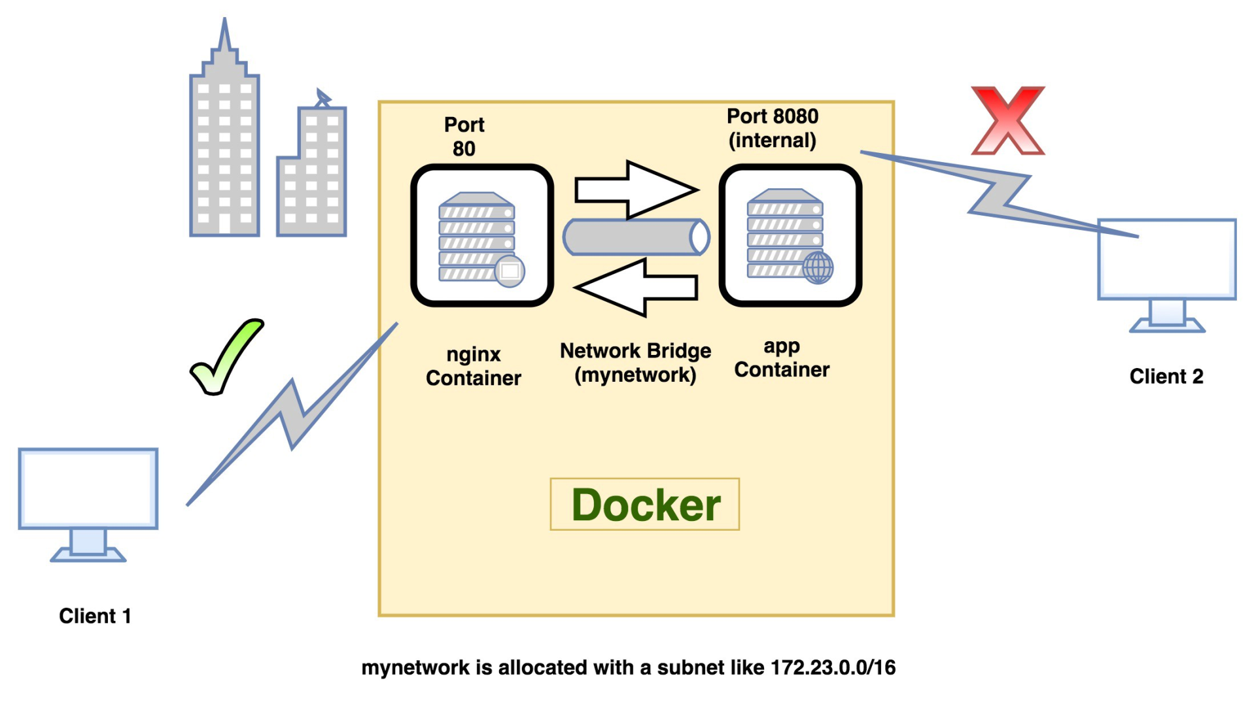

Slide 11
Prerequisites
App container
Node.js or compatible script to read the data from InfluxDB
Plugin for Excel/GoogleSheets
Implementation
Query flow
Excel/GoogleSheet Plugin -> IoT Server App container -> InfluxDB
Data flow
InnfluxDb -> IoT Server App container -> Excel/GoogleSheet
Plugin requirement
Has option to provide IoT Server connection details
Has option to provide data range and period (From date and To date)
Has option to load the Excel template format
Button like, Get data, Refresh
Capability to fill the respective cells with proper data.
Possible, Next sheet has graph view of the data
IoT Server App container requirement:
Accept proper connection request from Plugin (Authentication required)
Get the Date range from the plugin (When Trigger - User press Getdata button or Refresh button)
It should have the list of the databases/measurements to access
Generate the query and get the data
Do any formatting if required
Forward the data to the plugin (If connection is valid and exists)

Slide 12
To do list
Murugan
Prepare a app container
https
Username
password
App container
Plugin
Connection
Query
Get data
Accept the valid connection
Recognize the query
Push the data
Nginx

Slide 13
