Slide 1
WeRadiate-2020-04-29
Plugin & Template Development

Slide 2
Attending
MCCI: Mukesh, Prabhu, Revathy, Vel

Slide 3
Template Development
Need to check,
To Place templates in AddData directory and see it appearing on “My Templates”?
Design the new 3 templates shared by Sashti.
Need to find which probe sending which data packets from Sungjoon – Already sent mail, need to follow-up
Once this is clarified, Revathy needs to narrow down
For second stage of demo: Need to come up with Plugin Installer – so resp add-ins and templates sits in appropriate place on client machine – Prabhu will look on this
Will need to see how we can automate the template creation using scripts, et to make the process easy.
Mind map for the plugins
Query has to be added in each macros and Macros has to fixed for each template and need not be changed).

Slide 4
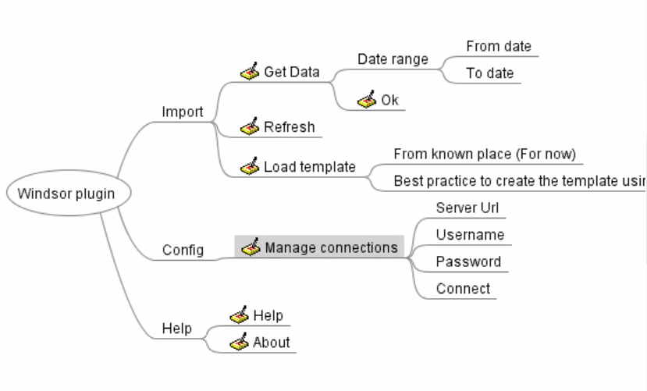
Mind Map of the Plugin

Slide 5
Additional Queries
Need to check Plugin Order:
Load Template
Manage Connections
Get Data
Refresh
Need to check with Error Codes for Plugin, Ask Siva.

