Slide 1
WeRadiate-2020-05-13
DB architecture and Plugin updates

Slide 2
Attending
MCCI: Mukesh, Prabhu, Revathy, Seenivas, Vel

Slide 3
Google Sheet
Main objective is to check “How to get HTTP response”
Data Normalization
Mukesh to prepare the Architecture diagram

Slide 4
Minutes of Meeting
Site Name and other info– WeRadiate has to assign (different names) and share it to MCCI.
WR can be updated in Admin page in case of adding new names
Time span – 5 days (approx.)
DB changes are prior, Plugin side can be changed according to it
Issues in implementing 131 F reference line, Prabhu might need higher version of MS office tools. Need to check and once report.
URL can be viewed by the Client?
Seenivas to come-up with a Document describing about the DB arch and share it to Terry before meeting.

Slide 5
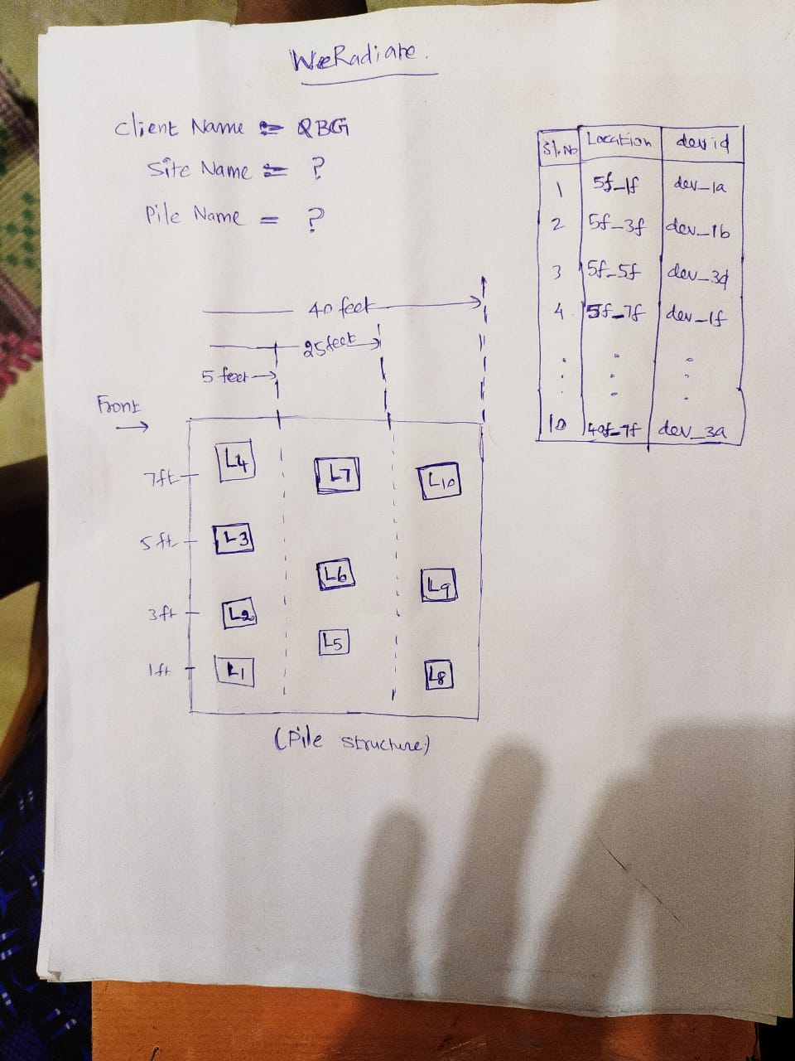
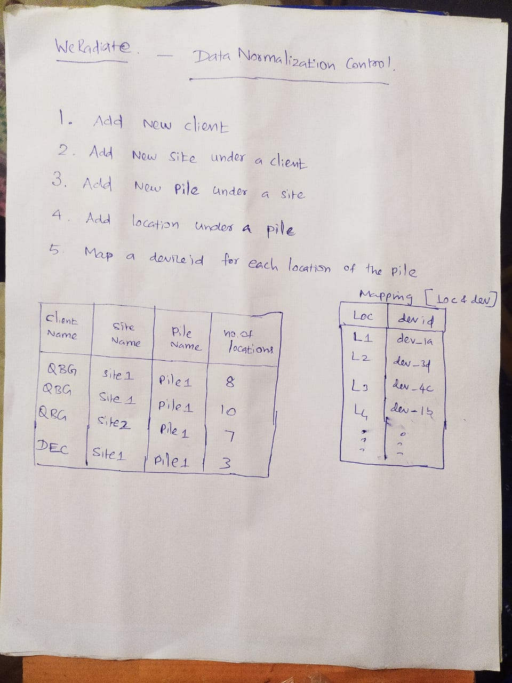
DB Proto Model by Seenivas

Slide 6
Next Internal Meeting
Friday (05/15) before WeRadiate Meeting; May be 12 Noon

