Slide 1

Bhilai Institute of Technology Durg C.G.
Airlines Data Analysis using MySQL
Capstone Project II
(January- June 2024)
Presented By
Mansi Mishra
Guided By
Mrs. Gargi Mishra

Slide 2
Introduction
Companies facing tough challenges from different directions. Things like stricter rules about the environment, higher taxes on flights, and rising costs are squeezing our profits. One plan they're focusing on is looking closely at our data to find ways to get more revenue.

Slide 3
Problem Statement 📈
Environmental Regulatory Challenges
Financial Implications of Flight Taxes
Human Resource Pressures

Slide 4
Objectives
Increase the Occupancy Rate
Improve Pricing Strategy
Profit Maximization
Enhance Customer Experience

Slide 5
Python
MySQL
Streamlit
Matplotlib
Jupyter Notebook
Pandas
Technologies

Slide 6
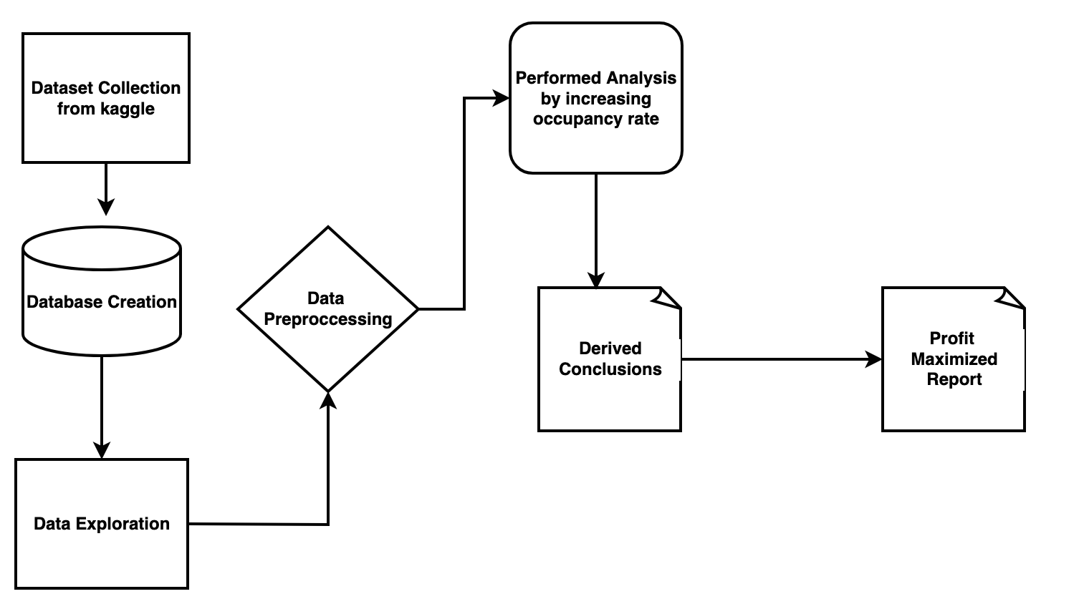
Workflow Diagram

Slide 7
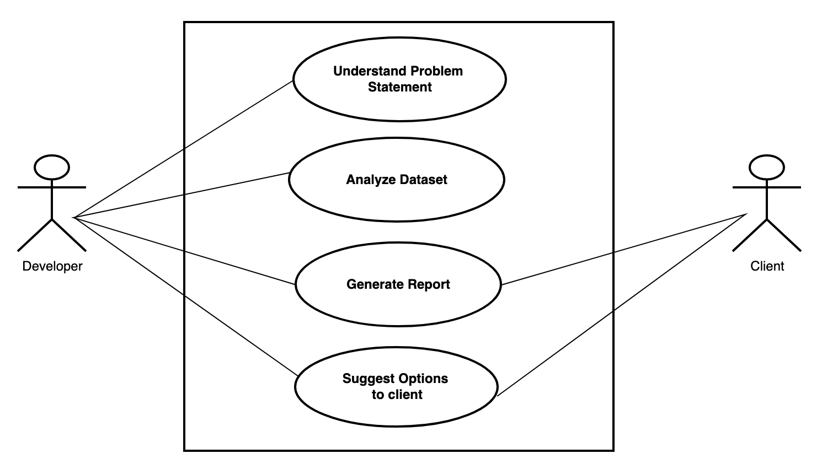
Use Case Diagram

Slide 8
Future Scope
Power BI Dashboard Integration:
Real time data Analysis
Enhance Customer UI//UX Experience

Slide 9
Conclusion
In summary, a 10% increase in occupancy rate could drive a substantial uptick in our total annual turnover, amounting to approximately $2,076,698,090. This underscores the significance of optimizing our operations to seize growth opportunities and reinforce our position in the market.

Slide 10
Thank you!

