Slide 1
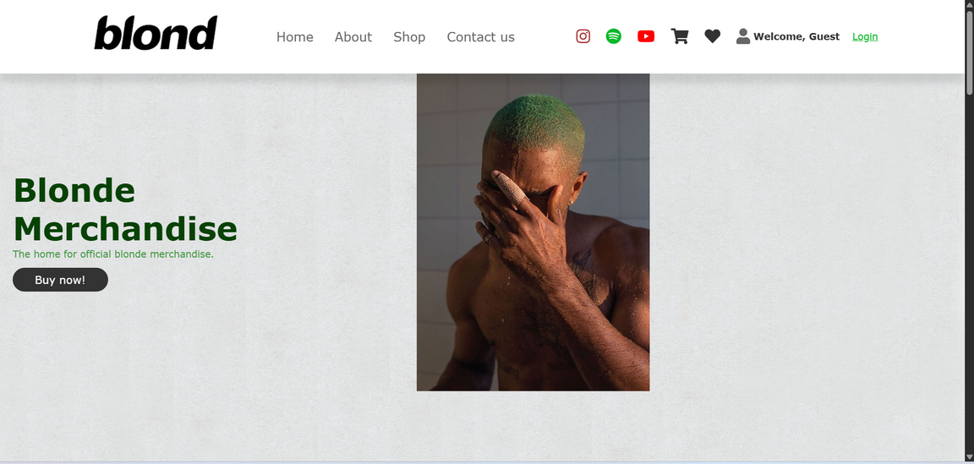
Acosta, Kobe Andrei R,
BLONDE SHOP WEB SYSTEM

Slide 2

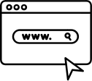


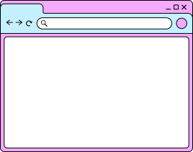







SYSTEM ARCHITECTURE
User/Costumer
Webpage
User Registration
Login
Main page
Add to Cart
Browsing products
Checkout
Payment
User Message/Feedback
Logout
Database

Slide 3
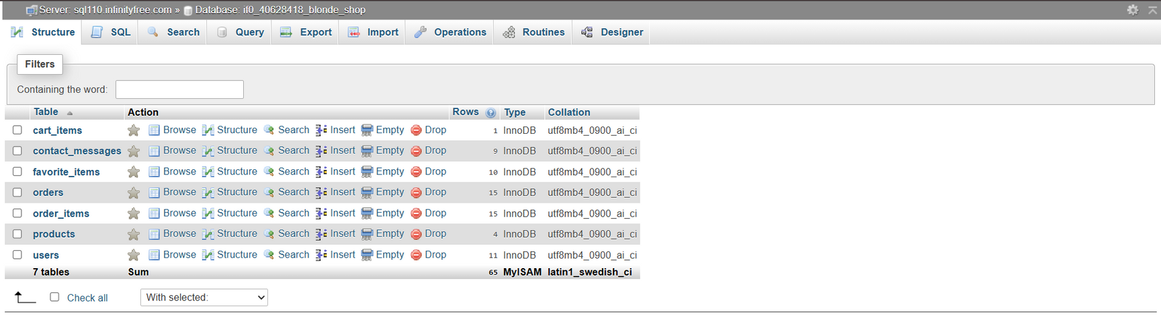
Database Design

Slide 4
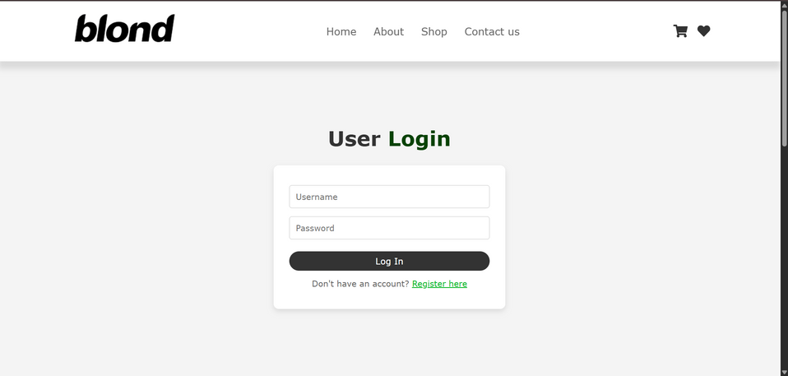
System Storyboard

Slide 5
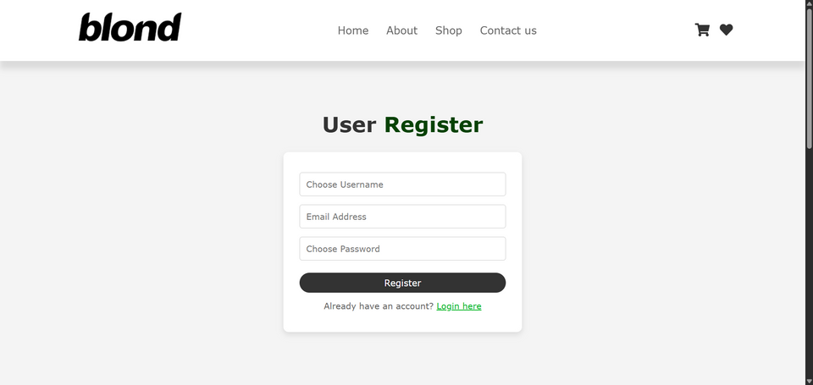
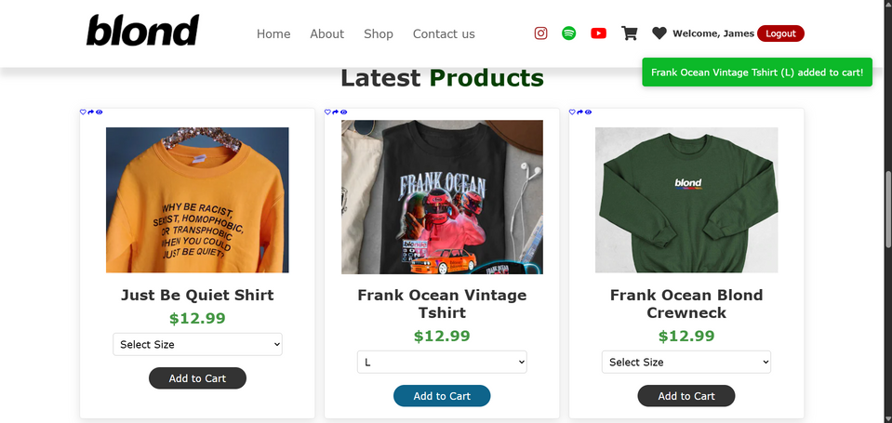
System Storyboard

Slide 6
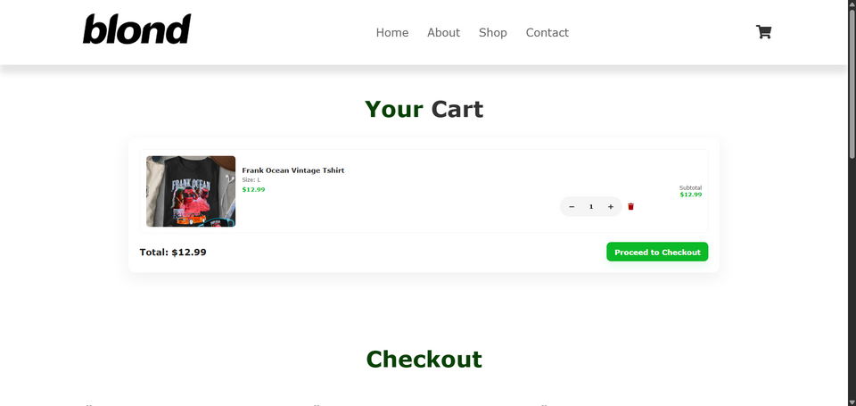
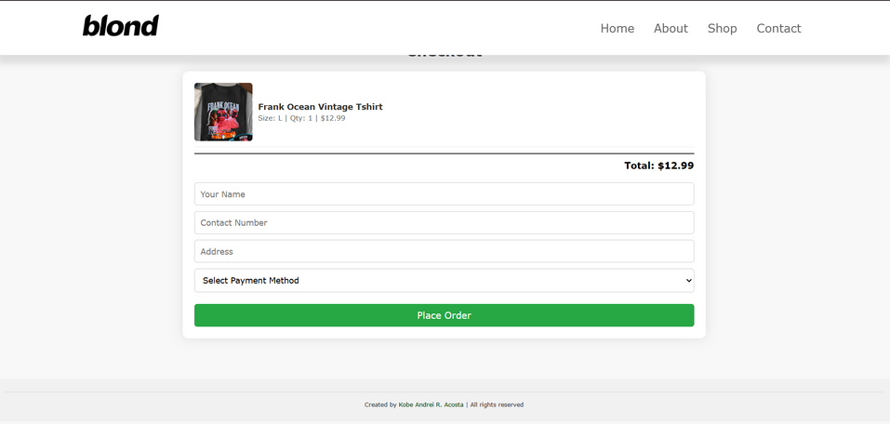
System Storyboard

Slide 7
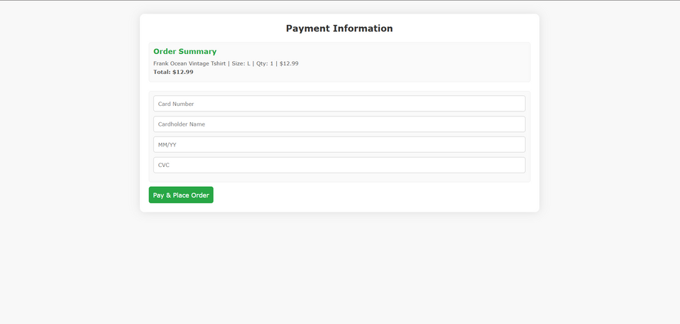
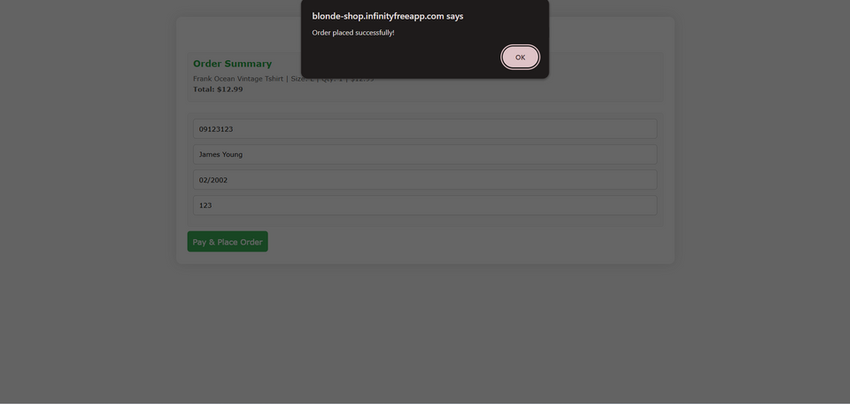
System Storyboard

Slide 8
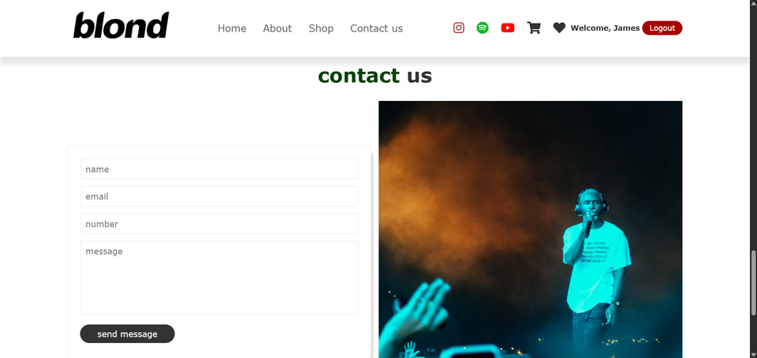
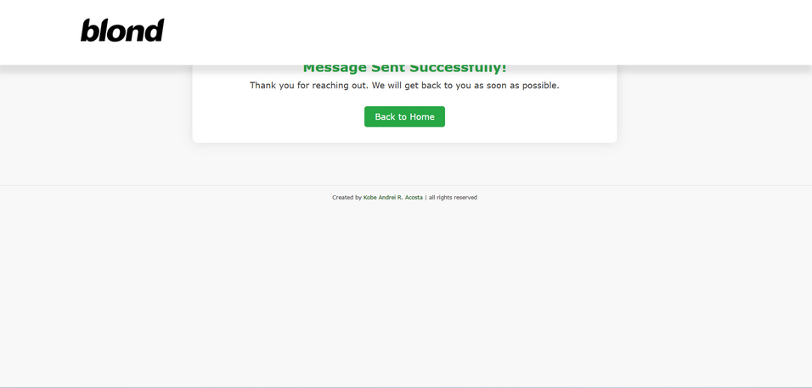
System Storyboard

