Slide 1
Front End and SDLC

Slide 2
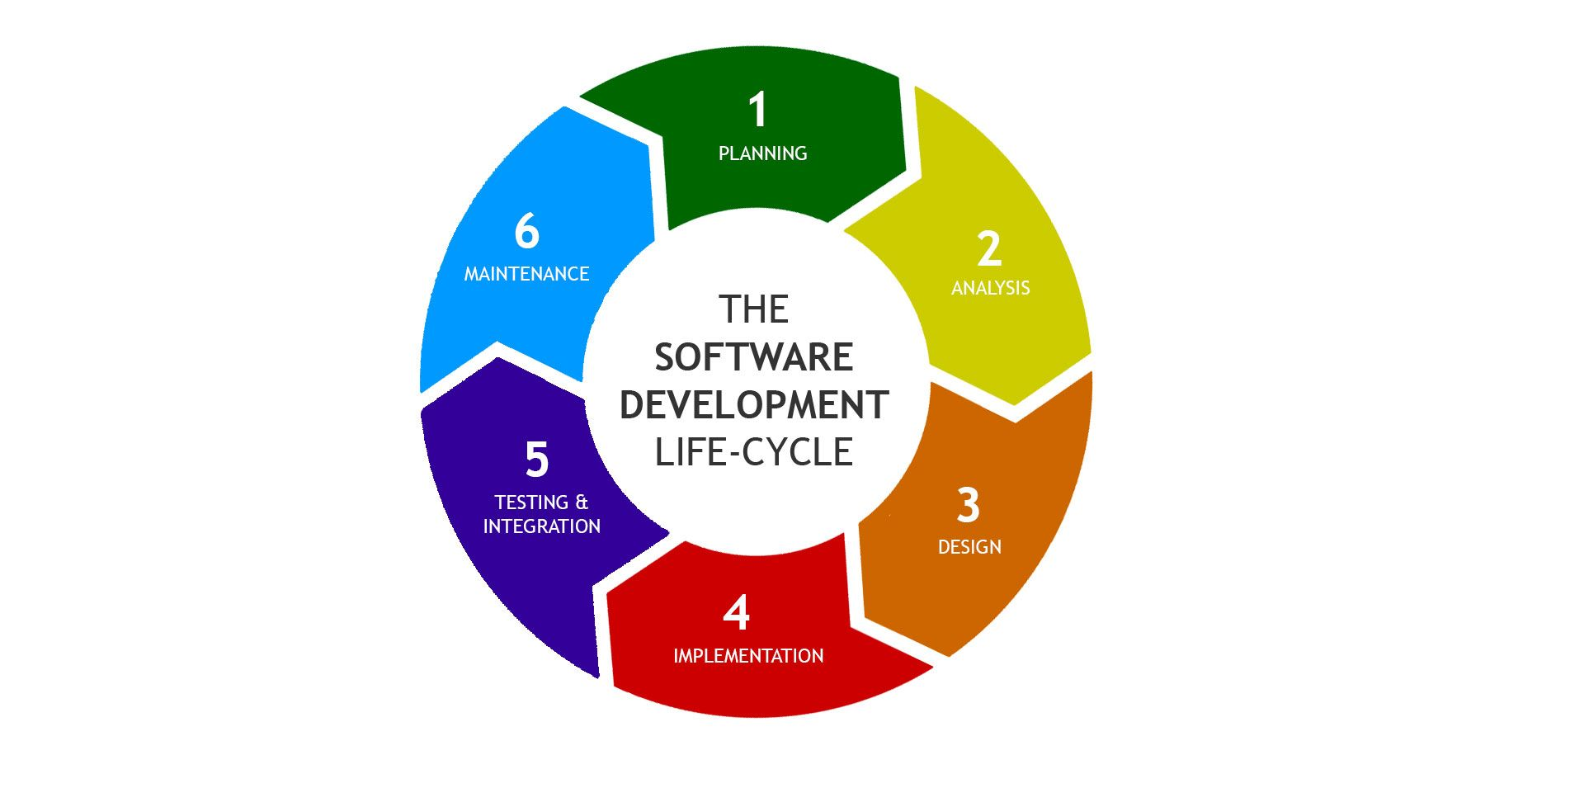
https://arkbauer.com/wp-content/uploads/2019/02/sdlc_software_development_lifecycle.jpg

Slide 3
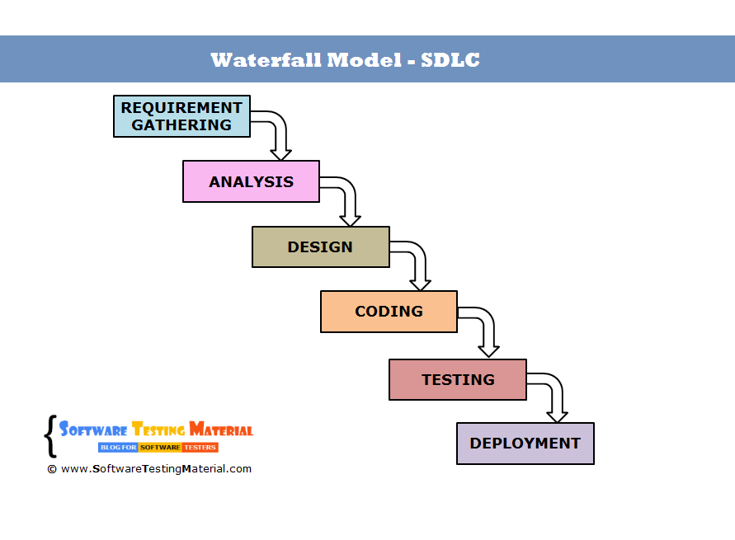
https://external-content.duckduckgo.com/iu/?u=http%3A%2F%2Fwww.softwaretestingmaterial.com%2Fwp-content%2Fuploads%2F2016%2F03%2Fwaterfall-model-sdlc.png&f=1&nofb=1

Slide 4
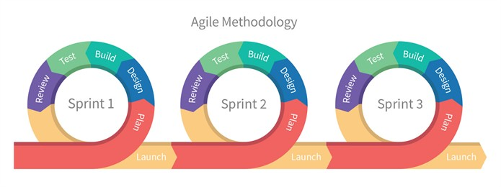
https://external-content.duckduckgo.com/iu/?u=https%3A%2F%2Fcdn-images-1.medium.com%2Fmax%2F1200%2F0*iDT-e3lTcGR0CSy8.&f=1&nofb=1

Slide 5
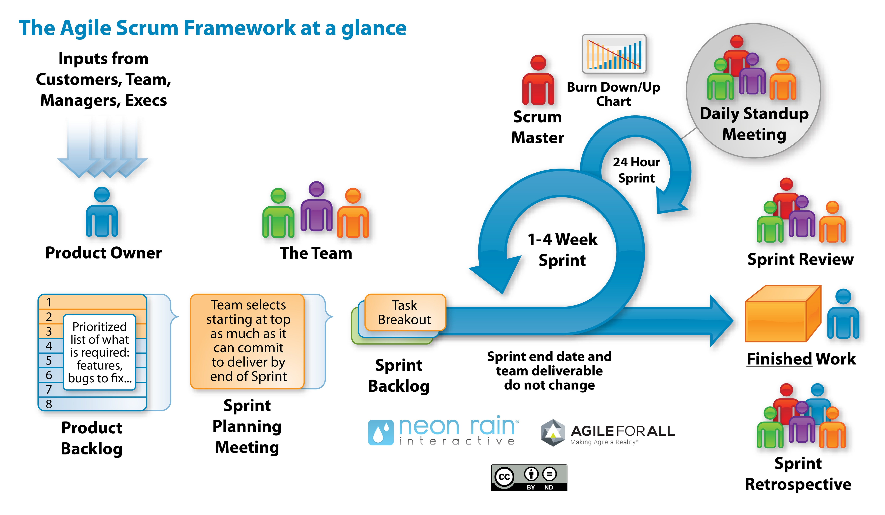

Slide 6
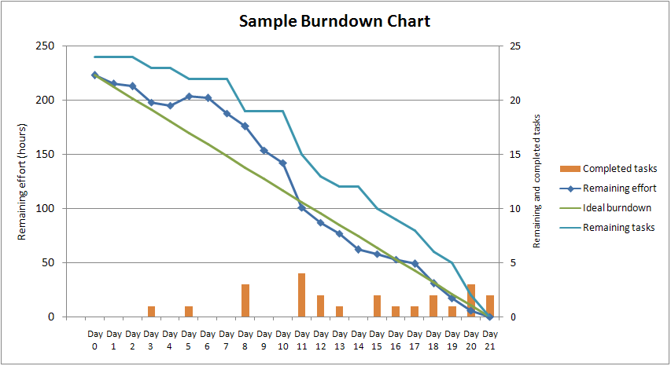
https://external-content.duckduckgo.com/iu/?u=https%3A%2F%2Fupload.wikimedia.org%2Fwikipedia%2Fcommons%2F0%2F05%2FSampleBurndownChart.png&f=1&nofb=1

Slide 7

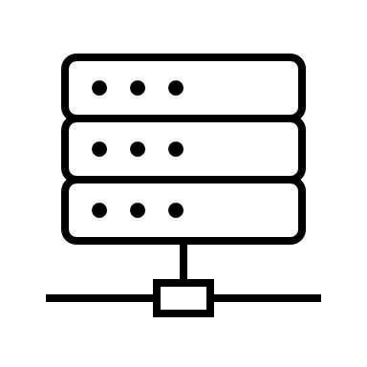
html
Presentation Layer/ client side/ ui/ux
Data access Layer/ service/ business logic
Bootstrap
Data BaseLayer

Slide 8
App design
Home
Pokedex

Slide 9
master
master
Local vs Remote Repository
Nav-branch
Nav-branch
Local repository
remote repository
origin

Slide 10
master
Nav-branch
master
remote repository
origin
Local repository
git clone is the same as….
git init
git remote add origin {{url}}
git pull origin master

Slide 11

Things that I like about the tech.

Slide 12

Things that frustrate me
Standup meetings (mostly standing up)

