Slide 1
Front End and SDLC

Slide 2
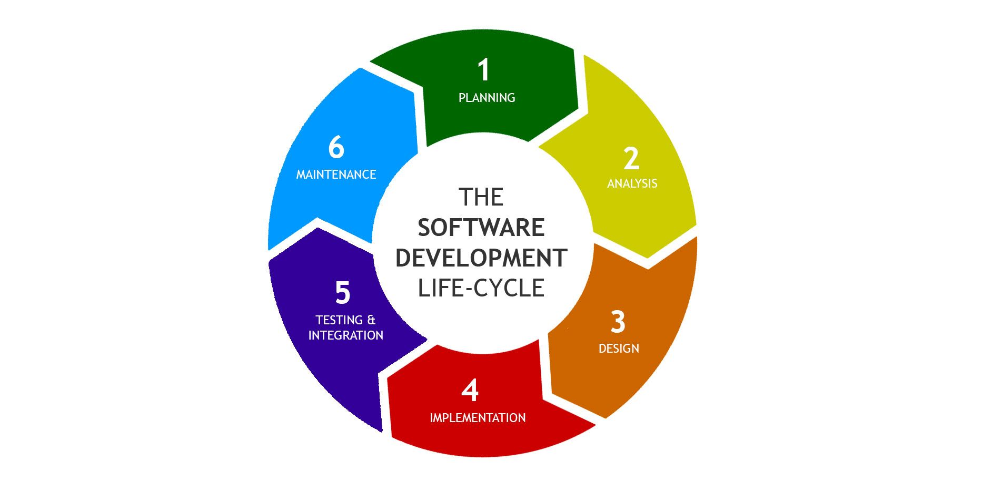
https://arkbauer.com/wp-content/uploads/2019/02/sdlc_software_development_lifecycle.jpg

Slide 3
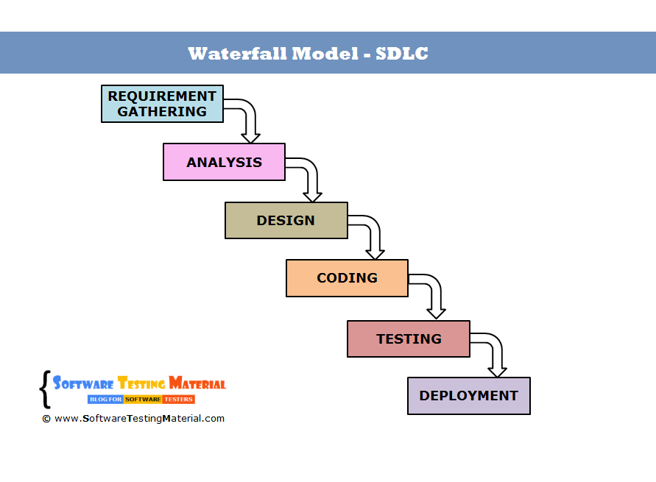
https://external-content.duckduckgo.com/iu/?u=http%3A%2F%2Fwww.softwaretestingmaterial.com%2Fwp-content%2Fuploads%2F2016%2F03%2Fwaterfall-model-sdlc.png&f=1&nofb=1

Slide 4
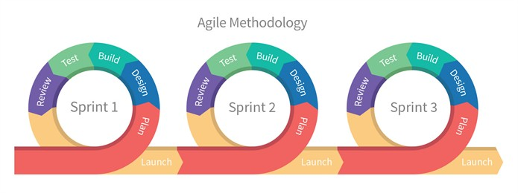
https://external-content.duckduckgo.com/iu/?u=https%3A%2F%2Fcdn-images-1.medium.com%2Fmax%2F1200%2F0*iDT-e3lTcGR0CSy8.&f=1&nofb=1

Slide 5
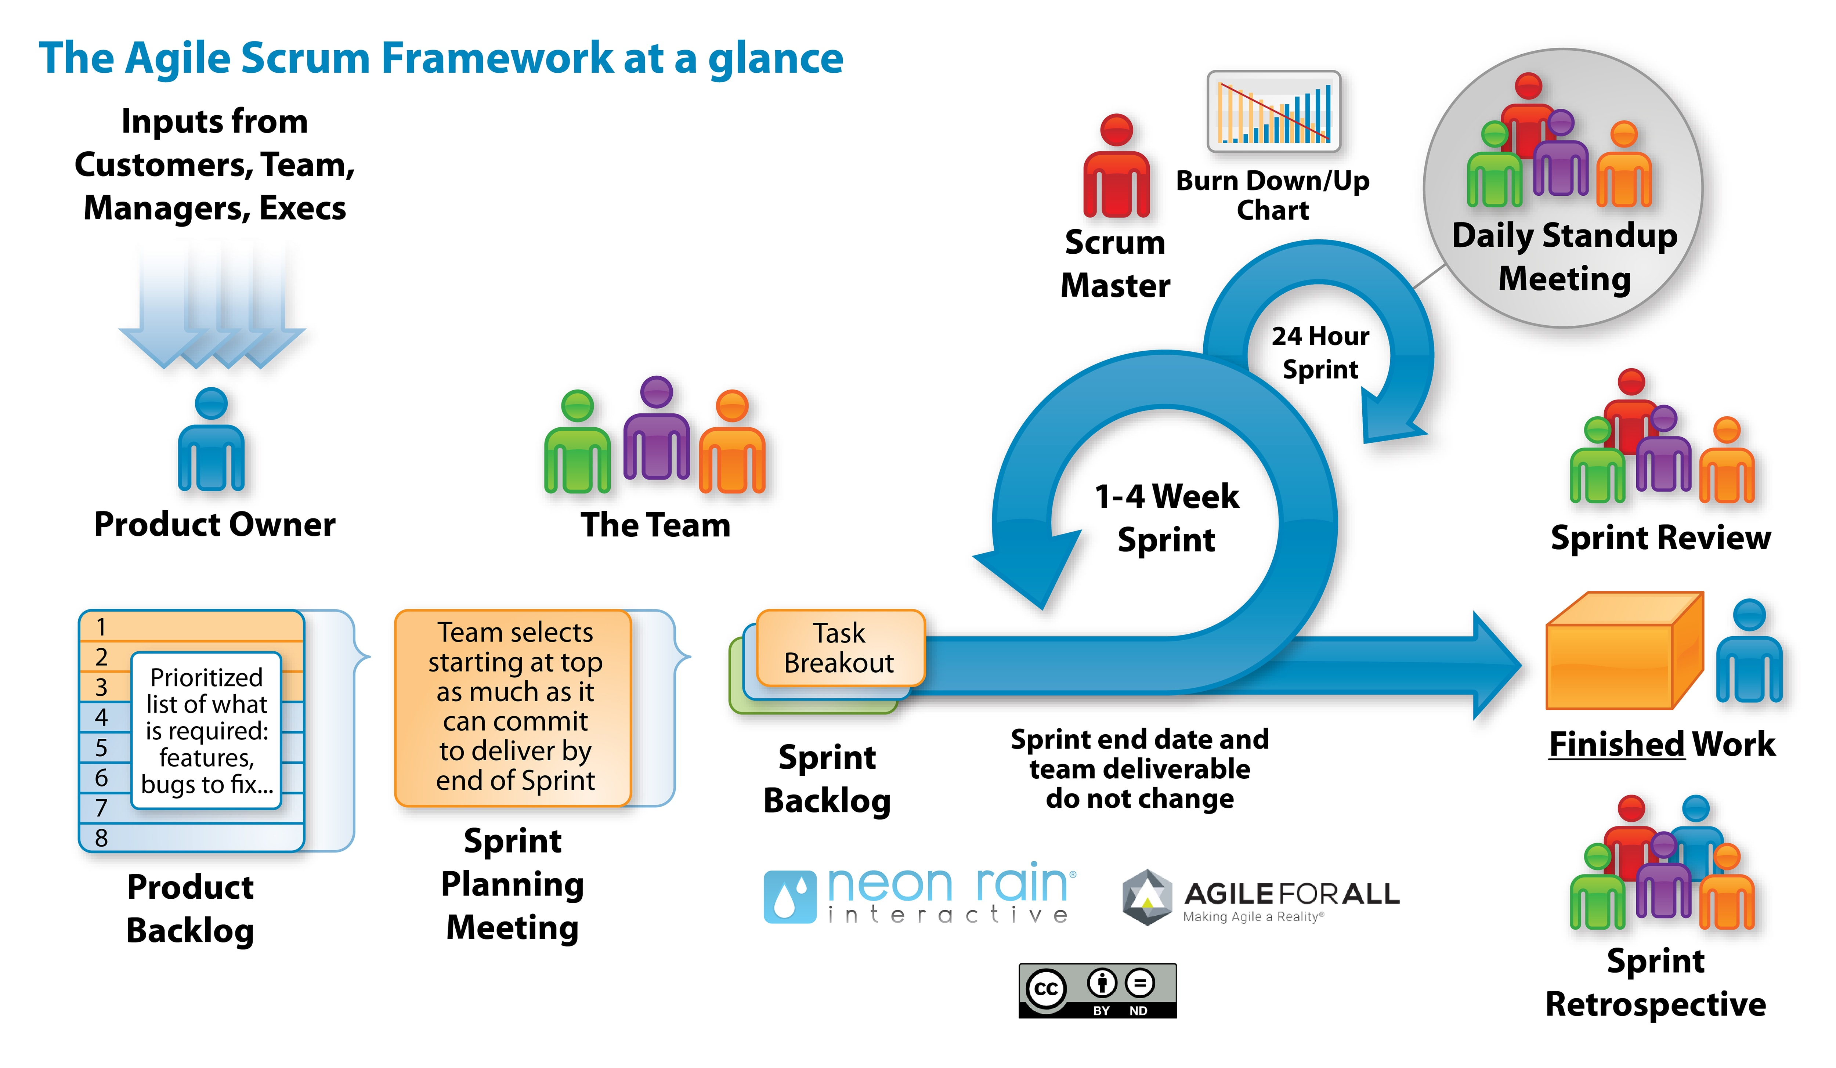

Slide 6
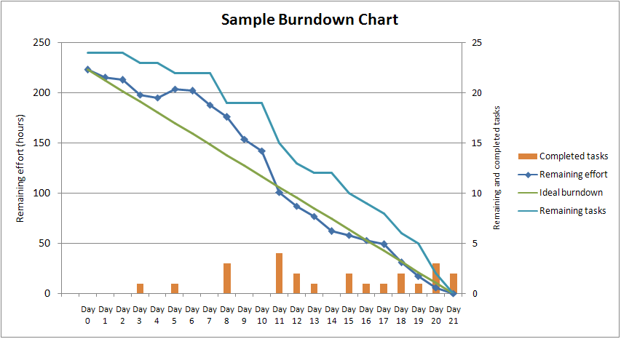
https://external-content.duckduckgo.com/iu/?u=https%3A%2F%2Fupload.wikimedia.org%2Fwikipedia%2Fcommons%2F0%2F05%2FSampleBurndownChart.png&f=1&nofb=1

Slide 7

Things that I like about the tech.

Slide 8

Things that frustrate me
Standup meetings (mostly standing up)

