Slide 1
DevOps and AWS

Slide 2

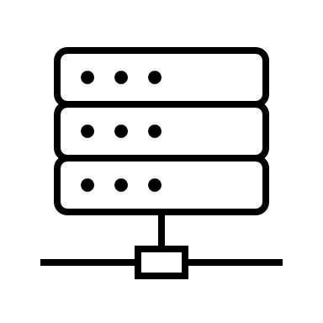
On-Premise
app

Slide 3
On the Cloud
app

Slide 4
On premise vs Cloud
On Premise
“Security”
Standards and Licenses
Control
Can choose exact hardware
Higher upfront cost
Also takes up space
You have to pay people to maintain infrastructure
On Cloud
You don’t have to maintain your own server
Indefinite (near infinite) storage
Scalability (in the case of more load, you have the ability to react and increase computing power)
Horizontal vs vertical scaling
Lower upfront cost, but maybe higher cost over very long period of time (probably not though)
Maintenance is included
Easier to have application available in multiple regions all over the world
Less downtime, more availablity

Slide 5
Horizontal scaling vs Vertical scaling
Horizontal
Vertical

Slide 6
Horizontal vs Vertical (in general)
Horizontal
Availability of Application
Vertical
Arguably simpler to set up
Potentially cheaper to buy one large machine

Slide 7
How do we go from Dev to Prod
GitHub
app
app
Deploy to server
Prepare for production
Deploy it (put it on a server)
Extra configurations

Slide 8
Java App Deployment (no Pipeline)
Prepare for production
Deploy it (put it on a server)
Extra configurations
GitHub
app
app
Deploy to server
For prod
Java
Tomcat Server
Maven ???
OS: Linux
For dev
JRE/JDK
Tomcat Server
Text editor/ IDE
Maven
OS: Windows/ Mac/ Linux

Slide 9
Java App Deployment (no Pipeline)
app
app
Deploy to server
Each time you make changes:
Push code to github
Make a new build (mvn package)
Upload to server (scp or git)
Stop/start tomcat server
Delete old app/ replace with new app

Slide 10
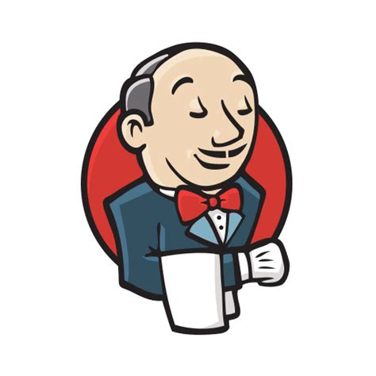
Java App Deployment (yes Pipeline)
app
app
DevOps Pipeline
Push code to repo
(optionally) press button to build application

Slide 11
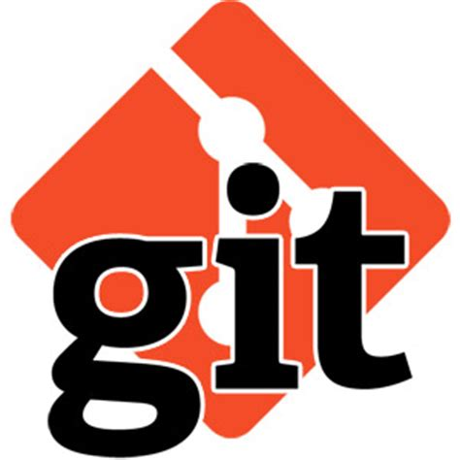
How Jenkins Works
Fetch codebase
Build app using codebase
Deploy to tomcat server
Maven
app
app
push
pull
Github

Slide 12
Github
Webhook

Slide 13
DevOps
CI (Continuous Integration)
Practice of as frequently as possible merging your codebase
CD (Continuous Delivery)
Automating your deployment to productions process such that your application can be released to production at the click of a button
CD (Continuous Deployment)
Cont Delivery + not having to push the button
No human intervention needed

Slide 14
Virtual machines
(Amazon Linux 2)
Virtual machines
(Ubuntu)
Virtual machines
(Windows)
Hypervisor
Underlying OS

Slide 15
Maven…Jar…War…Tomcat….etc
http request
Jar
Jar
Tomcat
Server
Jar
app
Deploy
(not maven deploy)
Jar
WAR
Jar
package
WAR
Maven

Slide 16
Architecture for SB app
Architecture for app deployed as war
Jetty
Server
Tomcat
Server
Jenkins.war
Jenkins.war
App.war
Spring boot jar

Slide 17
AWS Services
S3
EC2
AMI
EBS
Route 53
EIP
ELB
API Gateway

Slide 18
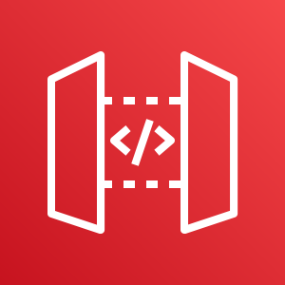
API Gateway
External api
Your api #1
client
Your api #2

Slide 19
EC2 and EBS
EC2
EC2
EBS
Root EBS
Root EBS

Slide 20
AWS Global Infrastructure
AZ (us-east-1a)
AZ (us-east-1b)
Regions
Availability Zones
Edge Locations
Region (us-east-1/ N. Virginia)
AZ (us-east-1c)

Slide 21
Load Balancing
App
Load Balancer
App
Client
App

Slide 22
Auto Scaling Groups
Apps
Autoscaling Group
Apps
Apps
Apps
Apps

Slide 23
What we like
Like how much automation Jenkins does for us
Jenkins can potentially save a lot of time
AWS CLI (faster and makes automation possible)
Tomcat is easy to use (easy deployments)

Slide 24
What we do not like
Naming conventions (confusing)
We don’t like ssh-ing because of intricacy (addition set of skills)
Confusing hidden fees (they tell you about it….so it’s your fault)

