Slide 1
DevOps and AWS

Slide 2

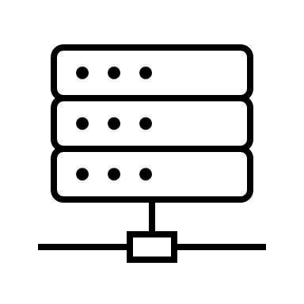
On-Premise
app

Slide 3
On the Cloud
app

Slide 4
On premise vs Cloud
On Premise
“Security”
Standards and Licenses
Control
Can choose exact hardware
Higher upfront cost
Also takes up space
You have to pay people to maintain infrastructure
On Cloud
You don’t have to maintain your own server
Indefinite (near infinite) storage
Scalability (in the case of more load, you have the ability to react and increase computing power)
Horizontal vs vertical scaling
Lower upfront cost, but maybe higher cost over very long period of time (probably not though)
Maintenance is included
Easier to have application available in multiple regions all over the world
Less downtime, more availablity

Slide 5
Horizontal scaling vs Vertical scaling
Horizontal
Vertical

Slide 6
Horizontal vs Vertical (in general)
Horizontal
Availability of Application
Vertical
Arguably simpler to set up
Potentially cheaper to buy one large machine

Slide 7
How do we go from Dev to Prod
GitHub
app
app
Deploy to server
Prepare for production
Deploy it (put it on a server)
Extra configurations

Slide 8
Java App Deployment (no Pipeline)
Prepare for production
Deploy it (put it on a server)
Extra configurations
GitHub
app
app
Deploy to server
For prod
JRE
Tomcat Server
Maven ???
OS: Linux
For dev
JRE/JDK
Tomcat Server
Text editor/ IDE
Maven
OS: Windows/ Mac/ Linux

Slide 9
Maven…Jar…War…Tomcat….etc
http request
Jar
Jar
Tomcat
Server
Jar
app
Deploy
(not maven deploy)
Jar
WAR
Jar
package
WAR
Maven

Slide 10
AWS Services
S3
EC2
AMI

Slide 11
EC2 and EBS
EC2
EC2
EBS
Root EBS
Root EBS

Slide 12
What we like

Slide 13
What we do not like

