Slide 1
Front End and SDLC

Slide 2
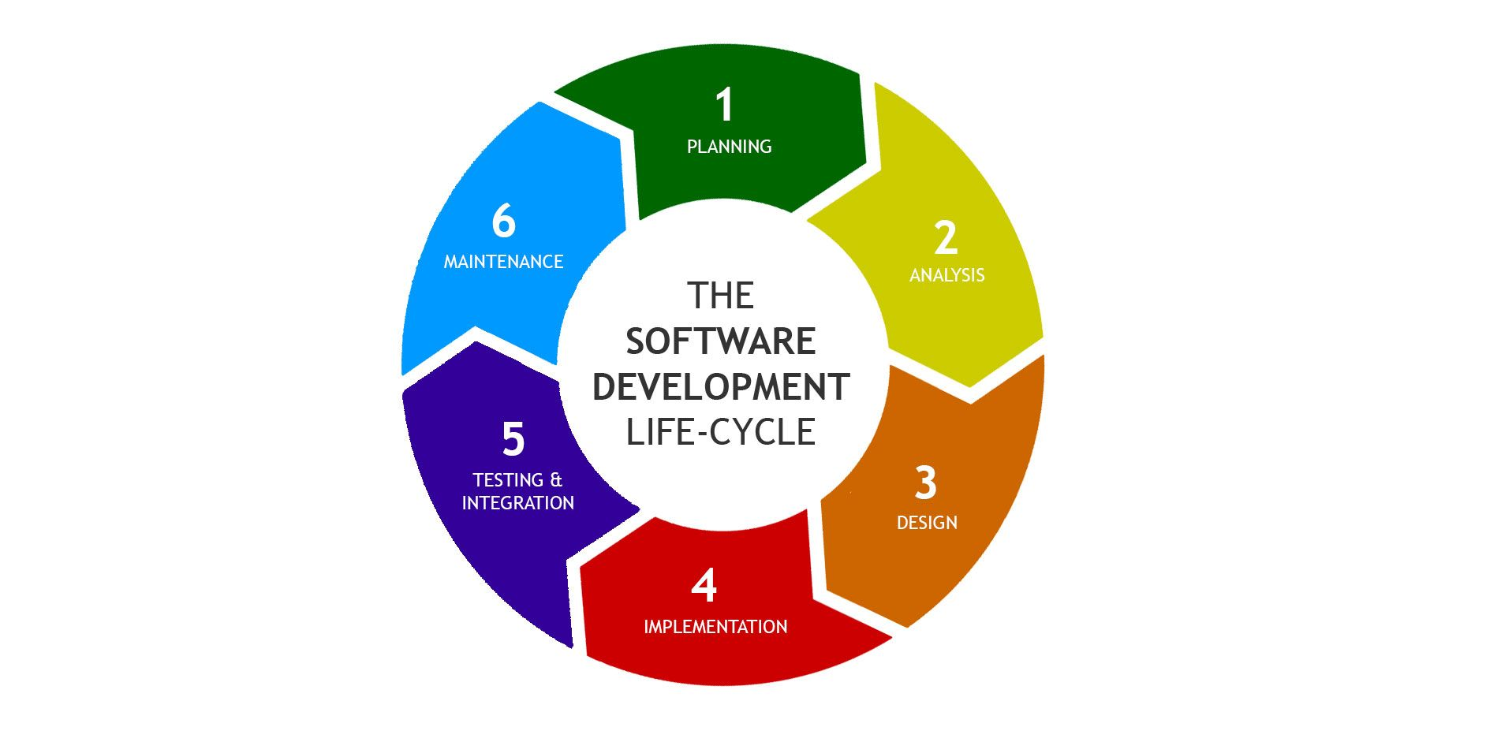
https://arkbauer.com/wp-content/uploads/2019/02/sdlc_software_development_lifecycle.jpg

Slide 3
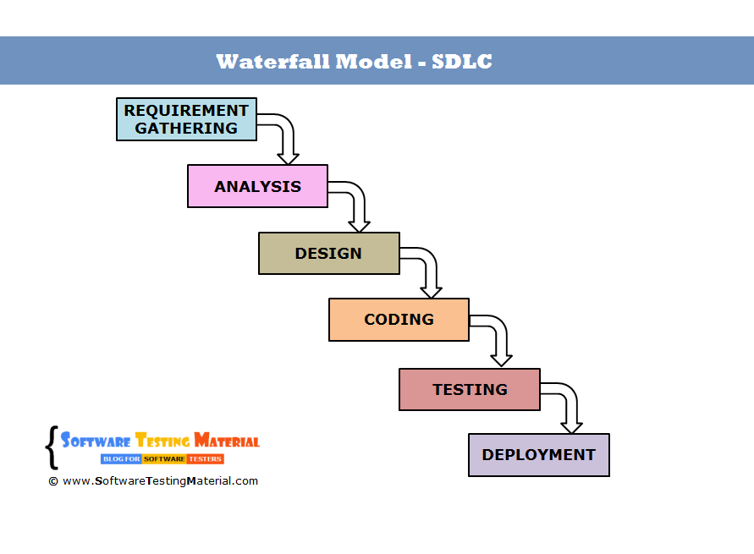
https://external-content.duckduckgo.com/iu/?u=http%3A%2F%2Fwww.softwaretestingmaterial.com%2Fwp-content%2Fuploads%2F2016%2F03%2Fwaterfall-model-sdlc.png&f=1&nofb=1

Slide 4
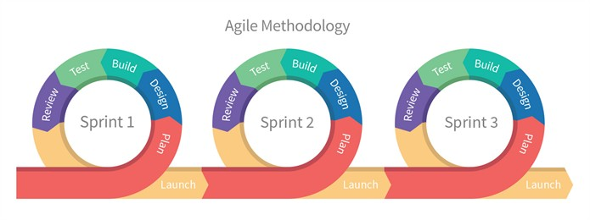
https://external-content.duckduckgo.com/iu/?u=https%3A%2F%2Fcdn-images-1.medium.com%2Fmax%2F1200%2F0*iDT-e3lTcGR0CSy8.&f=1&nofb=1

Slide 5
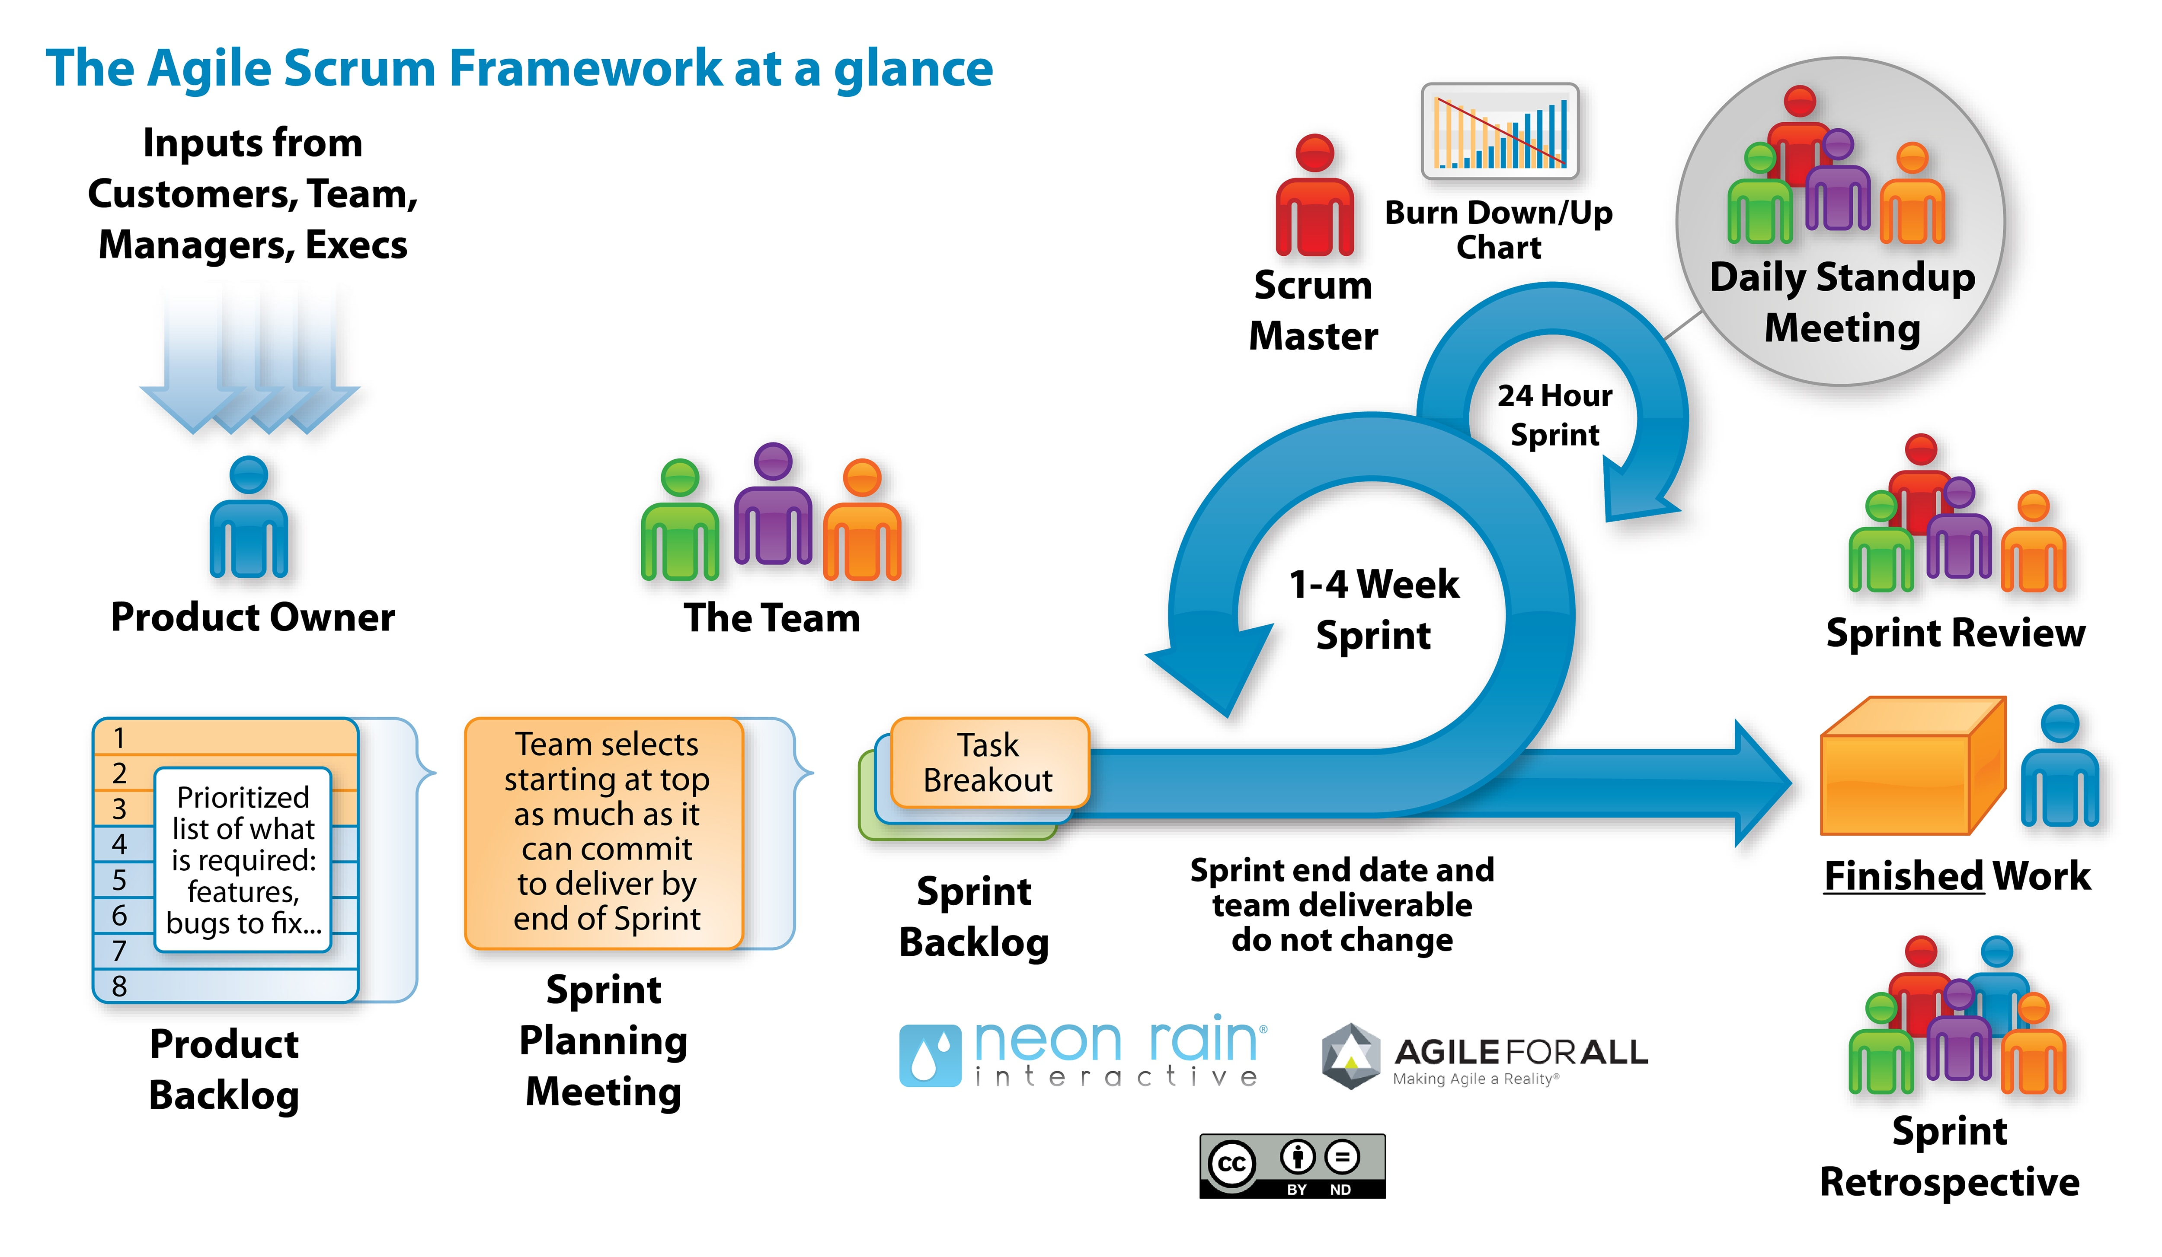

Slide 6
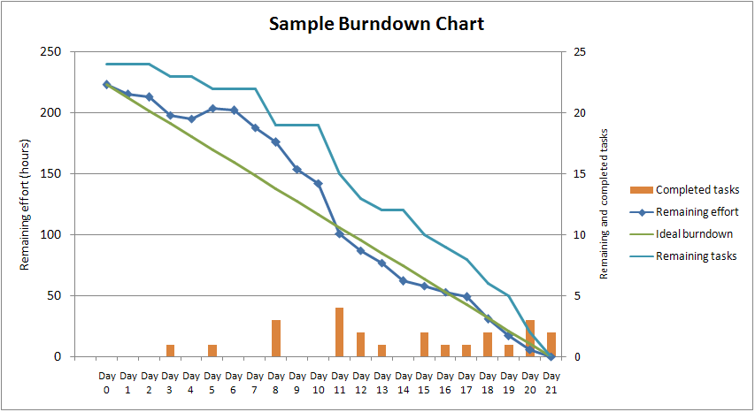
https://external-content.duckduckgo.com/iu/?u=https%3A%2F%2Fupload.wikimedia.org%2Fwikipedia%2Fcommons%2F0%2F05%2FSampleBurndownChart.png&f=1&nofb=1

Slide 7

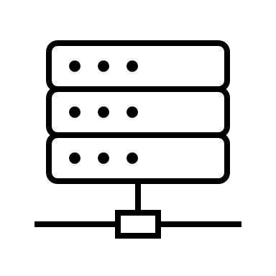
html
Presentation Layer/ client side/ ui/ux
Data access Layer/ service/ business logic
Bootstrap
Data BaseLayer

Slide 8
App design
Home
Pokedex

Slide 9
master
master
Local vs Remote Repository
Nav-branch
Nav-branch
Local repository
remote repository
origin

Slide 10
master
Nav-branch
master
remote repository
origin
Local repository
git clone is the same as….
git init
git remote add origin {{url}}
git pull origin master

Slide 11
Bubbling and Capturing
Bubbling
Capturing

Slide 12

Things that I like about the tech.
How dynamic CSS is
We like the Cascading part of CSS -- More consistent
HTML, CSS, JS … more “simple” (faster to learn)
We like how modular css and js are
JS is efficient (less lag)

Slide 13

Things that frustrate me
Standup meetings (mostly standing up)
Having to change multiple copies of same html elements in each file
Having to do paddings and margin for text
Changes depending on browser
Dealing with CSS

