Slide 1

Car Insurance Claim Prediction Data Science Project
By Group-19

Slide 2

THE PROBLEM
Insurance companies face significant challenges due to the financial risks associated with policy claims. In the context of car insurance, accurately predicting which policies will result in claims can provide substantial benefits. By leveraging car, policy, and demographic features, we aim to develop a predictive model that helps mitigate financial risks and improve decision-making processes.

Slide 3
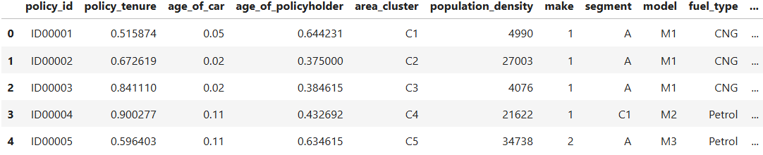
THE DATA
Kaggle dataset with 44 columns and 58,592 rows. Each column represent a feature, including the target variable. Each row represent a policy record.
Datasources: The project will utilize a provided dataset containing car and policyholder details, as well as an insurance claim label. Link to the dataset:
https://www.kaggle.com/datasets/ifteshanajnin/carinsuranceclaimprediction-classification?select=train.csv

Slide 4
DATA WRANGLING
Assess the data types
Encode categories
Split columns
Check for missing values
Verify ID Uniqueness
Check for duplicates

Slide 5
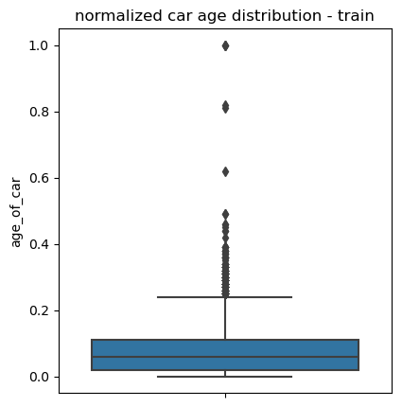
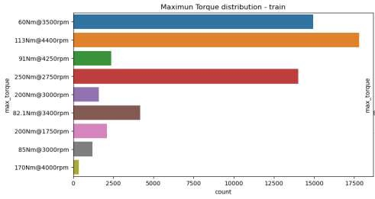
EXPLORATORY DATA ANALYSIS (EDA)
Explore each variable separately
Explore relations between variables
Explore relations between the features and the target variable

Slide 6
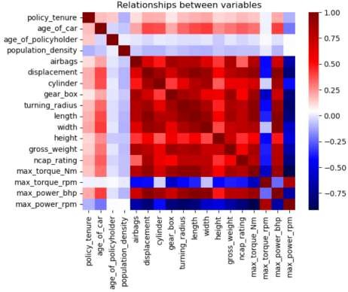
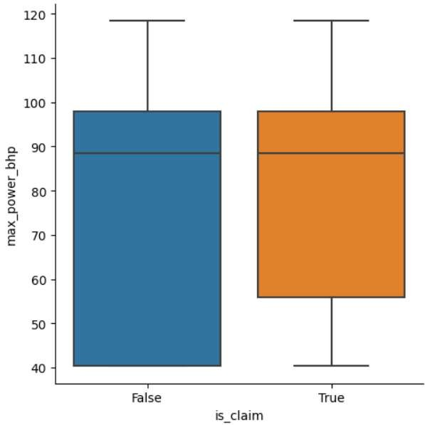
EXPLORATORY DATA ANALYSIS (EDA)

Slide 7
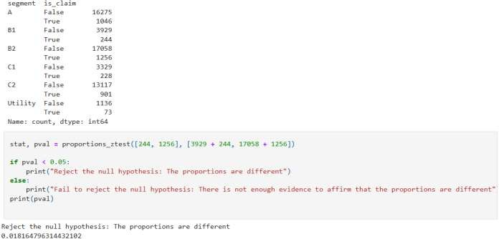
EXPLORATORY DATA ANALYSIS (EDA)
Proportions difference null hypothesis significance tests
Means difference null hypothesis significance tests

Slide 8
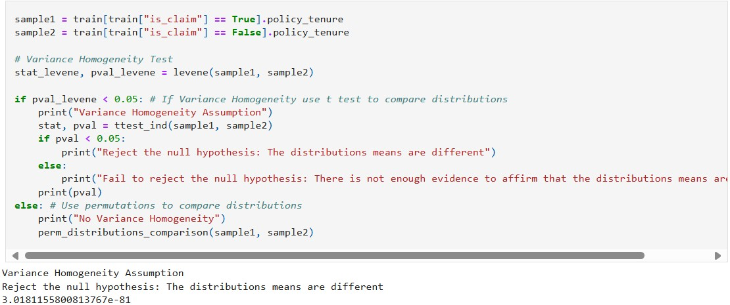
EXPLORATORY DATA ANALYSIS (EDA)

Slide 9

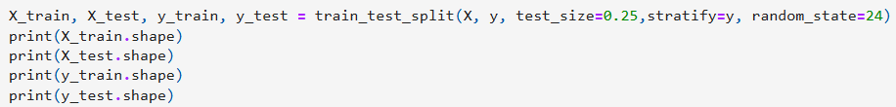
PREPROCESSING
Get dummies for categorical variables
Scale the numeric variables
Split the data in training and test sets

Slide 10
MODELLING, EVALUATION AND OPTIMIZATION
Baseline Models: K-Nearest Neighbors Classifier, Decision Tree Classifier, and Logistic Regression
Ensemble Methods: Random Forest Classifier and Extreme Gradient Boosting
Hyperparameter Tuning: Random Search
SMOTE: Synthetic Minority Over-sampling Technique
Advanced Model: Multilayer Perceptron Classifier (MPC)
Evaluation Metrics: Classification Report (precision, recall, f1 score), Confusion Matrix, Receiver Operating Characteristic (ROC) curve and its Area Under the Curve (AUC)

Slide 11
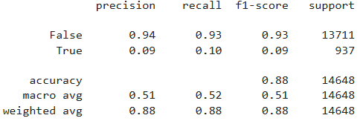
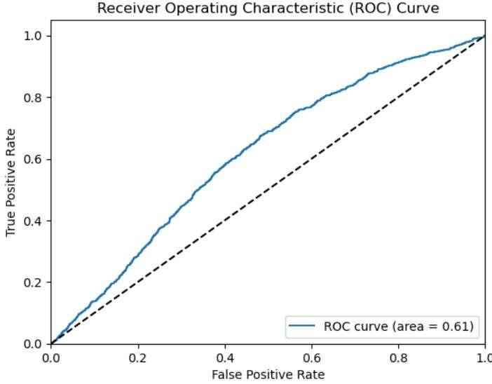
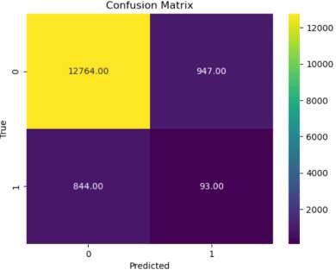
RANDOM FOREST CLASSIFIER (RANDOM SEARCH)

Slide 12
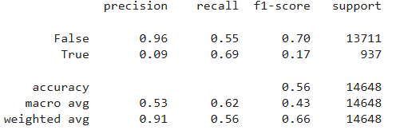
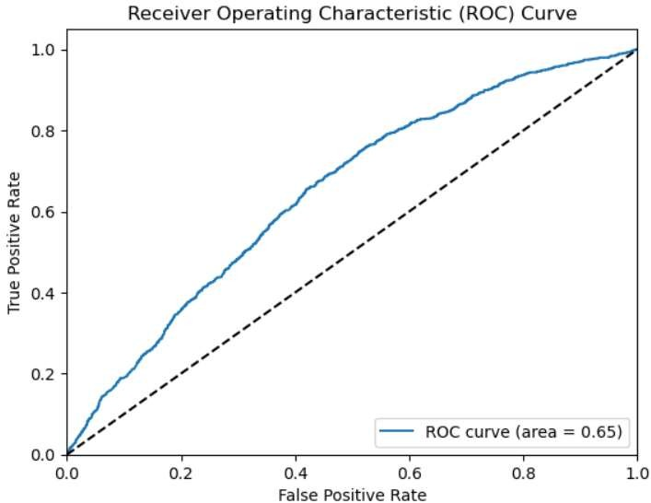
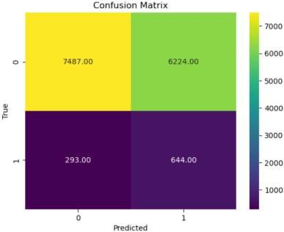
EXTREME GRADIENT BOOSTING (RANDOM SEARCH)

Slide 13
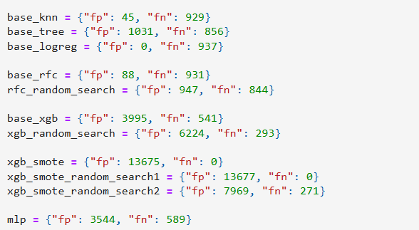

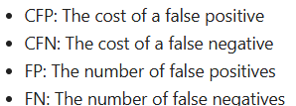
BUSINESS MODEL USING COST FUNCTION

Slide 14

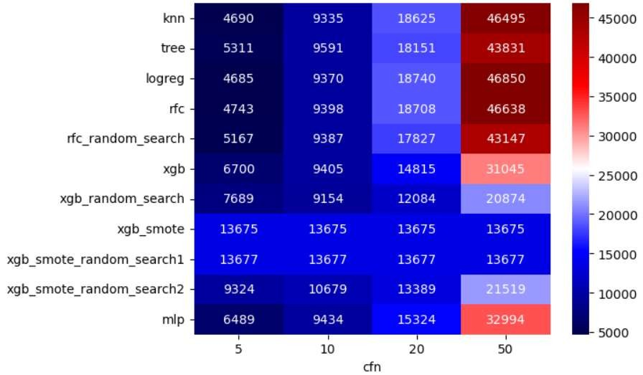
BUSINESS MODEL USING COST FUNCTION

Slide 15
CONCLUSION
Best Model: Extreme Gradient Boosting with Random Search
Best Hyperparameters: {'n_estimators': 200, 'max_depth': 6, 'learning_rate': 0.01, 'gamma': 0}
Metrics: {AUC: 0.65, accuracy: 0.56 , f1_score (True) = 0.17, business_cost_10 = 9154, business_cost_20 = 12084}
Final Recommendations: Reduce the dataset's class imbalance. Increase computational resources to perform a Complete Grid Search for hyperparameter tuning. Establish a precise ratio between the cost of false positives and false negatives

Slide 16

Team Members Name
*Hardik Mishra (2215000716)
*Anshita Agarwal (2215000288)
*Nitin Gupta (2215001186)
*Sachin Yadav (2215001518)
*Vineet Rajput (2215001964)
THANKS

