Slide 1
Human Computer Interaction
Introduction

Slide 2
Weightages
Quizzes | 10 % | No re-takes allowed Strict actions will be taken in case of plagiarism
Assignments | 10 % | In case of late submission 25% marks will be deducted per day i.e. if the late submission is being allowed
Mid Term | 20 % | Strict actions will be taken in case of plagiarism
Project | 10% | In case of late submission 25% marks will be deducted per day i.e. if the late submission is being allowed
Class Activities | 10 % | To be done and submitted in class If you are absent, then you have missed your class activity, nothing can be done about it.
Final Term | 40 % | Strict actions will be taken in case of plagiarism
Total | 100 %

Slide 3
Introduction
Bad Designs are everywhere
Human Computer Interaction
Difference between focus of SE and HCI
History of User Interfaces
Course Reference Material

Slide 4
1. Bad Designs are everywhere

Slide 5
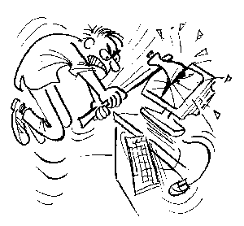
Did You Ever Hate Your Computer?

Slide 6
Facts
1 in every 4 computers has been physically attacked by its owner - Novatech (British PC Manufacturer)
Almost ⅓ of people have physically attacked a computer – National Opinion Poll/Symantec
67% experienced frustration, exasperation and anger – National Opinion Poll/Symantec
70% swore at their machines – National Opinion Poll/Symantec

Slide 7

Good and Bad Interfaces!
Computers are every where
And
Their good design is very important

Slide 8
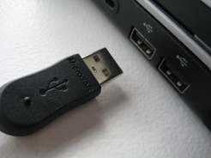
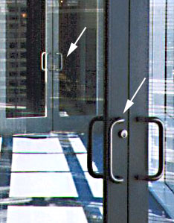
Bad Designs are Everywhere

Slide 9
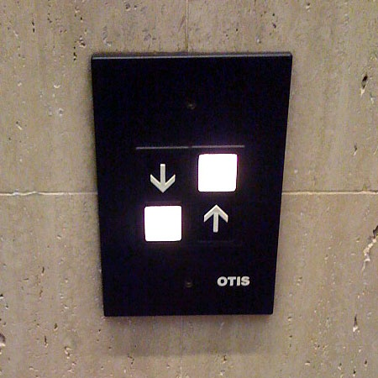
Good or Bad?

Slide 10
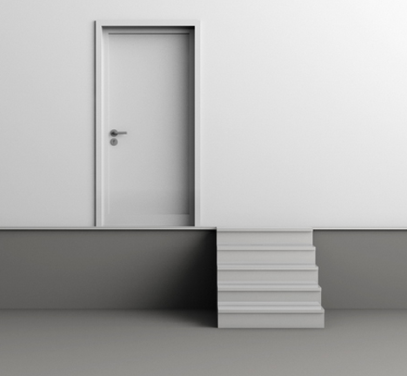

Slide 11



Slide 12

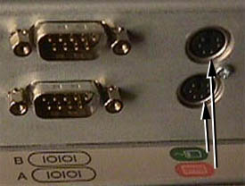

Good and bad design

Slide 13
Case Study: Unix Commands
Intend to type: rm *˜ to remove Emacs backup files.
Actually type: rm * ˜ which removes everything!
And there is no undo . . .

Slide 14
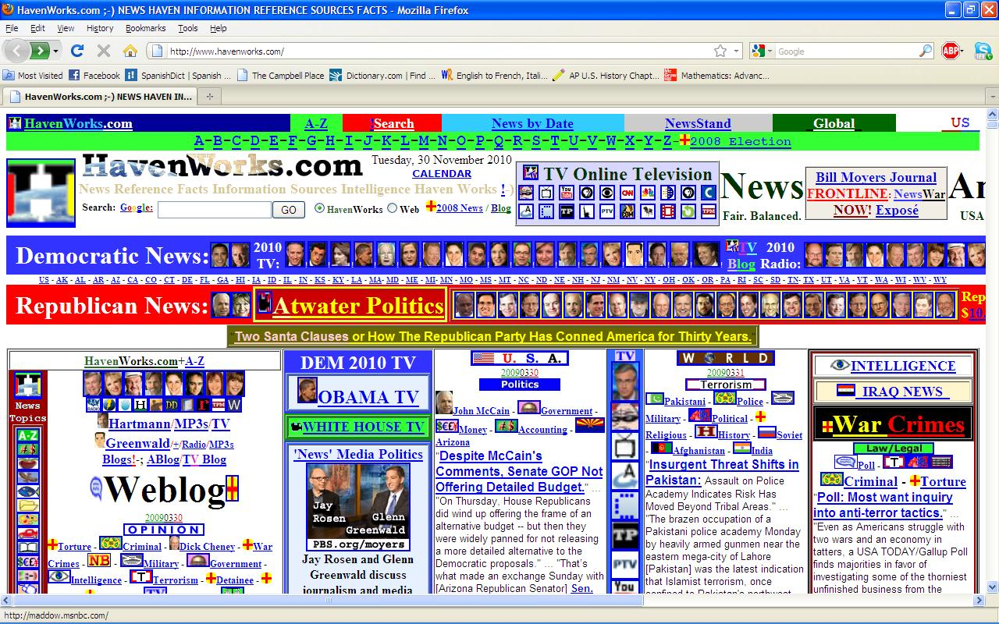
Bad Design

Slide 15
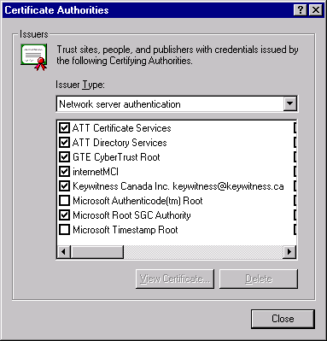
Bad Design

Slide 16
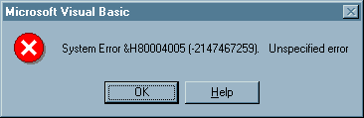
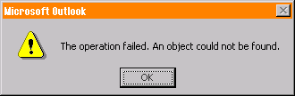
Useless Error Messages

Slide 17
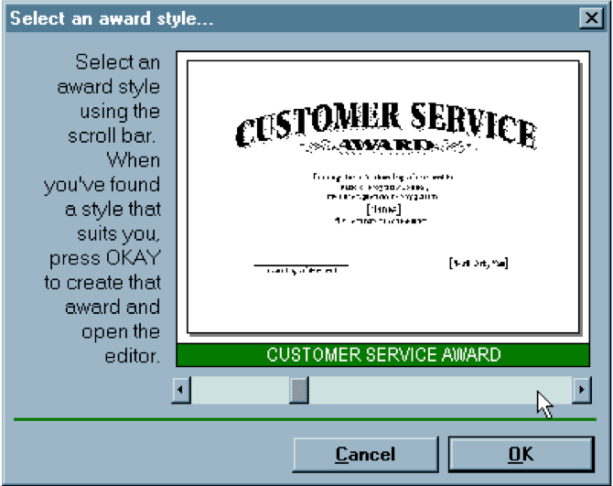
Good or Bad?

Slide 18
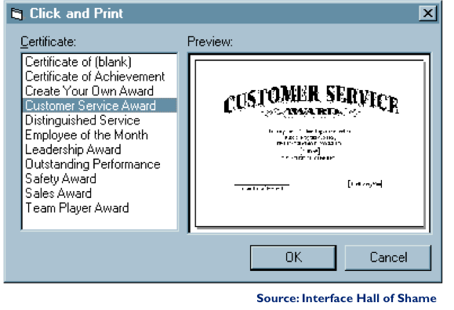
Redesign

Slide 19
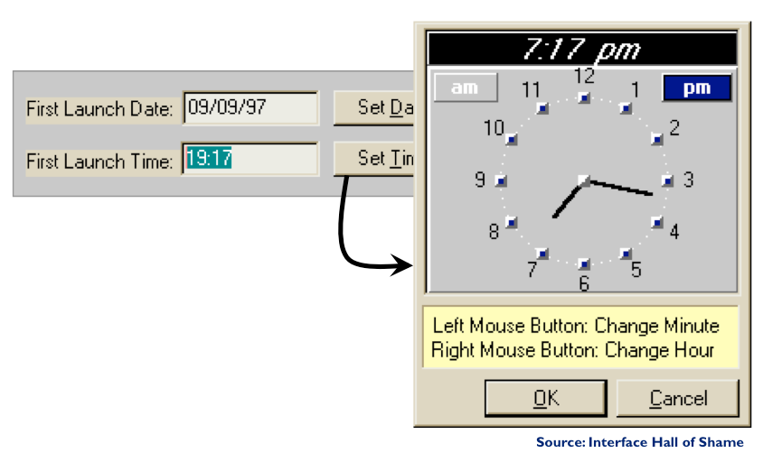
Good or Bad?

Slide 20
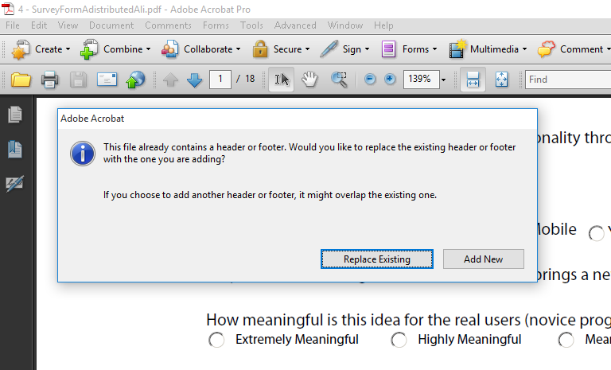
Bad Designs are Everywhere

Slide 21
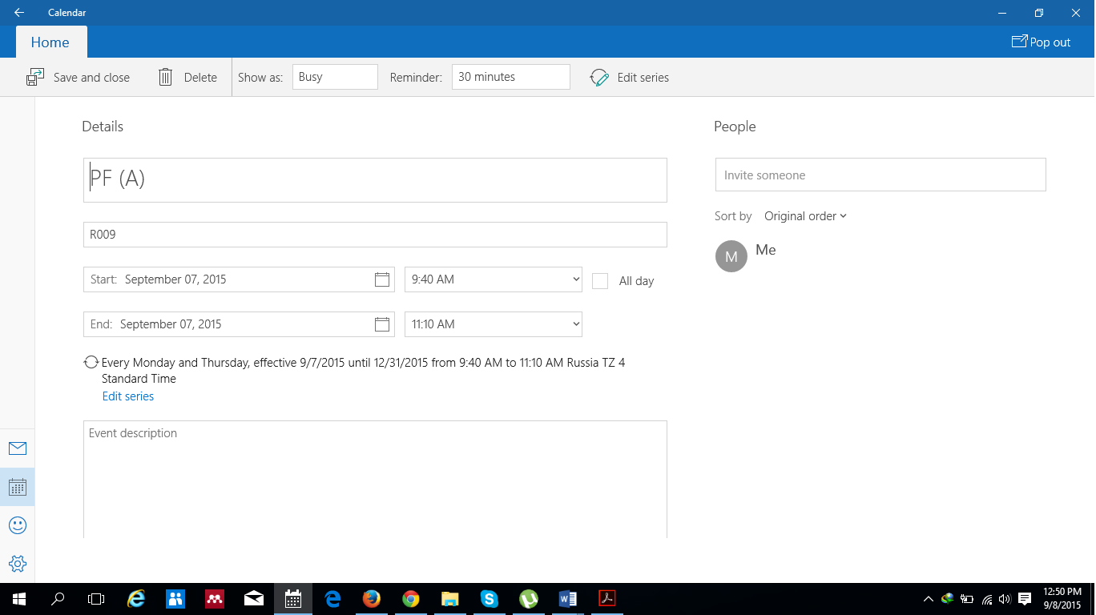
Bad Designs are Everywhere

Slide 22
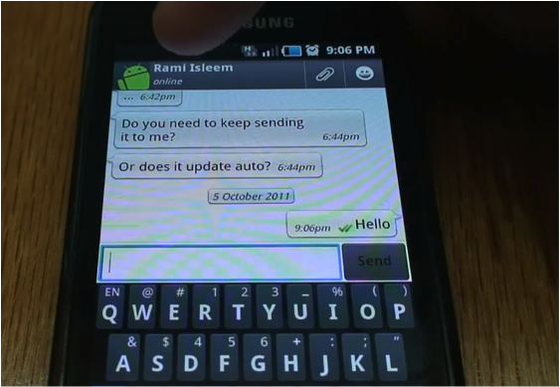
Bad Designs are Everywhere

Slide 23
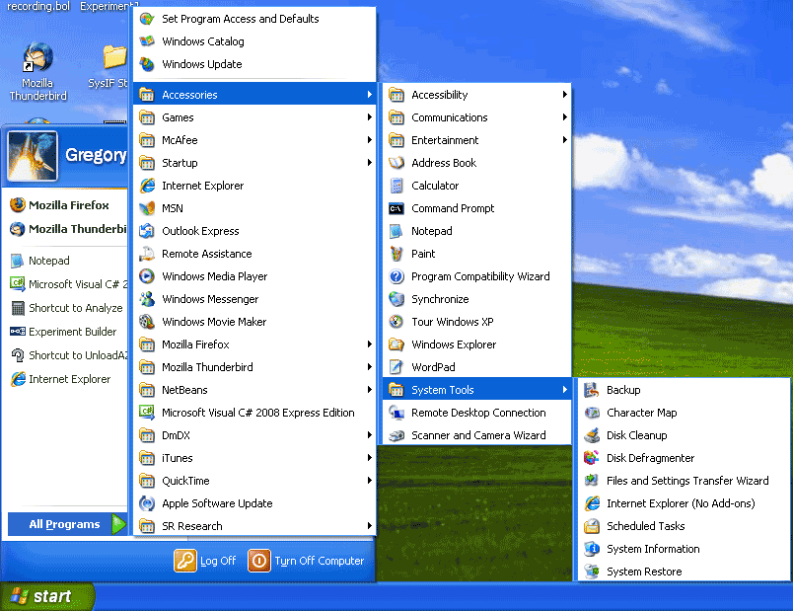
Bad Designs are Everywhere

Slide 24
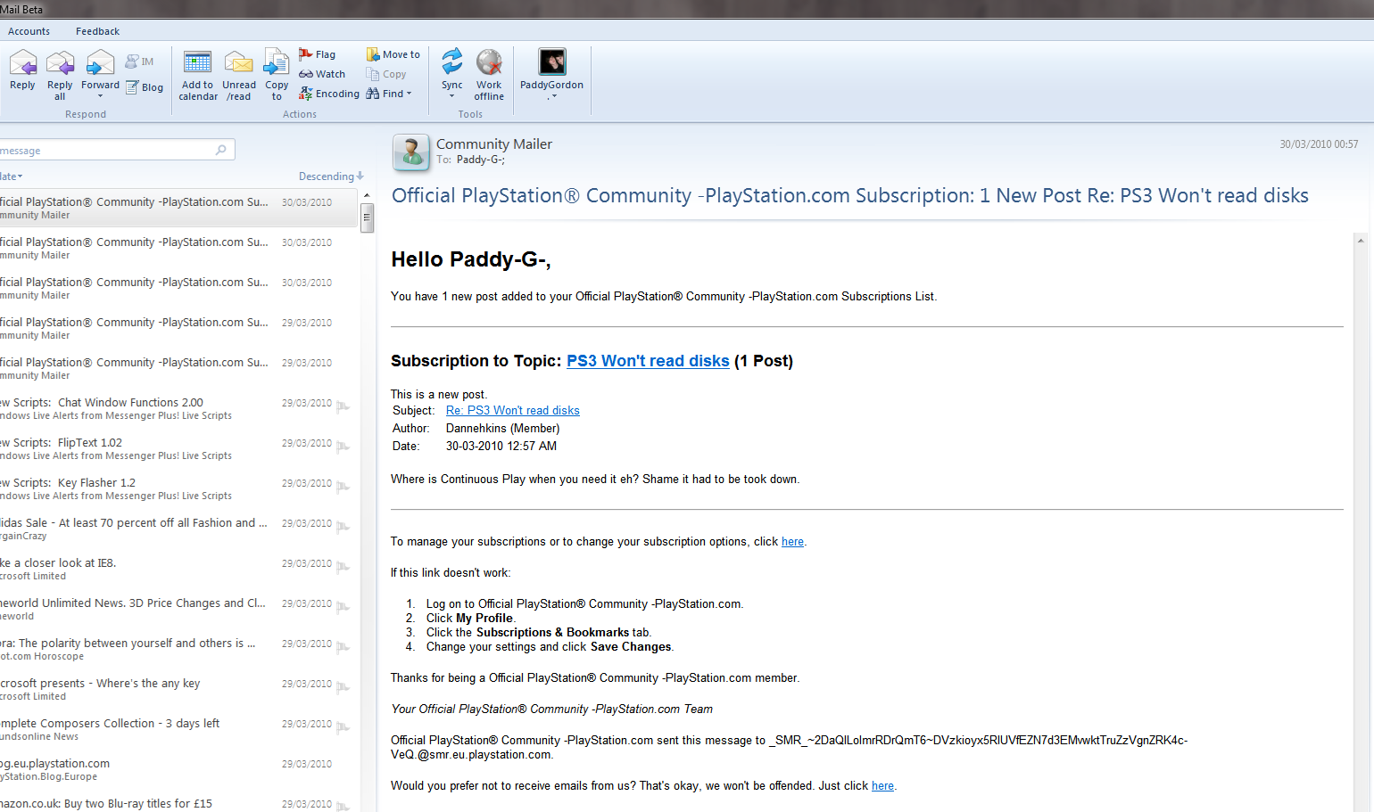
Bad Designs are Everywhere

Slide 25
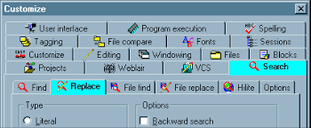

Slide 26
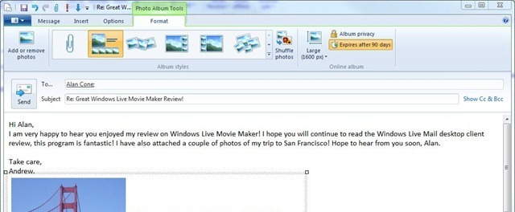
Bad Designs are Everywhere

Slide 27
Solutions!
Better Designs!

Slide 28
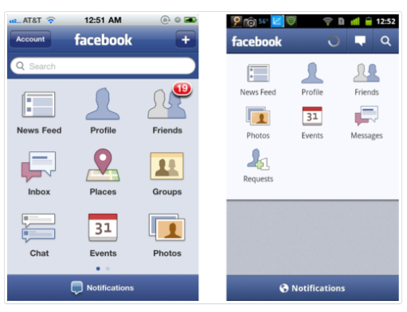
Good Design

Slide 29
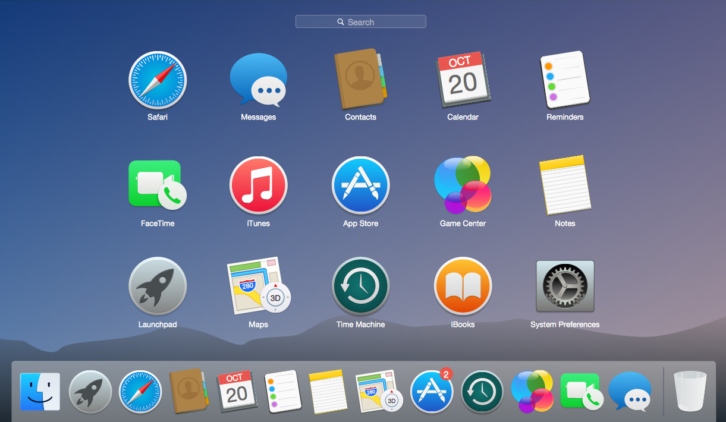

Slide 30
Human Computer Interaction
Significance of HCI
Computers are everywhere

Slide 31
Computer is becoming Ubiquitous
Bright Side
  Computers are enabling new discoveries
  Leading to efficiency
  Making out life easy and convenient
Dark Side
  Computers are annoying us
  They are infuriating us
  They even kill a few of us
Notes:
http://www.dailymotion.com/video/x7fxmz_angry-man-computer-smash-too-funny_fun

Slide 32
Role of HCI
HCI plays a role to bridge up the gap between the interfaces of machines and human understanding that we have seen in previous examples

Slide 33
Human Computer Interaction
The Humans
The Computers
The Interaction
Interaction
Computer
Human

Slide 34
GENERAL STEPS OF AN INTERACTION
  Articulation
  Performance
  Uploading

Slide 35
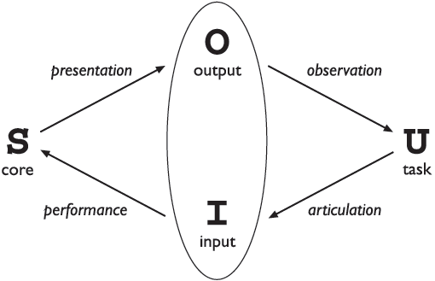
Interaction Model: Abowd and Beale Framework
Evaluation Area
Execution Area
Notes:
tasks - operations on the concepts of the domain
core language - language that describes the computational attributes of the domain relevant to the system state
Articulation is the user's translation of their task into the input language. Consider a user who wants to turn on the lights at the far end of a room.
Poor Articulation
The user sees a bank of unlabelled switches. The user has no idea which switch controls the lights at the far end of the room. The problem here is that the langauge provided (the unlabelled switches) does not allow the user to articulate the goal (turn on the lights at the far end of the room).
Good Articulation
The switches are clearly labelled. The user articulates their task of pressing the switch that is labelled "the far end of the room". The language provided here (the labelled switches) allows the user to articulate their task without difficulty.
Performance
Performance is the interface's translation of the input language into stimuli to the system. This translation is determined by the designer or programmer (not the user).
Poor Performance
Consider a remote control for a television without a button for turning off the television. The user must go directly to the device and turn it off on the control
panel.
Presentation
Presentation is the translation of the system's new state into the output language of the interface. This translation is determined by the designer or programmer.
Poor Presentation
Consider writing an essay using a word processor. You need to see the effects of your editing as a whole. However, the word processor only displays the immediate paragraph without the surrounding text or other pages. The surrounding text and other pages may have changed as well during the editing. In effect, all of the state changes cannot be displayed in the output language. You cannot readily confirm the effect of your editing throughout the essay.
Observation
Observation is the translation of the output language into personal understanding. This translation is done by the user.
https://cs.senecac.on.ca/~bth740/pages/content/model.html

Slide 36
Human Computer Interaction
Human computer interaction is a discipline concerned with the
of interactive computing systems for human use and with the study of major phenomena surrounding them.
design
implementation
evaluation

Slide 37
Human-Computer Interaction
What
  the study of interaction between people and computer-based systems
  concern with the physical, psychological and theoretical aspects of this process
Why
  to enable us to design interactive products to support people in their everyday and working lives
Goals
  Usability
  Pleasurability
  User experience and emotions

Slide 38
Human Computer
Complex
Intelligent
Free will
Range of emotions
Make mistakes
Dumb
Unintelligent
Only do what they are told to do
Emotionless
Don’t make mistakes

Slide 39
Is all computer aided equipment inherently hard to use?
Paradox
  Computerized tools hard to use
  Computers were invented to make life easy, convenient and efficient
So who is to be blamed?

Slide 40
How do we design good interfaces?
Requirements
Design
Implement
Test
Maintain
Not like this!

Slide 41
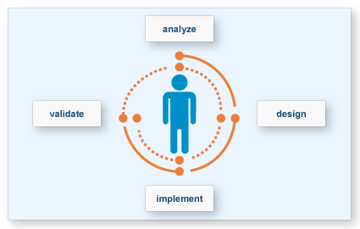
User Centered Design

Slide 42
HCI and Software Engineering
Software engineers focus on internal workings of software
  Engineers believe that since they made it, can use it, everyone can use it
  “If WE can use it, YOU can use it. If you can’t, YOU must be STUPID”
  “Users are stupid” – anonymous
  “Users are dummies” – anonymous
In HCI we are concerned with external workings of software

Slide 43
User Centered Design
Usability is about communicating with users
  Which you (designer) are not
  Different than other software engineering
Users can seldom express accurately what they want
  Get their needs out of their environment
Users are never wrong

Slide 44
Why is HCI Important?
80% of software lifecycle costs occur after the product is released, in the maintenance phase - of that work, 80 % is due to unmet or unforeseen user requirements; only 20 % is due to bugs or reliability problems (IEEE Software)
Business Success ∝ User Experience
Effects on
  Effectiveness
  Productivity
  Morale
  Safety
  Society
  Individuals
  And a lot more
IFE Example
Notes:
One airline’s IFE was so frustrating for the flight attendants to use that many of them
were bidding to fly shorter, local routes to avoid having to learn and use the difficult
systems. This is remarkable considering that the time-honored airline route-bidding
process is based on seniority, and that those same long-distance routes have always been
considered the most desirable plums because of their lengthy layovers in exotic locales
like Singapore or Paris. For flight attendants to bid for unglamorous, unromantic yo-yo
flights from Denver-to-Dallas or LA-to-San Francisco just to avoid the IFE indicated a
serious morale problem. Any airline that inflicted bad tools on its most prized
employee—the ones who spent the most time with the customer---was making a foolish
decision and was profligately discarding money, customer loyalty, and staff loyalty.
The computer-IFE of another large airline was even worse. The airline had created an inflight
entertainment system that linked movie delivery with the cash collection function.
In a sealed et airplane flying at 37,000 feet, cash collection procedures had typically been
quite laissez-faire; after all, nobody was going to sneak out the back door. Flight
attendants delivered goods and services when it was convenient and collected cash in
only a very loosely coupled fashion. This kept them from running unnecessarily up and
down the narrow aisles. Sure there were occasional errors, but never more than a few
dollars were involved, and the system was quite human and forgiving; everyone was
happy and the work was not oppressive.
With cash-collection connected to content delivery by computer, the flight attendant had
to first get the cash from the passenger, then walk all the way to the head-end of the
cabin, where the attendant’s console was, enter an attendant password, then perform a
cash register-like transaction. Only when that transaction was completed could the
passenger actually view a movie or listen to music. This inane product design forced the
flight attendants to walk up and down those narrow aisles hundreds of extra times during
a typical trip. Out of sheer frustration, the flight attendants would trip the circuit breaker
on the in-flight entertainment system at the beginning of each long flight, shortly after
departure. They would then blandly announce to the passengers that, sorry, the system
was broken and there would be no movie on this flight.
The airline had spent millions of dollars constructing a system so obnoxious that its users
deliberately turned it off to avoid interacting with it. The thousands of bored passengers
were merely innocent victims. And this happened on long, overseas trips typically packed
with much-sought-after frequent flyers. I cannot put a dollar figure
On the expense this caused the airline, but I can say with conviction that it was
catastrophically expensive.
The software inside the IFEs worked with flawless precision, but was a resounding failure
because it misbehaved with its human keepers.

Slide 45
5. History of User Interfaces

Slide 46
A Brief History of User Interfaces
Batch-processing
  No interactive capabilities
  All user input specified in advance (punch cards, ...)
  All system output collected at end of program run (printouts,...)
  Applications have no user interface component distinguishable from File I/O
  Job Control Languages (example: IBM3090–JCL): specify job and parameters

Slide 47
A Brief History of User Interfaces
Time-sharing Systems
  Command-line based interaction with simple terminal
  Similar program structure
  Applications read arguments from the command line, return results
  Example: still visible in Unix commands
Full-screen textual interfaces
  Interaction starts to feel "real-time" (example: vi)
  Applications receive UI input and react immediately in main "loop" (threading becomes important)

Slide 48
A Brief History of User Interfaces
Menu-based systems
  Discover "Read & Select" over "Memorize & Type" advantage
  Still text-based!
  Example: UCSD Pascal Development Environment
  Applications have explicit UI component
  But: choices are limited to a particular menu item at a time (hierarchical selection)
  Application still "in control"

Slide 49
A Brief History of User Interfaces
Graphical User Interface Systems
  From character generator to bitmap display (Alto/Star/Lisa..)
  Pointing devices in addition to keyboard
  -> Event-based program structure
    Most dramatic paradigm shift for application development
    User is "in control"
    Application only reacts to user (or system) events
    Callback paradigm
  Event handling
    Initially application-explicit
    Later system-implicit

Slide 50
6. Course Reference Material
Human-Computer Interaction (3rd ed.), by Alan Dix - Janet Finlay - Gregory Abowd - Russell Beale PRENTICE HALL 2004
Interaction Design: Beyond Human - Computer Interaction (3rd ed.), by Yvonne Rogers, Helen Sharp, Jenny Preece. Wiley, 2011.
The Design of Everyday Things, by Donald Norman. Currency/Doubleday, 1990.
Understanding Your Users: A Practical Guide To User Requirements Methods, Tools, And Techniques, By Catherine Courage And Kathy Baxter. Elsevier, 2005.

