Slide 1

Needfinding
The process of understanding users, finding requirements, and Analyzing Data

Slide 2
Know Thy Users
I’m a very selfish designer: when I design, I design it for me.
And so
my first task is to become you.

Slide 3
Preliminary Research and Analysis
Identify Target Market
Identify user classes
  By going into the users
  By surveying
  By interviewing
  By ethnography

Slide 4
Target Market
Passenger, Drivers of Pakistan
Classification
Passegner
Drivers
POS
Biller
Manager

Slide 5
User classification
  Teachers
  Students
  Parents
  Admins

Slide 6
Preliminary Target Market Analysis
Shall be all inclusive, as well as all exclusive
Do not focus on only the “best” or most experienced users
Consider a range of users to ensure that your product works for at least 80% of your user population.
However, it is not impracticable to target 90–95% of the population.

Slide 7
Preliminary Target Market Analysis
Who: Start with questioning yourself about who is going to buy your product. Are they children, teens, millennials, or baby boomers? Are they males or females? Are they service classed or self-employed? What’s their yearly income?
What: What type of products and services do they buy now and what do they expect from it? Does your product fits their requirements?
When: When do they buy the product? Is it daily or rarely? When do they use the product?
Where: Where do they live? Where do they use the product?
Why: Do they buy it because it’s their need, or is it a luxury product for them?

Slide 8
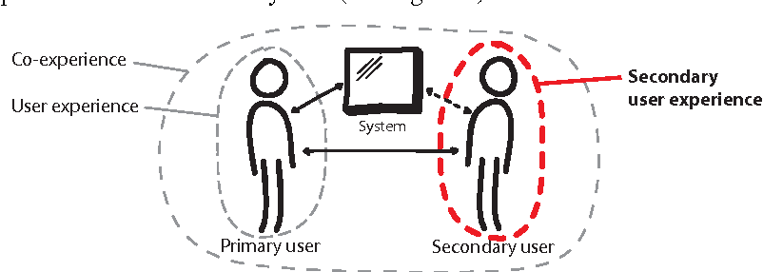
User Classification

Slide 9
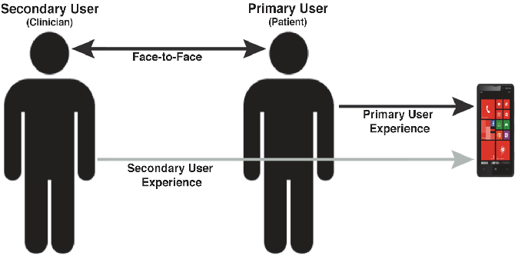
Primary/Secondary Users

Slide 10
Resources
https://medium.theuxblog.com/user-experience-primary-and-secondary-users-in-healthcare-8dd4c5c61490

Slide 11
User Research
Ethnography and Interviewing

Slide 12
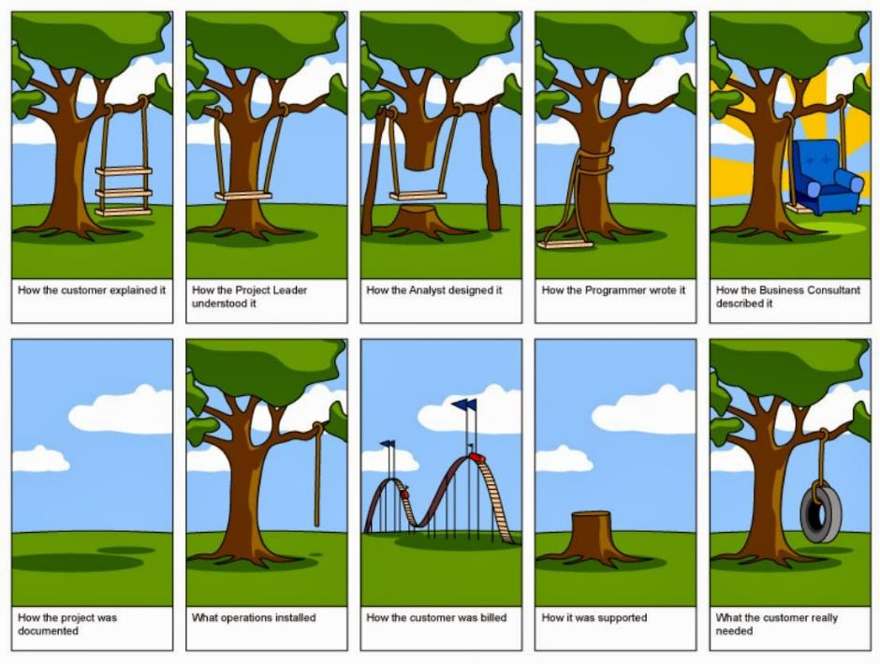
Requirement Elicitation Problem

Slide 13
Target market identification
  Covid-19 patients and hospitals in Lahore
User classes
  Patients
  Hospital staff

Slide 14
Ethnography
  Planning
  Observation
  Interviewing (Semi-structured, intensive)
  Data analysis

Slide 15
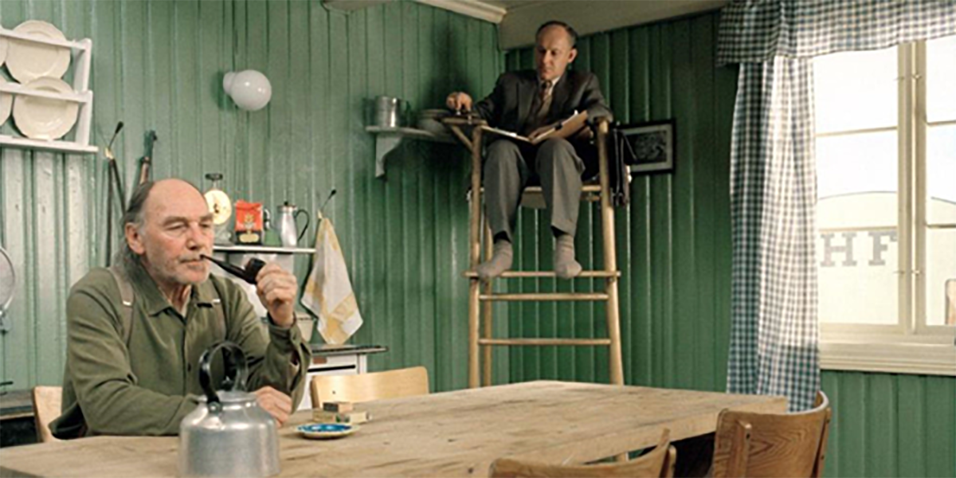
Ethnography (Observation + Intensive Interview)

Slide 16

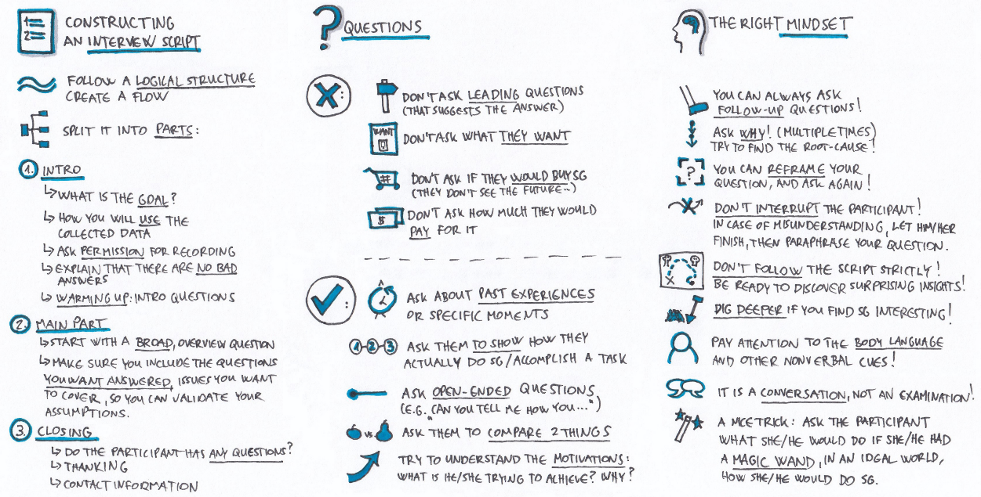

Slide 17

Recruiting Criteria
Typical user
Non-user
Extreme user
Peripheral user
Expert user
Subject-matter expert (Domain Experts)
Wannabe user
Should be user
Future user
Past user
Hater
Loyal to competitor

Slide 18
Assignments
Interview protocol and script
  Submit before next class on Monday
After user Observation and Interviews, submit the following assignment
  User needs
  Photos and captions
  Submit before next class on Friday

Slide 19
Resources
See the “05-Empathy Field Guide.pdf” on Portal
https://medium.com/@userfocus/what-is-design-ethnography-b0a3f8f0339c
https://medium.muz.li/coffee-ethnography-4ee31901286d
https://medium.com/thinking-design/better-understanding-users-through-ethnography-fd6f6395d4

Slide 20
User Modelling
Revise your target market definition and classification
Build the following
  Class profiles
  Personae
  Scenarios (Storyboards)

Slide 21
Target market of Blood donation application
  Blood banks, Blood Recipients and blood donors in Lahore
User classes
  Blood recipients
  Blood donors
  Blood banks

Slide 22
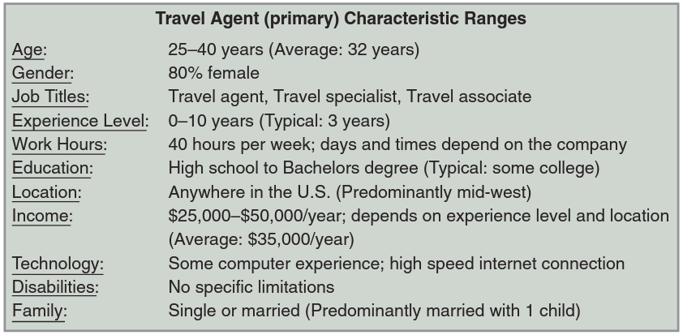
Class Profile: Travel Agent (Primary)

Slide 23
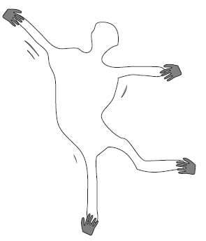
Personae
The non-Elastic User

Slide 24
Personas
At least One representative of each class

Slide 25
The Persona
Never refer to “the user”, instead refer to a very specific individual, a persona.
Take a class profile and then fill in details to create a “typical” user
  At least One representative of each class
From the insight you gained in your ethnography (immersion, observation and interviews), you now invent user archetypes to represent the main user groups of your product.
It is more important to define the persona in great and specific detail, so that it cannot wiggle under the pressure of development.

Slide 26
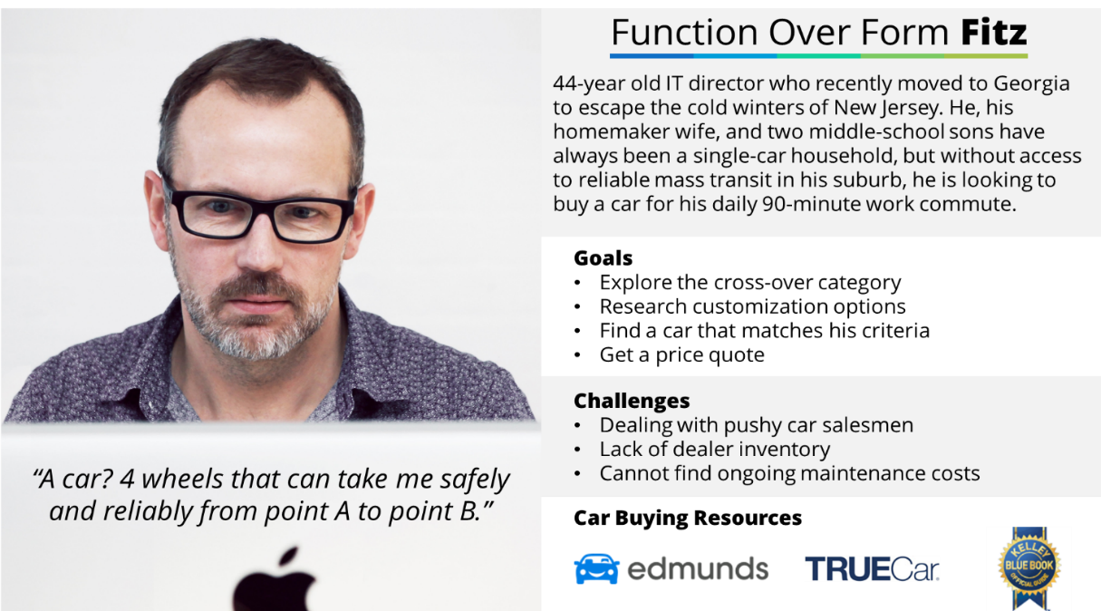

Slide 27
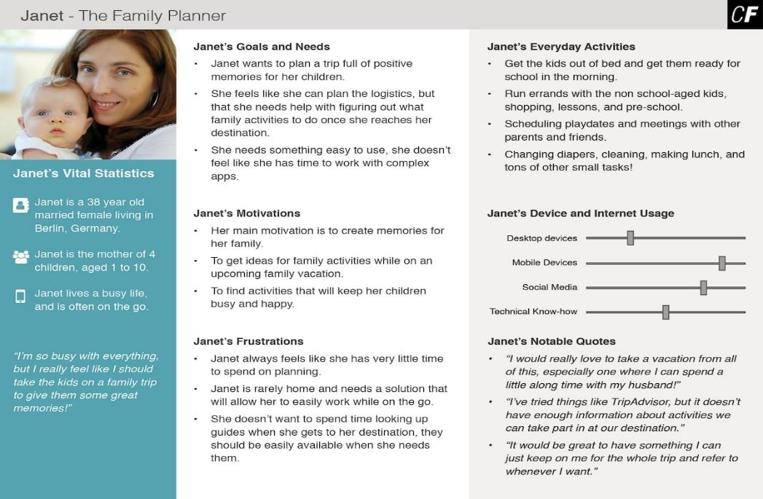

Slide 28
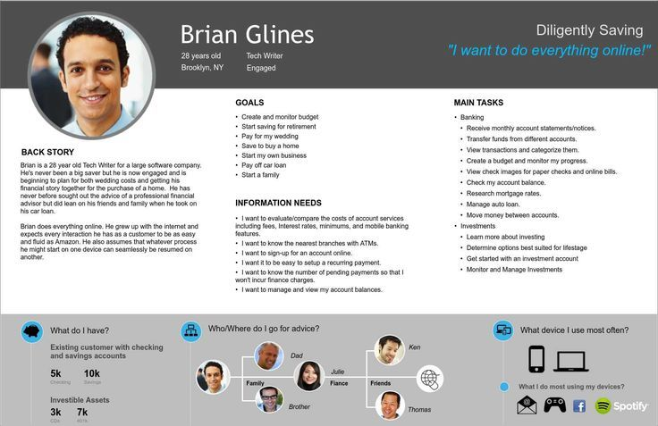

Slide 29
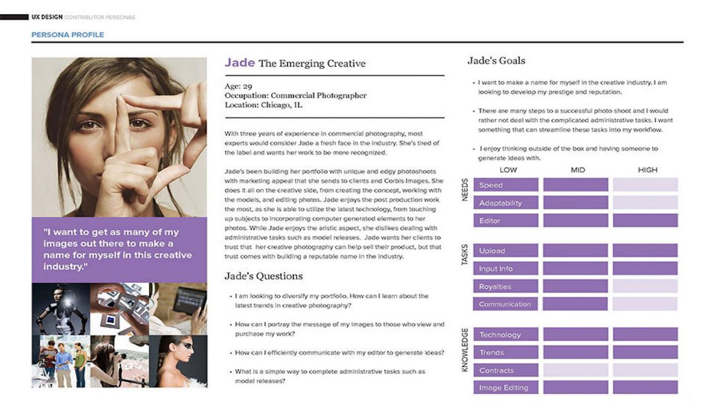

Slide 30
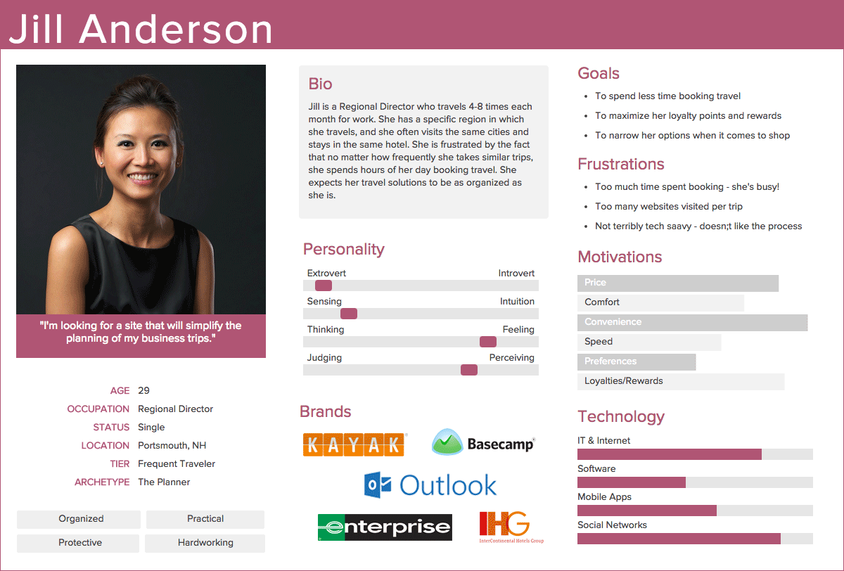

Slide 31
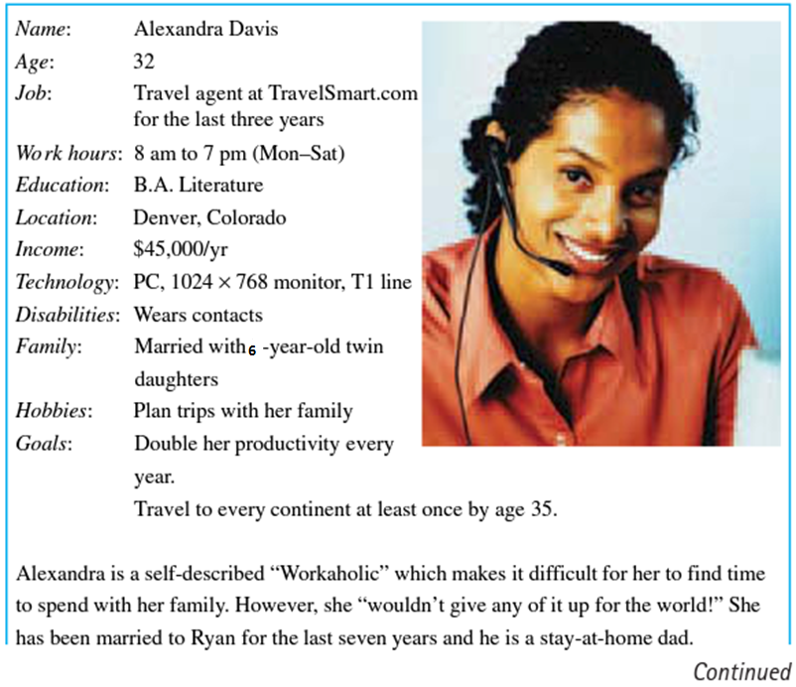
An Example Persona

Slide 32
Alexandra Davis’s Persona (contd.)
She loves the perks she gets working for TravelSmart.com. She is able to travel all over the world with her family at a substantially reduced rate. This is very important to her and she wouldn’t work those kinds of hours without such perks. Alexandra began working as a travel agent right after college.
She has used every system out there and is amazed at how difficult they are to use. Speed is the name of the game. “Clients don’t want to sit on the phone and listen to me typing for five minutes while I look up all the available five-star hotels in Barbados”. I need that information with few keystrokes and all on one screen. Don’t make me page through screen after screen to see the rates for all the hotels.” Alexandra loves helping clients design their dream vacation! She helps to take care of all of their travel needs – including choosing destinations, booking airfares, arranging car rentals, booking hotels, and arranging tickets for attractions. Clients often send Alexandra postcards and pictures from their destinations because they are so grateful for all her help. She appreciates the fact the TravelSmart.com offers clients the opportunity to do it all themselves or to seek out the help of a professional. She feels that travel agents are sorely under-appreciated. “Of course people can make travel reservations on any website today. There are tons of them out there and they all offer pretty much the same deals. But if you don’t know anything about your destination, you could easily pick a bad hotel because their advertising literature is out of date, or you could pay too much because you don’t know what to ask for. Travel agents do so much more than book flights!”

Slide 33
Ingredients of a Persona
Personality Description part
  Real Picture of a real user
  Personal description
  Personal goals
Things related to the future System
  Goals with the system
  Wants / needs from the future system
  Irritation / pain points with the current system
  Any other usability or functional requirements

Slide 34
Resources
See “05-Ten Steps to Personas.pdf” on Portal
https://careerfoundry.com/en/blog/ux-design/how-to-define-a-user-persona/
https://www.smashingmagazine.com/2014/08/a-closer-look-at-personas-part-1/

Slide 35
Scenarios
Also called user / use / usage scenarios

Slide 36
1 – title (goal), 2 – persona, 3 – background story (situation),
4 – abstract task steps
Qasim wants to send an email while on the road
Qasim is travelling from his home towards his office. This morning, he already got up late and thus is rushing. He is afraid that he might get late to work. However, at mall road he encounters a serious traffic jam. Its been 15 minutes that he is stuck and not able to move even a few meters. Suddenly, he receives an email notification from his colleague that boss is asking for his whereabouts. He decides to send an email to his boss.

Slide 37
4 – abstract task steps
Qasim starts composing a new email. He explain to his boss about his situation in the traffic jam. He then adds boss’s email address and also adds a CC to the hr manager. He then send his email.

Slide 38
1 – title, 2 – persona’s name, 3 – background story,
4 – abstract Task steps
Nasir sends an email to his boss
Nasir was on the way to his office when he got stuck into a traffic jam. The traffic jam was very intense, and he spent more than an hour without even moving for a meter. He was afraid of being late from his work. Soon after, he found a new email on his email client from his colleague telling about boss’s arrival. He decided to write an email to his boss explaining the situation ….

Slide 39
4 – abstract Task steps
Nasir starts a new email. He adds his boss as the recipient and adds HR department head into CC list. He then writes an appropriate subject explaining that he might get late, and writes email body detailing his current situation.

Slide 40
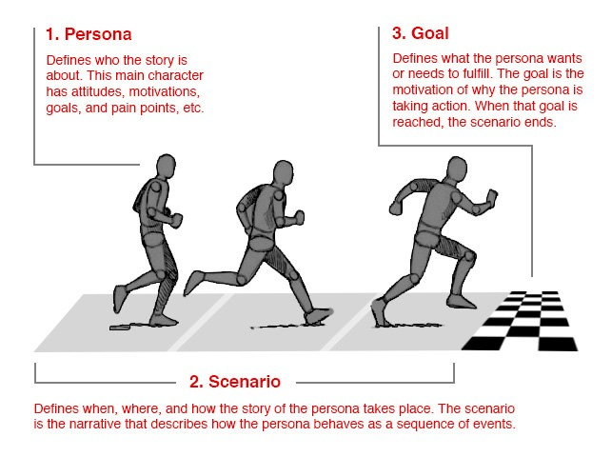
User Scenario
A precise description of a persona using an interface to achieve a goal

Slide 41
Creating Scenarios
Scenarios normally include descriptions about:
  The individual user (i.e., the persona)
  The task or situation
  The user’s desired outcome/goal for that task
  Procedure and task flow information
  A time interval
  Envisioned features/functionality the user will need/use.
Success and/or failure scenarios
  You may also want to include exceptions. What are some of the rare events that happen?

Slide 42
Ingredient of a Scenario
  Title of the scenario
  Background story
  Goal of the user
  Abstract steps to achieve the task
All of the above written in a story format
Also, do not forget to use a particular persona’s name, instead of he/she

Slide 43
Sally plans her vacation
Summer vacation are already started in schools. Sally needs to plan a vacation for her family. She decides to hop on TravelSmart.com and do both the research and reservations there. She begins by researching the top family-friendly destinations as recommended by TravelSmart.com customers. She wants to compare the travel time, travel costs, hotel costs, hotel availability, and amusement activities for each destination. For each of those criteria, Sally gave a weighting to help her make her decision. She finally settled on the destination that required the least travel time, cheapest travel costs, moderate hotel costs, good availability, and a large selection of activities for the whole family. From that spot, Sally begins searching for the flights and hotels that meet her criteria. She decides to save those results for later because she wants to be sure the whole family is in agreement before she makes the reservations with her credit card.

Slide 44
Miss Roohi teaches grade two Mathematics. She plans to take a pop-up quiz in her class. There are total 31 students in her class. She calls three students randomly by their serial numbers, write three problems on the board, and assign one problem to each of them. Each student solves the assigned problem which she then evaluates. After this she calls the next batch of students and repeats the same process with them. All students are called only once. To be fair in her selection she uses the ‘Number’ feature of the RNG application where she sets the range from 1 to 31, turns on the no repeat, sets the quantity to 3, and turns off the sound effect.

Slide 45
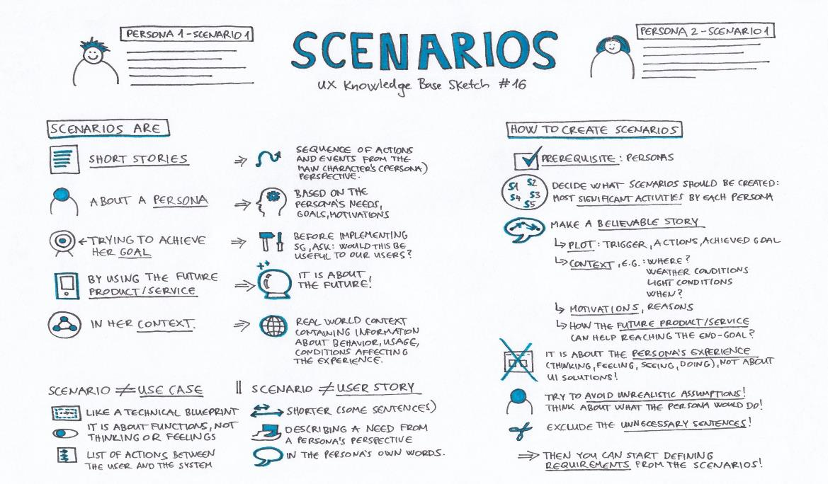

Slide 46
Resources
https://uxdesign.cc/asking-the-right-questions-on-user-research-interviews-and-testing-427261742a67
https://medium.com/interactive-mind/5-steps-to-create-good-user-interview-questions-by-metacole-a-comprehensive-guide-8a591b0e2162
https://medium.com/user-research/never-ask-what-they-want-3-better-questions-to-ask-in-user-interviews-aeddd2a2101e

Slide 47
Submit your first report
Project Deliverable 1 (PD1)

Slide 48
Project Deliverable 1 (PD1)
Please put details here

