Slide 1
efficiency
Human computer interaction

Slide 2
Topics
Human information processing
Pointing and steering
  Fitts’s Law
Shortcuts
Keystroke level Model
Notes:
Note that when we say efficiency, we’re not concerned with the performance of the backend, or choices of algorithms or data structures, or analyzing or proving their performance. Those are important questions, but you can take other courses about answering them. We’re concerned with the channel between the user and the system; how quickly can we get instructions and information across that interface? In other words, assuming that the user interface is the performance bottleneck, how fast can the whole system go?

Slide 3
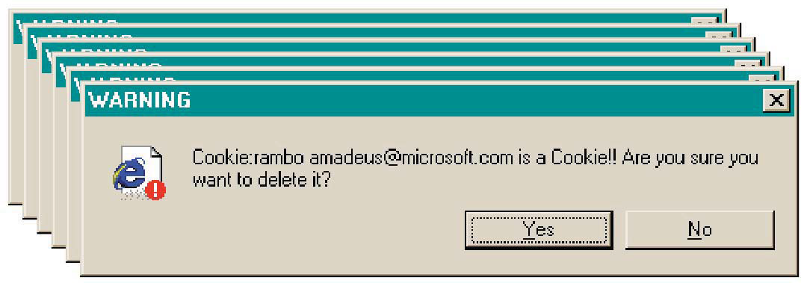
Efficiency Hall of Shame

Slide 4
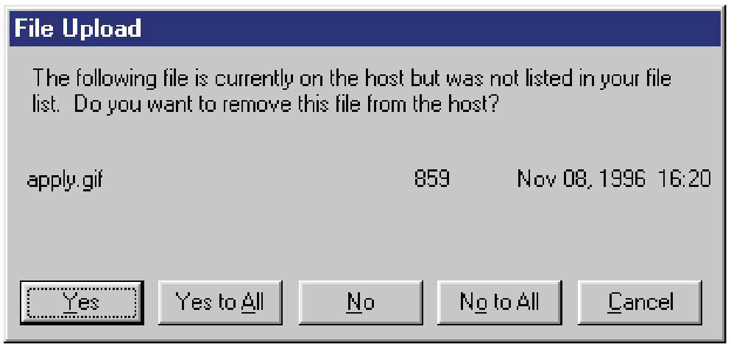
Efficiency Hall of Fame or Shame?

Slide 5
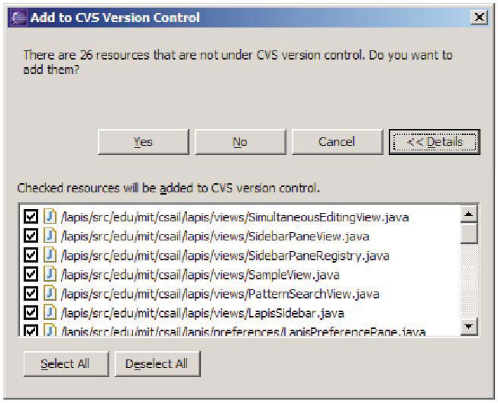
Efficiency Hall of Fame

Slide 6
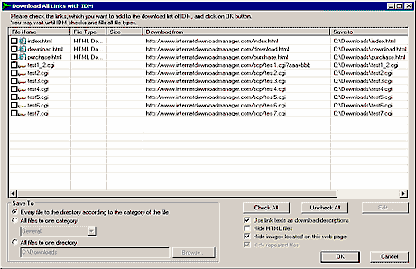

Slide 7
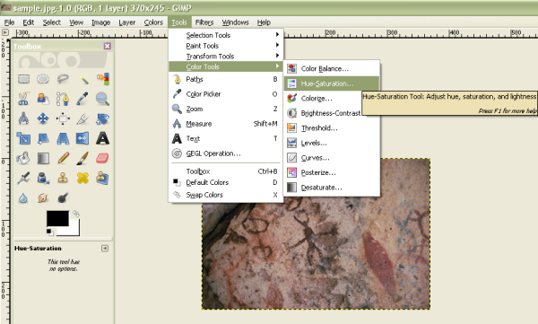
An interface with no shortcuts

Slide 8
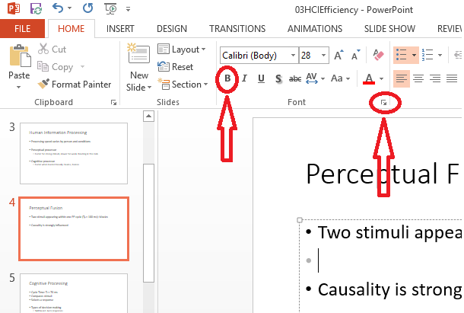
Which one is easy to point

Slide 9
Human information processor

Slide 10
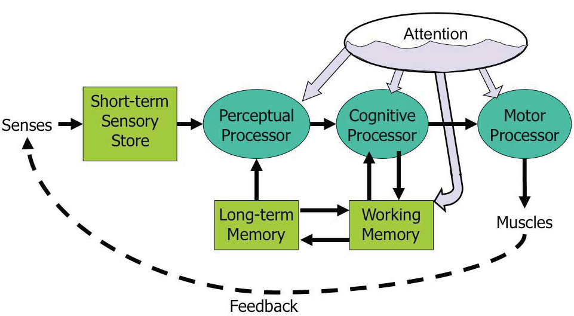
Human Information Processing
Model Human Processor (MHP)
Notes:
This model is an abstraction, of course. But it’s an abstraction that actually gives us numerical parameters describing how we behave. Just as a computer has memory and processor, so does our model of a human. Actually, the model has several different kinds of memory, and several different processors.
Input from the eyes and ears is first stored in the short-term sensory store. As a computer hardware analogy, this memory is like a frame buffer, storing a single frame of perception.
The perceptual processor takes the stored sensory input and attempts to recognize symbols in it: letters, words, phonemes, icons. It is aided in this recognition by the long-term memory, which stores the symbols you know how to recognize.
The cognitive processor takes the symbols recognized by the perceptual processor and makes comparisons and decisions. It might also store and fetch symbols in working memory (which you might think of as RAM, although it’s pretty small). The cognitive processor does most of the work that we think of as “thinking”.
The motor processor receives an action from the cognitive processor and instructs the muscles to execute it. There’s an implicit feedback loop here: the effect of the action (either on the position of your body or on the state of the world) can be observed by your senses, and used to correct the motion in a continuous process.
Finally, there is a component corresponding to your attention, which might be thought of like a thread of control in a computer system.
Note that this model isn’t meant to reflect the anatomy of your nervous system. There probably isn’t a single area in your brain corresponding to the perceptual processor, for example. But it’s a useful abstraction nevertheless.

Slide 11
Make bigger targets
Reduce distance
Make things stand out so that they are identified in perception, i.e. don’t need cognitive cycles.

Slide 12
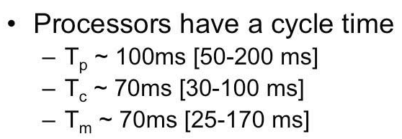
Processors
Cycle time is the time needed to accept one input and produce one output
Processing speed varies by person and conditions
Perceptual processor
  Faster for strong stimuli, slowe.r for week: Reading in the dark
Cognitive processor
  Faster when loaded heavily: Exams, Games

Slide 13
Perceptual Processing
Cycle Time: T_{p} ≈ 100 ms
Organizes stimuli
Creates a scene
Perceptual Fusion
  Two stimuli appearing within one PP cycle (T_{p} ≈ 100 ms): Movies
  Causality is strongly influenced (e.g. glass breaking)
Notes:
We’ve already encountered one interesting effect of the perceptual processor: perceptual fusion. Here’s an intuition for how fusion works. Every cycle, the perceptual processor grabs a frame (snaps a picture). Two events occurring less than the cycle time apart are likely to appear in the same frame. If the events are similar – e.g., Mickey Mouse appearing in one position, and then a short time later in another position – then the events tend to fuse into a single perceived event – a single Mickey Mouse, in motion. Fusion also strongly affects our perception of causality. If one event is closely followed by another – e.g., pressing a key and seeing a change in the screen – and the interval separating the events is less than Tp, then we are more inclined to believe that the first event caused the second.

Slide 14
Cognitive Processing
Cycle Time: T_{c} ≈ 70 ms
Compares stimuli (comparisons)
Selects a response (decisions)
Types of decision making
  Rule based
    Consciously processing a set of rules of the form if X, then do Y
    Typically made by novices or occasional performers of a task
    Learner driving: is there a sign, is there a car in left side etc.
    With practice the rules become skills
  Knowledge based
    To handle unfamiliar or unexpected problems: New software, car not starting etc
  Skill based
    Skill is a procedure that has been leaned thoroughly from practice; walking talking, pointing, reading, driving etc.
    Automatic responses that Require little or no attention: cutting vegetables .
Efficiency is most important for well-learned procedures
Notes:
The cognitive processor is responsible for making comparisons and decisions. Cognition is a rich, complex process. The best-understood aspect of it is skill-based decision making. A skill is a procedure that has been learned thoroughly from practice; walking, talking, pointing, reading, driving, typing are skills most of us have learned well. Skill-based decisions are automatic responses that require little or no attention. Since skill-based decisions are very mechanical, they are easiest to describe in a mechanical model like the one we’re discussing. Two other kinds of decision making are rule-based, in which the human is consciously processing a set of rules of the form if X, then do Y; and knowledge-based, which involves much higher-level thinking and problem-solving. Rule-based decisions are typically made by novices or occasional performers of a task. When a student driver approaches an intersection, for example, they must think explicitly about what they need to do in response to each possible condition (“is there a stop sign? Are there other cars arriving at the intersection? Who has the right of way?”). With practice, the rules become skills, and you don't think about how to do them anymore. Knowledge-based decision making is used to handle unfamiliar or unexpected problems, such as figuring out why your car won’t start.

Slide 15
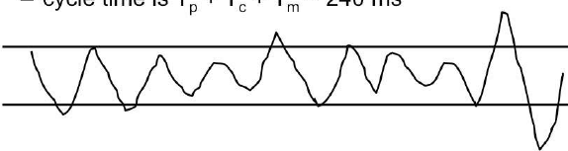
Motor Processing
Motor processor can operate in two ways
Open Loop Control
  Not dependent on feedback, motor processor runs by itself
    Cycle time: T_{m} ≈ 70 ms
Closed Loop Control
  Depends upon the feedback: perceived and decision made about adjustment
    Cycle time: T_{p} + T_{c} + T_{m} ≈ 240 ms
Draw a sawtooth wave between two parallel lines for 5 seconds
  Frequency of wave is dictated by open-loop control (T_{m} )
  Frequency of corrections is closed-loop control (T_{p} + T_{c} )
Notes:
The motor processor can operate in two ways. It can run autonomously, repeatedly issuing the same instructions to the muscles. This is “open-loop” control; the motor processor receives no feedback from the perceptual system about whether its instructions are correct. With open loop control, the maximum rate of operation is just Tm. The other way is “closed-loop” control, which has a complete feedback loop. The perceptual system looks at what the motor processor did, and the cognitive system makes a decision about how to correct the movement, and then the motor system issues a new instruction. At best, the feedback loop needs one cycle of each processor to run, or Tp + T c + T m ~ 240 ms.
Here’s a simple but interesting experiment that you can try: take a sheet of lined paper and scribble a sawtooth wave back and forth between two lines, going as fast as you can but trying to hit the lines exactly on every peak and trough. Do it for 5 seconds. The frequency of the sawtooth carrier wave is dictated by open-loop control, so you can use it to derive your Tm. The frequency of the wave’s envelope, the corrections you had to make to get your scribble back to the lines, is closed-loop control. You can use that to derive your value of Tp + T c.

Slide 16
Shortcuts

Slide 17
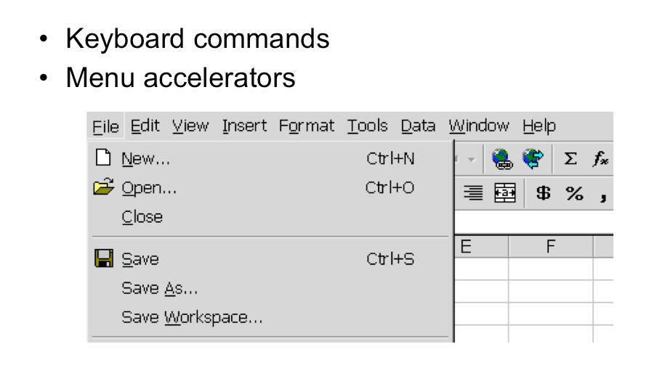
Keyboard Shortcuts
Notes:
Menubars and buttons often have accelerators as well (the underlined letters, which are usually invoked by holding down Alt to give keyboard focus to the menubar, then pressing the underlined letter)

Slide 18
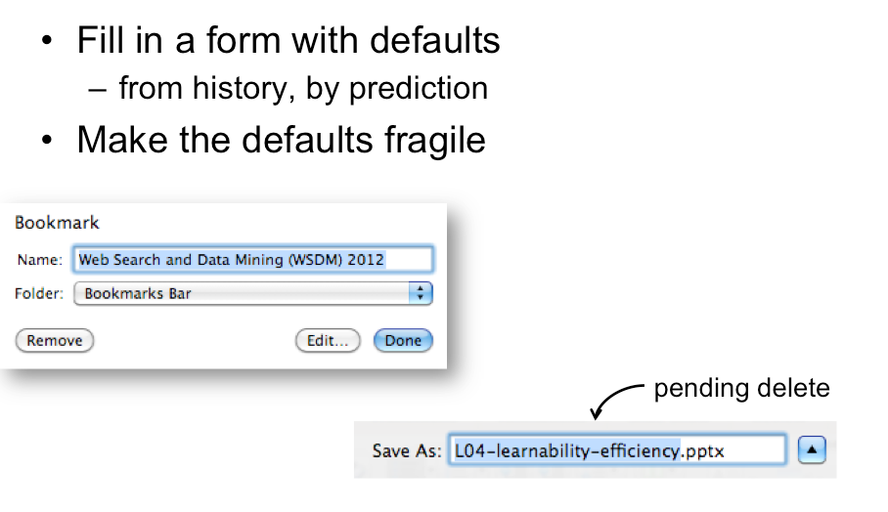
Defaults and Pending deletes
Notes:
Defaults are common answers already filled into a form. Defaults should be fragile; when you click on or Tab to a field containing a default value, it should be fully selected
technique, where typing replaces the selection, is called pending delete

Slide 19
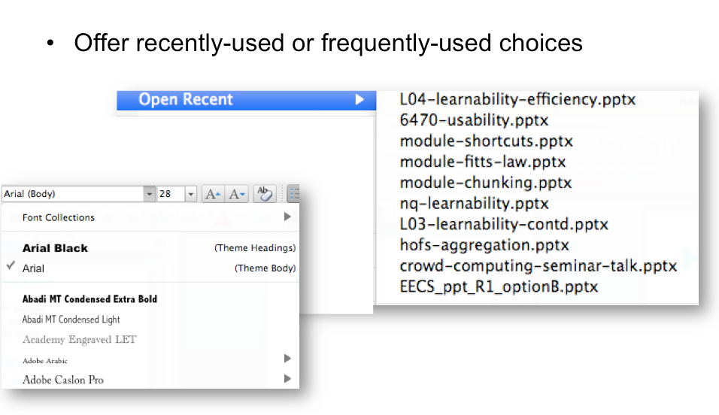
History

Slide 20
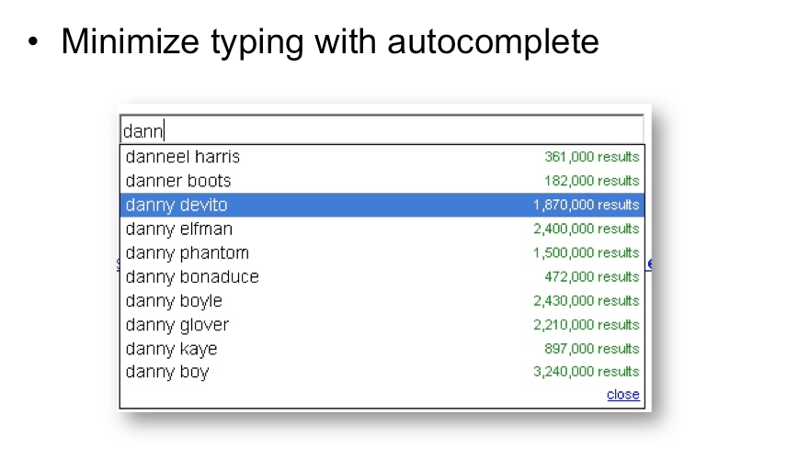
Autocomplete

Slide 21
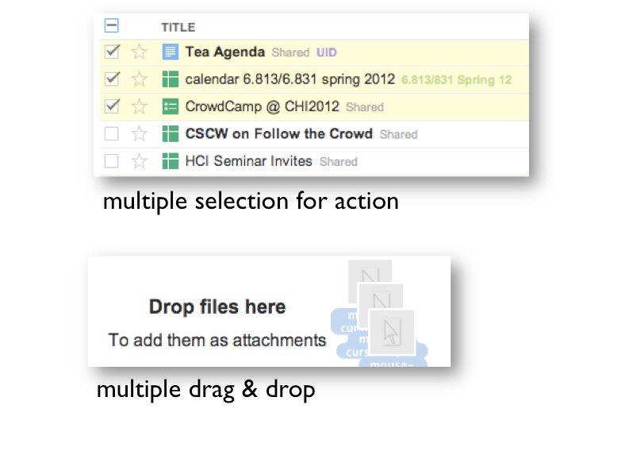
Aggregation

Slide 22
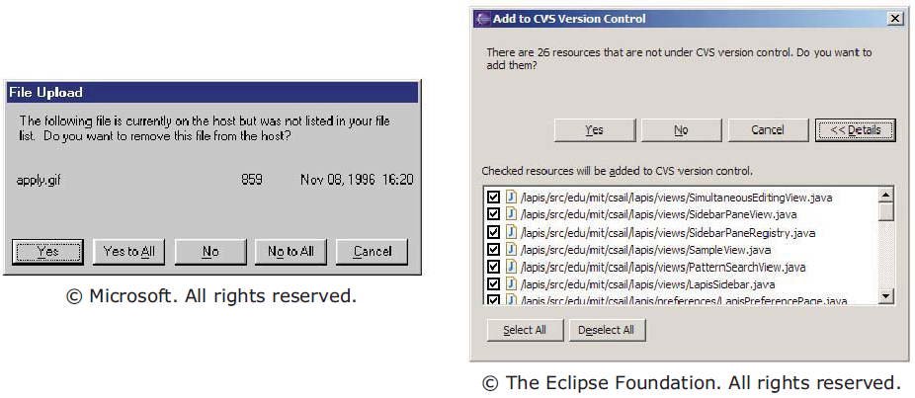
Aggregating questions

Slide 23
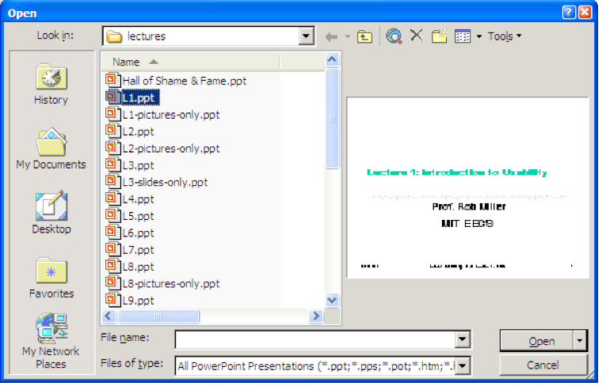
Anticipation
Anticipation means that a good design should put all needed information and tools within the user’s easy reach.

Slide 24
Pointing and steering

Slide 26
Fitts’s Law
It is a mathematical model of fine motor control which predicts how long it takes to move from one position to another as a function of the distance to and size of the target area.
The farthest away a target is, the longer it takes to acquire it with the mouse
The smaller a target is, the longer it takes to acquire it with the mouse
The inverse of both statements is true as well (closer and bigger targets can be more quickly acquired)
Notes:
http://blogs.msdn.com/b/jensenh/archive/2006/08/22/711808.aspx

Slide 27
Difficulty
  Size = Width
  Distance = Amplitude
ID = Index of Difficulty
ID = log₂(2 * Distance / Size + C)
ID = log₂ (2A/W + C)
MT = a + b * ID = a + b * ( log₂(2A/W + C) )

Slide 28
ID (A)

Slide 29
Index of Difficulty = log₂(2 * distance / size + C)
MT = a + b * ID = a + b (log₂(2 * distance / size + C) )
ID = 2 * Dist / Size + C
ID = 2 * Amp / Width + C
ID = log₂(2A/W + C)

Slide 30
ID (A) = log2(2A/W + C)
ID (A) = log2 (2*80 / 12) = log₂13.3 = 3.73
MT (A) = .2 + .16 * 3.73 = .8
ID (B) = log2 (2*170 / 36) = log₂ 9.55 = 3.23
MT (B) = .2 + .16 * 3.23 = .72
80
170
B = 36
A = 12

Slide 31
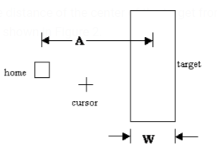
Fitts’s Law Formula
Time MT to move your hand to target of size W at distance A away is:
  MT is the movement time to hit the target
  a and b are experimentally determined constants, that are device dependent.
    a is the reaction time for getting your hand moving
  c is a constant of 0, 0.5 or 1
  A is the distance of the center of the target from the starting location
  W is the width of the target
Index of difficulty (ID) = log₂(2A/W + c)
MT = a + b log₂(2A/W + c)

Slide 32
Implications of Fitts’s Law
Greater mouse distances mean an increased MT target acquisition time.
  Put the objects closer
  Make the objects bigger
Acceleration time vs Deceleration time
Edges of screen are infinitely wide
  The distance A to the center of the target is virtually equal to W, so MT = a + b log(2A/W) solves to the minimum time MT=a
  Macintosh menu bar vs Windows menu bar

Slide 33
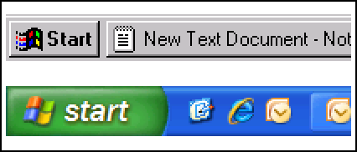
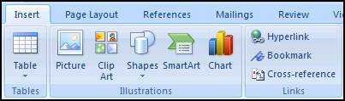
Mile‐High Menus, Magic Corners and Mini toolbar
Windows 95: Missed by a pixel
Windows XP: Good to the last drop
Larger, labeled controls can be clicked more quickly

Slide 34
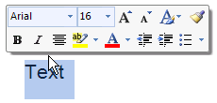

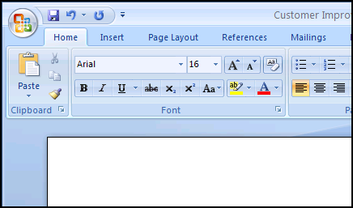
Examples
Mini Toolbar: Close to the cursor
Quick Access that's a mile high...
Magic Corner: Office Button in the upper‐left corner

Slide 35
FUNCTIONAL AGGREGATION

Slide 36
Pointing
  From point A to B, mouse movement
  MT = a + b ( A / W )
Steering (Drawing, or tunneling)
A
B

Slide 37
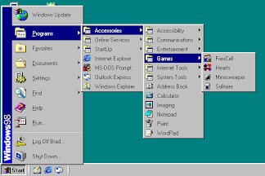
Steering / drawing / tunneling

Slide 38
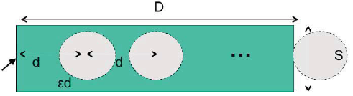
Steering tasks
Time T to move your hand through a tunnel of length D and width S is:
    T = a + b ( D/S), MT = a + b (A/W)
Index of difficulty is linear, not logarithmic
  So steering is much harder than pointing
Thus cascading submenus are hard to use
Note:
D => A
S => W
Notes:
Wsdm2012.org

Slide 39
Improve mouse efficiency
Make frequently used targets big
Put targets used together near each other
Use screen corners and screen edges
Avoid steering tasks

Slide 40
Keystroke Level Model (KLM)
Also called, KLM-GOMS

Slide 41
B → Mouse Button press/release = 0.1 sec
B = 0.2
0.28 0.14 0.14
Mustafa Mustafa Hassan
I am going to tell you about a story.
90%
K → keystroke = 1.2 sec, 0.28 sec, .08 sec
M → Mental, = 1.2 sec
H → Homing = 0.4 sec
P → Pointing, = 1.1 Sec
D → Drawing = 1.1 Sec

Slide 42
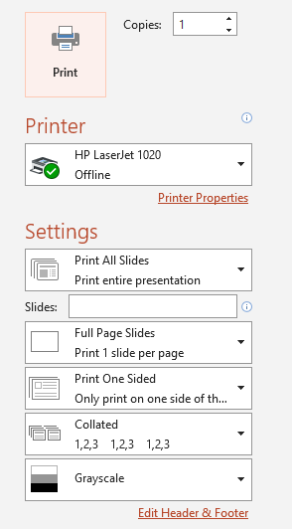
Operators
  B = 0.1 sec (click / release )
  K = 1.2 sec
  M = 1.2 sec
  P = 1.1 sec (actually Fitts Law)
  D = 1.1 sec (actually Fitts Law)
  H = 0.4 sec
  You need to print 4 copies of the slide, and assume that your hand is initially on mouse, and all other options are kept as default, you need to set # of copies using mouse

Slide 43
Set copies to 4 by using arrow keys
M + P + 2B + M + H + 3K
1.2 + 1.1 + 0.2 + 1.2 + 0.4 + 3.6 = 7.7 sec
Hand on mouse, move with tab key, increase by typing 4
M + H + M + K + K

Slide 44
Set number of copies to 4
M + P + 6B
1.2 + 1.1 + 0.6 = 2.9
Set copies using keyboard
M + P + 2B + M + K
1.2 + 1.1 + 0.2 + 1.2 + 1.2
4.9 sec
Click on print button
M + P + 2B
1.2 + 1.1 + 0.2 = 2.5
Hit enter to print

Slide 45
Increase copies to 4 using keyboard and arrow keys
  M + P + 2B + H + M + 3K =
  1.2 + 1.1 + 2*0.1 + 0.4 + 1.2 + 3(1.2) =
  1.2 + 1.2 + 0.6 + 1.2 + 3.6 = 7.8
Click on Print Button
  M + P + 2B = 1.2 + 1.1 + 0.2 = 2.5
  Total Task time = 7.8 + 2.5 = 10.3 sec

Slide 46
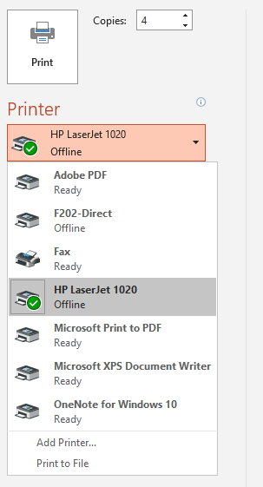
Select F202-Direct
Initially we were on keyboard
M + H + P + 2B + M + P + 2B

Slide 47
Keystroke Level Model (KLM) - operators
Keystroke
Button press or release with mouse
Point with mouse
Draw line with mouse
Home hands between mouse and keyboard
Mentally prepare
Response Time
Notes:
The first predictive model was the keystroke level model (proposed by Card, Moran & Newell, “The
Keystroke Level Model for User Performance Time with Interactive Systems”, CACM, v23 n7, July 1978).
This model seeks to predict efficiency (time taken by expert users doing routine tasks) by breaking down the
user’s behavior into a sequence of the five primitive operators shown here.
Most of the operators are physical – the user is actually moving their muscles to perform them. The M
operator is different – it’s purely mental (which is somewhat problematic, because it’s hard to observe and
estimate). The M operator stands in for any mental operations that the user does. M operators separate the
task into chunks, or steps, and represent the time needed for the user to recall the next step from long-term
memory.

Slide 48
KLM Analysis
Choose one or more representative task scenarios.
Have the design specified to the point that keystroke-level actions can be listed for the specific task scenarios.
For each task scenario, figure out the best way to do the task, or the way that you assume users will do it.
List the keystroke-level actions and the corresponding physical operators involved in doing the task. (KPHD)
If necessary, include operators for when the user must wait for the system to respond
Insert mental operators for when user has to stop and think.
Look up the standard execution time to each operator. Add up the execution times for the operators.
The total of the operator times is the estimated time to complete the task.
Notes:
Here’s how to create a keystroke level model for a task.
First, you have to focus on a particular method for doing the task. Suppose the task is deleting a word in a text
editor. Most text editors offer a variety of methods for doing this, e.g.: (1) click and drag to select the word,
then press the Del key; (2) click at the start and shift-click at the end to select the word, then press the Del key;
(3) click at the start, then press the Del key N times; (4) double-click the word, then select the Edit/Delete
menu command; etc.
Next, encode the method as a sequence of the physical operators: K for keystrokes, B for mouse button presses
or releases, P for pointing tasks, H for moving the hand between mouse and keyboard, and D for drawing tasks.
Next, insert the mental preparation operators at the appropriate places, before each chunk in the task. Some
heuristic rules have been proposed for finding these chunk boundaries.
Finally, using estimated times for each operator, add up all the times to get the total time to run the whole
method.

Slide 49
Assumptions
The user is an expert in the domain and system being analyzed.
The user will start with her hands on the keyboard or stated otherwise.
The user is not interrupted during the tasks.
The user is familiar with the hardware.
The user's system has essentially instantaneous response time (or you will include a "Wait" operator).
The user is an average typist (and thus will take 0.28 seconds to press a key).

Slide 50
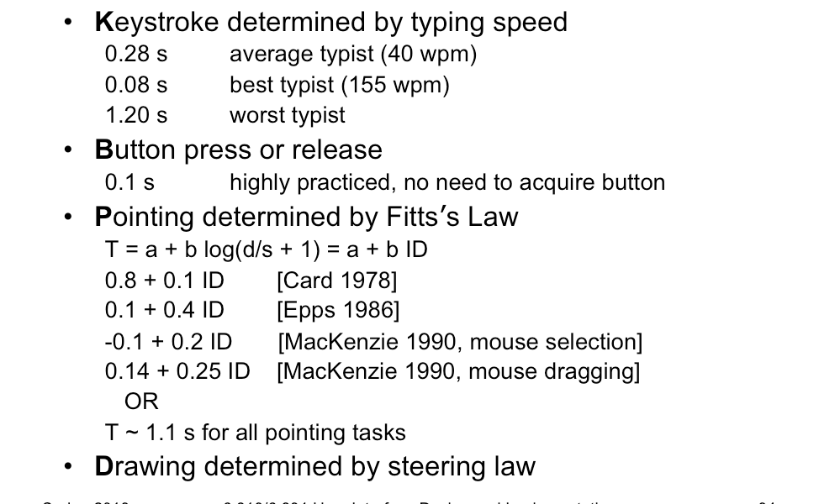
Estimated operator Times
Notes:
The operator times can be estimated in various ways.
Keystroke time can be approximated by typing speed. Second, if we use only an average estimate for K, we’re
ignoring the 10x individual differences in typing speed.
Button press time is approximately 100 milliseconds. Mouse buttons are faster than keystrokes because there
are far fewer mouse buttons to choose from (reducing the user’s reaction time) and they’re right under the
user’s fingers (eliminating lateral movement time), so mouse buttons should be faster to press. Note that a
mouse click is a press and a release, so it costs 0.2 seconds in this model.
Pointing time can be modelled by Fitts’s Law, but now we’ll actually need numerical parameters for it.
Empirically, you get a better fit to measurements if the index of difficulty is log(D/S+1); but even then,
differences in pointing devices and methods of measurement have produced wide variations in the parameters
(some of them seen here). There’s even a measurable difference between a relaxed hand (no mouse buttons
pressed) and a tense hand (dragging). Also, using Fitts’s Law depends on keeping detailed track of the location
of the mouse pointer in the model, and the positions of targets on the screen. An abstract model like the
keystroke level model dispenses with these details and just assumes that Tp ~ 1.1s for all pointing tasks. If
your design alternatives require more detailed modeling, however, you would want to use Fitts’s Law more
carefully.
Drawing time, likewise, can be modeled by the steering law: T = a + b (D/S).

Slide 51
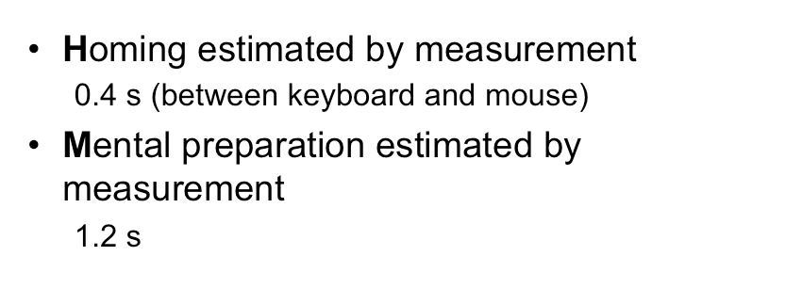
Estimated operator times
Notes:
Homing time is estimated by a simple experiment in which the user moves their hand back and forth from the
keyboard to the mouse.
Finally we have the Mental operator. The M operator does not represent planning, problem solving, or deep
thinking. None of that is modeled by the keystroke level model. M merely represents the time to prepare
mentally for the next step in the method – primarily to retrieve that step (the thing you’ll have to do) from
long-term memory. A step is a chunk of the method, so the M operators divide the method into chunks.
The time for each M operator was estimated by modeling a variety of methods, measuring actual user time on
those methods, and subtracting the time used for the physical operators – the result was the total mental time.
This mental time was then divided by the number of chunks in the method. The resulting estimate (from the
1978 Card & Moran paper) was 1.35 sec – unfortunately large, larger than any single physical operator, so the
number of M operators inserted in the model may have a significant effect on its overall time. (The standard
deviation of M among individuals is estimated at 1.1 sec, so individual differences are sizeable too.) Kieras
recommends using 1.2 sec based on more recent estimates.

Slide 52
Estimated operator times
K (Keyboard) = 1.2s
B (Mouse Button) = 0.1s
P (Pointing) = 1.1s
D (Drawing) = 1.1s (commonly)
H (Homing) = 0.4s
M (Mental) = 1.2s
M + P + 2B + H + M + K + 7K =
M + H + P + B + D + B =
M + H + M + 2K =

Slide 53
General suggestions for working with Ms
Consistency is key. Consistency in M placement is more important than absolute accuracy - be sure that you follow the same rules or philosophy in assigning Ms to each alternative design.
Number of Ms is more important than placement. Sometimes it's pretty clear what pieces of thinking the user might have to do, but the exact times or sequence in which they do these piece might be very unclear.

Slide 54
Specific suggestions for activities that take an M
Initiating a task
Making a strategy decision
Retrieving a chunk from memory
Finding something on the screen
Thinking of a task parameter
Verifying that a specification or action is correct
Some useful conventions
  The values for task parameters have to be explicitly obtained in a step
  Pointing to an object on the screen
  If something on the screen changes in response to user input, there should be a step to verify that the desired result appeared
Notes:
Initiating a task. The user has to pause and make a definite decision about what the task is, and what should be
done. Thus users often pause before emitting a sequence of actions; this pause should be routinely represented by an
M.
Making a strategy decision. If there is more than one way to proceed, and the decision is not obvious or well
practiced, but is important, the user has to stop and think.
Retrieving a chunk from memory. A chunk is a familiar unit such as a file name, command name or
abbreviation. For example, if the user wants to list the contents of directory foo, they need to retrieve two chunks,
dir and foo, each of which takes an M.
Finding something on the screen. The user must pause and scan the screen for an item that they do not already
know or whose location on the screen they do not already know from practice.
Thinking of a task parameter. The user must either remember or otherwise access a task parameter value.
Verifying that a specification or action is correct. Before users signal the system to proceed, they often pause
and check their entry. For example, users often stop and examine a command before hitting return, or check a
dialog box before clicking on the OK, or that a destination folder is reverse-video before releasing the mouse button.
Some useful conventions. Models often contain certain sequences of actions which should be represented in a
consistent way. Some suggestions:
• The values for task parameters have to be explicitly obtained in a step.
• Pointing to an object on the screen should be preceded by a mental operator to locate the object.
• If something on the screen changes in response to user input, there should be a step to verify that the desired
result appeared.

Slide 55
Example – deleting a word
Shift-click selection
  Move pointer to the start of word
  Click at the start of word
  Move pointer to the end of word
  Move hand to shift key
  Press shift
  Click to select
  Move hand to the Del key
  Press key
P
B B
P
H
K
B B
H
K
Total = 2P + 4B + 2K + 2H
= 2(1.1) + 4(0.1) + 2(0.28) + 2(0.4)
= 3.96 seconds

Slide 56
Example – deleting a word
For initiating the task
Shift-click selection
  Move pointer to the start of word
  Click at the start of word
  Move pointer to the end of word
  Move hand to shift key
  Press shift
  Click to select
  Move hand to the Del key
  Press key
M
P M
B B
P M
H
K
B B
H
K
Total = 3M + 2P + 4B + 2K + 2H
= 3(1.2) + 2(1.1) + 4(0.1) + 2(0.28) + 2(0.4)
= 7.56 seconds

Slide 57
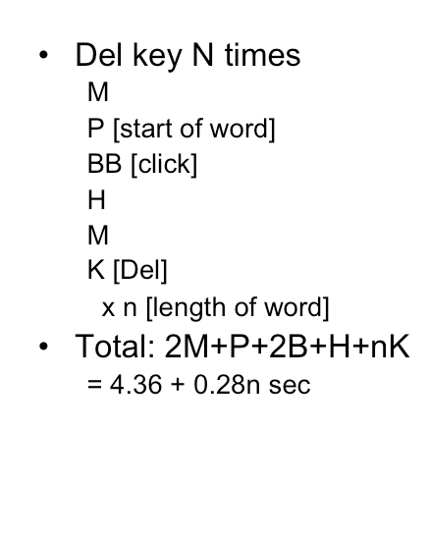
Example: Deleting a Word
Notes:
Here are keystroke-level models for two methods that delete a word.
The first method clicks at the start of the word, shift-clicks at the end of the word to highlight it, and then
presses the Del key on the keyboard. Notice the H operator for moving the hand from the mouse to the
keyboard. That operator may not be necessary if the user uses the hand already on the keyboard (which
pressed Shift) to reach over and press Del.
The second method clicks at the start of the word, then presses Del enough times to delete all the characters in
the word.

Slide 58
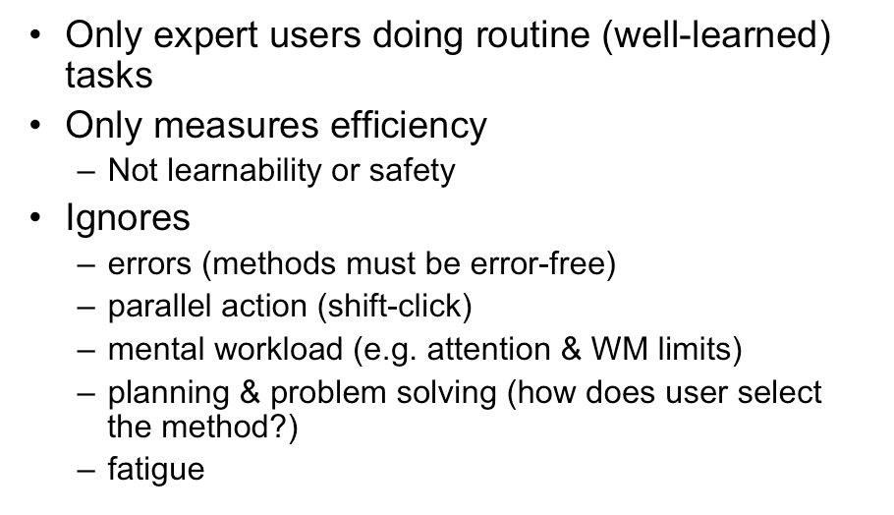
Limitations of KLM
Notes:
Keystroke level models have some limitations -- we’ve already discussed the focus on expert users and
efficiency. But KLM also assumes no errors made in the execution of the method, which isn’t true even for
experts. Methods may differ not just in time to execute but also in tendency of errors, and KLM doesn’t
account for that.
KLM also assumes that all actions are serialized, even actions that involve different hands (like moving the
mouse and pressing down the Shift key). Real experts don’t behave that way; they overlap operations.
KLM also doesn’t have a fine-grained model of mental operations. Planning, problem solving, different levels
of working memory load can all affect time and error rate; KLM lumps them into the M operator.

Slide 59
Activity – Delete a file
Design A: drag the file into the trash can
  Assumption: Currently the desktop is opened and the file is available there.
Design B: use the Del button and confirm the dialog box
  Assumption: Currently the desktop is opened and the file is available there. Also your hand is initially on the keyboard.

