Slide 1
Learnability and Memorability

Slide 2
How do people learn
How do people learn?
  Reading manuals
  Receiving trainings
  Learning by doing
  Learning by watching
  Any other?
Is it dependent on context?

Slide 3
Learning by Doing
User has a goal to achieve
  Explores the interface to achieve that goal
But, the Users’ goal is not learning!

Slide 4
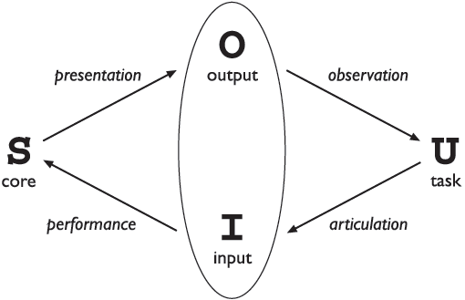
Interaction Model: Abowd and Beale Framework
Evaluation Area
Execution Area
Notes:
tasks - operations on the concepts of the domain
core language - language that describes the computational attributes of the domain relevant to the system state
Articulation is the user's translation of their task into the input language. Consider a user who wants to turn on the lights at the far end of a room.
Poor Articulation
The user sees a bank of unlabelled switches. The user has no idea which switch controls the lights at the far end of the room. The problem here is that the langauge provided (the unlabelled switches) does not allow the user to articulate the goal (turn on the lights at the far end of the room).
Good Articulation
The switches are clearly labelled. The user articulates their task of pressing the switch that is labelled "the far end of the room". The language provided here (the labelled switches) allows the user to articulate their task without difficulty.
Performance
Performance is the interface's translation of the input language into stimuli to the system. This translation is determined by the designer or programmer (not the user).
Poor Performance
Consider a remote control for a television without a button for turning off the television. The user must go directly to the device and turn it off on the control
panel.
Presentation
Presentation is the translation of the system's new state into the output language of the interface. This translation is determined by the designer or programmer.
Poor Presentation
Consider writing an essay using a word processor. You need to see the effects of your editing as a whole. However, the word processor only displays the immediate paragraph without the surrounding text or other pages. The surrounding text and other pages may have changed as well during the editing. In effect, all of the state changes cannot be displayed in the output language. You cannot readily confirm the effect of your editing throughout the essay.
Observation
Observation is the translation of the output language into personal understanding. This translation is done by the user.
https://cs.senecac.on.ca/~bth740/pages/content/model.html

Slide 5
Design Lesson
Know users’ goals
  By applying techniques we learn later
Interface shall communicate how it works and how to use it
  By incorporating messages in design, we learn later
Provide goal-oriented help
  User is not interested in anything/any information other than his goal

Slide 6
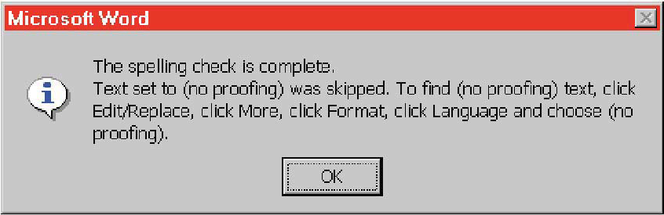
Just because you've said it, doesn't mean they know it
Modal Dialogue: vanishes as soon as you click OK
Users struggle to remember the sequence

Slide 7
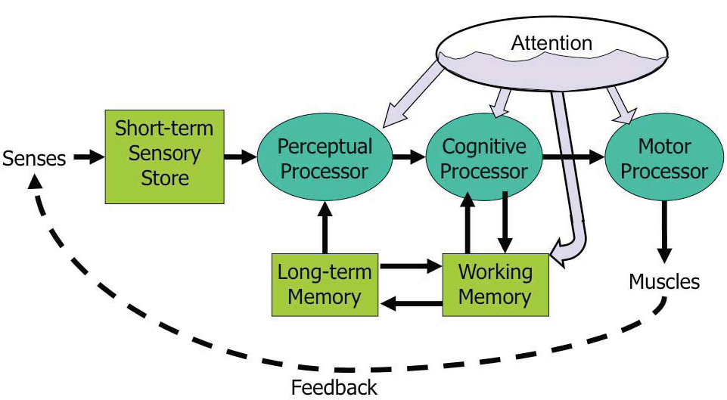
Human Information Processing
Model Human Processor (MHP)
Notes:
This model is an abstraction, of course. But it’s an abstraction that actually gives us numerical parameters describing how we behave. Just as a computer has memory and processor, so does our model of a human. Actually, the model has several different kinds of memory, and several different processors.
Input from the eyes and ears is first stored in the short-term sensory store. As a computer hardware analogy, this memory is like a frame buffer, storing a single frame of perception.
The perceptual processor takes the stored sensory input and attempts to recognize symbols in it: letters, words, phonemes, icons. It is aided in this recognition by the long-term memory, which stores the symbols you know how to recognize.
The cognitive processor takes the symbols recognized by the perceptual processor and makes comparisons and decisions. It might also store and fetch symbols in working memory (which you might think of as RAM, although it’s pretty small). The cognitive processor does most of the work that we think of as “thinking”.
The motor processor receives an action from the cognitive processor and instructs the muscles to execute it. There’s an implicit feedback loop here: the effect of the action (either on the position of your body or on the state of the world) can be observed by your senses, and used to correct the motion in a continuous process.
Finally, there is a component corresponding to your attention, which might be thought of like a thread of control in a computer system.
Note that this model isn’t meant to reflect the anatomy of your nervous system. There probably isn’t a single area in your brain corresponding to the perceptual processor, for example. But it’s a useful abstraction nevertheless.

Slide 8
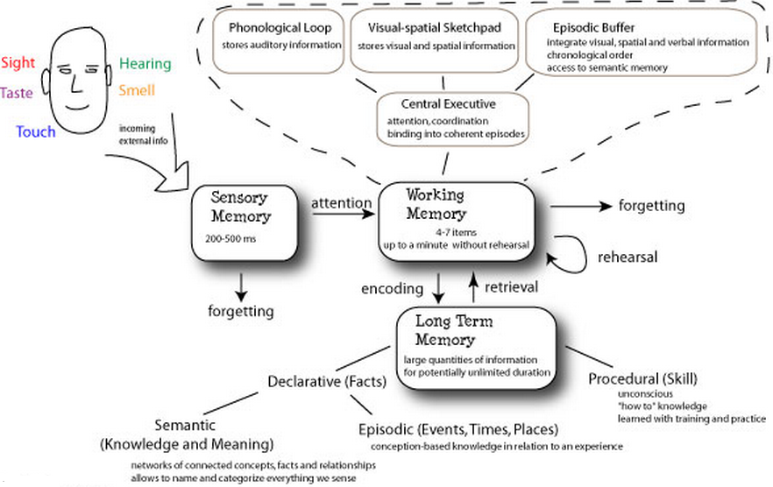
How do people store information
Notes:
http://faculty.washington.edu/chudler/stm0.html
http://www.human-memory.net/types_short.html
http://memory.ucsf.edu/brain/memory/episodic

Slide 9
PRE-ATTENTION
  SENSORY MEMORY: In-node processing: reflexes and Filtration system
  PERCEPTUAL PROCESSING
  COGNITIVE PROCESSING: SKILL BASED
  Extremely fast
  Before conscious mind
ATTENTION
  Conscious mind
  Main processors: perceptive + cognitive + motor
  Considerably slower than pre-attentive processing
  Two main parts (Perception + Cognition)
WHENEVER YOU BYPASS ATTENTION: YOU INCREASE CHANCES OF ERRORS BY MULTIFOLD

Slide 10

Human Memory
Short Term Memory (Working Memory)
  limited capacity: 7± 2 chunks
  rapid decay: ~ 10s
  Maintenance rehearsal fends off decay (but costs attention)
Long Term Memory
  Infinite size
  Elaborative rehearsal (making connections to existing chunks) transfers chunk to LTM
Notes:
Maintenance rehearsal – repeating the items to yourself – fends off this decay, but maintenance rehearsal requires attention. So distractions can easily destroy working memory.
elaborative rehearsal, which seeks to make connections with existing chunks

Slide 11
Design Lesson
Making Memorability and Learnability easy …
  Present well designed chunks
  Familiarity
  make connection making as easy as possible

Slide 12
Design Lesson: Make Chunking Easier
Chunks
  Symbols in memory
  Depends strongly on how information is presented
  Familiarity plays a big role
  Better able to retain TLA on the right
M W B C R A L O A B I M B F I
MWB CRA LOA BIM BFI
BMW RCA AOL IBM FBI
Notes:
TLA = Three Letter Acronyms

Slide 13
M W B C R A L O A B I M B F I
5 +- 2
MWB CRA LOA BIM BFI
BMW RCA AOL IBM FBI

Slide 14
M W B C R A L O A B I M B F I
MWB CRA LOA BIM BFI
BMW RCA AOL IBM FBI

Slide 15
M W B C R A L O A B I M B F I
5 +- 2
MWB CRA LOA BIM BFI
BMW RCA AOL IBM FBI

Slide 16
Connection
1 bun SHOE 6 sticks
2 shoe DOOR 7 heaven
3 tree 8 gate
4 door 9 wine
5 hive 10 hen

Slide 17
CHUNKING
MAKE CONNECTIONS
RECOGNITION RATHER THAN RECALL

Slide 18
Recognition Rather than Recall
Recognition
  Knowledge in the world
  Remembering with the help of a visible cue
Recall
  Knowledge in the head
  Remembering something with no help from the outside world
Recognition is far easier than recall

Slide 19
Recognition Rather than Recall
Recognition rather than recall
  Make objects, actions and options visible.
  The user should not have to remember information from one part of the dialog to another.
  Provide examples, default values, easily retrievable instructions.

Slide 20
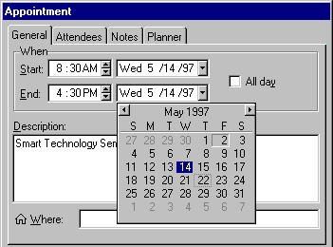
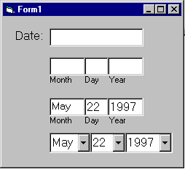
Recognition Rather than Recall
Give input format, example and default

Slide 21
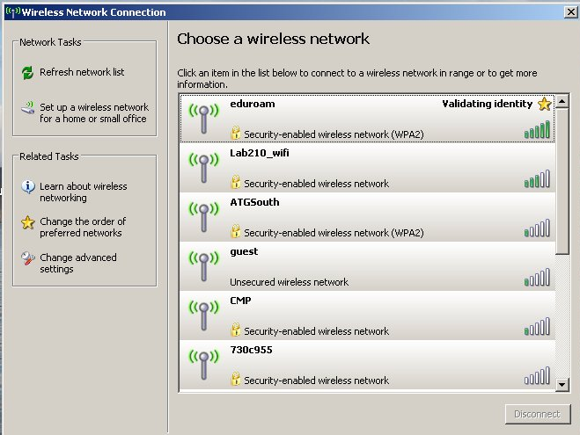
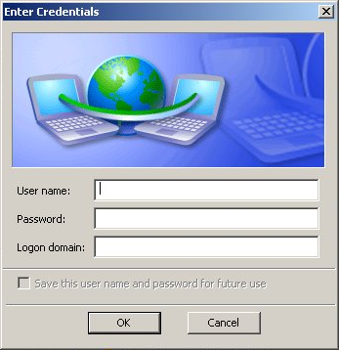
Recognition Rather than Recall

Slide 22
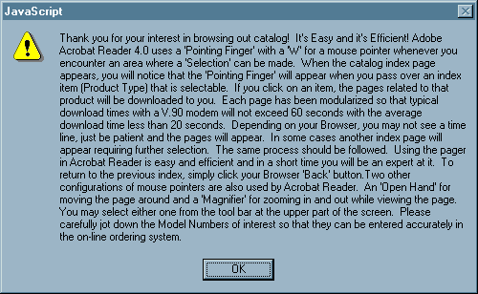
Recognition Rather than Recall

Slide 23
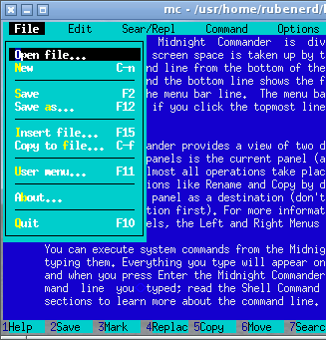
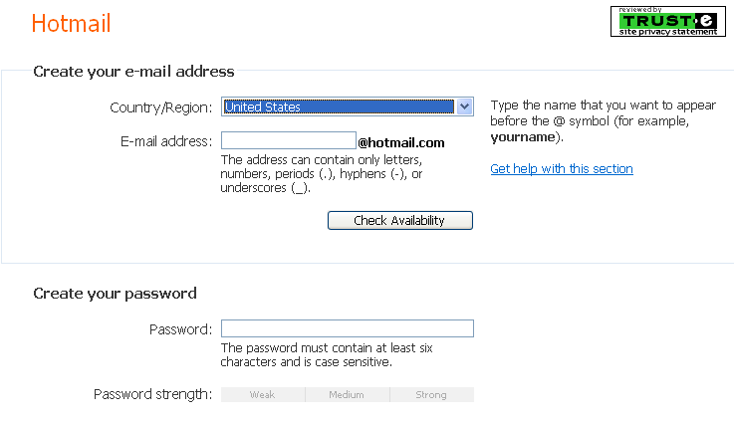
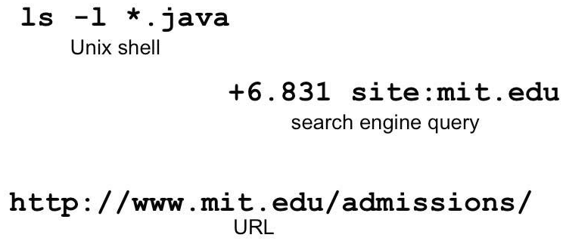
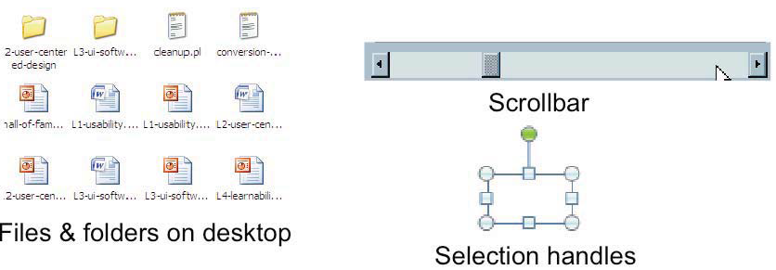
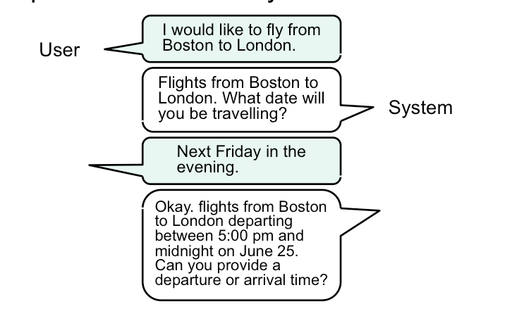
Interaction Styles
Notes:
Command language (CL)
Menus & forms (MF)
Direct manipulation (DM)
Speech dialogue

Slide 24
Comparison of Interaction Styles
Efficiency
Error Handling
User Experience for different user classes
Ease of use

Slide 25
Design Lesson
Select appropriate interaction style
  Direct manipulation, Menu, and Form all have learnability and memorability
  Command Line and Speech dialogue are efficient and have boundaries defined in a better way
  Different user classes have different experience, experts prefer CL
Use multiple interaction styles to gain benefits of all

Slide 26

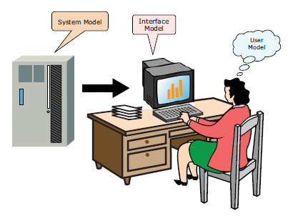
Models of a System
How text editor stores text
  Strings vs lines?
  User does not needConceptual to know
Users’ models may (or may not) be wrong
  Harmless: Electricity as flowing water
  Harmful: Thermostat as a valve, feedback problem
Notes:
The system model (sometimes called implementation model) is how the system actually works.
The interface model (or manifest model) is the model that the system presents to the user through its user interface.
The user model (or conceptual model) is how the user thinks the system works.

Slide 27
Design Lesson
Interface model shall reflect Mental model (users’ model of the task)
Well communicated
Simple enough
  Cell phone presents a simpler model like landline, while system model is quite complex

Slide 28
Learnability and Memorability Design Principles

Slide 29
Communicating the System Model
Affordances
Mapping
Feedback
Visibility
CONSTRAINTS
Consistency
    Internal
    External
    Speak user’s language
    Platform Standards

Slide 30
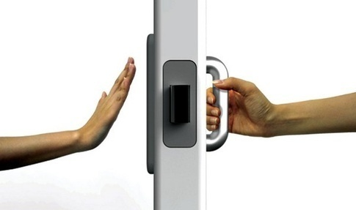
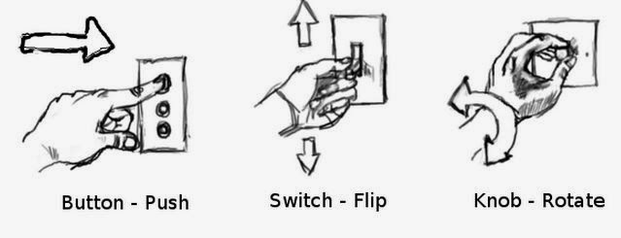
Affordances
Perceived and actual properties of a thing that determine how the thing could be used.
Interface communicates non verbally how an object can be used
Affordances are rarely natural,
they are learned from experience.
Notes:
Affordances are rarely natural – they are learned from experience. We recognize properties suitable for sitting on the basis of our long experience with chairs. We recognize that listboxes allow you to make a selection because we’ve seen and used many listboxes, and that’s what they do.
Note that perceived affordance is not the same as actual affordance. A facsimile of a chair made of papier mache has a perceived affordance for sitting, but it doesn’t actually afford sitting: it collapses under your weight. Conversely, a fire hydrant has no perceived affordance for sitting, since it lacks a flat, human-width horizontal surface, but it actually does afford sitting, albeit uncomfortably.

Slide 31
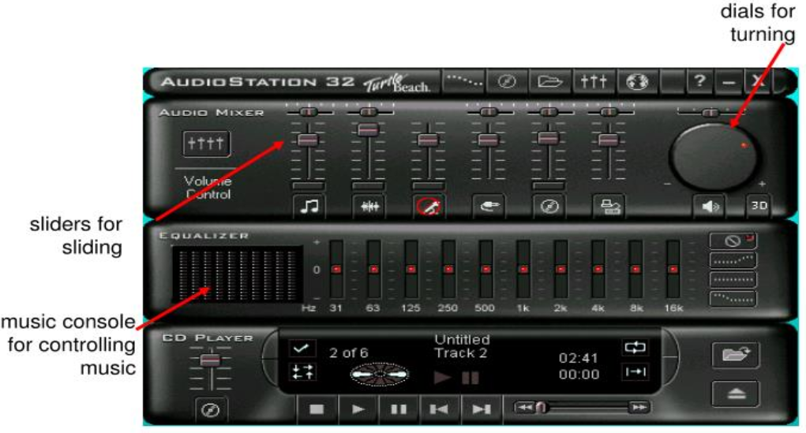
Perceived affordances

Slide 32
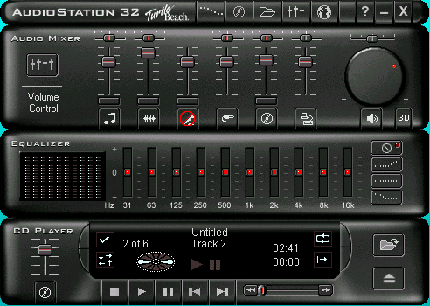
Perceived Affordance Problems
is this equalizer control a toggle or button?
button for pressing,
but action unknown
are these buttons?

Slide 33
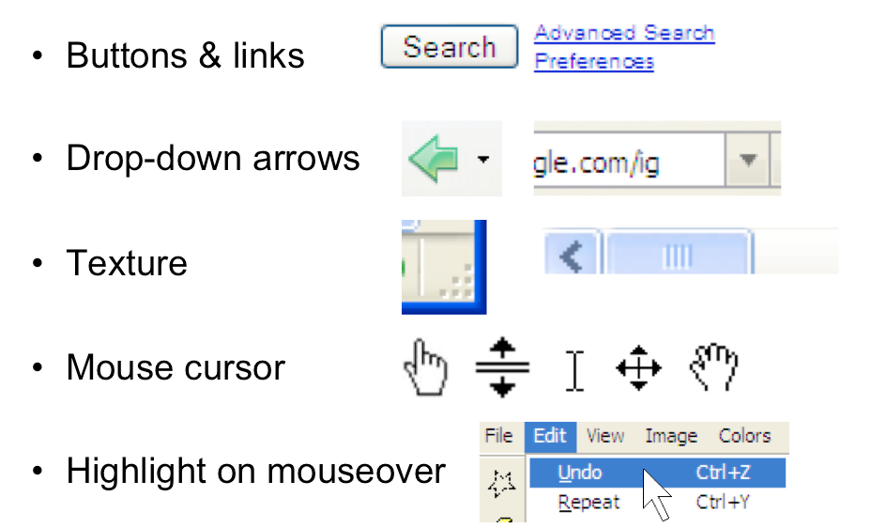
Use appropriate affordances

Slide 34
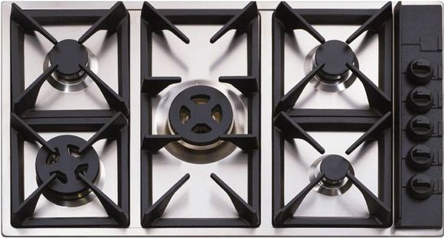
Mapping
Relationship between controls and their effects on a system
Notes:
Relationships between controls and their effects on a system.

Slide 35
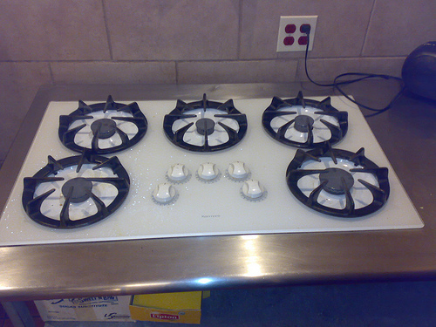
Mapping

Slide 36
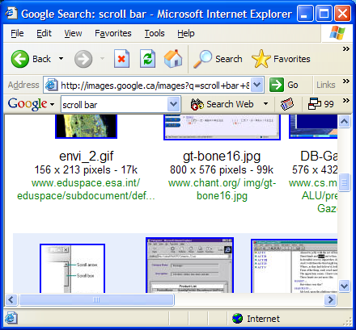
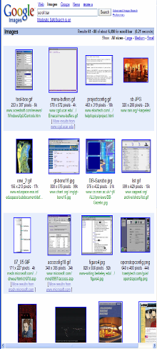
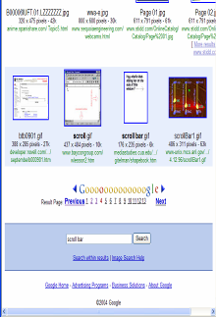
Mapping
scroll bar – scroll down viewport goes down
Cause and effect
Depressed button indicates current mapped item
Cursor re-enforces selection of current item

Slide 37
Visibility
Relevant parts of system should be visible
  Not usually a problem in the real world
  But takes extra effort in computer interfaces
  Availability of drag & drop is often invisible

Slide 38
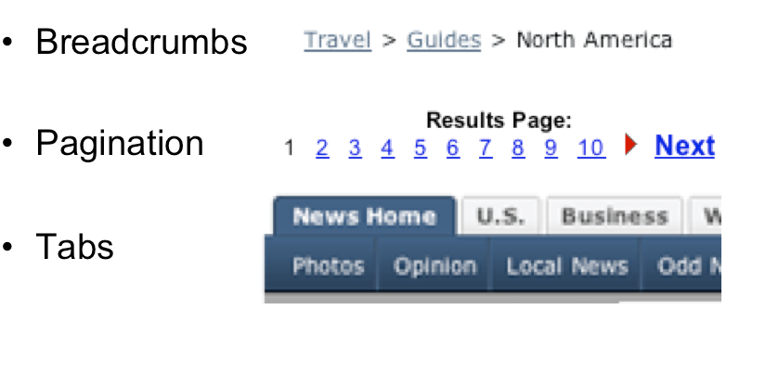
Visible Navigation state
It shows where you are as a path through the site’s hierarchy
They show the user where they are, along with some context of where else they could go
Notes:
Breadcrumb trails show where you are as a path through the site’s hierarchy.

Slide 39
Visible Constraints
The difficulty of dealing with a new situation is directly related to the number of possibilities.
Where affordances suggest the range of possibilities, constraints (restrictions) limit the number of alternatives.
May 12 2021

Slide 40
Visible Constraints
Limitations of the actions possible perceived from object’s appearance
  provides people with a range of usage possibilities
Push or pull?
Which side?
Can only push,
side to push clearly visible
Notes:
If the user can’t see an important control, they would have to (1) guess that it exists, and (2) guess where it is.
Interestingly, lack of visibility is responsible for a common learnability flaw in direct manipulation interfaces that use drag & drop. Drag & drop is an incredibly powerful direct manipulation technique, but it has so little visibility that many users simply don’t realize when drag & drop is possible, and when it isn’t. As a result, this wonderful direct-manipulation technique is often secondary, a shortcut used only by expert users who know about it, while some less usable (often menu & form style) interface is used by the bulk of novice and casual users.
There’s an interesting experiment from cognitive psychology (mainly concerned with biases in problem solving, not with learnability). Two ropes are hanging from ceiling, more than an arm span apart, and the goal is to tie their ends together. People were more likely to solve the problem if the experimenter gently swung one rope a bit while explaining the goal. (Maier, "Reasoning in humans," J Comp Psych v12, 181-194, 1931.) In other words, a visual hint helped a lot. Perhaps drag able things might make themselves visible by wiggling a bit when you come near them, or when you’re dragging them toward a likely target.

Slide 41
Visible constraints: Entering a Date
The more constraints, the less opportunity for error
  particularly important for managing user input
Controls constructed in Visual Basic

Slide 42
26897 – 234158963 – 5

Slide 43

Feedback
Actions should show immediate effects
  Push buttons
  Scrollbars
  Drag and drop
Kinds of feedback
  Visual
  Audio
  Haptic (conveyed by the sense of touch)
Low level feedback
  Push button
High level feedback (actual result of the user’s action )
  Starts Page loading
Perceptual Fusion
Notes:
feedback: what the system does when you perform an action. When the user successfully makes a part work, it should appear to respond. Push buttons depress and release. Scrollbar thumbs move. Dragged objects follow the cursor.
Feedback doesn’t always have to be visual. Audio feedback – like the clicks that a keyboard makes – is another form. So is haptic feedback, conveyed by the sense of touch. The mouse button gives you haptic feedback in your finger when you feel the vibration of the click. That’s much better feedback then you get from a touchscreen, which doesn’t give you any physical sense when you’ve pressed it hard enough to register.
PERCEPTUAL FUSION. The sensations created in our environments rarely exist in a single modality. Especially visual events are usually accompanied by auditory events. When an object falls and breaks, the simultaneous reception of the visual and auditory inputs form a single perception of this event.
Low-level feedback is provided by a view object itself, like push-button feedback. This kind of feedback shows that the interface at least took notice of the user’s input, and is responding to it. (It also distinguishes between disabled widgets, which don’t respond at all.)
High-level feedback is the actual result of the user’s action, like changing the state of the model.

Slide 44
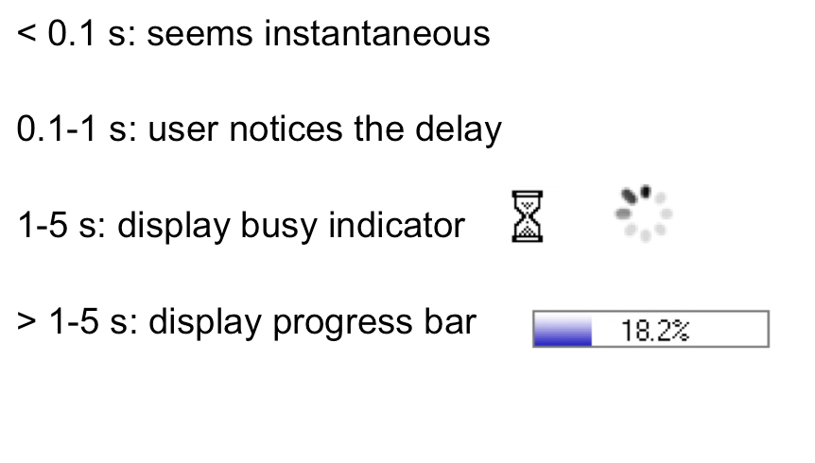
Response Time

Slide 45
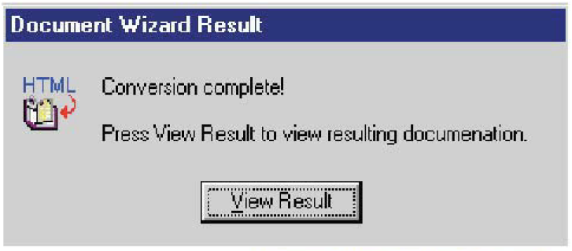
Unnecessary feedback
Feedback is important, but don’t overdo it.

Slide 46
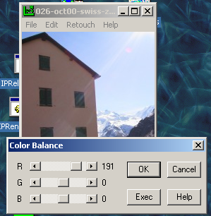
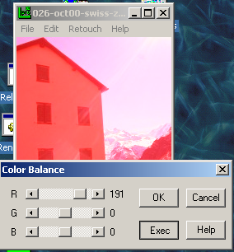
Feedback Problems
Effects visible only after Exec button is pressed
  Ok does nothing!
  awkward to find appropriate color level
LViewPro

Slide 47
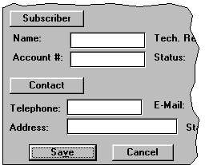
Consistency
The principal of least surprise
  Similar things should look and act the same
  Different things should look different
Internal
External
Metaphorical
Notes:
internal consistency within your application
external consistency with other applications on the same platform
metaphorical consistency with your interface metaphor or similar real-world objects

Slide 48
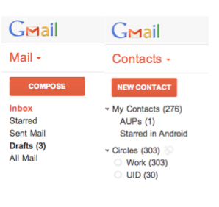
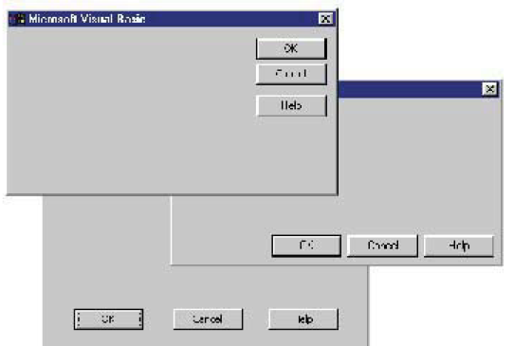
Internal Consistency – consistency of layout
Notes:
internal consistency within your application
One important area of consistency is in layout – where controls and information are displayed on the screen.

Slide 49
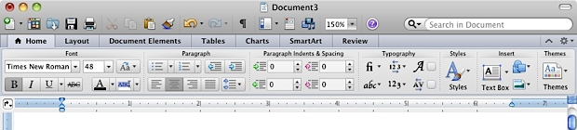
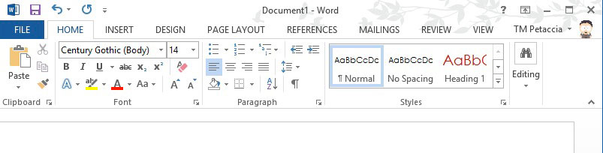
External Consistency – consistency of layout
Notes:
external consistency with other applications on the same platform

Slide 50

Consistency in wording
Use the same terms throughout your user interface
Notes:
Use the same terms throughout your user interface. If your interface says •share price in one place, •stock price in another, and •stock quote in a third, users will wonder whether these are three different things you’re talking about. Don’t get creative when you’re writing text for a user interface; keep it simple and uniform, just like all technical writing.

Slide 51
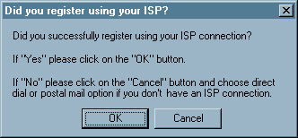
Language Consistency

Slide 52
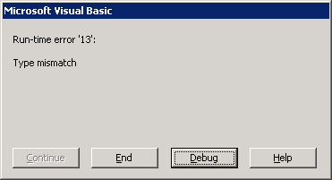
Speak User’s Language

Slide 53
Speak User’s Language
Use common words, not techie jargon
  But use domain-specific terms where appropriate
When the user is talking, the interface should make a maximum effort to understand the user, allowing synonyms and aliases.
When the interface is speaking, it should be consistent, always using the same name to describe the same command or object.

Slide 54
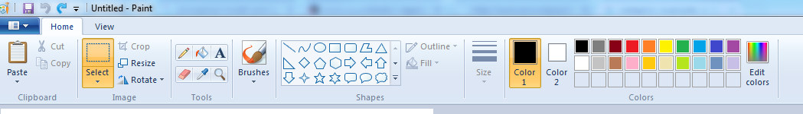
Metaphors
Borrow a conceptual model which user has already in mind
  Library
  Theater
  Pen
The basic rule for metaphor is: use it if you have one, but do not stretch for one, if there is no suitable metaphor available.
Should deviate from the real at some point
  Software interface is more capable than a real world type writer
Can be deceptive
  It looks like a book but can I write in the margins ? Can I rip out a page?
Can be constraining
  No deep nesting in actual folders.
Notes:
metaphorical consistency with your interface metaphor or similar real-world objects

Slide 55
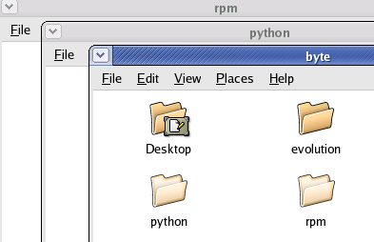

Metaphorical Consistency

Slide 56
Summary
Learnable interfaces communicate good mental model by exploiting
Affordances
Mapping
Constraints
Visibility
Feedback
Consistency

