Slide 1
Human Computer Interaction
Design Perceptual Organization

Slide 2
Perception
It is a process by which individuals organize and interpret their sensory impressions in order to give meaning to their environment.
People's behavior is based on their perception of what reality is, not on reality itself.
Human mind assembles, organizes and categorizes information
Notes:
Stimulus = a thing or event that evokes a specific functional reaction in an organ or tissue.

Slide 3
Perceptual process
Stimuli
Receiving stimuli (or organizing)
Selective attention (or selecting stimuli)
Perceptual organization (group stimuli into recognizable patterns)
Interpreting (assigning meaning)
Response
Notes:
Stimulus = a thing or event that evokes a specific functional reaction in an organ or tissue.

Slide 4
Perceptual organization
The process by which people group stimuli into recognizable patterns
  What mental picture do you have for a wooden object with 4 legs?
  When people actually see the above wooden object having these characteristics, they are able to organize information into meaningful whole and recognize the object to be a chair.

Slide 5
Perceptual Illusions
They can be understood as reliable perceptual errors
People don’t perceive length, area, angle, brightness the way they “should”.

Slide 6
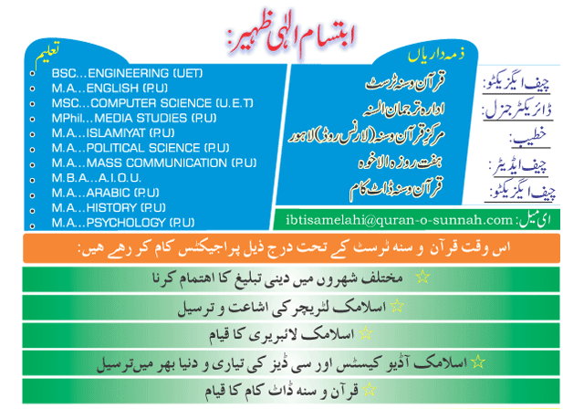
Cognitive Processing

Slide 7
Perceptual Illusions

Slide 8
Perceptual Illusions

Slide 9
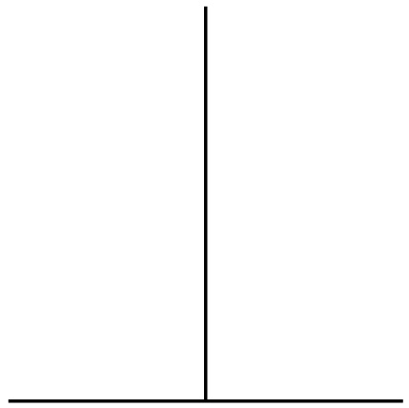
Perceptual Illusions

Slide 10
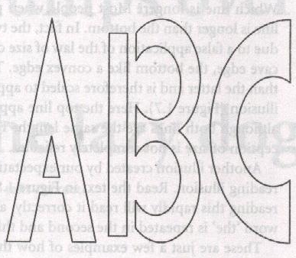
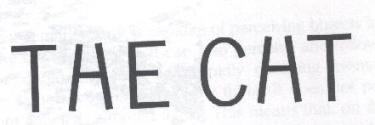
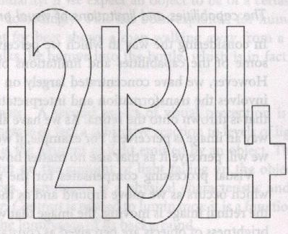
Perceptual Illusions: Contextual

Slide 11
2. Pre-Attention

Slide 12
Pre-attentive Processing
A limited set of visual properties are processed/detected very rapidly and accurately (pre-attentively i.e. without need for focusing attention) by the low level visual system.
This is important for design of graphics visualizations
  what can be perceived immediately
  what properties are good discriminators
  what can mislead viewers

Slide 13
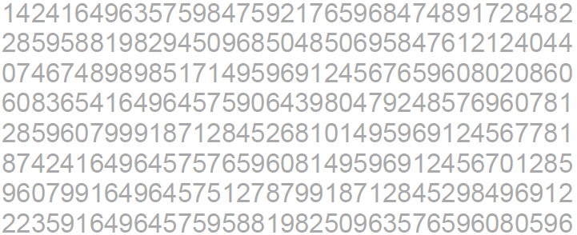
How many 3’s ?

Slide 14
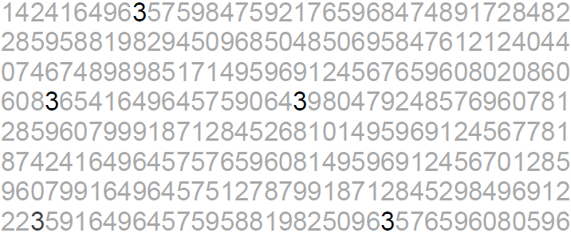
How many 3’s ?

Slide 15
Pre-attentive Processing
< 200 - 250ms qualifies as pre-attentive
  eye movements take at least 200ms
  yet certain processing can be done very quickly, implying low-level processing in parallel
If a decision takes a fixed amount of time regardless of the number of distractors, it is considered to be preattentive.

Slide 16
Pop-Out in Visual Search
2 distractors
5 distractors
10 distractors
O
V
V
V
V
V
V
O
V
V
O
V
V
V
V
V
V
V
V
V
T
T
T
T
T
T
T
L
T
L
T
T
T
T
T
T
L
T
T
T

Slide 17
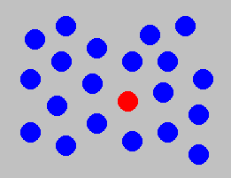
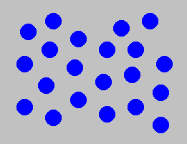
Example: Color Selection
Viewer can rapidly and accurately determine
whether the target (red circle) is present or absent.
Difference detected in color.

Slide 18
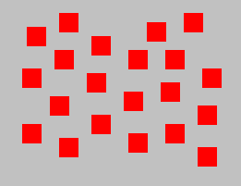
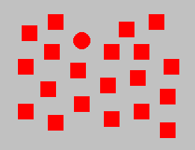
Example: Shape Selection
Viewer can rapidly and accurately determine
whether the target (red circle) is present or absent.
Difference detected in form (curvature)

Slide 19
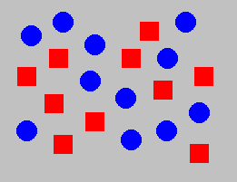
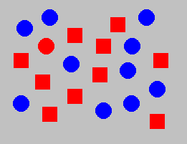
Example: Conjunction of Features
Viewer cannot rapidly and accurately determine
whether the target (red circle) is present or absent when
target has two or more features, each of which are
present in the distractors. Viewer must search sequentially.

Slide 20
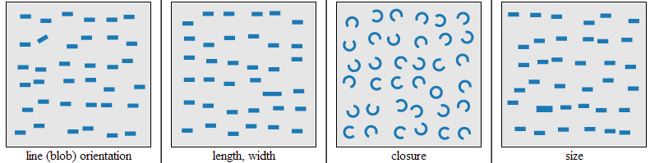
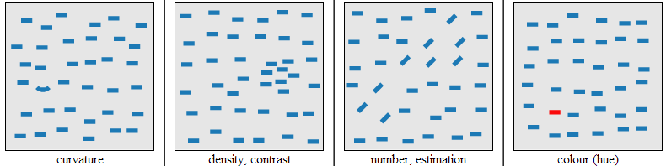
Pre-attentive features
Notes:
https://www.csc2.ncsu.edu/faculty/healey/PP/index.html

Slide 21
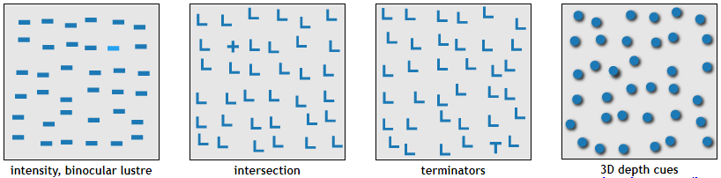
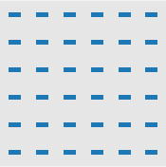
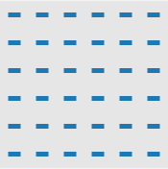
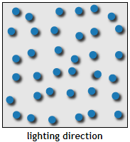
Pre-attentive features

Slide 22
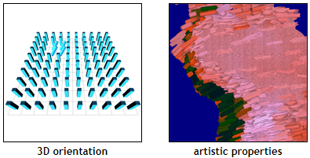
Pre-attentive features

Slide 23
Influences on Perception

Slide 24
Influences on Perception

Slide 25
Influences on Perception

Slide 26
Influences on Perception

Slide 27
Gestalt principles (laws)
Gestalt refers to shape or form in German.
They describe how the human eye perceives visual elements
In particular they tell us that complex images tend to be reduced to simpler shapes
The whole is other than the sum of parts
  The human eye and brain perceive a unified shape in a different way to the way they perceive the individual parts of those shapes. This global whole is a separate entity that is not necessarily formed by the sum of its parts.

Slide 28
Gestalt principles (laws)
When we fully understand Gestalt design principles, we can utilize them to create more interesting and engaging visual experiences for website and app users.
You can take advantage of these laws to design more thoughtfully and effectively, knowing exactly how your work can impact your users.

Slide 29
Gestalt principles (laws)
Proximity
Symmetry
Closure
Similarity
Common fate
Continuity
Figure-ground
Connectedness
Simplicity
Past Experience
Notes:
2
2

Slide 30
Principle of Proximity
Objects that are near to each other are seen as being more related than objects that are father apart.

Slide 31
Principle of Proximity
The distance between objects effects our perception of the objects.
Are the objects grouped, or not?
Objects that are close together are perceived as being grouped.
If your intent is that items in a user interface are to be “read” by the user as being grouped, place them in close proximity.
If items in the user interface are not intended to be “read” as being grouped, be careful to allow enough space between them.

Slide 32
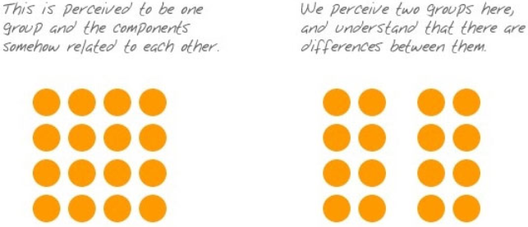
Principle of Proximity

Slide 33
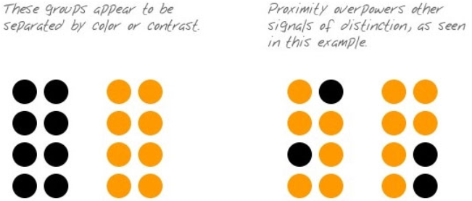
Principle of Proximity

Slide 34

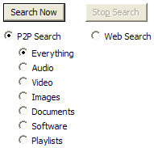
Principle of Proximity

Slide 35
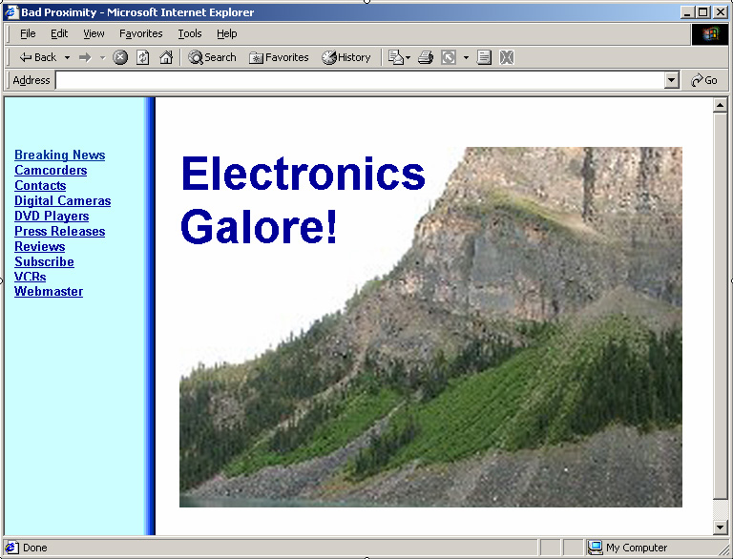

Slide 36
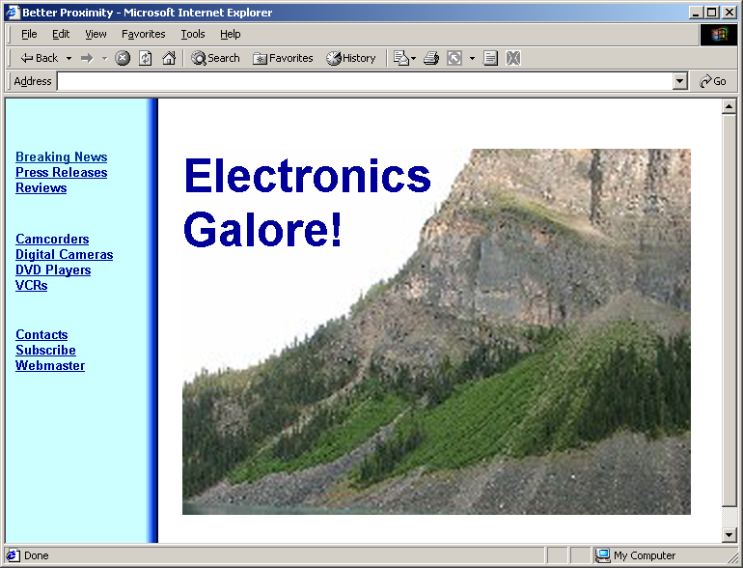

Slide 37
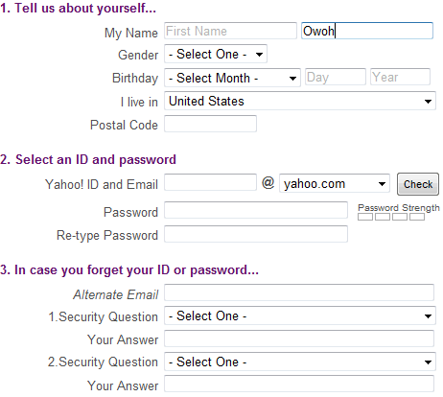

Slide 38



Principle of Proximity

Slide 39
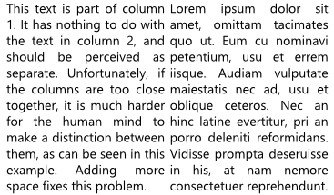
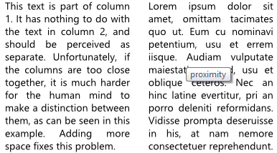
Principle of Proximity

Slide 40
Principle of Similarity
The human eye tends to build a relationship between similar elements within a design. Similarity can be achieved using basic elements such as shapes, colors, and size.

Slide 41
Principle of Similarity
Objects that look similar appear to be grouped
This is a good thing, when it is done intentionally
Often, objects in an interface are similar enough that they are misinterpreted as being related. This can be overcome by using the law of Proximity.

Slide 42




Slide 43
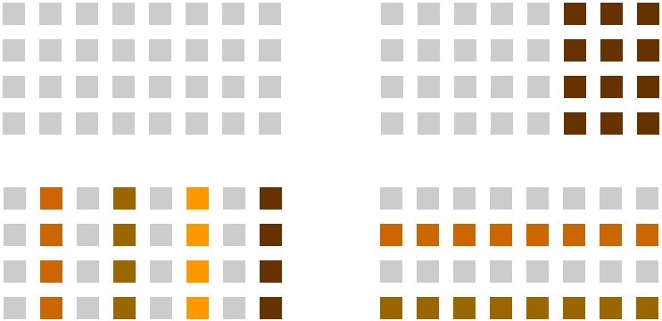
Principle of Similarity

Slide 44
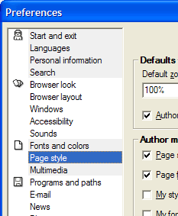
Principle of Similarity

Slide 45
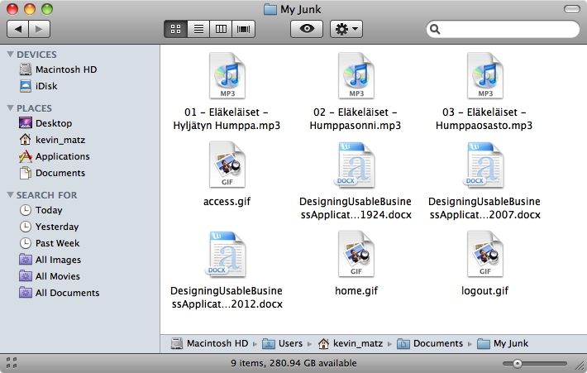
Principle of Similarity

Slide 46
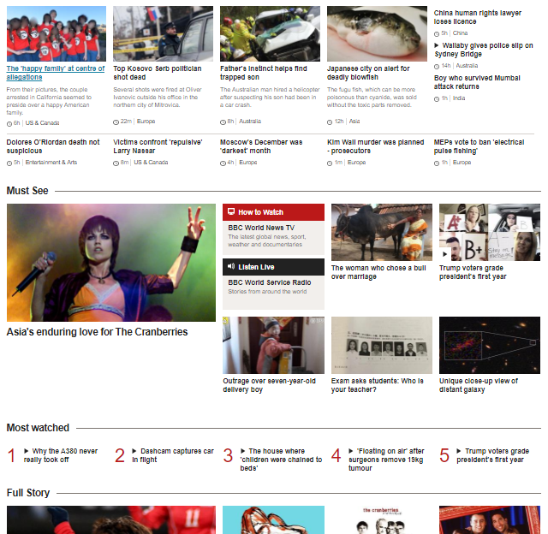
Link
Content
Header

Slide 47
Principle of Continuity
We tend to perceive figures or objects as belonging together if they appear to form a continuous pattern.
The human eye follows the paths, lines, and curves of a design, and prefers to see a continuous flow of visual elements rather than separated objects.

Slide 48
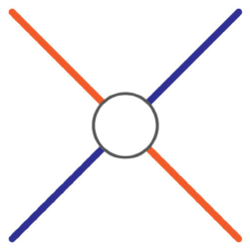

Principle of Continuity
Visual perception is based on continuous forms, not disconnected segments
Our minds fills in missing segments automatically, completing an incomplete form.

Slide 49
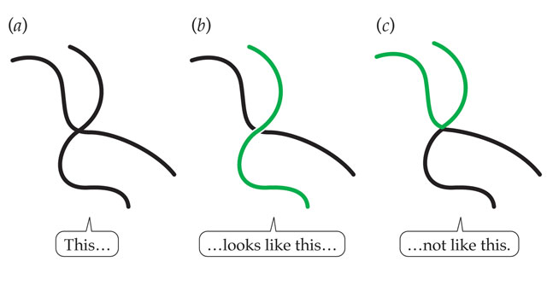
Principle of Continuity

Slide 50
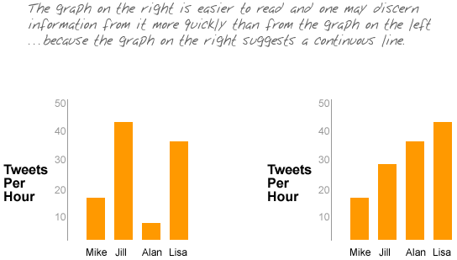
Principle of Continuity

Slide 51
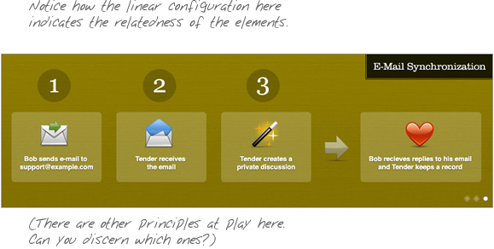
Principle of Continuity
Use of numbering
Use of arrows

Slide 52
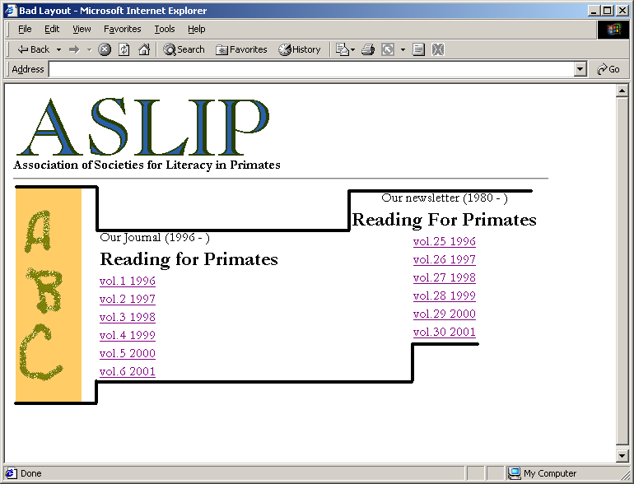
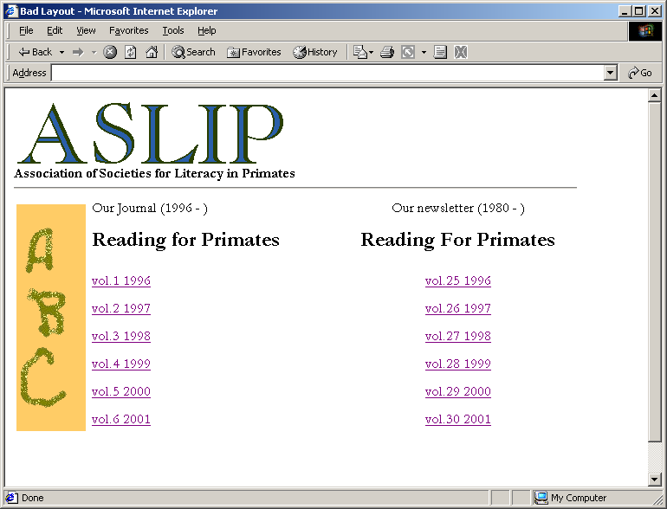
Law of Continuity

Slide 53
Principle of Closure
The law of Closure explains how we perceive incomplete shapes. When there is missing information in an image, the eye ignores the missing information and fills in the gaps with lines, color or patterns from the surrounding area to complete the image.
We can use this law to achieve visual effects.

Slide 54
Principle of Closure
We automatically attempt to complete “open” objects so that we perceive them as whole.
Our visual system can interpret totally blank areas as objects.
This is what graphic designers refer to as “white space”

Slide 55
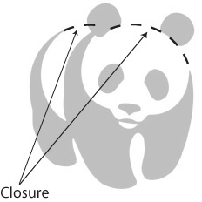
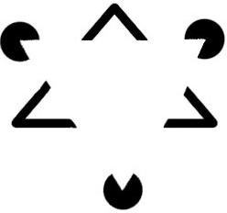

Principle of Closure

Slide 56


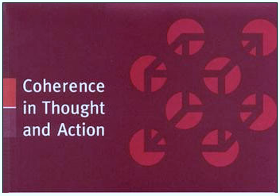


Principle of Closure

Slide 57

Principle of Closure

Slide 58
Principle of Symmetry
When we look at certain objects, we see them as symmetrical shapes that form around their center.
Humans like symmetry, and find it aesthetically appealing.

Slide 59
Principle of Symmetry
The goal of our visual system: reduce complexity
We interpret data in our visual field in more than one way, but always with the goal of simplification
Organizing objects into symmetrical shapes allows for easier understanding
It’s automatic
Symmetry is the primary principle used to interpret three dimensional renderings on a two dimensional display.

Slide 60
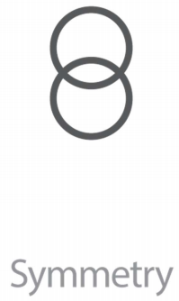
Principle of Symmetry

Slide 61
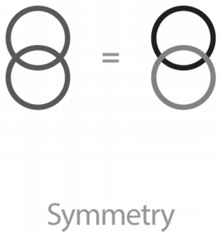
Principle of Symmetry

Slide 62
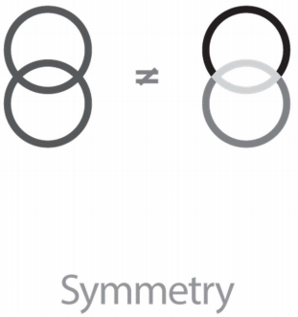
Principle of Symmetry

Slide 63
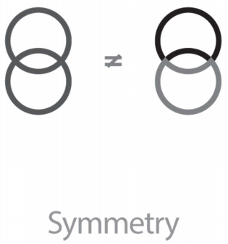
Principle of Symmetry

Slide 64
Law of symmetry

Slide 65
Principle of Figure-Ground
How the human eye separates shapes from the background in a design.
Elements are perceived as either figures (distinct elements of focus) or ground (the background or landscape on which the figures rest).

Slide 66
Principle of Figure-Ground
There are two main factors that affect the way we perceive the figure and the ground in any given design.
Size of the figure when compared to the background
  Header text is figure and body text is ground
Contrast between the figure and the ground
  Black color for text (figure) and white color for page (ground)

Slide 67
Principle of Figure-Ground
Our mind separates the visual field into figure (the foreground) and ground (the background)
When objects overlap, we tend to see the smaller object as existing in the foreground and the larger object as in the background
Objects in our primary attention seem to be in the foreground, while everything else seems to fade into the background.

Slide 68
Principle of Figure-Ground
The relationship between figure and ground can be classified into three categories
Stable
  The figure will be clearly identifiable from the background
Reversible
  The figure and background have near-equal density. This enables the eye to flip the figure with the background. This can be used to create visual illusions.
Ambiguous
  There is a little distinction between the ground and the figure. At any point, a single element might be both figure and ground at the same time.

Slide 69

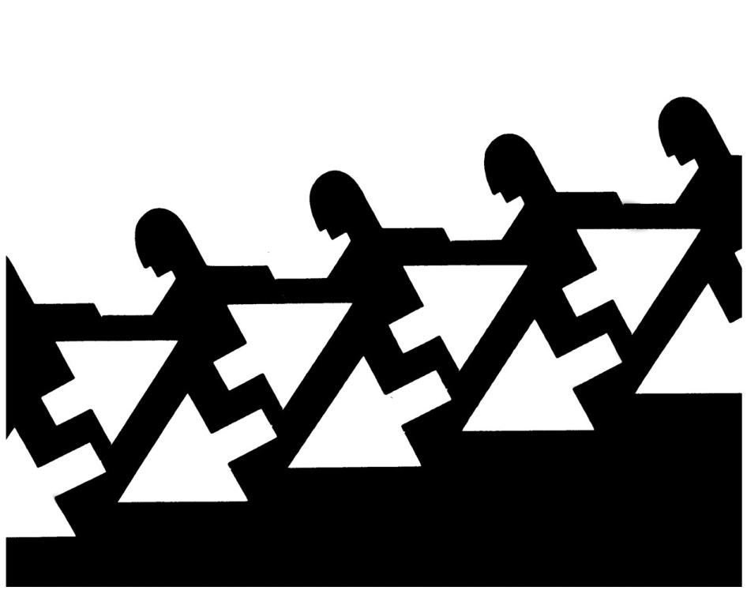

Principle of Figure-Ground - reversible

Slide 70
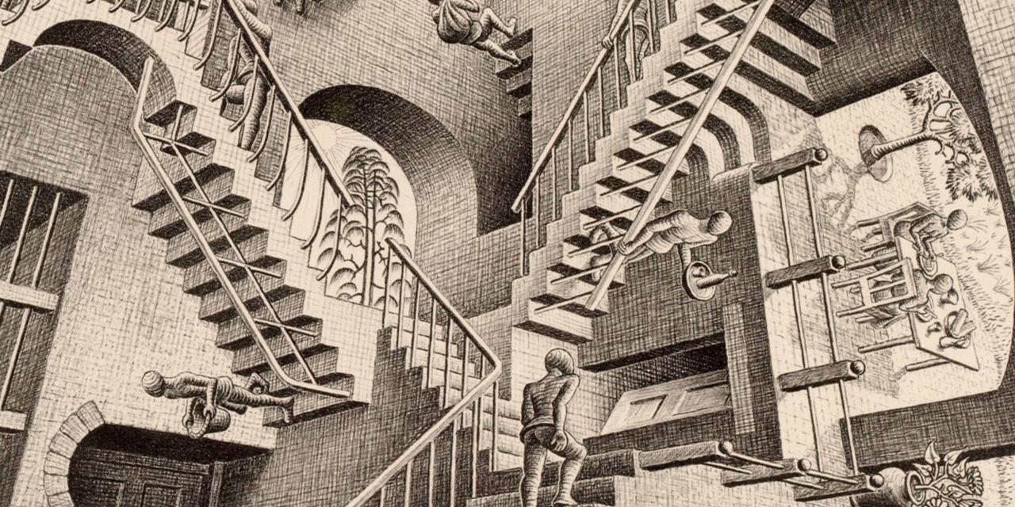
Principle of Figure-Ground - ambiguous

Slide 71




Using Principle of Figure-Ground

Slide 72
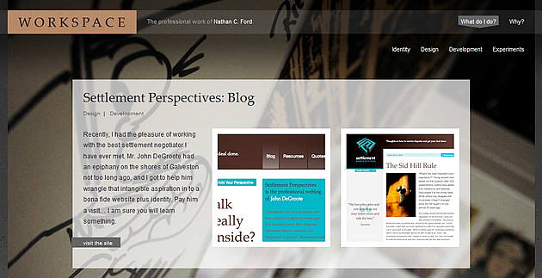
Using Principle of Figure-Ground

Slide 73
Principle of Common Fate
Visual elements moving together in the same direction simultaneously tend to be perceived as a group.
For example, in Microsoft Windows or Mac OS, if you select a number of icons and then drag-and-drop them, partially-transparent copies of all of the selected icons move together
Notes:
http://www.scholarpedia.org/article/Gestalt_principles

Slide 74
Principle of Common Fate
This principal deals with motion and animated objects
All things being equal, if a group of objects moves in a similar way, they are perceived to be a related group
Common motion = common fate

Slide 75
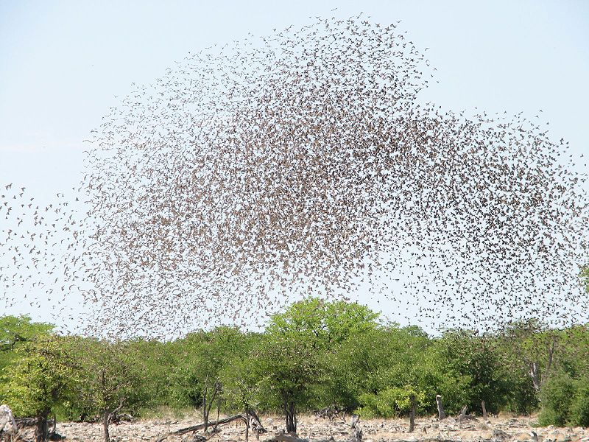
Principle of Common Fate

Slide 76

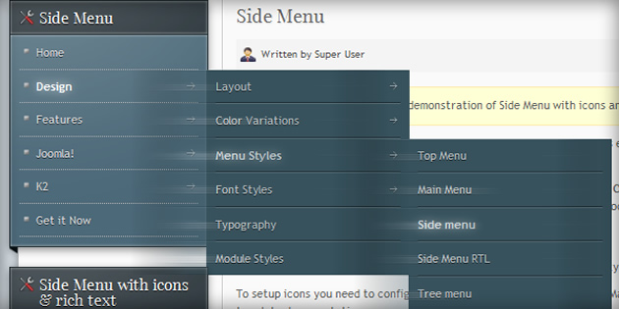
Principle of Common Fate

Slide 77
Principle of Connectedness
The law of connectedness states that elements that are connected to each other using colors, lines, frames, or other shapes are perceived as a single unit when compared with other elements that are not linked in the same manner.

Slide 78

Principle of Connectedness

Slide 79

Principle of Connectedness

Slide 80

Principle of Connectedness

Slide 81
Principle of Simplicity (or Prägnanz)
Prägnanz is a German word that means “good figure” or “pithiness” (literally defined as, “brief, forceful and meaningful in expression”).
The human eye likes to find simplicity and order in complex shapes

Slide 82
Principle of Simplicity

Slide 83


Principle of Simplicity
Notes:
(a) This is usually perceived as five circles, not as the nine shapes in (b).
Principles of perceptual organization
Pragnanz (also called law of simplicity) - every stimulus is seen as simply as possible

Slide 84

Principle of Simplicity

Slide 85

Principle of Simplicity

Slide 86

Principle of Simplicity

Slide 87
Principle of Past Experience
Elements or objects frequently seen together in the past experience of a person are perceived to be included in one group.
Elements tend to be grouped together if they were together often in the past experience of the observer.

Slide 88




Principle of Past Experience

